Slide 1
Cloud and Mobile Device Risk Analysis and Mitigation
Bob Marshall, MD MPH MISM FAAFP
Faculty, DoD Clinical Informatics Fellowship

Slide 2
Learning Objectives
Define the domains for discussion
Mobile device risk analysis
Mobile device risk mitigation
Cloud computing risk analysis
Cloud computing risk mitigation
BYOD issues & management

Slide 3
Definitions
A mobile device is a small computing device, typically small enough to be handheld, having a display screen with touch input and/or a miniature keyboard and weighing less than 2 pounds (0.91 kg)
Cloud computing is a type of Internet-based computing that provides shared computer processing resources and data to computers and other devices on demand.
It is a model for enabling ubiquitous, on-demand access to a shared pool of configurable computing resources (e.g., computer networks, servers, storage, applications and services), which can be rapidly provisioned and released with minimal management effort

Slide 4
Another Definition
Bring your own device (BYOD)—also called bring your own technology (BYOT), bring your own phone (BYOP), and bring your own Personal Computer (BYOPC)—refers to the policy of permitting employees to bring personally owned devices (laptops, tablets, and smart phones) to their workplace, and to use those devices to access privileged company information and applications
BYOD usage is primarily driven by perceived enjoyment
The phenomenon is commonly referred to as IT consumerization
The term is also used to describe the same practice applied to students using personally owned devices in education settings

Slide 5
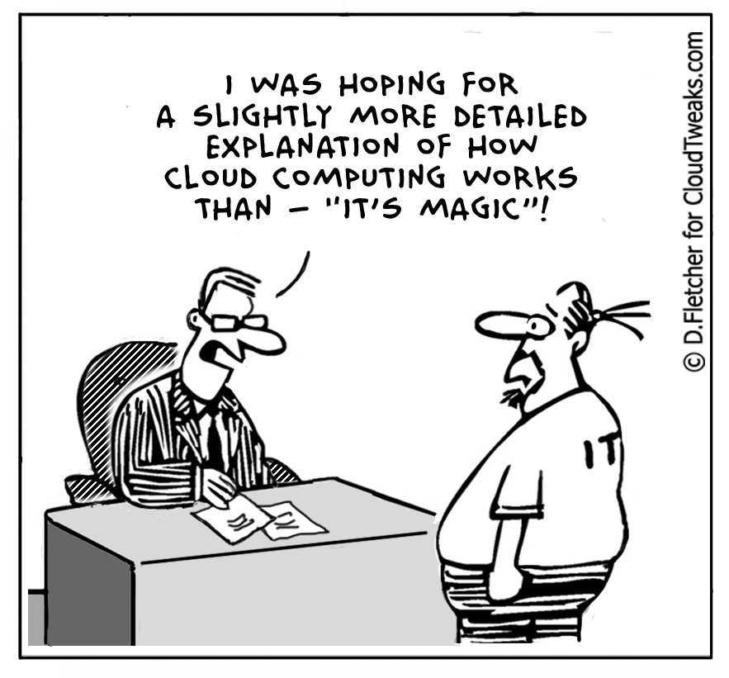


Slide 6
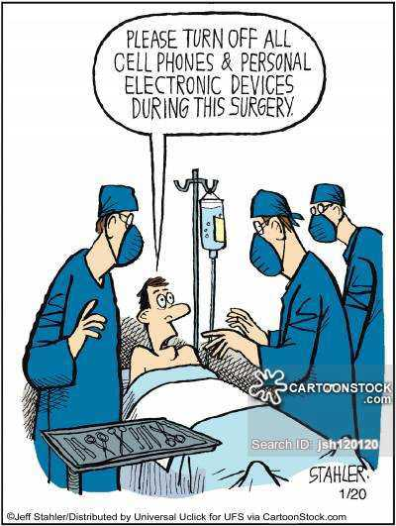
Mobile Devices

Slide 7
Mobile Device Risk Analysis
How do you perform a risk assessment on a technology that changes weekly and that you might not even own?
Follow the general risk assessment steps below:
Understand the environment, requirements and objectives, risk tolerance and boundaries
Identify threats, vulnerabilities and existing controls
Assess risks based on the impact and likelihood of loss
Determine risk response
Document final risk determination and approval/acceptance
Establish ongoing monitoring of risks and responses

Slide 8
Mobile Device Risk Assessment
Think about these common risks associated with mobile devices:
Are IT Security and Usage policies updated to include mobile devices?
Are users aware of these policy updates and expectations for their behavior?
Many of these devices contain cameras – is this a concern?
Insecure WiFi connectivity
Lost or stolen mobile devices
Users change or upgrade their mobile devices regularly – Is organization data wiped before the device is replaced?
Consumer data mixing with corporate data
Number of malicious apps and malware on the rise

Slide 9
Sensitive Data Access
Top level concern about mobile devices: they can access sensitive data and potentially cause a breach or leak of this data to the public
To document which sensitive information a mobile device has access to, start by building data flows based on data classifications; document who touches what and when
For each spot where sensitive data "changes hands" (either via a human or a system), interview the folks involved to discuss if and how that data could land on mobile devices
Most mobile devices don't have direct access to sensitive data. Rather, they have peripheral access; existing security systems, such as data loss prevention, identity management, and access control, can usually address those sources

Slide 10
Device Risk
Spend less time worrying about viruses and Trojans and more time worrying about how you'll encrypt sensitive data, guard against theft of the device, educate the help desk, and extend the reach of your mobile security technologies
You can't foresee the next threat coming down the pike, so focus your efforts on making sure you have as many capabilities as possible to secure as many mobile device types and platforms as possible
That is where the mobile device management (MDM) software comes in. Its job is to do just that – manage all the devices on the network and safeguard the data

Slide 11
Management Risk
Make sure you have a process to quickly analyze the risk any given mobile threat presents to your data, as well as to evaluate new operating systems and devices
Analyze the processes you'll use to deal with malware alerts and end user problems.
How likely is it that you can consistently execute these processes?
Do you have a person or team responsible for monitoring the latest malware notifications or evaluating popular new platforms for vulnerabilities?
Do you have enforcement mechanisms for mobile security policies?

Slide 12
Awareness
The first and last line of defense for mobile devices is the user
A handout as they go through new hire training isn't enough
They need to know exactly what to do when they see something suspicious going on with their mobile devices
Comprehensive mobile security awareness training is very effective at reducing risk
It is one of the strongest security controls you can invest in outside of MDM technology

Slide 13


Slide 14
Mobile Device Risk Mitigation
Define a set of allowable devices/versions
Use built in capabilities and combine with third-party management utilities and security tools
Implement policies and procedures
Implement training and awareness for users
Signed acknowledgement of acceptable use
Utilize encryption and sandboxes
Limit sensitive data from being accessed/stored

Slide 15
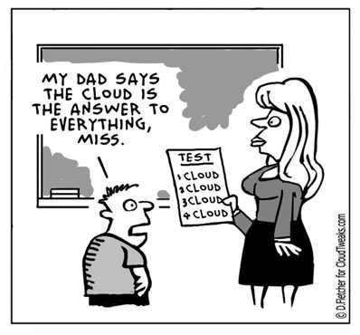
Cloud Computing

Slide 16
Cloud Computing Risk Analysis
How should cloud risk be assessed: like any other security-related business decision, the basis for assessment has to be a solid quantification of the associated business risk versus the economic effort that it would take to mitigate or avoid this risk
There are many risk assessment methodologies, but they all require similar steps to be carried out
A loss event occurs when a threat agent (e.g. a hacker) successfully exploits a vulnerability. The frequency with which this happens depends on:
The frequency with which threat agents try to exploit a vulnerability
The difference between the threat agent’s attack capabilities and the strength of the system to resist the attack

Slide 18
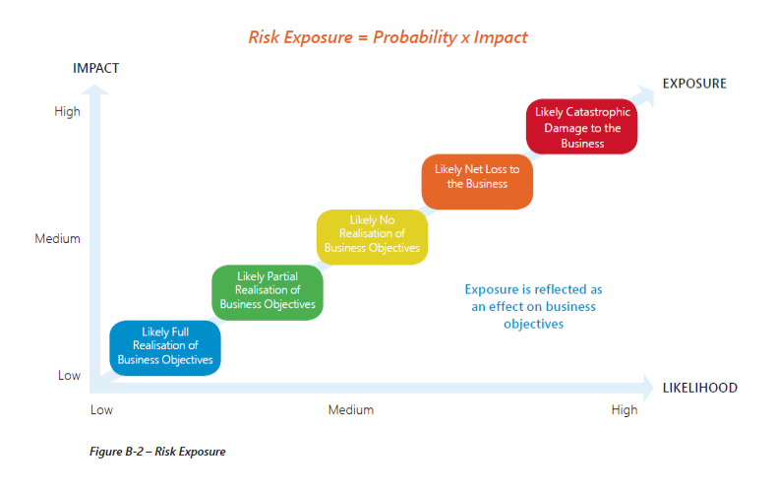

Slide 19
Top Risks of Cloud Computing
Disruptive force – Facilitating innovation (with increased speed) and the cost-savings aspects of cloud computing can themselves be viewed as risk events for some organizations
Residing in the same risk ecosystem as the CSP (cloud service provider) and other tenants of the cloud
Lack of transparency
Reliability and performance issues
Vendor lock-in and lack of application portability or interoperability
Security and compliance concerns

Slide 20
Top Risks of Cloud Computing cont
High-value cyber-attack targets
Risk of data leakage
IT organizational changes - organization needs fewer internal IT personnel ; morale and dedication of remaining members could be at risk
Cloud service provider viability
Reduced control by the organization

Slide 21
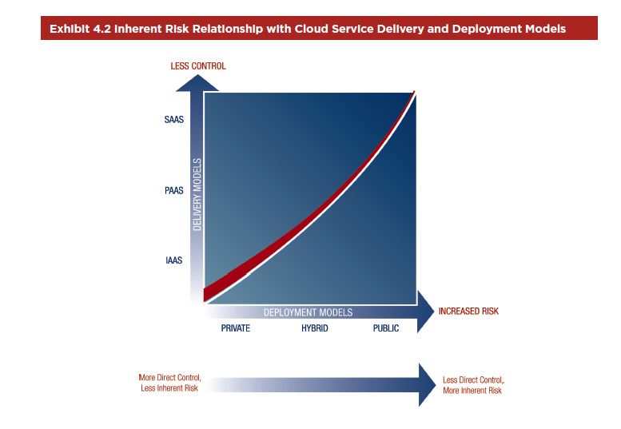

Slide 22
Cloud Risk Mitigation
Risk – Unauthorized cloud activity
Risk Response – Cloud policies and controls
Risk – Lack of transparency
Response – Assessments of the CSP control environment
Risks – Security, compliance, data leakage, and data jurisdiction
Response – Data classification policies and processes
Risks – Transparency and relinquishing direct control
Response – Management oversight and operations monitoring controls

Slide 23
Cloud Risk Mitigation cont
Risks – Reliability, performance, high-value cyber-attack target
Response – Incident management
Risk – Noncompliance with regulations
Response – Monitoring of the external environment
Risk – Vendor lock-in
Response – Preparation of an exit strategy
Risk – Noncompliance with disclosure requirements
Response – New disclosures in financial reporting

Slide 24
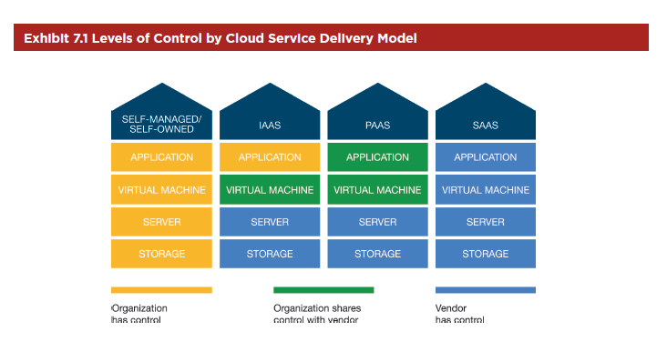

Slide 25
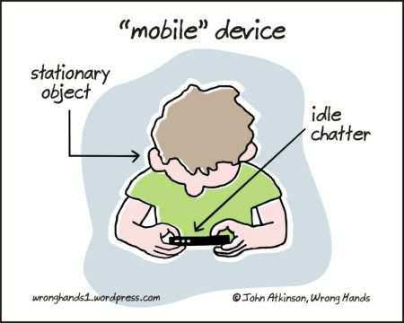
Bring your Own Device (BYOD)

Slide 26
Why is BYOD an Issue?
In the current economic environment, companies are demanding that employees be more productive
Having a robust mobile program that allows personal devices to be used safely in a work capacity can raise employee productivity and be a significant competitive advantage
It can even yield higher recruiting acceptance rates
An employee IT ownership model, typically called bring your own device (BYOD), presents an attractive option to organizations

Slide 27
The Impact of BYOD
BYOD significantly impacts the traditional security model of protecting the perimeter of the IT organization by blurring the definition of that perimeter, both in terms of physical location and in asset ownership
With personal devices now being used to access corporate email, calendars, applications and data, many organizations are struggling with how to fully define the impact to their security posture and establish acceptable procedures and support models that balance both their employees’ needs and their security concerns

Slide 28
BYOD - Issues to Consider
BYOD mobile device deployment risk landscape largely dependent on:
The organization’s risk profile
How the organization defines and treats risk plays a key role in choosing the type of security controls the organization should employ
Current (and future) mobile use cases
Take into consideration the types of data and functionality that are exposed through the deployment
The geographic deployment of the devices
International deployments increase risk levels due to geography and varying regulations

Slide 29
Defining the BYOD Risk
The risk introduced by BYOD tends to be an expansion of the current risk landscape — rather than introducing completely new risks, it has the potential to amplify and increase certain risk
Securing mobile devices
Lost and stolen devices
Physical access
The role of end user device ownership
Always on with increased data access
Lack of awareness

Slide 30
Securing Employees’ Devices
Evaluate device usage scenarios and investigate leading practices to mitigate each risk scenario.
Invest in a mobile device management (MDM) solution to enforce policies and monitor usage and access.
Enforce industry standard security policies as a minimum: whole-device encryption, PIN code, failed login attempt actions, remotely wiping, etc.
Set a security baseline: certify hardware/operating systems for enterprise use using this baseline.
Differentiate trusted and untrusted devise access: layer infrastructure accordingly.
Introduce more stringent authentication and access controls for critical business apps.
Add mobile device risk to the organization’s awareness program.

Slide 31
Defining the BYOD Risk cont
While apps demonstrate utility that is seemingly bound only by developer imagination, it also increases the risk of supporting BYOD devices in a corporate environment
Addressing BYOD app risks:
Malicious apps (malware): the increase in the number of apps on the device increases the likelihood that some may contain malicious code or security holes
App vulnerabilities: apps developed or deployed by the organization to enable access to corporate data may contain security weaknesses

Slide 32
Countering App Risk
Use mobile anti-virus programs to protect company issued and BYOD malware-prone mobile operating systems with mobile anti-virus.
Ensure security processes cover mobile app development and leverage tools, and vendors to bridge assessment skill gaps.
Manage apps through an in-house app store and a mobile app management product.
Introduce services that enable data sharing between BYOD devices.
To increase productivity and security, continually assess the need for new apps.

Slide 33
Defining the BYOD Risk cont
While not a direct security risk, unmanaged devices form a hidden security problem as they may lack corporate security controls and patch management
A BYOD environment will have significantly more variability in the hardware and software versions of devices holding corporate data and providing employee access.
This will further decrease the ability of MDMs to manage and consistently apply technical security policies to the endpoints.
This variation in platforms will also complicate device wiping when the phones are replaced, resold or upgraded by employees, or when they change carriers

Slide 34
Managing Support for BYOD Devices
Create and enforce an appropriate BYOD support and usage policy.
Revamp existing support processes to include secure provisioning and deprovisioning (wipe) of devices, and an increased level of self-help.
Create a patch education process to encourage users to update their mobile devices.
Introduce a social support mechanism to augment the existing IT support team.
Implement a wiki/knowledge base employee self-service support solution.

Slide 35
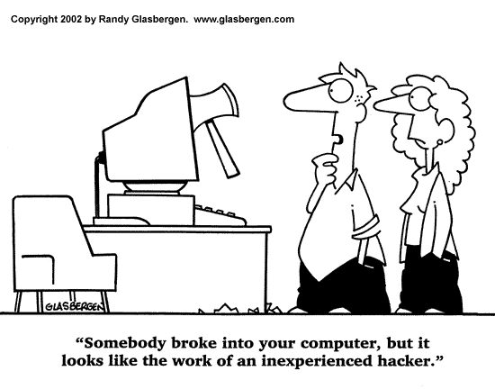
Questions

