Slide 1
Clinical Workflow Analysis Part 1
Bob Marshall, MD MPH MISM FAAFP
DoD Clinical Informatics Fellowship

Slide 2
Learning Objectives
Discuss overview of Workflow Analysis
Review the why and how of workflow analysis
Go over the methods for workflow analysis
Show and discuss the different views for the workflow analysis techniques
Review the questionnaires about capturing the workflow analysis data

Slide 3
What is workflow?
Workflow is the sequence of physical and mental tasks performed by various people within and between work environments.
It can occur at several levels (one person, between people, across organizations) and can occur sequentially or simultaneously

Slide 4
Why Do Clinical Workflow Analysis 1of 2
Clinical workflow tends to be quite complex with multiple people involved and sometimes multiple departments or facilities
Often, multiple processes need to be coordinated, with time-sensitive material information exchanged to others, including patients
Documenting these processes can lead to better understanding of how different tasks interact and have dependencies on others

Slide 5
Why Do Clinical Workflow Analysis 2 of 2
Understanding the various tasks and the steps to complete them can identify inefficiencies, redundancies and potential errors
By better understanding these existing or potential issues, clinics, departments and facilities can save time and money at multiple levels, increase staff satisfaction and improve the patient experience (which can include patient safety)

Slide 6
What are the consequences of not analyzing and revising workflow?
Research assessing health IT implementations demonstrates that delays in patient care, billing, and communication are likely to occur if workflow is not taken into account.
This is generally due to the fact that clinical and practice management requirements are overlooked or oversimplified

Slide 7
How do I analyze workflow? Five things to keep in mind
Maintain an open and constructive environment
Focus on the system or process, not the people
Before mentioning a variation of the process, think about whether this event was a one-time occurrence or a habit
Map out the process you currently have (not the one you wish you had) so your team can pinpoint flaws in the process and improve them
Workflow mapping is a tool for continuous improvement

Slide 8
Simple steps for creating the initial workflow map (the AS IS workflow)
Step 1. Pick a process to map, pick which type of workflow to use (high-level or detailed), pick a lead person
Step 2. Determine the beginning and end points in the process Step 3. Identify each step in the process
Step 4. Put the steps in order (on paper, with stickies, or on computer -- word, PowerPoint, Vizio)
Step 5. Review and edit first draft
Step 6. Review flowchart with the team for input and to ensure the flowchart is accurate

Slide 9
When Should one analyze workflow?
Collect workflow information as early as possible, and preferably before implementing a new health IT system.
As a form of ongoing process improvement, one should continue to assess workflows post implementation.

Slide 10
Basic Symbols for Workflow Mapping

Slide 11
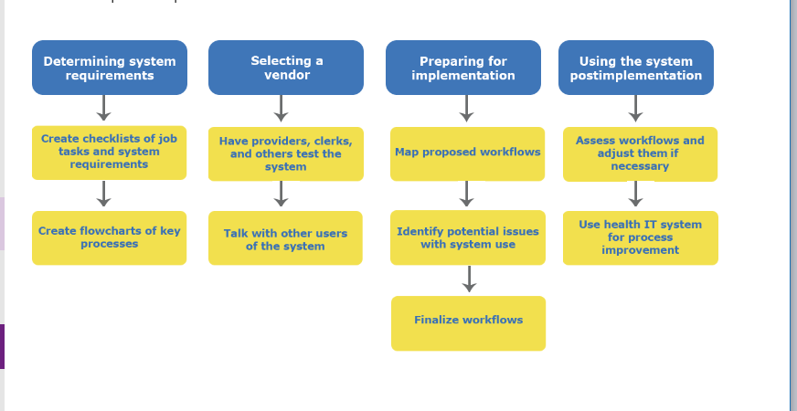
Workflow Tool Examples

Slide 12
The Interview
Interviews provide a means of eliciting information from a group of individuals regarding their opinions, behavior, or knowledge
They involve two or more people (interviewer and interviewee)
The interviewer is the individual collecting data, and the interviewee is the person providing the data
Interviews can be face-to-face or conducted over the phone or with other electronic communication methods

Slide 13
Conducting the interview
Be clear about the purpose of the interview
Prepare a list of questions
Decide on an interview method
Decide the number of interviews to conduct and who is present
Conduct practice interviews
Contact interviewees and schedule interviews
Decide how to collect the interview data – keep notes, record, etc.
Conduct Interviews
Transcribe notes and continue with data analysis

Slide 14
Conducting a Workflow Assessment – Asking the Questions – an Example
What is the first step that occurs when a patient presents for check-in?
What are the next steps…in order? Think of every detail if possible, even if you usually do each subsequent step automatically.
What is the last step you do before handing off the patient to the next person?
How do you complete the handoff to the next person?
Any other tasks/steps you might do, even if they only occur occasionally?

Slide 15
Example of a Clinic Visit Workflow

Slide 17
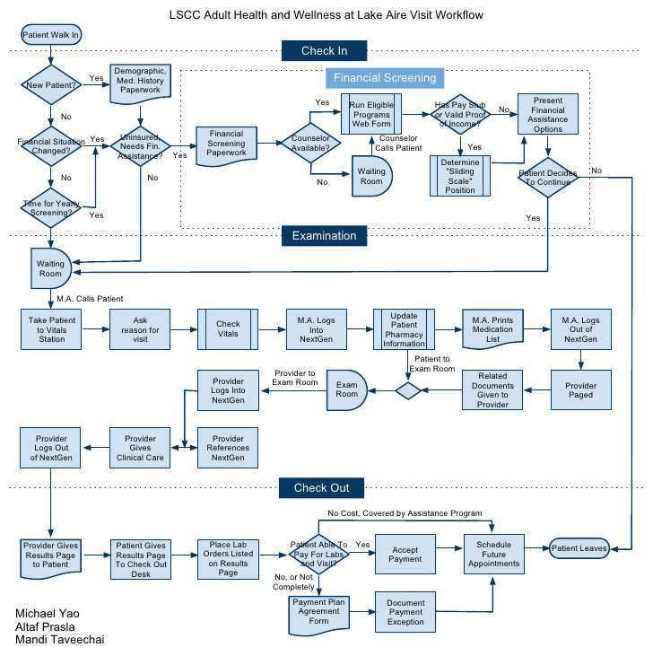

Slide 18
Pre- and Post-implementation Steps Involving Workflow Analysis

Slide 20
Capturing the Data
Can use a number of methodologies to capture the data.
One of the simplest is Post-it pads, where each step goes in an individual page
Alternatively, you can write each step down on a sheet of paper and then transfer them to Post-it pads or some other method of demonstrating flow
Another option is to use flowcharting software to capture the flow – both Windows and Apple devices have such software

Slide 21
Using a Flowcharting Tool – one example
DEFINE THE PROCESS represented in the flowchart.
DETERMINE ALL INDIVIDUALS, DEPARTMENTS, AND GROUPS INVOLVED in the process.
BRAINSTORM THE STEPS in the process. The specific sequence is less important than determining all of the steps at this point (although thinking sequentially may help identify any missing steps).
CONSTRUCT THE FLOWCHART GRAPHICALLY using rows or columns corresponding to the associated work units
ARRANGE THE STEPS SEQUENTIALLY. Place the card with the first step in the column or row that corresponds to the player responsible for it. The second step should be placed further along in the process to show that it occurs later in time, opposite that step's player. Continue in this fashion until all the steps have been placed in the respective lane of the responsible player.
DRAW ARROWS between cards to show the process flow.
REVIEW THE FLOWCHART and validate its accuracy with other individuals who are actually involved in the process.

Slide 22
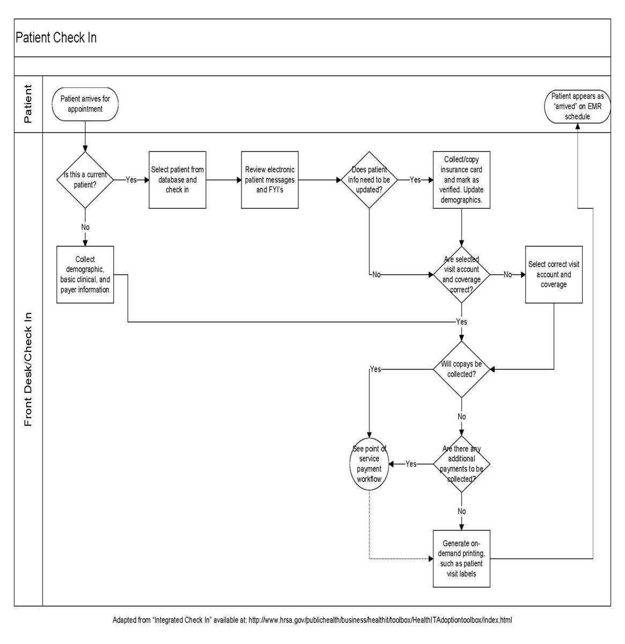

Slide 23
Mapping out Workflow with Post-It Notes

Slide 24
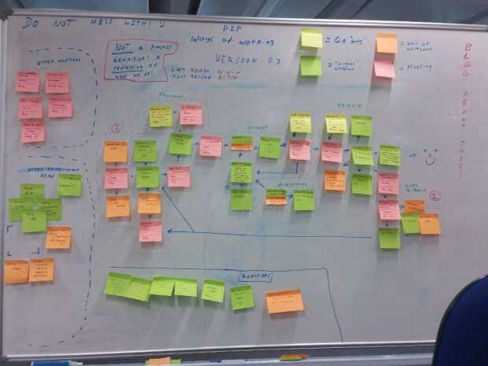

Slide 25
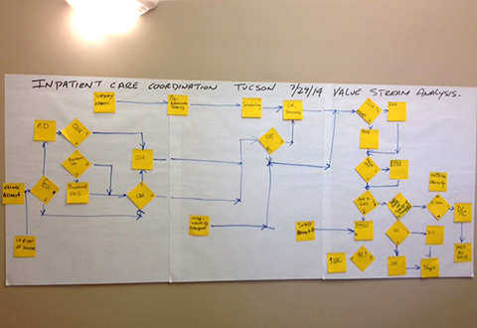

Slide 26
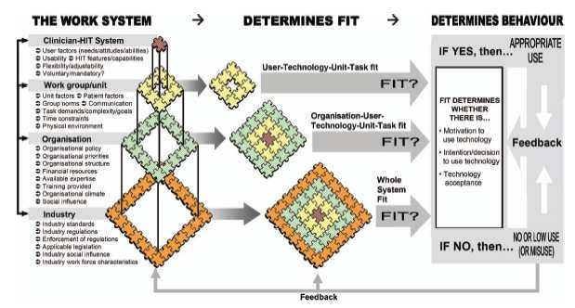
Questions

