Slide 1

Clinical Decision Support
Bob Marshall, MD MPH MISM FAAFP
DoD Clinical Informatics Fellowship

Slide 2
Learning Objectives
Introduction and Overview
Medical Decision Making
Mechanisms of Intervention
CDS Engagement Mechanisms
Implementing, Evaluating and Maintaining Decision Support Tools
Five Rights of CDS
10 Commandments for Effective Clinical Decision Support

Slide 3
Introduction
Clinical decision support is broadly defined as:
software that provides clinicians, patients or individuals with knowledge and person-specific or population information, intelligently filtered or presented at appropriate times, with the goals to foster better health processes, better individual patient care and better population health
A clinical decision support system is a health information technology system that is designed to provide physicians and other health professionals with clinical decision support
A working definition of CDSS, proposed by the Center for Health Evidence is that CDSS's link health observations with health knowledge to influence health choices by clinicians for improved health care outcomes

Slide 4
Medical Decision-Making
Among all the tasks that clinicians face, medical decision-making is among the most challenging
to make the right diagnosis, a clinician must first actually consider that diagnosis among the list of all possible diagnoses
Second, a clinician must determine which questions, physical exam findings, laboratories, or imaging will best narrow this list as far as possible while taking into account the costs and risks of the tests as well as the consequences of the missed diagnosis
Third, a clinician must offer the best possible therapy, taking into account national clinical guidelines and local drug formularies
Finally, clinicians must accomplish all of the above tasks without committing grave medical errors such as drug-drug interactions in life-threatening allergic reactions

Slide 5


Slide 6
Mechanisms of Intervention
The use of EHR and CPOE systems has taken tasks previously accomplished using pen and paper successfully into a digital form
However, the isolated use of these two technologies does not demonstrably improve clinical workflow or clinical outcomes
When clinicians evaluate patients, we must synthesize information from the current visit along with information contained within the electronic health record in order to decide which medications and tests to order
Then they must separately document their decisions in the clinical note in place orders in a CPOE system
Clinical decision support place at the intersection of EHR and CPOE systems can foster better health processes while simultaneously improving workflow

Slide 7
CDS Engagement Mechanisms
There are several ways in which clinical decision support can engage with a clinician an integrated more broadly into an EHR and CPOE system
These include such things as non-interruptive alerts, interruptive alerts and reminders, order sets, templates and smart forms
We will briefly discuss each of these on the following slides

Slide 8
Non-Interruptive Alerts
Non-interruptive alerts are often placed on EHR patient chart summary screens to display tasks that are less time-sensitive
This includes such things as immunizations and age- and gender-specific screening tests
They may also be used to convey important but non-critical information
Their placement ensures that they can be seen by the multiple providers for a patient, but there non-interruptive nature means that they may be missed and less actively sought out

Slide 9
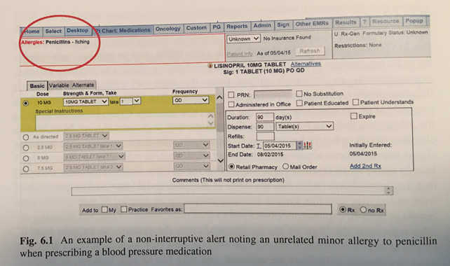

Slide 10
Interruptive Alerts and Reminders
The terms "alerts" and "reminders" are used interchangeably and refer to problems that are delivered to the clinician at the point of care to communicate critical information
In the most basic implementation, a series of logical rules are evaluated by the CDS system in response to a clinical action such as prescribing a medication
If the criteria for rule is met, a corresponding alert is generated
Rule-based CDS systems may be viewed as simplistic in their evaluation of patients
However, the simplicity serves as an advantage because clinician users have no ambiguity about why a particular alert was generated

Slide 11
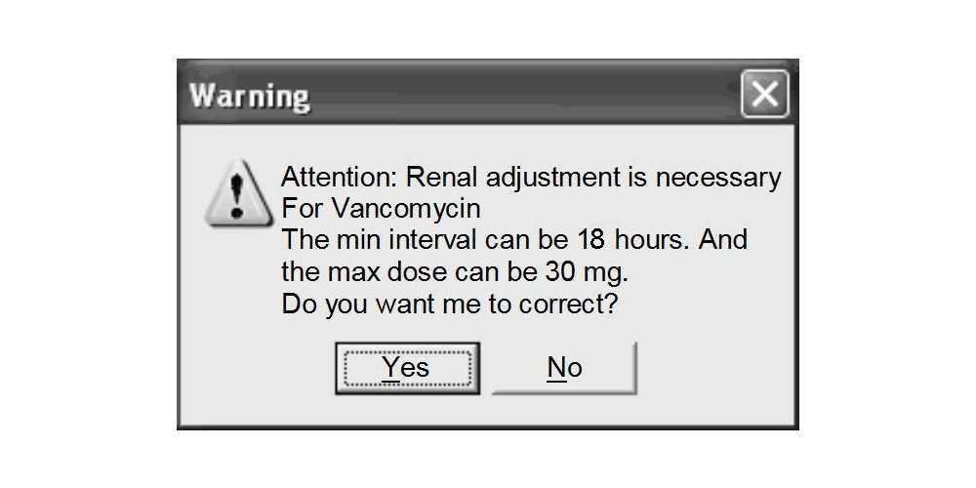

Slide 12
Order Sets, Templates and Smart Forms
A basic form of workflow facilitation using CVS lies in the use of order sets, which allows clinicians to view and act on a given set of orders for a particular condition
Such orders as are commonly used to encourage actions that may otherwise be forgotten, such as to prescribe medications to prevent deep vein thrombosis in patients admitted to the hospital (e.g. congestive heart failure) or to a hospital location (e.g. surgical intensive care unit admission orders)
Smart forms or templates represent a more advanced form of integration, or clinical documentation, the ability to add or remove coded order structured information in order entry are intrinsically linked and displayed on the same screen

Slide 13
Smart Forms
Smart forms differ from traditional CDS systems in the following ways:
Decision support is not interruptive in nature, but rather is in the form of suggested orders and presented at a place and a time within a user's workflow
Placing the decision support within the user's workflow, such as while gathering information in writing their note, tends to make the decision support more acceptable to the user
The documentation function allows the user to document a typical outpatient visit/inpatient encounter note in a patient with multiple medical problems, some of which may be supported by clinical decision support and some may not
The Smart Form is designed to provide decision support for multiple problems simultaneously and to allow for future expansion to a additional acute and chronic conditions

Slide 14
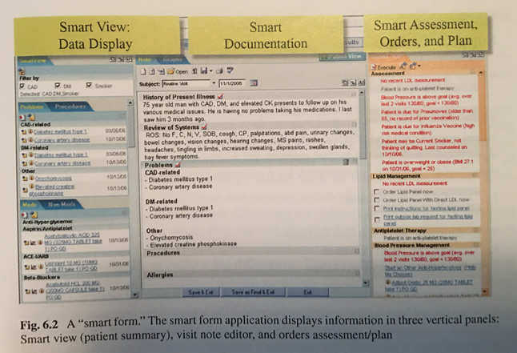

Slide 15
Implementing, Evaluating and Maintaining Decision Support Tools

Slide 16
The Five Rights of CDS
While clinical decision support systems have tremendous potential to improve individual patient care and population health, any positive impact can be severely blunted if not implemented in a way that respects the desires and needs of the end-users
the "five rights" of CDS is a framework for a successful implementation that includes the following:
  The Right Information
  To the Right Person
  In the Right Intervention Format
  Through the Right Channel
  At the Right Time in a Workflow

Slide 17
The 10 Commandments for Effective Clinical Decision Support
The "10 Commandments" highlight key factors in implementing, evaluating and maintaining decision support tools:
Speed is everything
Anticipate needs and deliver in real time
Fit into the user's workflow
Little things can make a big difference
Recognize that physicians will strongly resist stopping
Changing direction is easier than stopping
Simple interventions work best
Ask for additional information only when you really need it
Monitor impact, get feedback and respond
Manage and maintain your knowledge-based systems

Slide 18
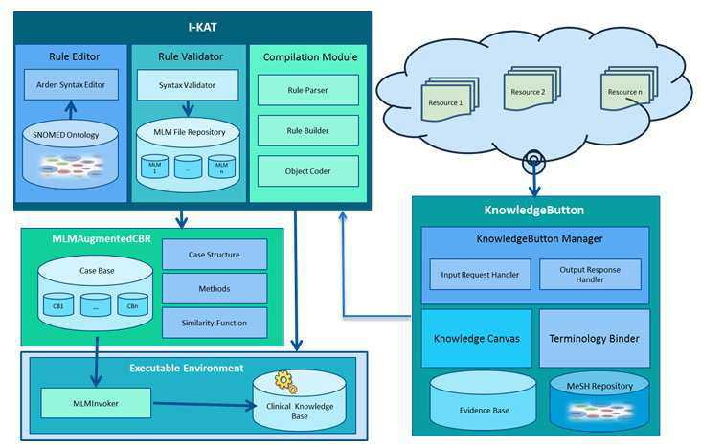

Slide 19
Speed Is Everything
The time it takes users to navigate a CDS system is the primary determinant of user satisfaction
Sub- second screen transitions should be the goal when designing a CDS intervention

Slide 20
Anticipate Needs and Deliver in Real Time
CDS systems should strive to present key bits of pertinent information to the clinician to make decision-making easier
An example would be displaying the potassium level when ordering a medication that may raise or lower it
CDS systems should also anticipate "latent needs" of clinicians and suggest corollary orders, such as checking medication levels when ordering a medication that requires monitoring

Slide 21
Fit into the User's Workflow
Clinicians are unlikely to consider even excellent recommendations when they are not presented at the right time in a user's workflow
This is one of the most critical components of clinical decision support, and studies have shown that the lack of integration into the workflow is the single most important factor for lack of CDS success

Slide 22
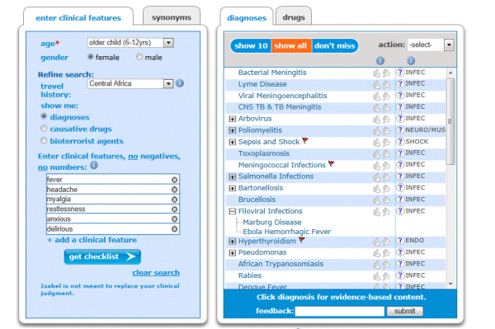

Slide 23
Little Things Can Make a Big Difference
The presentation of information is as important as the content
Offering clinicians the ability to enter free text diagnoses greatly reduces the entry of coded information, which may have downstream consequences
Presenting alerts that are easy to ignore and nullify their impact
Usability testing can be helpful in finding and correcting unintended consequences

Slide 24
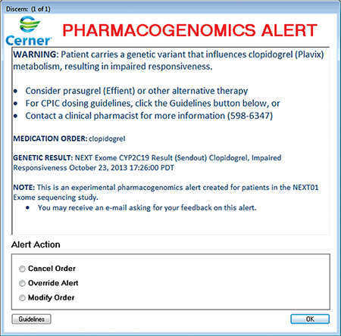

Slide 25
Recognize That Physicians Will Strongly Resist Stopping
Clinicians rarely discontinue an order based on CDS recommendations, even when ordering redundant tests or prescribing medications without appropriate evidence
If clinician behavior must absolutely be changed due to high costs or limited resources, then coercing clinicians to choose an appropriate indication for an order and allowing overrides only with the approval of the local clinical expert may be effective strategies in preventing inappropriate order entry
Close and ongoing monitoring of such CDS interventions is critical to prevent "gaming" of the system

Slide 26
Changing Direction Is Easier Than Stopping
Changing clinician behavior can be easy when, clinicians do not have strong feelings about certain attributes of an order
Some examples include dosing or route of a medication or the number of use for a particular radiology test
Altering the default selections and suggesting appropriate attributes based on the indication are effective strategies to change direction

Slide 27
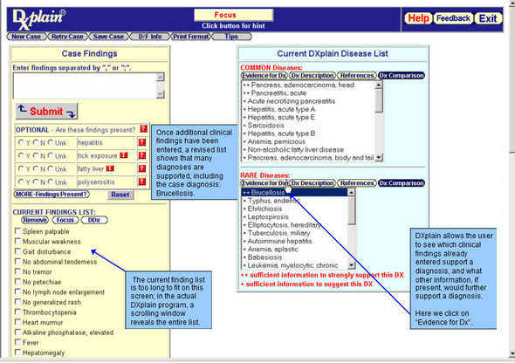

Slide 28
Simple Interventions Work Best
Guidelines must be condensed to a single screen to be usable at the point of care
Clinicians often give up when working through complex CDS interventions

Slide 29
Ask for Additional Information Only When You Really Need It
The likelihood of success in implementing a computerized guideline is often inversely proportional to the number of extra data elements needed
Getting buy-in from clinicians to enter unnecessary information, particularly when the risks to the patient are low, may threaten the success of the intervention

Slide 30
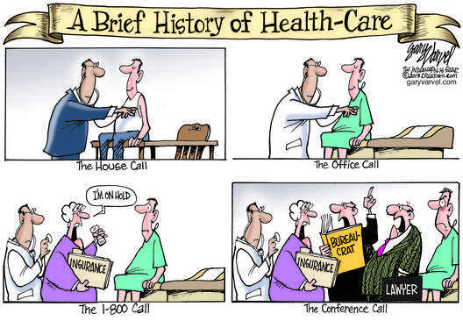

Slide 31
Monitor Impact, Get Feedback and Respond
When action-oriented alerts are presented to a clinician, there should be a reasonable chance that they are acted upon
Alerts that are rarely acted upon should be closely evaluated to determine why they are being ignored
  In many cases the reason may be medically appropriate and not originally anticipated
Making corrections to the content and severity level of clinical alerts, and even removing alerts that are not having the intended impact, is critical to the ongoing success of CDS systems

Slide 32
Manage and Maintain Your Knowledge-Based Systems
The effort required to monitor and address issues and CDS systems is easily underestimated
in the face of rapid changes in medical knowledge and clinician behavior, Knowledge encoded in CDS systems must be continually adjusted, pruned and corrected
Assigning each subject area of a knowledge-based system to an appropriate clinical expert is a first step toward successful management of the knowledge base

Slide 33
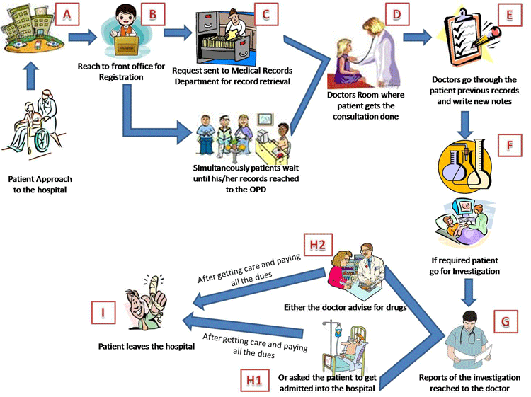
CDS before EHRs

