Slide 1
Change Management
COL Eric A. Shry, MD

Slide 2
Change
To become different, replace, modify, transform, or transition
“Organizational transformation”
“Time of transition”
“Disruption”
But what happens without effort to become different?
  Change is inevitable
  Change happens without attempt to alter course
“You are either trying to get better or getting worse”

Slide 3
Change
If change is going to happen, why do we need to “manage” it?
  Align change with our strategic priorities
  Adopt best practice
  Bring in new capabilities with goal of “leap” (rather than incremental) improvement
    History: Standish Group study of software implementations (2004)
      29% “successful”
      18% “failed”
      53% “challenged”
      Improved by 2012 to 39%, 18%, and 43%, respectively (better products, project management, leadership, and change management)

Slide 4
Change Management
Leading transitions in a direction toward a desired future state
Organizational process—assisting groups, individuals in the change process
Managing the “people side” of change
Current State
Strategy
Future State
Assess
Implement

Slide 5
Assess
People
Organizational Culture and Prior Behavior
  Leadership
    Clear goals and vision
    Attitude toward change
    Risk tolerance
  Personnel
    Openness, perceived time and ability to accept change
    Engagement
  Resources
    Ability, willingness to commit
  Major prior projects (success or failures?)
  Current major projects that could conflict/be dependencies

Slide 6
Assess
Process and Technology Factors
Change alignment with organizational goals
Amount of process change required
  Current process assessment
  Future process assessment
    Customization v. standardization
    Risks
Technical feasibility/risks
Tangible benefits to users

Slide 7
Change Theories
Diffusion of Innovations
Transition theory
Lewin’s Change Theory
Precede-Proceed Model
Complex Adaptive Systems
Kübler-Ross Grief Stages

Slide 8
Change Theories
Diffusion of Innovations
  Everett Rogers, sociologist
  Innovators (2.5%), Early Adopters (13.5%), Early Majority (34%), Late Majority (34%), and Laggards (16%)
  Diffusion through innovation, communication channels, time, social systems

Slide 9
Change Theories
Transition theory
  William Bridges, psychologist
  Managing situational change is not as difficult as the psychological transitions of people impacted by the change
  Phase 1 Ending, Losing, Letting Go: Deal with loss before moving on
    What ended? Who is impacted most?
  Phase 2 The Neutral Zone: Confusion, chaos, attempt re-alignment to change
    Promote communication, encourage innovation, adaptation
  Phase 3 The New Beginning: Energy, purpose, unity, embrace change
    Help people create and embrace the new

Slide 10
Change Theories
Lewin’s Change Theory
  Kurt Lewin
  Unfreeze
    Preparation, overcome inertia, deal with resistance
  Change
    Confusion, discomfort
  Refreeze
    New habits and comfort with future state

Slide 11
Change Theories
Precede-Proceed Model
  Lawrence Green
  Community/public health; CDC, Dept of Health and Human Services
  Design and develop through looking at different perspectives
    PRECEDE phases (predisposing, reinforcing, enabling constructs)
      Social diagnosis
      Epidemiologic, behavioral, and environmental diagnosis
      Educational and ecological diagnosis
      Administrative and policy diagnosis
    PROCEED phases
      Implementation of the program
      Process evaluation
      Impact evaluation
      Outcome evaluation

Slide 12
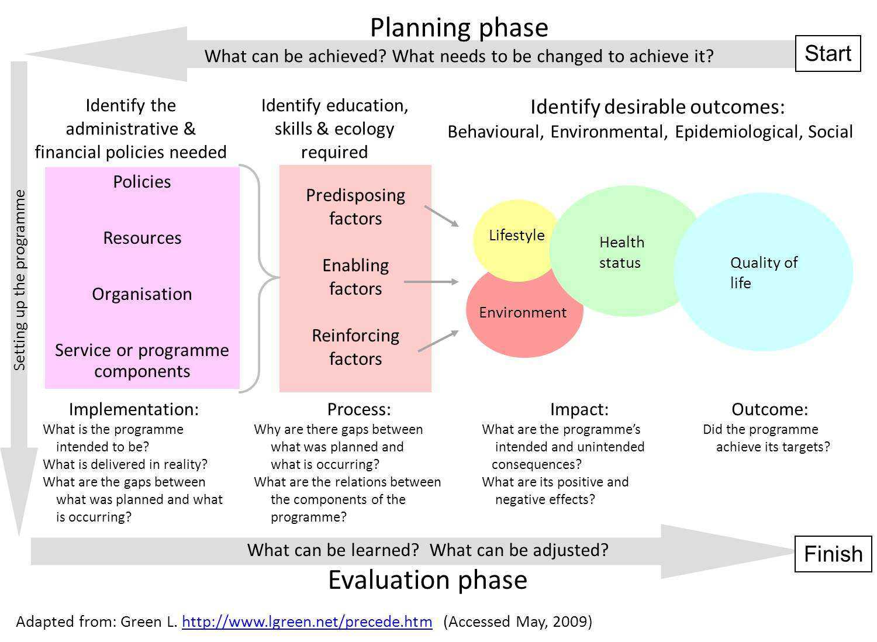

Slide 13
Change Theories
Social Influence Theory
  Herbert Kelman, expanded by many others
  Behavior is social
  Types
    Compliance (hide true feelings)
    Identification (famous person)
    Internalization (fully accept)
    Conformity
    Minority influence
    Self-fulfilling prophecy
    Reactance (anticonformity)
    Obedience (Stanford prison experiment)
    Persuasion
  Social norms have influence

Slide 14
Change Theories
Complex Adaptive Systems
  Diverse agents that learn (adapt)
  Usually non-linear interdependencies
  Can self-organize in networks
  Emergence into larger systems
  Co-evolve with changing external environment
  Research tool for modeling dynamic, inter-dependent systems with little structure or hypotheses; e.g. unsupervised machine learning, hypothesis generation

Slide 15
Change Theories
Kübler-Ross Grief Stages
  Physician
  Denial
  Anger
  Bargaining
  Depression
  Acceptance

Slide 16
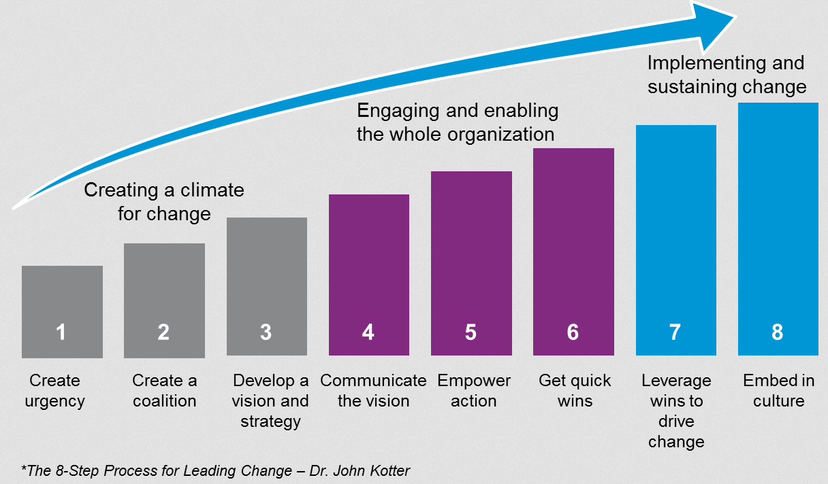
Implementing Change
Kotter’s 3 phases and 8 steps
www.kotterinternational.com

Slide 17
Implementing Change
Organizational commitment
Good communication
  Set expectations
  Communicate benefits
Planning
  Detailed research on workflow change
Leadership and champions (know all the stakeholders)
Understanding user needs
Functioning technical solution
Train before, support during
No plan survives first contact—be ready for change control
Have deliverables
Recognize and celebrate success

Slide 18
Resistance
Systemic factors
  Regulations
  Lack of drivers (or uncertainty)
  Lack of outcomes data
  Costs
Organizational factors
  Competing goals
  Prior failures (even success)
    Change fatigue
  Inertia (“governance”)
  Morale
Individual factors
  Lack of perceived benefit
  Change in roles and responsibilities
  Loss of status
  Lack of ownership
  Disengagement

Slide 19
Effective Strategies to Overcome Resistance
Assess and address culture, leadership, people and process problems before investing in technology
Know your risk areas
Have a senior sponsor, champions in areas AND a good team
Don’t underestimate the potential impact of resistance
Establish urgency
Communicate a clear future state
Train
Create short-term wins
Communicate with different messages to different audiences
Complete improvement cycle with repeat evaluation, adjustment, and rewards

Slide 20
Global
Socio-technical
Foundational
Implementation
Early (planning, workflow, champions)
Actual (materials, training, support)
Recovery (iteration, responsiveness)
Communications
Leadership
Organizational
Culture
Other major org efforts
Strategy
Technical feasibility
Team

Slide 21
Summary
Change is hard; expect resistance
Change involves people, process, and technology (last 2 are easy part)
Use change theories
Will get much more on use of planning and project management

Slide 22
Reading
http://www.kotterinternational.com
https://www.healthit.gov/sites/default/files/tools/nlc_changemanagementprimer.pdf

