Slide 1
Business Case Analysis
Bob Marshall, MD MPH MISM FAAFP
DoD/MAMC Clinical Informatics Fellowship

Slide 2

Objectives
Define business case
Discuss difference between business case and business plan
Identify when to create a business case
Overview the seven steps to a business case
Discuss each of the seven steps to a business case

Slide 3
What is a Business Case?
A business case captures the reasoning for initiating a project or task
Often presented in a well-structured written document
May also come in the form of a short verbal argument or presentation
Logic of the business case:
Whenever resources such as money or effort are consumed
Should be in support of specific business need

Slide 4
Business Case versus Business Plan
Business case answer the question: “What happens if we take this course of action?”
Business plan describes how an organization or business unit intends to navigate successfully through its long-range projections of revenues, expenses, business strategy and other information.
Managers and executives use business plans to secure funding from investors or to plan strategy execution for an organization or business

Slide 5
When to Create a Business Case
Business case is useful when you want to:
Demonstrate the value a proposed product of service would generate for the organization
Prioritize projects within your group and identify which ones to eliminate
Demonstrate the value of a product or service to a customer/external stakeholder
Obtain additional resources for a new project, initiative or organization
Modify an existing product, project or offering
Invest in a new capability
Decide whether or not to outsource a particular function

Slide 6
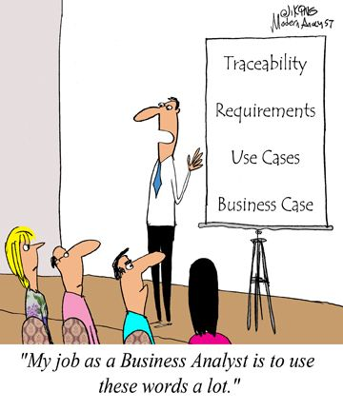
Seven Steps to a Business Case
Step 1: Define the opportunity
Step 2: Identify the alternatives
Step 3: Gather data and estimate time frame
Step 4: Analyze the alternatives
Step 5: Make a choice and assess the risk
Step 6: Create a plan for implementing your idea(s)
Step 7: Communicate your case

Slide 7
Define Opportunity 1 of 2
The first step in a business case is to define the problem to solve or opportunity to seize
If your boss has the idea and wants you to build the BCA, you still need a full understanding of the issue/opportunity
Next is to identify and describe the benefits of the problem solving or opportunity seizing
Next, identify the relevant business objectives involved
Once identified, you must prioritize the objectives

Slide 8
Define Opportunity 2 of 2
Objective priorities should align with organizational mission, vision and goals
You need to assign feasible (achievable and measurable) metrics for each objective
It is best if you can design your metrics to not entail extra work for end users

Slide 9
Identify Alternatives
Develop/brainstorm a full set of alternatives, vice a single, first idea
Identify and talk with stakeholders early in the process – to obtain ideas and get buy-in
Once you have received input from stakeholders, narrow the list of alternatives to the best 2-3 options that best address business objectives and stakeholder needs
Favor the easy-to-implement option over the complex/elaborate, expensive and difficult one
Combine alternatives when feasible

Slide 10
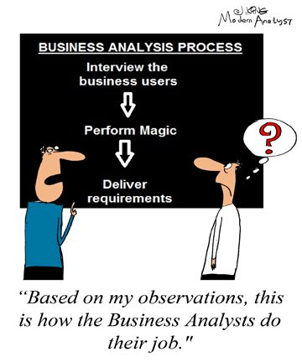
Building Business Case Support
Identify key stakeholders and decision makers
Ask for stakeholder input early in the process
Incorporate any feedback in your case
Ask for input from trusted advisors
Collect benchmarks on other organizations
Create multiple delivery formats for your case

Slide 11
Gather Data and Estimate Time Frame
List all the information needed to compare options and choices
Collect the data from the potentially multiple sources
Once data is gathered, estimate a time frame for implementing the initiative and achieving the outlined objectives
When making timeline estimates, document information used and assumptions made to derive the estimate
This helps to explain the reasoning later, if asked

Slide 12
Tips for Data Gathering
Define the categories of information you need
Make a list of the specific questions you want to answer
Be prepared to add to your list of questions
Document sources and assumptions as you go
Make sure your estimates are reasonable/realistic
For each piece of information, consult multiple sources
Once data is gathered, ask for input from primary stakeholders

Slide 13
Analyze Alternatives
Show each alternative’s impact on the defined metrics – financial and other metrics of prime interest to stakeholders
The primary financial metrics for this effort include the following: payback period; net present value; and return on investment
Document conclusion so they are easy to compare
For more difficult comparisons (limited financial data), create a pros and cons table

Slide 14
Steps for Analyzing Alternatives 1 of 2
List the costs
List benefits, both increased revenues and decreased costs (cost savings)
Identify when you would expect to see costs and revenues/cost savings
List the impact on other corporate/organizational metrics – like customer satisfaction, customer retention, operational efficiency
List unquantifiable benefits and costs
Conduct a business impact analysis

Slide 15
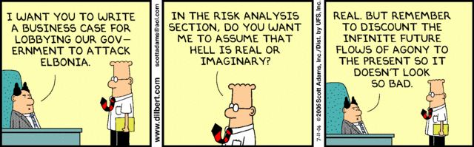
Steps for Analyzing Alternatives 2 of 2
Conduct a security impact analysis (you will need assistance from IT for this)
Organize all of your data into a spreadsheet or table for ease of comparison

Slide 16
Make Choice and Assess Risk
Once you have compared the pros and cons of your alternatives, you need to select the best possible solution – and justify your choice
Identify the potential risks to the organization before fully committing to the option
Consider how to mitigate the risks identified
Determine whether or not you need to modify your recommended course of action after the previous two steps
If two options have comparable benefits, you may want to assess overall risks and compare those as well

Slide 17
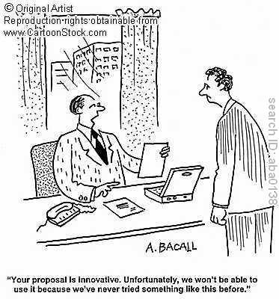
Steps for Choosing a Final Recommendation
Select a preliminary recommendation
Document the rationale for your decision
Consider the risks
Look for ways to mitigate risks
Revisit your original recommendation

Slide 18
Create Plan for Implementing Idea
The implementation plan lays out how you will track your progress and measure success if plan accepted
You need to list the major steps (milestones) needed to carry out the solution – keep it simple and straightforward
Communicate with decision makers to assess progress towards goals
Identify early the resources you will need for each project phase
Clarify responsibilities for all involved
Indicate the expected payoff to stakeholders
Track your results and keep stakeholders informed

Slide 19
Communicate Your Case
Understand your audience
Clarify what you want/need them to do
Identify what they value/care about most (usually by asking them in advance)
Articulate what they stand to gain
Assess their level of risk tolerance (willingness to accept risk…and at what level)
Determine how they like to receive information (learning styles/preferences)
Use visuals to present case, as appropriate
Do this even if your organization only requires a written business case

Slide 20
Tips for Writing Your Business Case 1 of 2
Ask about a required format for business cases
Remember this is a sales pitch
Engage your audience using the BLUF style
Clearly delineate how you arrived at your recommendation
Briefly document each step you took in the process
This helps the reader understand the reasoning behind the proposal
Make it interesting
Make it concise

Slide 21
Tips for Writing Your Business Case 2 of 2
Use descriptive language to “fill in the blanks” and not just a bunch of bullets that may mean nothing to your readers
Demonstrate the value of the proposal from all perspectives
Explicitly tell your reader why the project is important to him/her and to the organization as a whole
Be clear about what you are asking your audience to do
Do you need resources?
Do you simply need their support to approve the project or to get people?
Verify that you have calculated all numbers correctly

Slide 22
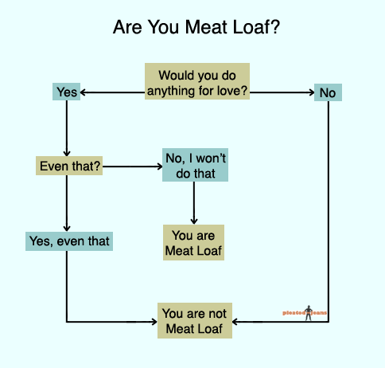
Questions?¿

