Slide 1
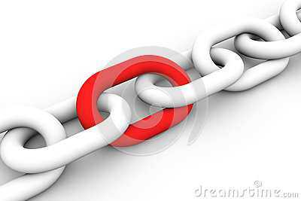
Blockchain in Healthcare
Bob Marshall, MD MPH MISM FAAFP Program Director, DoD Clinical Informatics Fellowship

Slide 2
Objectives
Introduction to Blockchain Basics
Review Blockchain Security
Blockchain and MPI – How it can help
Blockchain Promise in Healthcare – lots of potential
Blockchain Pitfalls in Healthcare – some of these as well
Discuss HIE and Blockchain

Slide 3
Blockchain – What is it?
A Blockchain is a distributed database that maintains a continuously growing list of ordered records called blocks
Each block contains a timestamp and a link to a previous block
By design blockchains are inherently resistant to modification of the data
Once recorded, the data in a block cannot be altered retroactively
Blockchains are an open, distributed ledger that can record transactions between two parties efficiently and in a verifiable and permanent way

Slide 4
In Other Words
Blockchain is a peer-to-peer (P2P) distributed ledger technology that establishes transparency and trust
Blockchain is the underlying fabric for Bitcoin and is a design pattern consisting of three main components: a distributed network, a shared ledger and digital transactions
Blockchain uses a decentralized P2P architecture with nodes consisting of network participants
Each member in the network stores an identical copy of the blockchain and contributes to the collective process of validating and certifying digital transactions for the network

Slide 5
Shared Ledger
Members in the distributed network record digital transactions into a shared ledger
To add transactions, members in the network run algorithms to evaluate and verify the proposed transaction
If a majority of the members in the network agree that the transaction is valid, the new transaction is added to the shared ledger
Changes to the shared ledger are reflected in all copies of the blockchain in minutes or, in some cases, seconds
After a transaction is added it is immutable and cannot be changed or removed
Since all members in the network have a complete copy of the blockchain no single member has the power to tamper or alter data

Slide 7
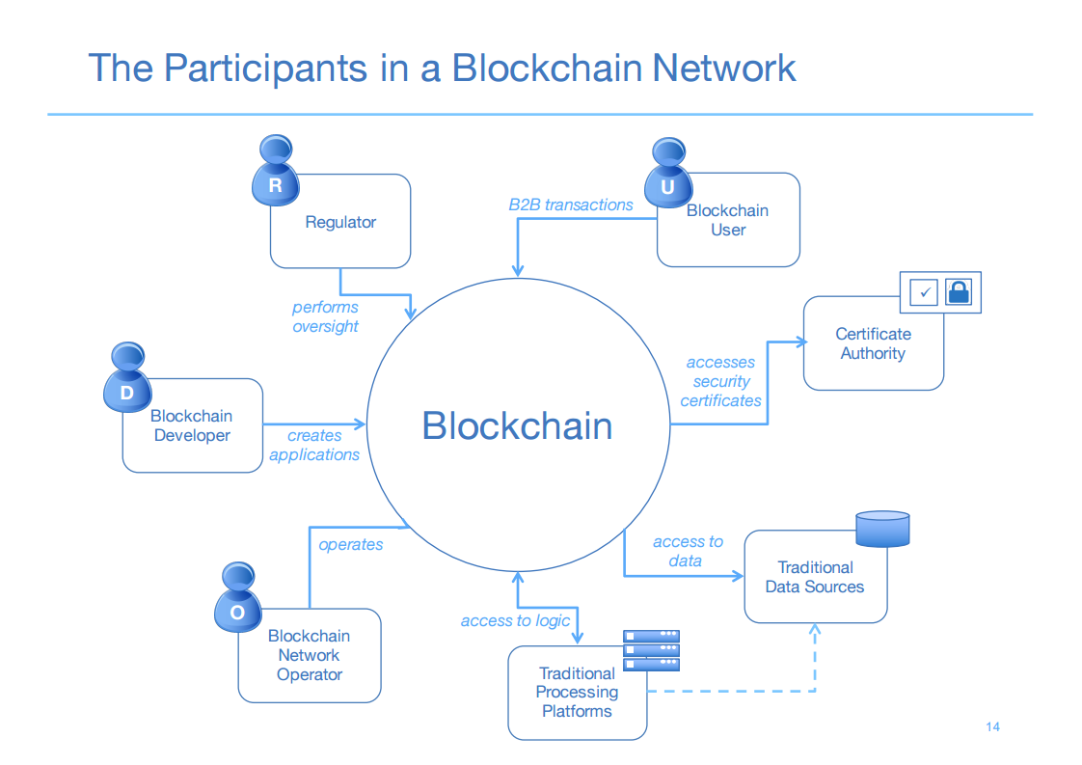

Slide 8
Digital Transactions
Any type of information or digital asset can be stored in a blockchain, and the network implementing the blockchain defines the type of information contained in the transaction
Information is encrypted and digitally signed to guarantee authenticity and accuracy
Transactions are structured into blocks and each block contains a cryptographic hash to the prior block in the blockchain
Blocks are added in a linear, chronological order

Slide 9
Transaction Structure
Transactions contain encrypted and digitally signed data along with an index that points to the prior block in the chain. Transactions are structured in blocks and recorded in chronological order.

Slide 10
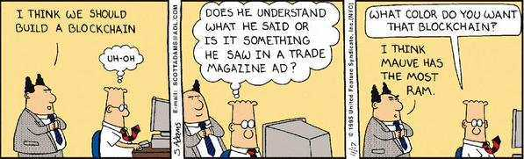
Some will never get it

Slide 11
Blockchain Security 1 of 2
Blockchain incorporates a level of security that could take the world's most powerful supercomputers, working every second of every day, over 10,000 years to crack
How is this security so strong? Imagine multiplying 2 prime numbers so large that if you typed the result of their multiplication onto 8.5 x 11 paper, the stack of paper would be large enough to go to the moon and back and further.

Slide 12
Blockchain Security 2 of 2
Imagine the result of that multiplication of very large prime numbers as the public identifier for a person's electronic healthcare record
If you plugged the result into a supercomputer it could take forever to identify the 2 prime numbers that were initially multiplied together to create the result
It is also useful to consider that there are even more sophisticated security algorithms beyond the RSA Prime number example

Slide 13
Blockchain and MPI
Not only is blockchain way beyond PGP (pretty good privacy) offered by today’s healthcare information systems, but the very nature of blockchain incorporates the equivalent of a Master Patient Identifier
This means every person on the planet could eventually have a unique identifier at some point in time in the future
Once you have this "Private Key" then you can unlock the multiplication result by simple division which, hypothetically opens up the health records contained on the "blockchain backbone"

Slide 14
Blockchain Healthcare Promise
Data Integrity & Security
New Standards
Disruption
Improve the security and management of patient data
Higher quality clinical trial data
Reduce regulatory & compliance costs
Opportunity to establish new standards and practices
Optimize interactions between healthcare and insurance companies
Mid-sized companies and startups have the opportunity to form consortiums and disrupt incumbents

Slide 15
Data Integrity & Security 1 of 2
There are two primary approaches to using blockchain to securely record and share data
First - build a private blockchain system among a trusted set of parties
Not yet clear if this approach offers advantages over systems that use a distributed database
Second - anchor data to the public blockchain network
This generates a proof that can be used to verify the integrity and timestamp of any data, file, or business process
Anyone with this proof can use open source tools to independently verify the data without relying on a trusted third-party

Slide 16
Data Integrity & Security 2 of 2
The second approach, a seemingly minor technological advance, could have far reaching implications for the healthcare industry:
Verify the integrity of patient health data shared between organizations
Create immutable audit trails for health care business processes
Prove the integrity of data collected in clinical trials
Reduce the cost of audits and regulatory compliance
More on this later with Blockchain and HIE’s

Slide 17
New Standards
Blockchain technology brings the opportunity to improve standards for managing healthcare records, insurance claims, and patient data
R3Cev is a consortium of 45 member banks that researches and develops the usage of blockchain technology in the financial sector
A similar consortium could be formed by large health care and insurance companies
Additionally, organizations such as the Council for Affordable Quality Health (CAQH) can start analyzing blockchain technology and make recommendations on its usage

Slide 18
Disruption
Modernization of infrastructure creates the opportunity for smaller players to disrupt incumbents
Interest in blockchain may encourage smaller players to create networks and compete in new ways
These networks don’t necessarily need to use blockchain technology
Interest in blockchain combined with secure cloud computing technology may be sufficient to have a meaningful impact

Slide 19
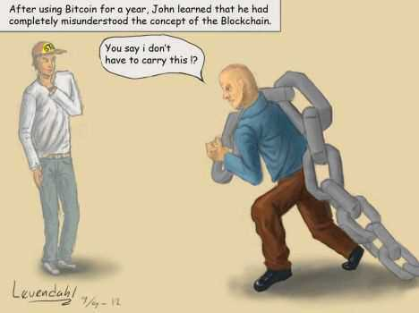

Slide 20
Blockchain Healthcare Pitfalls 1 of 2
Vendor Lock-in
Hype Overload
Blockchain vendors want customers locked into their platform
High switching costs give vendors control and pricing power
Risk building new data silos where customers rent access from vendors
Analysts and professional experts issue overly optimistic reports in an effort to make their mark on the industry
Betting on technology before it’s ready is a fast way to lose your job
Tokenized platforms such as Ethereum have an incentive to hype the technology to increase the value of the token

Slide 21
Blockchain Healthcare Pitfalls 2 of 2
Immature Infrastructure
Patient-Controlled Data
Most blockchain technology is experimental and untested.
Greater security risk and higher development costs.
Use blockchain to enhance secure cloud based architectures
Enabling patients to manage their health care data is risky
Deploying wallets creates a large key management problem

Slide 22
Vendor Lock-in
Blockchain vendors want customers locked into their platform
The network effect of getting many companies on their platform increases switching costs
This gives vendors control of customer data and the ability to raise prices
Companies promoting blockchain platforms know that once an application is built with their software, the cost of moving to another platform is prohibitively high
It may be best to wait for established software vendors to integrate new technology than to try and build something from scratch

Slide 23
Hype Overload 1 of 2
Analysts and professional experts are issuing overly optimistic reports in an effort to make their mark on the industry
There's little penalty for them to be wrong about predicting the future
The consequences for those making strategic technology decisions can be disastrous
Betting on technology before it’s ready is a quick way to lose your job

Slide 24
Hype Overload 2 of 2
Before making any commitment, ask hard questions and compare new technology to existing solutions
Start small and scale up once something has demonstrated value
Tokenized platforms such as Ethereum have an incentive to hype their technology to increase the value of the token
This risk hasn’t existed with prior generations of technology
Blockchain hype has led to misinformation and widespread misunderstanding
This is an important factor to consider when evaluating vendors

Slide 25
Immature Infrastructure 1 of 2
Most blockchain technology is less than two years old and has not been tested in a production environment
Smart contracts, blockchain identity, decentralized systems, and other popular buzzwords are in very early stages of development
Developers with blockchain expertise are rare
Blockchain developer tools are nascent
These factors increase security risks and make the cost of developing with blockchain platforms higher than existing technology stacks

Slide 26
Immature Infrastructure 2 of 2
Public blockchain platforms are constantly attacked and subject to security exploits
For example, in Q3 2016, Ethereum suffered two attacks that shut down a large percentage of nodes
An exploit in a smart contract resulted in the loss of $60 million USD
There are now two competing versions of Ethereum
The risks of building mission critical applications on unstable infrastructure is significant
Over time, countermeasures to attacks may harden the security and resilience of blockchain networks

Slide 27
Patient-Controlled Data 1 of 2
Giving patients control of their health records sounds like a good idea, but it comes with significant risks
If a patient is incapacitated, emergency workers need to gain access to health records without the patient’s permission
This necessitates an alternative access method is built into the technology that safeguards the data
This backdoor represents a security risk

Slide 28
Patient-Controlled Data 2 of 2
There is a significant cost and risk in deploying wallets and training consumers on their proper use
Usability problems and user errors could increase the likelihood that patient data is stolen or lost
Consumer Bitcoin wallet companies have struggled with usability issues for years
Managing access to healthcare data is more complicated than managing payments
It’s likely that the risk of errors would be even higher than the already high error rate of Bitcoin wallets

Slide 29
Blockchain for HIE
While blockchain technology is not a panacea for data standardization or system integration challenges, it does offer a promising new distributed framework to amplify and support integration of health care information across a range of uses and stakeholders
It addresses several existing pain points and enables a system that is more efficient, disintermediated, and secure

Slide 31

Questions

