Slide 1
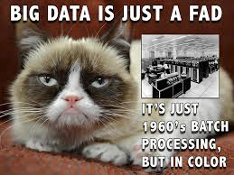
Big Data
Bob Marshall

Slide 2
Objectives
Define Big Data (and what it is not)
Review Big Data history, characteristics and importance
Define/discuss Hadoop and MapReduce
Define/discuss Health relevant data
Discuss Big Data value proposition
Discuss Big Data and health care – challenges/benefits

Slide 3
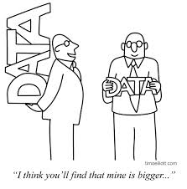
Definition of Big Data
In 2012, Gartner updated its deﬁnition as follows:
“Big data is high volume, high velocity, and/or high variety information assets that require new forms of processing to enable enhanced decision making, insight discovery and process optimization.
Another definition:
“Big data is a large volume unstructured data which can not be handled by standard database management systems like DBMS, RDBMS or ORDBMS".

Slide 4
Big Data versus Business Intelligence
Business Intelligence uses descriptive statistics with high information density data to measure things, detect trends, etc.
Big data uses inductive statistics and concepts from nonlinear system identiﬁcation to infer laws (regressions, nonlinear relationships, and causal effects) from large sets of data with low information density to reveal relationships, dependencies and perform predictions of outcomes and behaviors

Slide 5
Big Data Characteristics
Volume – The quantity of data that is generated. It is the size (amount) of the data which determines the value and potential of the data under consideration and whether it can actually be considered as Big Data or not.
Variety - This means that the category to which Big Data belongs to is also a very essential fact that needs to be known by the data analysts.
Velocity - The term ‘velocity’ in this context refers to the speed of data generation or how fast the data is both generated and processed to meet the demands and the challenges which lie ahead in the path of growth and development.
Variability - This refers to the inconsistency shown by the data at times, thus hampering the process of being able to handle and manage the data eﬀectively.
Complexity - Data management can become a very complex process, especially when large volumes of data come from multiple sources. The data need to be linked, connected and correlated in order to be able to grasp the information that is supposed to be conveyed.
Veracity – (not in Gartner’s definition, but commonly added) – the accuracy and validity of the data being generated. Garbage in, gospel out.

Slide 6
An Abbreviated History
In 2000, Seisint Inc. develops C++ based distributed ﬁle sharing framework for data storage and querying.
In 2004, Google published a paper on a process called MapReduce that used such an architecture.
An implementation of the MapReduce framework was adopted by an Apache open source project named Hadoop.
Recent studies show that the use of a multiple layer architecture is an option for dealing with big data.
This type of architecture inserts data into a parallel DBMS, which implements the use of MapReduce and Hadoop frameworks.

Slide 7
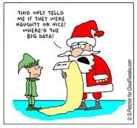
Why is Big Data Important
~80% of world’s information unstructured
Unstructured information growing at 15 times the rate of structured information
In 2000, total world information: 800,000 petabytes
By 2020, estimated to be 35 zetabytes (Twitter – 7 TB per day; Facebook – 10 TB per day; others – TB’s per hour)
Volume, velocity and variety of information beyond what most organizations/companies can process/analyze
Infrastructure/personnel costs for this data potentially immense for individual organization/company
1 petabyte is one quadrillion bytes; 1 zettabyte is one sextillion bytes

Slide 8

Hadoop – What is it?
Apache Hadoop is an open-source software framework for storage and large-scale processing of data-sets on clusters of commodity hardware.
Hadoop is an Apache top-level project being built and used by a global community of contributors and users.
It is licensed under the Apache License 2.0.
Hadoop was created by Doug Cutting and Mike Cafarella in 2005.
Cutting named it after his son’s toy elephant.

Slide 9
Four components of Hadoop
Hadoop Common – contains libraries and utilities needed by other Hadoop modules.
Hadoop Distributed File System (HDFS) – a distributed ﬁle-system that stores data on commodity machines, providing very high aggregate bandwidth across the cluster.
Hadoop YARN – a resource-management platform responsible for managing compute resources in clusters and using them for scheduling of users’ applications.
Hadoop MapReduce – a programming model for large scale data processing.

Slide 10
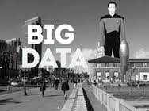
Hadoop Components: YARN
YARN stands for “Yet Another Resource Negotiator”
YARN takes the resource management capabilities that were in MapReduce and packages them so they can be used by new engines.
This also streamlines MapReduce to do what it does best, process data.
With YARN, you can now run multiple applications in Hadoop, all sharing a common resource management.

Slide 11
Hadoop Components: HDFS
The Hadoop distributed ﬁle system (HDFS) is a distributed, scalable, and portable ﬁle-system written in Java for the Hadoop framework.
HDFS stores large ﬁles (typically in the range of gigabytes to terabytes) across multiple machines.
An advantage of using HDFS is data awareness between the job tracker and task tracker. The job tracker schedules map or reduce jobs to task trackers with an awareness of the data location.
By default Hadoop uses FIFO, and optionally 5 scheduling priorities to schedule jobs from a work queue.

Slide 12
HDFS Features and Distributed Systems
Failure tolerant
Data duplicated across multiple datanodes; industry standard is three
Scalability
Data transfers occur directly with the datanodes
Read/write capacity scales with the number of datanodes engaged
Space
Need more space; just add more datanodes and re-balance
Industry standard
Lots of distributed applications built on HDFS (HBase, Map-Reduce)
Pairs well with MapReduce (not the same as Map-Reduce)

Slide 13
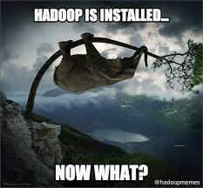
HDFS Cluster
Datanode
Where HDFS actually stores the data…usually quite a few of these
Namenode
The ‘master’ machine
Controls all the metadata for the cluster (what blocks make up a file, and what datanodes those blocks are stored on)
Secondary Namenode
This is NOT a backup namenode
Separate service that keeps a copy of both edit logs and file system image, merging them periodically to keep size reasonable
To be replaced with backup node and checkpoint node

Slide 14
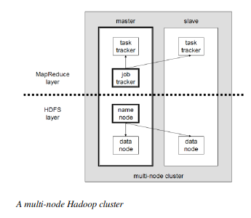
Hadoop Architecture

Slide 15
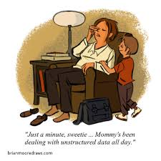
MapReduce
Created by Google, now part of Hadoop
Provides parallel processing model and associated implementation to process huge amount of data.
With MapReduce, queries are split and distributed across parallel nodes and processed in parallel (the Map step).
The results are then gathered and delivered (the Reduce step).
Hadoop adds:
API for writing MapReduce workflows in Java
Set of services for managing execution of these workflows

Slide 16
Final Words About Hadoop
Cost effective
Hadoop brings massively parallel computing to commodity servers
Significant decrease in cost per terabyte of storage
Makes it affordable to model all data, as desired
Open source
Lots of third party applications available to extend Hadoop’s capabilities
Good NLP processing apps to take unstructured data and provide structure
Processing location
Hadoop/MapReduce moves processing software to the data
QlikView and Tableau use this for their commercial offerings

Slide 17
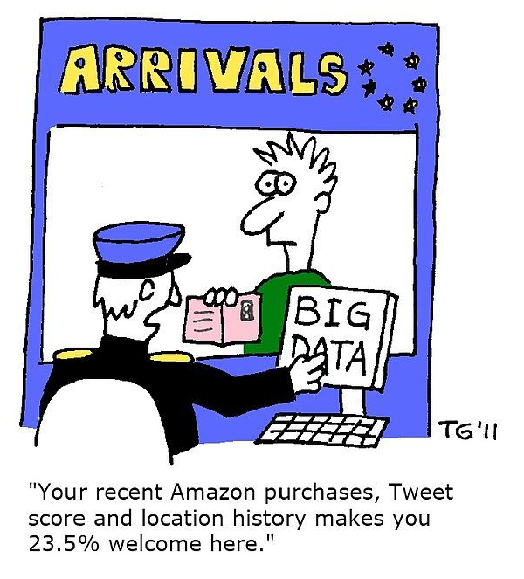
Value Proposition of Big Data
$300 billion – potential annual value to US health care
€250 billion – potential value to Europe’s public sector
$600 billion – potential annual surplus from using personal location data globally
60% - potential increase in retailer operating margins

Slide 18
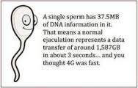
Health Relevant Data (HRD)
We define HRD as any data that can help an organization better understand costs, outcomes, and associated individual preferences and behaviors.
HRD spans four domains:
Clinical—data about a patient's medical observations
Administrative/Operational—data about the business processes within the health ecosystem (e.g., delivering care, research operations)
Financial—data about revenues and costs
Behavioral—data relating to the way people live their lives

Slide 19
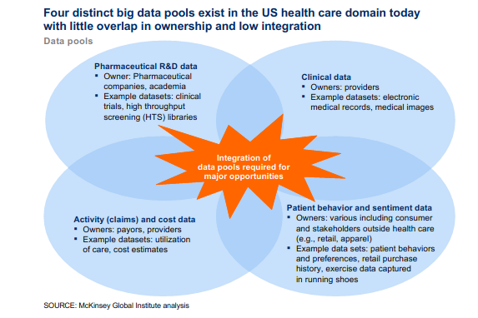
Sources of HRD - Graphic

Slide 20
Big Data and Clinical Operations
Comparative effectiveness research
Critically analyzing large datasets that include patient characteristics and the cost and outcomes of treatments can help to identify the most clinically effective and cost-effective treatments to apply.
Clinical decision support systems
Transparency about medical data
Analyzing data on medical procedures and creating transparency around those data both to identify performance opportunities for medical professionals, processes, and institutions and to help patients shop for the care that offers the best value

Slide 21
Big Data and Clinical Operations - 2
Remote patient monitoring
Collecting data from remote patient monitoring for chronically ill patients and analyzing the resulting data to monitor adherence (determining if patients are actually doing what was prescribed) and to improve future drug and treatment options
Advanced analytics applied to patient profiles
Applying advanced analytics to patient profiles (e.g., segmentation and predictive modeling) to identify individuals who would benefit from proactive care or lifestyle changes
Can also enable the better selection of patients with a preexisting condition for inclusion in a disease-management program that best matches their needs

Slide 22

Big Data and Payment/Pricing
Automated systems
implementing automated systems (e.g., machine learning techniques such as neural networks) for fraud detection and checking the accuracy and consistency of payors’ claims
Health Economics and Outcomes Research and performance-based pricing plans
Use real-world patient outcomes data to arrive at fair economic compensation, from drug prices paid to pharmaceutical companies to reimbursements paid to providers by payors

Slide 23
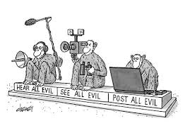
Big Data and R&D - 1
Predictive modeling
Aggregation of research data so that PMP companies can perform predictive modeling for new drugs and determine the most efficient and cost-effective allocation of R&D resources
Predictive modeling can shave 3 to 5 years off the approximately 13 years it can take to bring a new compound to market
Statistical tools and algorithms to improve clinical trial design
Using statistical tools and algorithms to improve the design of clinical trials and the targeting of patient recruitment in the clinical phases of the R&D process

Slide 24
Big Data and R&D - 2
Analyzing clinical trials data
Analyzing clinical trials data and patient records to identify additional indications and discover adverse effects.
Drug repositioning, or marketing for additional indications, may be possible after the statistical analysis of large outcome datasets to detect signals of additional benefits
Personalized medicine
Examine the relationships among genetic variation, predisposition for specific diseases, and specific drug responses and then to account for the genetic variability of individuals in the drug development process

Slide 25
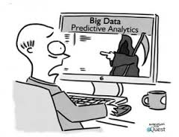
Big Data and R&D - 3
Analyzing disease patterns
Analyzing disease patterns and trends to model future demand and costs and make strategic R&D investment decisions

Slide 26
Big Data and Business Models
Aggregating and synthesizing patient clinical records and claims datasets
This business model aggregates and analyzes patient records to provide data and services to third parties. Companies could build robust clinical datasets that would enable a number of adjacent businesses.
Online platforms and communities
Examples of this business model in practice include Web sites such as PatientsLikeMe.com, where individuals can share their experience as patients in the system; Sermo.com, a forum for physicians to share their medical insights; and Participatorymedicine.org, a Web site made available by a nonprofit organization that encourages patient activism

Slide 27
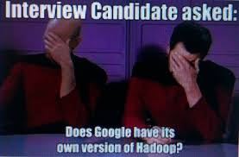
Big Data and Public Health
The use of big data can improve public health surveillance and response.
By using a nationwide patient and treatment database, public health officials can ensure the rapid, coordinated detection of infectious diseases and a comprehensive outbreak surveillance and response through an Integrated Disease Surveillance and Response program.

Slide 28
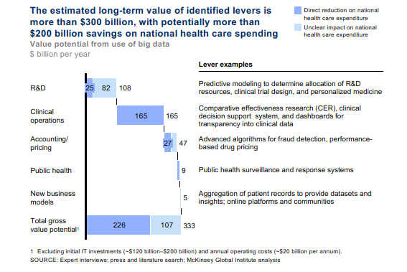

Slide 29
Big Data and Health Care - Challenges
Majority of health data is unstructured
Even structured data is not in usable format for standard data analysis
No universal patient identifier, so patient matching challenging
Few health care systems or EHR vendors willing to share data broadly, especially patient-specific data
HIPAA security rules and privacy advocates constitute barriers to data sharing
Data security and attempts to hack health data ongoing challenge

Slide 30
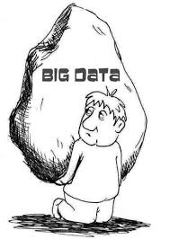
Big Data and Health Care - Benefits
As mentioned by MGI, big data can markedly reduce timeline and costs for commercial R&D
Big data can do wonders for public health, disease surveillance and cost tracking
Promise of big data for:
Chronic disease management
Clinical research – at any level, including translational research
Clinical decision support – including real-time CDS
Patient access to care (load leveling, demand management, etc)
Remote monitoring and mHealth

Slide 31
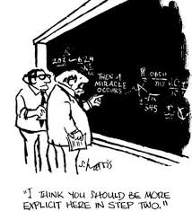
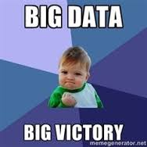
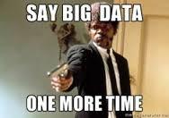
Questions

