Slide 1
Secure Messaging
Bob Marshall, MD MPH MISM
Chief – Clinical Informatics (CMIO)

Slide 2
Secure Messaging – What is it?
SM is a method to communicate asynchronously between patients and the health care team
It is not e-mail
Two major providers: RelayHealth and Medfusion
Encrypted e-mail: Kryptiq (lacks other tools)
SaaS, Fully HIPAA-compliant, 128 bit encryption, Web-based, 2-factor authentication
Text-based messages or structured visits
Patient education and preventive health reminders
Results distribution; Network provider consults

Slide 3
NCQA PCMH Recognition
PPC-PCMH Recognition is based on meeting specific elements included in nine standard categories:
  1. Access and Communication
  2. Patient Tracking and Registry Functions
  3. Care Management
  4. Patient Self-Management and Support
  5. Electronic Prescribing
  6. Test Tracking
  7. Referral Tracking
  8. Performance Reporting and Improvement
  9. Advanced Electronic Communication

Slide 4
Secure Messaging and PCMH
Asynchronous communication allows more efficient and more completely documented discussions between patients and health care team
Minor problems can be discussed and managed via SM vice clinic or ED visit
Results from lab and radiology tests can be communicated with patients and coordinated
ED and consultant visits can be discussed without requiring clinic visit…or clinic visit confirmed
Network consultants can send results via SM

Slide 5
Secure Messaging and Practice Improvement
How SM helps improve overall patient care
  Results distribution
  Reduce unnecessary clinic visits
  Medication reconciliation and F/U
  Better documentation of remote interactions
  Improved efficiency for health care team
  Improved patient and health care team satisfaction
  Patient engagement improved
  Overall improved care coordination

Slide 6
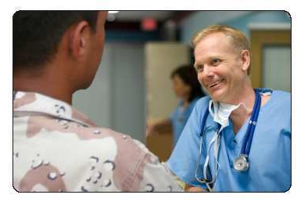

Connecting Patients with Their Care Team
Patient to Physician Secure Messaging includes:
Administrative Messaging
  Note to Office
  Appointments: Request and Reminder
  Referral Request
  Rx Renewal Request
  Lab Tests: Request and Result Delivery
Clinical Messaging
  Note to Provider
  Structured WebVisit®
  Template Management for Patient Messaging

Slide 7
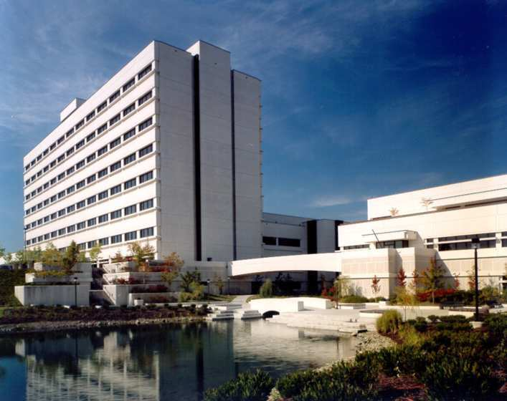
Connecting Patients with Their Care Team…cont
Patient to Physician Secure Messaging includes…cont:
Broadcast messaging
Reminder Messaging
Patient Education Library
Physician to Physician Connectivity:
  Clinical Messaging for Referrals and Care Collaboration
  Health Records Sharing
Colleague to Colleague Messaging
Integrated Personal Health Records

Slide 8
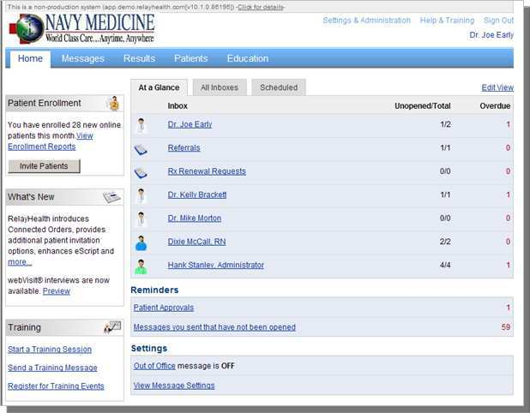
Secure Messaging
Physician/Staff Home Page
The system provides physicians & staff with a suite of secure internet based applications & services to communicate with patients, connect with colleagues, and coordinate care across the care team and community.
Providers and staff can:
Offer patients improved access and service
Send patient lab results electronically
Conduct online WebVisit®
Push reminders and alerts
Access and share a patient’s Personal Health Record
Integrate these services with workflow and process to gain efficiency and improve productivity
Demonstrate measurable returns

Slide 9
Lessons Learned
Create the vision: First months of implementation are culture change
Build a Coalition: Leverage early adopters/physician champions
Communicate the Vision: Frequent Marketing & Communications are key to BOTH physician/ staff awareness & patient adoption
Notes:
John Kotter (Harvard Professor)…organization change.

Slide 10
Lessons Learned…cont
Early Wins: Continuous outreach and education help providers and teams understand advantages and see results
  Vital to ensure “credit” is recognized
Value Prop: Referral management to network providers is a high value transaction; users also site greater efficiency
Enhancements: Data exchange and tighter integration with the ambulatory record will simplify the process

Slide 11

Secure Messaging
Myth 1: It will cause a deluge of emails from patients and take too much time to respond
  “Not true”
  “Really not an issue here”
  “Has actually saved time overall due to less telephone tag”
Myth 2: It will take too much time to learn the system; I’ll never be able to do this
  “Ease of logon, ease of navigation”
  “Test messages worked great to show how easy it is”
  “I say ‘just log on and try it’ and you will see how easy it is”
Myth 3: It’s just the younger providers who use this
  “Most of us are already using the AHLTA, CHCS and other core systems, so we are already computer savvy. And, this is actually easier than those systems”
Myth 4: My patients are:(1) older, (2) not online (3) not tech savvy
  ePatients: 72% 18-29, 71% 30-49, 59% 50-64, 27% 65+*
  88% of US adults with internet access research health info online*
  61% of all Americans rely on internet for health info*
Source: Consumers and Health Information Technology, A National Survey (CA Healthcare Foundation, 2010)

Slide 12
Value Stream 1 of 2
MSA’s
  Inclement weather notifications
  Letters informing patient panels about staffing changes
  Fewer walk-ins for appointments, complaints, result information
  Fewer complaints and improved satisfaction
RN’s
  No phone tag
  Ensured of patient verification
  Can give out more information
  Better communication
  Fewer walk-ins to handle
  Can send out handouts and better patient information to supplement phone advice

Slide 13
Value Stream 2 of 2
Populations Health
  Improved communication with patients
  Can send out all wellness letters electronically – much easier and quicker
  Can target chronic medical problems with educational materials
  Better HEDIS interventions
Providers
  No patient phone tag
  Can send out all lab letters electronically
  With fewer in office visits for routine issues can have fewer in office appointments and reach many more patients daily
  Fewer wasted appointments for routine follow ups

Slide 14
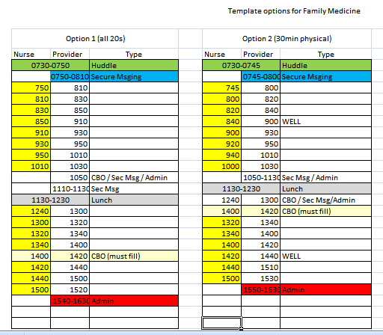
LPN and Provider templates

Slide 15
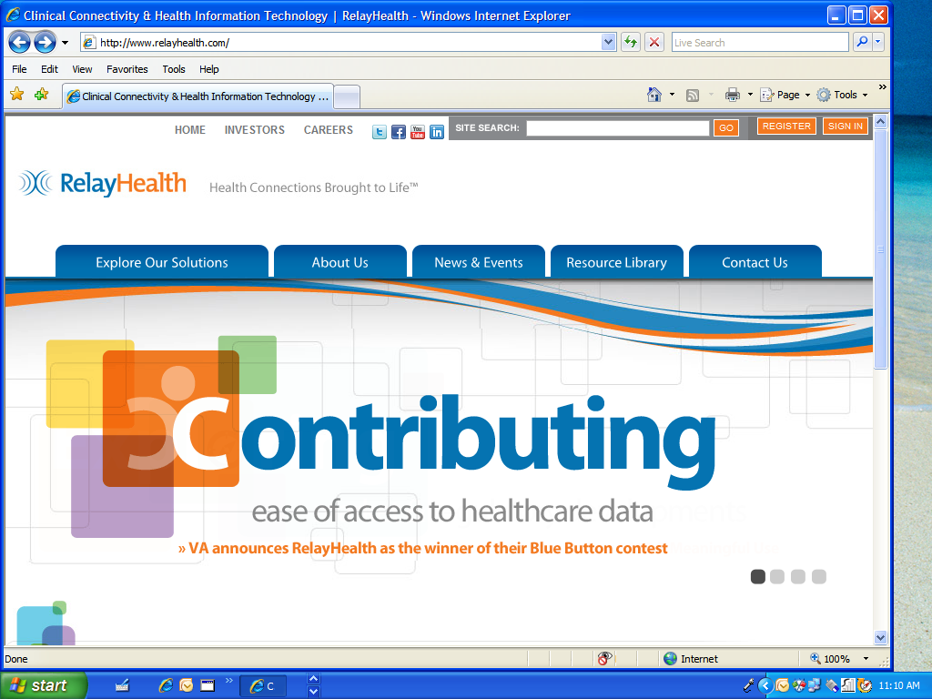

Slide 16
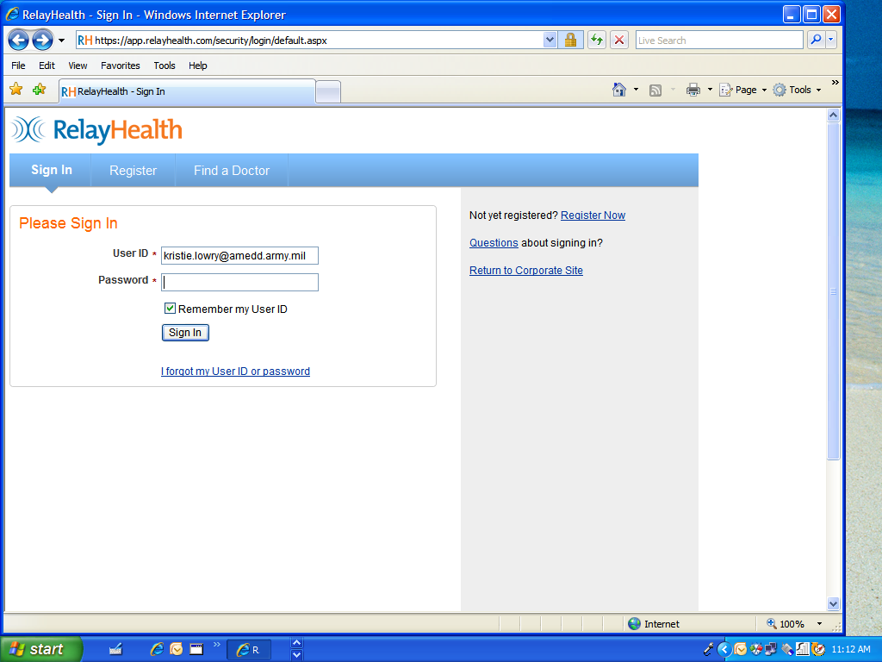

Slide 17
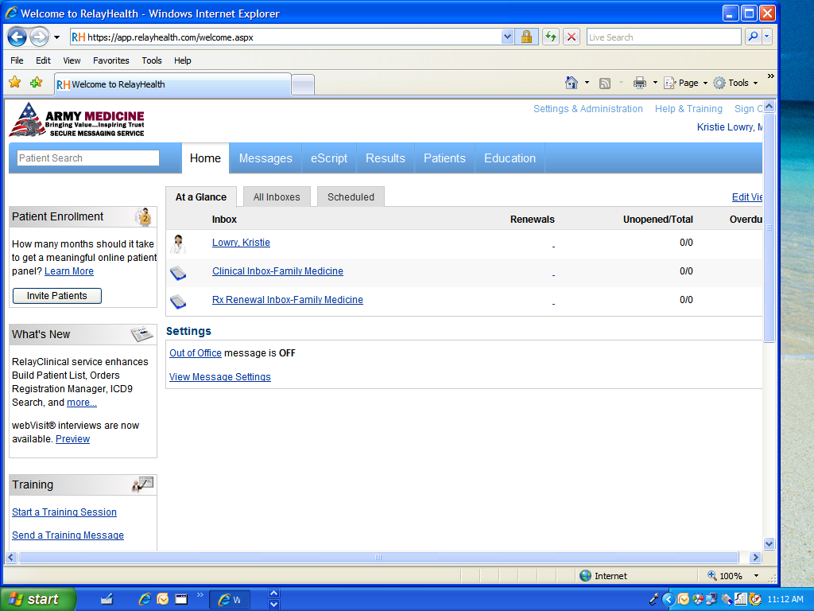

Slide 18
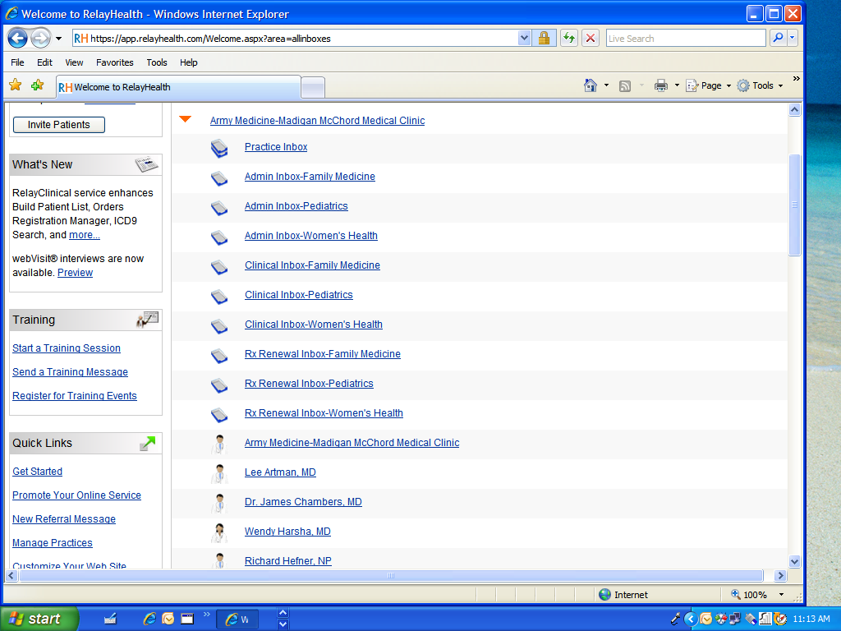

Slide 19
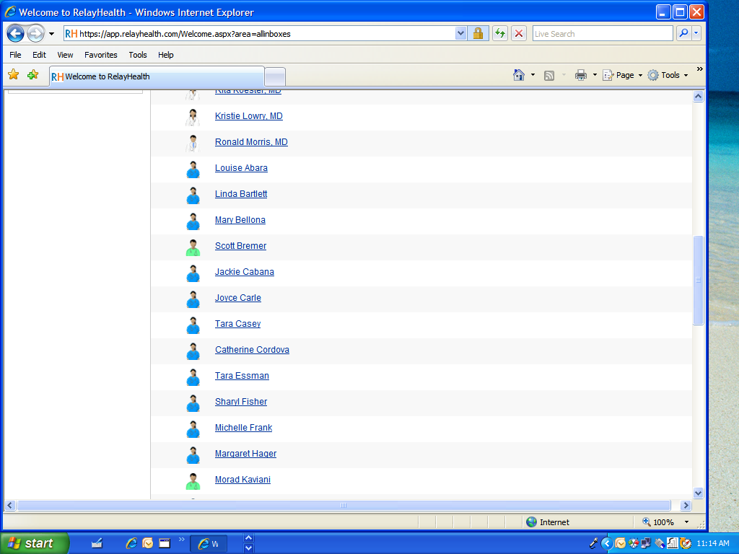

Slide 20
Work Flow Process McChord Clinic begins with MSA or CNA
Patient Sends virtual Message
Administrative
Clinical
MSA or CNA Evaluate the message
Ensure clinic and provider enrollment
If administrative or clinical questions
Answer message or sends message to patient that the message has been sent to the nurse and then forwards to the RN for action and add-note
forward VM and generate T-con
Accept patient as VM enrollee
Patient Sends Virtual Message

Slide 21
If Prescription Renewal
CNA or LPN assigned to prescription renewals opens VM
Create T-con
Send message to patient that request has been forwarded to nurse
T-con and VM forwarded to provider specific RN’s box
RN reviews T-con and adds in appropriate data for completion and puts in order
Forward to Provider for completion
Provider reviews data and signs and closed T-con
Provider write VM message and sends to patient

Slide 22
If Clinical Question
MSA or CAN will open message and ensure it truly is a clinical questions
Immediate message will be sent to patient that the RN has been notified and VM will be forwarded to Provider’s RN box
T-con will be generated and pertinent data will be cut and pasted into T-con
RN will open T-con
If minor illness nurse may answer VM, generate T-con and then close out
Provider will open T-con and VM
Provider will complete T-con and close out or forward to nurse for additional data collection or patient appointment
If T-con completed provider will complete VM and forward answer to patient
If it requires provider involvement pertinent data will be collected and T-con and VM will be forward to provider

Slide 23
Work Load Credit
Non – physician RVU coding and credit
  Code is 98969
  Credit per completed VM 0.39 RVU
Physician RVU coding and credit
  Code 99444
  Credit per completed VM 0.58 RVU

Slide 24
Coding Nuances
If you are not answering a clinical questions, acting upon labs results or making a clinical judgment this may be non-count work-load and you would code 99499
If you will schedule an appointment within 24 hours or have seen the patient in the past 72 hours
  non-work load T-con 99499
  Add-note to the recent appointment

Slide 25

Questions
25

Slide 26
Backup

Slide 28
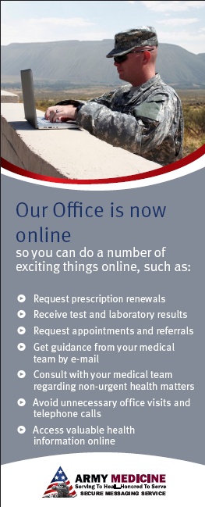
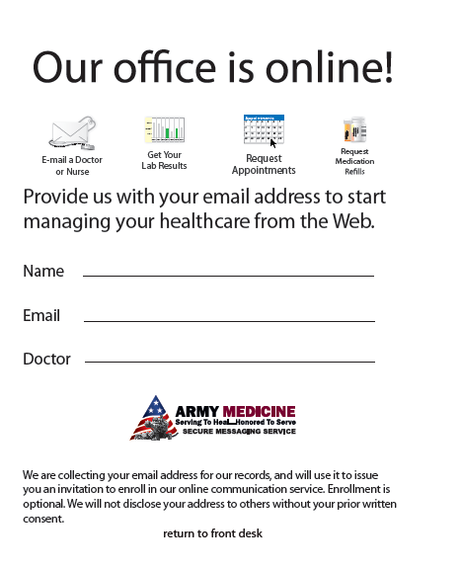
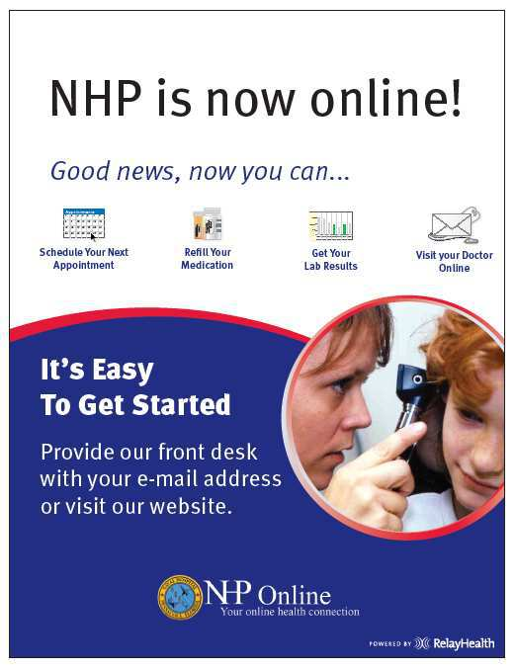
Marketing

Slide 29
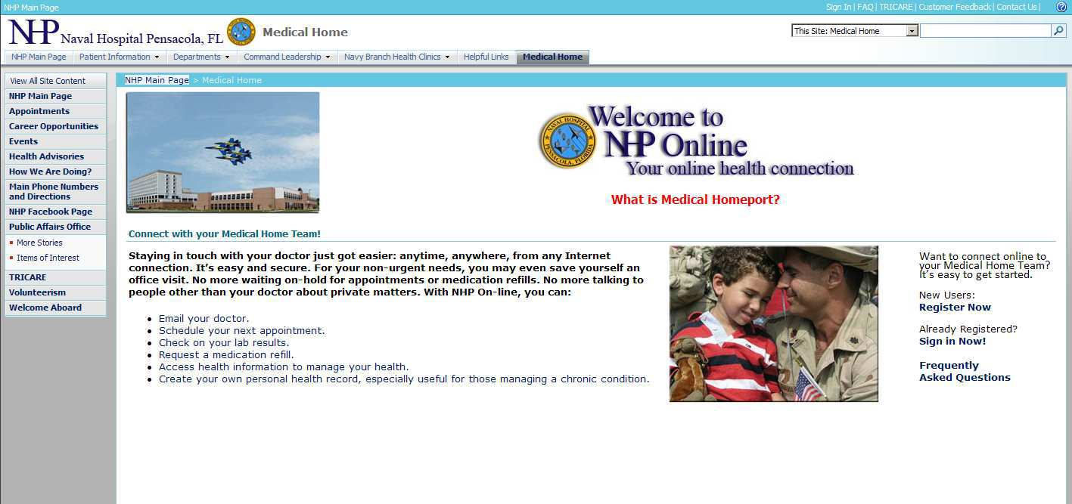
NHP Online
Notes:
This is the portal or entry point that the medical center are directing patients. From here they can sign in or register.

Slide 30
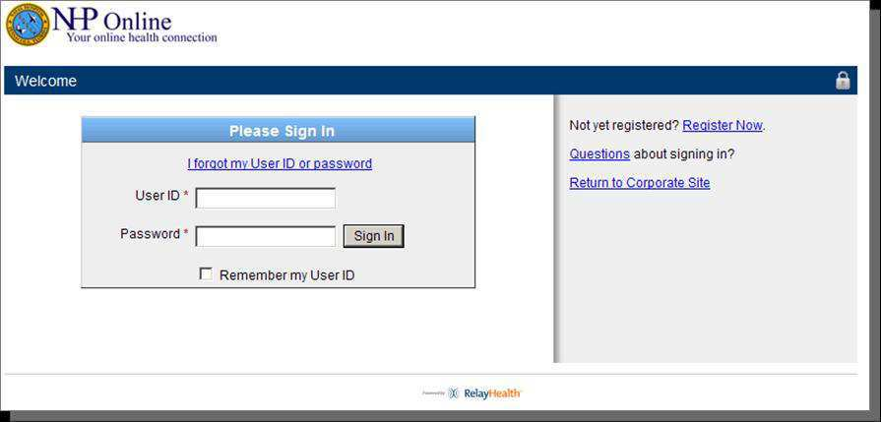
Secure Login

Slide 31
Provider / Staff View

Slide 32
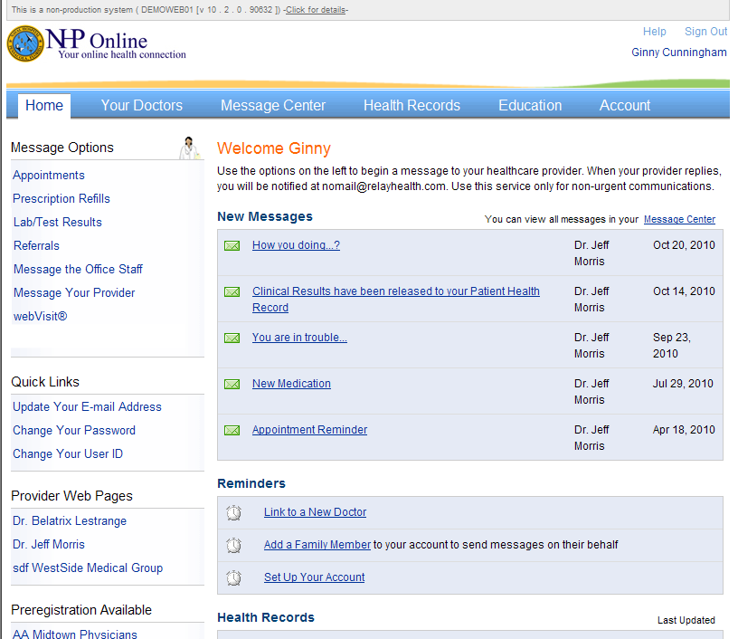
NHP Online –
Patient Home Page
Appointment Requests
Prescription Renewals
Lab test Results
Notes to the staff
Online webVisits

Slide 33
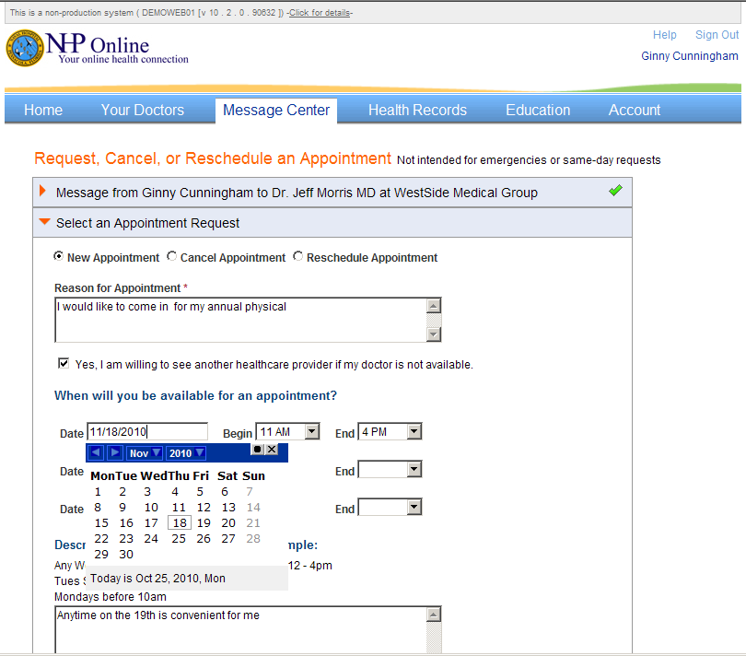
Appointments

Slide 34
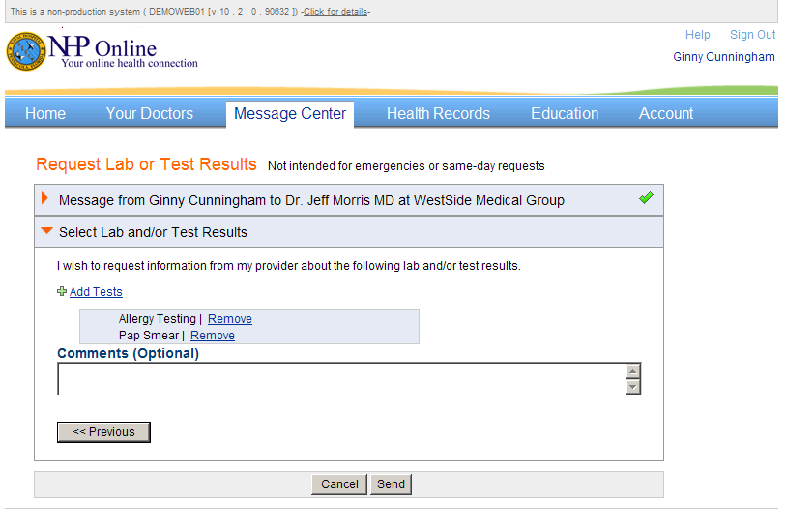
Request/Receive Lab Results

Slide 35
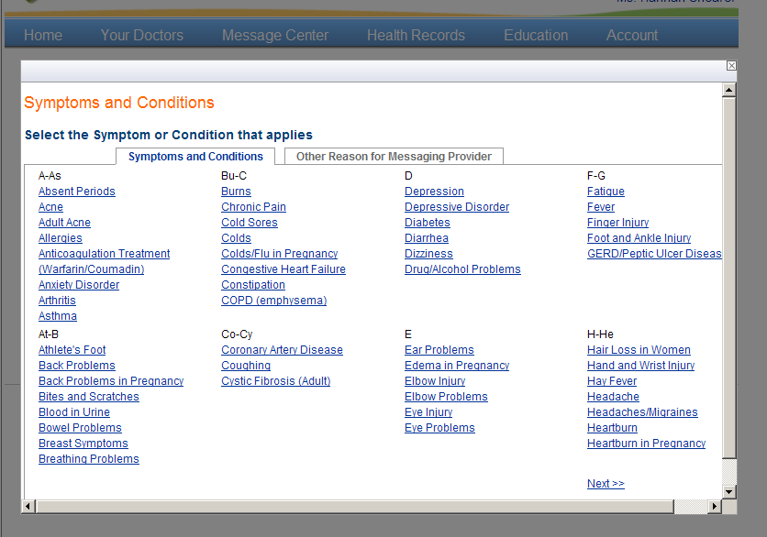
webVisit Message
Templates
Structured templates that guide you through a series of questions to convey your concerns to your provider in a meaningful and thoughtful manner

Slide 36
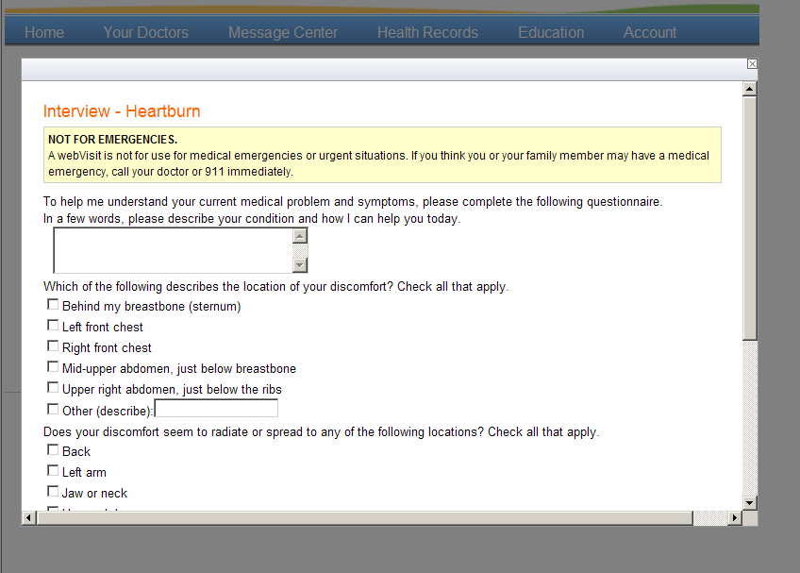
WebVisit Heartburn

Slide 37
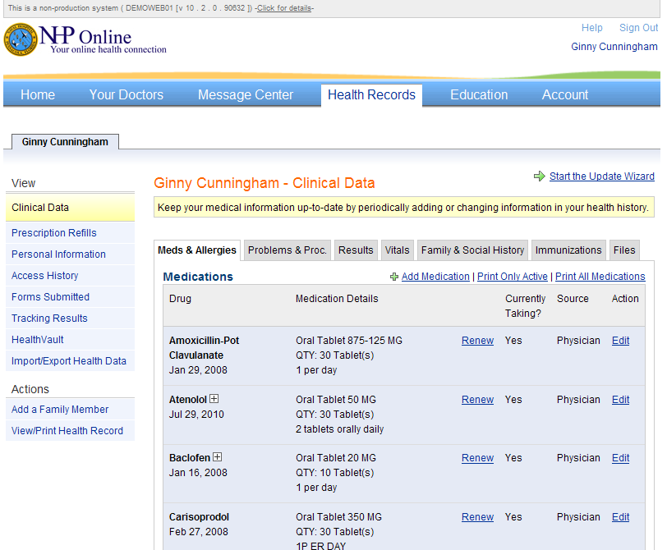
Integrated PHR
Convenient secure repository for your health information

Slide 38
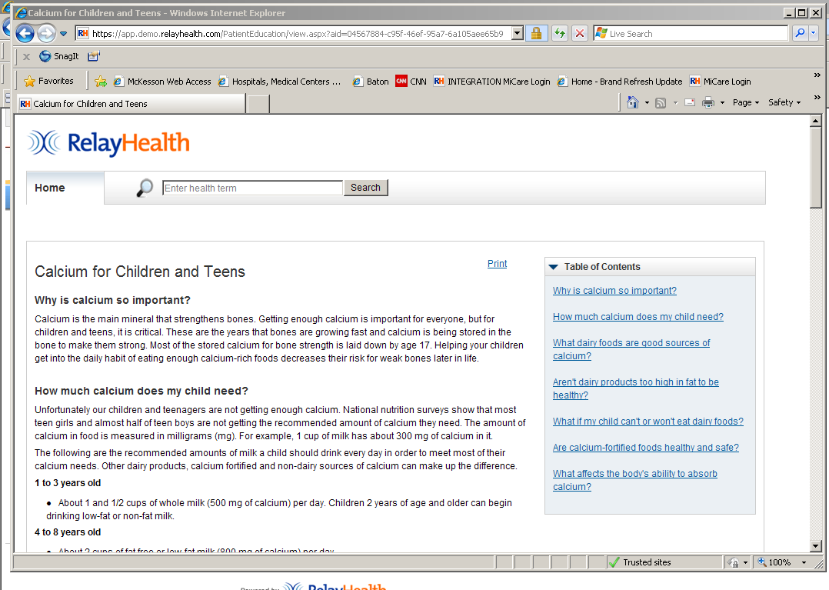
Educational Resources

Slide 39

Lessons Learned
Importance of provider endorsements to drive
credibility and adoption at the MTF
Patients will be most responsive to a direct
physician invitation
Engage and include your office staff for maximum
benefit
One of the key value propositions is the facilitation
of referrals
Medical Home needs to be a part of the workflow and accepted before staff will engage in process
Collecting emails for patient invitations can be challenging, but you have to start somewhere

Slide 40
AMEDD Advice 1 of 2
Immediately after remote training, get everyone their accounts
Start to use the SM capability and learn the system (it is very intuitive) as soon as the accounts are created... pairteams and having them send each other messages so they can practice and refine workflow.
Even before remote training and up to and including GoLive, collect names and e-mail addresses so that you can mass invite patients at GoLive. That will give you a bolus of patients to start with.
Manage expectations. The transition from all TelCons to mostly SM will occur over time. Until then, there will be some effort to do both. Providers and non-provider clinical staff may see this as extra work, vice more efficient work.
Teach everyone how to copy and paste into the AHLTA TelCon AddNote using keyboard shortcuts (Ctrl-C/Ctrl-V) with the left hand and mouse positioning with the right hand, vice just the mouse. It is faster. The How To is posted on the USAFP web site (www.usafp.org) under AHLTA 3.3.

Slide 41
AMEDD Advice 2 of 2
Get STRATCOM on board early and have them advertise the service in the MTF and in the base newspaper even before it goes live. Be non-specific, just that it is coming soon. A specific date can be added once solid. That builds desire and makes it easier to collect the names and e-mail addresses.
Match your TelCon and SM workflows to be as similar as possible. You will never get rid of TelCons completely, so the easiest way to manage them is in the same fashion as your SM's. That will reduce variation and reduce the potential for mistakes in managing them.
Remind your providers that they do not need to stay in clinic or their offices to manage SM's. They can manage them from home and simply copy/paste them into AHLTA the next morning.
Keep the statistics to show the team how the shift in contacts occurs as well as the RVU's and access to care. Generally, they are very positive reinforcements.

