Slide 1
Scheduled Reminders
How to use the scheduled reminders capability to perform care coordination

Slide 2
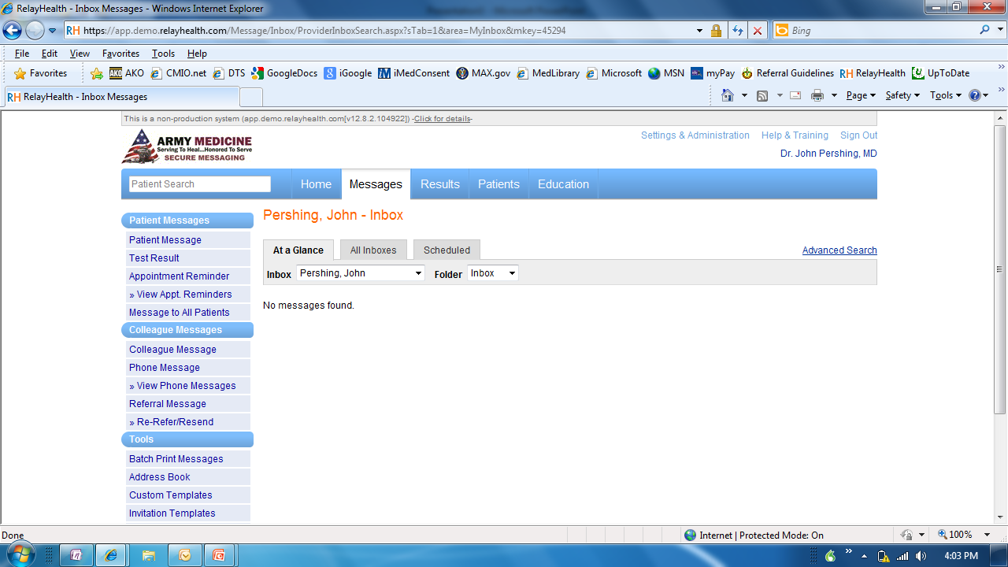

Slide 3
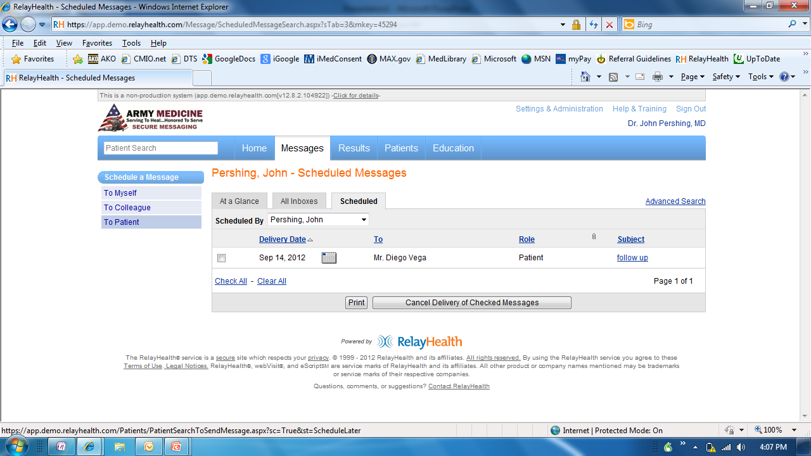

Slide 4
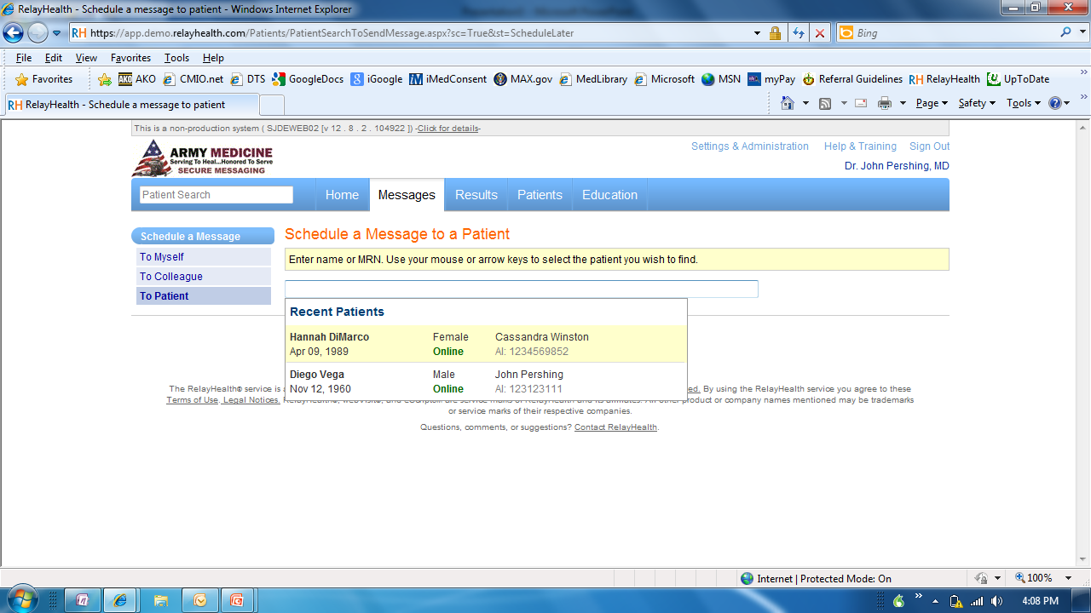

Slide 5
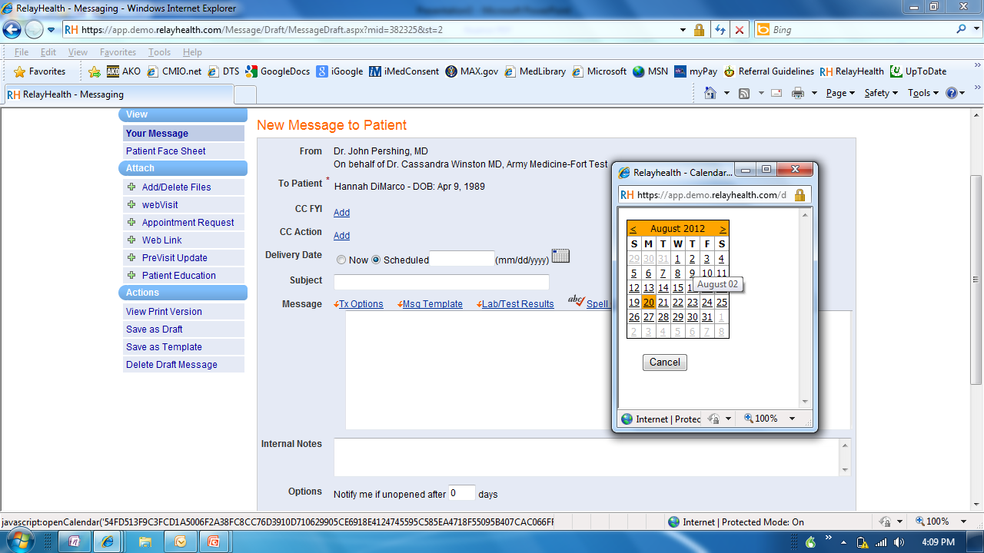

Slide 6
