Slide 1
Patient-Centered Medical Home and Secure Messaging
CAPT Bob Marshall, MC USN
Chief Medical Informatics Officer
Travis Szabo, PMP
Secure Messaging Project Manager

Slide 2
Learning Objectives
Describe and discuss the patient-centered medical home (PCMH)
Describe the concept and execution of secure messaging (SM)
Describe how SM affects care and supports the clinical and regulatory aspects of the PCMH
Describe secure messaging services and how they fit into the Medical Home model
Describe key lessons learned from the Navy implementations so far, including progress metrics, lessons learned, and user feedback
Directly address several common misunderstandings about the impacts of secure messaging
2

Slide 3
PCMH – What is it?
The Patient-Centered Medical Home (PCMH) - an approach to providing comprehensive primary care for children, youth and adults
The PCMH is a health care setting that facilitates partnerships between individual patients, and their personal physicians, and when appropriate, the patient’s family
The PCMH applies across the continuum of care. For DOD personnel, that includes the DOD and VA medical systems…as well as purchased care (Network providers)
The PCMH concept and execution is a component of “Digital Health Reform” – Improving Health by leveraging technology to the patient

Slide 4
PCMH Concepts
Personal physician - each patient has an ongoing relationship with a personal physician
Physician directed medical practice - the personal physician leads a team of individuals at the practice level who collectively take responsibility for the ongoing care of patients
Whole person orientation - the personal physician is responsible for providing for all the patient’s health care needs or taking responsibility for appropriately arranging care with other qualified professionals

Slide 5
PCMH Concepts cont
Care is coordinated and/or integrated across all elements of the complex health care system
Quality and safety are hallmarks of the PCMH
Enhanced access to care – available through systems such as open scheduling, expanded hours and new options for communication between patients, their personal physician, and practice staff

Slide 6
Team-Based
Healthcare Delivery
Improved Access to Care
Population
Health
Medical Home
Port
Advanced IT Systems
Patient-Centered Care
Decision Support Tools
Refocused Medical Training
Patient & Physician Feedback

Slide 7
Secure Messaging – What is it?
SM is a method to communicate asynchronously between patients and the health care team
It is not e-mail
Two major providers: RelayHealth and Medfusion
Encrypted e-mail: Kryptiq (lacks other tools)
SaaS, Fully HIPAA-compliant, 128 bit encryption, Web-based, 2-factor authentication
Text-based messages or structured visits
Patient education and preventive health reminders
Results distribution; Network provider consults

Slide 8
NCQA PCMH Recognition
PPC-PCMH Recognition is based on meeting specific elements included in nine standard categories:
1. Access and Communication
2. Patient Tracking and Registry Functions
3. Care Management
4. Patient Self-Management and Support
5. Electronic Prescribing
6. Test Tracking
7. Referral Tracking
8. Performance Reporting and Improvement
9. Advanced Electronic Communication

Slide 9
Secure Messaging and PCMH
Asynchronous communication allows more efficient and more completely documented discussions between patients and health care team
Minor problems can be discussed and managed via SM vice clinic or ED visit
Results from lab and radiology tests can be communicated with patients and coordinated
ED and consultant visits can be discussed without requiring clinic visit…or clinic visit confirmed
Network consultants can send results via SM

Slide 10
Secure Messaging and Practice Improvement
How SM helps improve overall patient care
Results distribution
Reduce unnecessary clinic visits
Medication reconciliation and F/U
Better documentation of remote interactions
Improved efficiency for health care team
Improved patient and health care team satisfaction
Patient engagement improved
Overall improved care coordination

Slide 11
How Secure Messaging
Supports Medical Home
11

Slide 12
Medical Home Secure Messaging Pilots
Naval Hosp
Bremerton
WRAMC
NNMC Bethesda
Quantico
Naval Med Ctr
Portsmouth
Naval Hosp
Camp Pendleton
Naval Hosp
Camp Lejeune
NMC San Diego
JBER
Elmendorf/Richardson
Naval Hosp
Jacksonville
Naval Hosp
Pensacola

Slide 13

Implementation Timeline
A case study in rapid deployment..
Six Navy Sites
Kickoff to completion of initial training-30 days
Six RelayHealth staff members oriented 300 users in one week
Physicians and staff received 30 minute orientation to begin using the service
With tight scheduling, 1 to 3 business days was required to complete MTF orientation (depending on size)
Notes:
New paradigm with a hosted model…IA references.

Slide 14
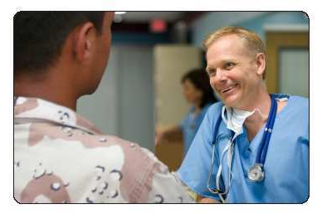

Connecting Patients with Their Care Team
Patient to Physician Secure Messaging includes:
Administrative Messaging
Note to Office
Appointments: Request and Reminder
Referral Request
Rx Renewal Request
Lab Tests: Request and Result Delivery
Clinical Messaging
Note to Provider
Structured WebVisit®
Template Management for Patient Messaging

Slide 15

Connecting Patients with Their Care Team…cont
Patient to Physician Secure Messaging includes…cont:
Broadcast messaging
Reminder Messaging
Patient Education Library
Physician to Physician Connectivity:
Clinical Messaging for Referrals and Care Collaboration
Health Records Sharing
Colleague to Colleague Messaging
Integrated Personal Health Records

Slide 16
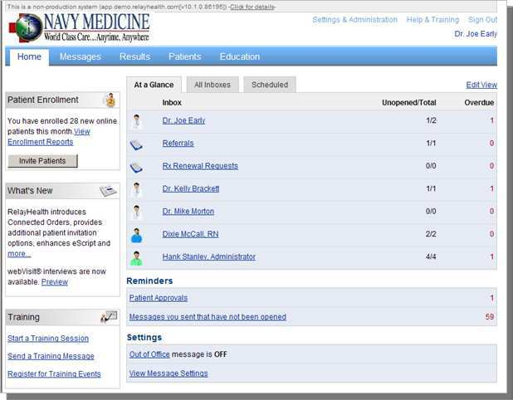
Secure Messaging Physician/Staff Home Page
The system provides physicians & staff with a suite of secure internet based applications & services to communicate with patients, connect with colleagues, and coordinate care across the care team and community.
Providers and staff can:
Offer patients improved access and service
Send patient lab results electronically
Conduct online WebVisit®
Push reminders and alerts
Access and share a patient’s Personal Health Record
Integrate these services with workflow and process to gain efficiency and improve productivity
Demonstrate measurable returns

Slide 17
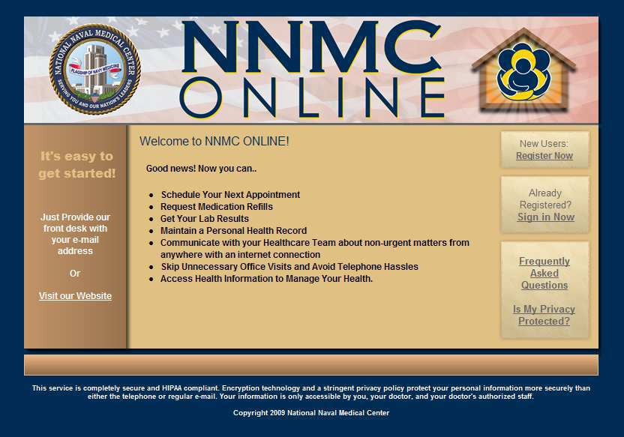
NNMC Online https://www.bethesda.med.navy.mil/nnmconline/
Notes:
This is the portal or entry point that the medical center are directing patients. From here they can sign in or register.

Slide 18
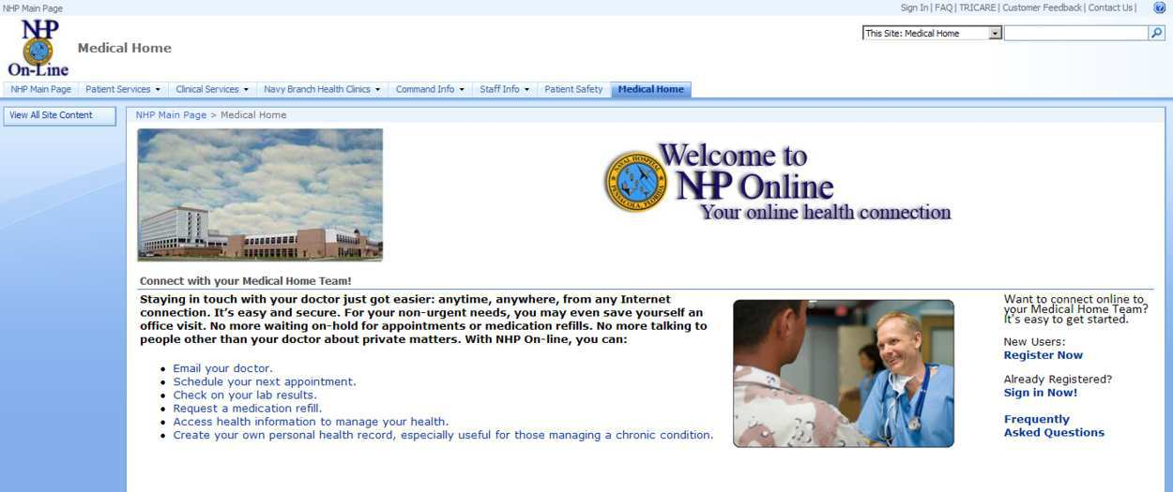
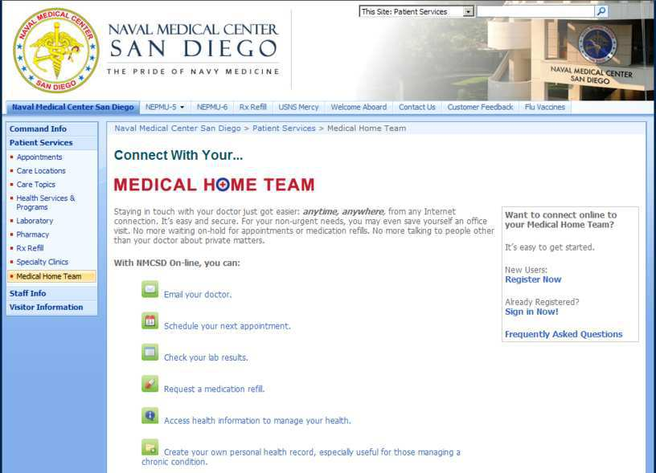
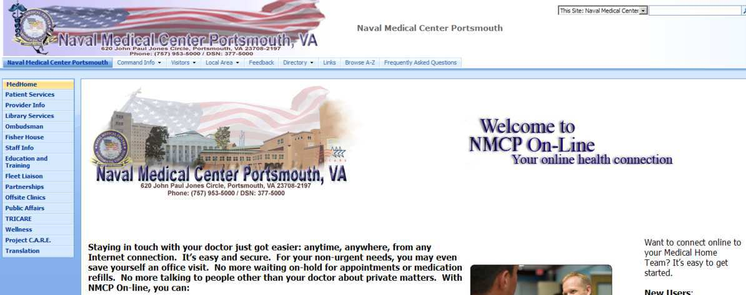
Navy Medical Home
Notes:
This is the portal or entry point that the medical center are directing patients. From here they can sign in or register.

Slide 19
Patient Enrollments Ramping
Six Pilot Sites Go Live

Slide 21
Lessons Learned
Create the vision: First months of implementation are culture change
Build a Coalition: Leverage early adopters/physician champions
Communicate the Vision: Frequent Marketing & Communications are key to BOTH physician/ staff awareness & patient adoption
Notes:
John Kotter (Harvard Professor)…organization change.

Slide 22
Lessons Learned…cont
Early Wins: Continuous outreach and education help providers and teams understand advantages and see results
Vital to ensure “credit” is recognized
Value Prop: Referral management to network providers is a high value transaction; users also site greater efficiency
Enhancements: Data exchange and tighter integration with the ambulatory record will simplify the process

Slide 23




User Feedback
The time savings from alleviating telephone tag are huge.
Things are going very smoothly; the system is so easy – just like using email only more secure.
When I train on this, I just get them to logon and in 15 minutes, they say “this is so easy”!
I really like the file attachment function, and I use it frequently to provide patients with rehab exercises or scans.
The documentation advantage is huge.

Slide 24

Secure Messaging
Myth 1: It will cause a deluge of emails from patients and take too much time to respond
“Not true”
“Really not an issue here”
“Has actually saved time overall due to less telephone tag”
Myth 2: It will take too much time to learn the system; I’ll never be able to do this
“Ease of logon, ease of navigation”
“Test messages worked great to show how easy it is”
“I say ‘just log on and try it’ and you will see how easy it is”
Myth 3: It’s just the younger providers who use this
“Most of us are already using the AHLTA, CHCS and other core systems, so we are already computer savvy. And, this is actually easier than those systems”
Myth 4: My patients are:(1) older, (2) not online (3) not tech savvy
ePatients: 72% 18-29, 71% 30-49, 59% 50-64, 27% 65+*
88% of US adults with internet access research health info online*
61% of all Americans rely on internet for health info*
Source: Consumers and Health Information Technology, A National Survey (CA Healthcare Foundation, 2010)

Slide 25
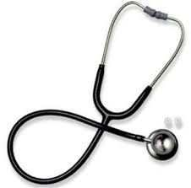
We Will Look Back…
“That it will ever come into general use, notwithstanding its value, is extremely doubtful because its beneficial application requires much time and gives a good bit of trouble, both to the patient and practitioner, because its hue and character are foreign and opposed to all our habits and associations.”
London Times in 1834, describing the stethoscope

Slide 26
Contact Information
CAPT Bob Marshall, MC USN
Robert.Marshall@med.navy.mil
Office: 202-762-3131
Travis Szabo
Travis.Szabo@med.navy.mil
Office: 210-808-0762

Slide 27
Backup

Slide 29
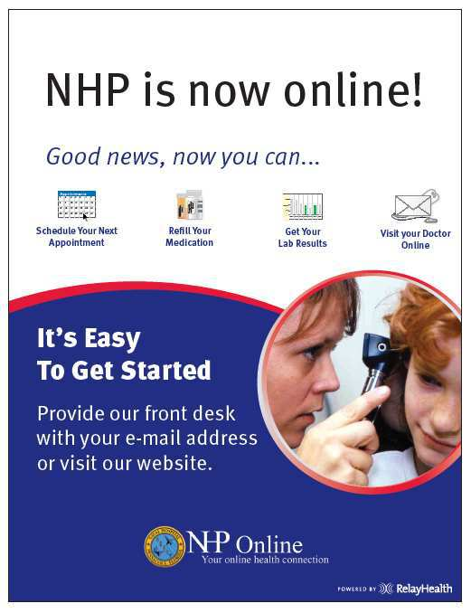
NHP Online - Marketing

Slide 30
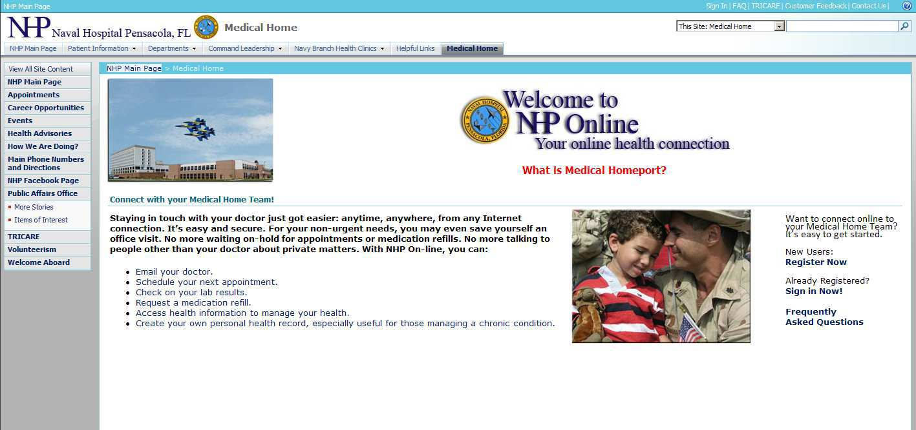
NHP Online
Notes:
This is the portal or entry point that the medical center are directing patients. From here they can sign in or register.

Slide 31
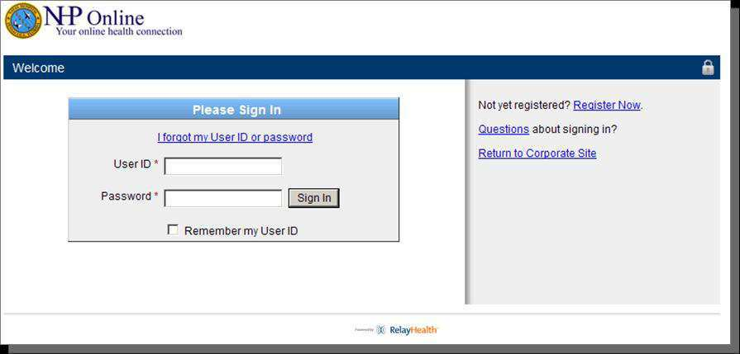
Secure Login

Slide 32
Provider / Staff View

Slide 33
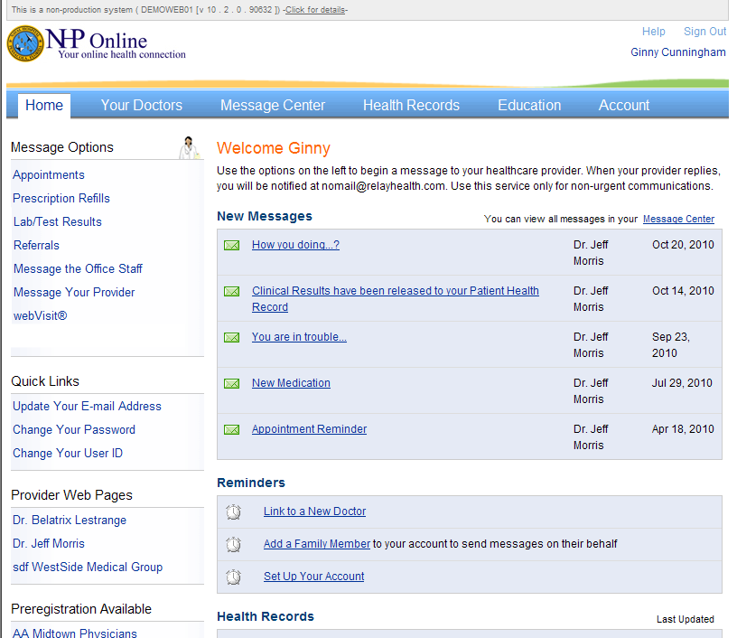
NHP Online – Patient Home Page
Appointment Requests
Prescription Renewals
Lab test Results
Notes to the staff
Online webVisits

Slide 34
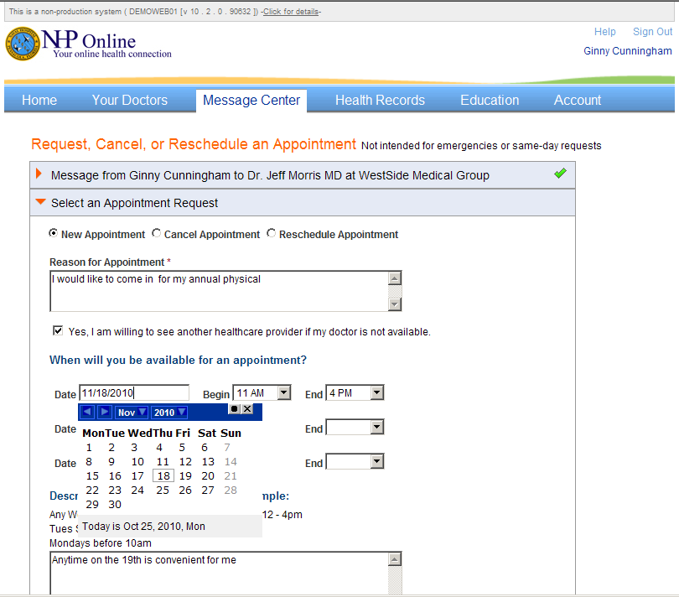
Appointments

Slide 35
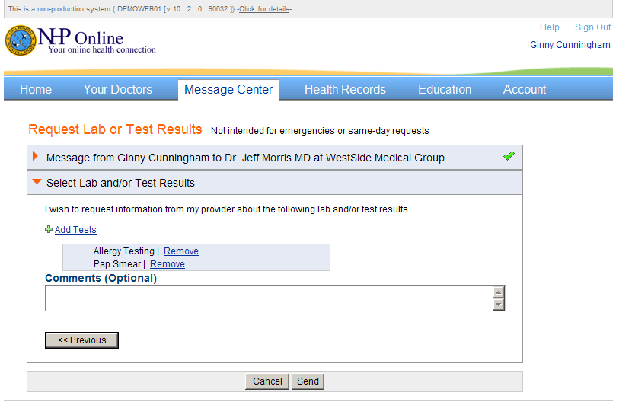
Request/Receive Lab Results

Slide 36
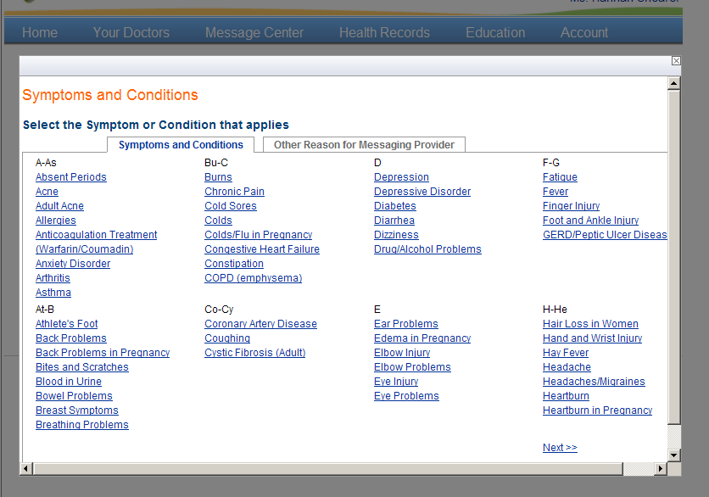
webVisit Message Templates
Structured templates that guide you through a series of questions to convey your concerns to your provider in a meaningful and thoughtful manner

Slide 37
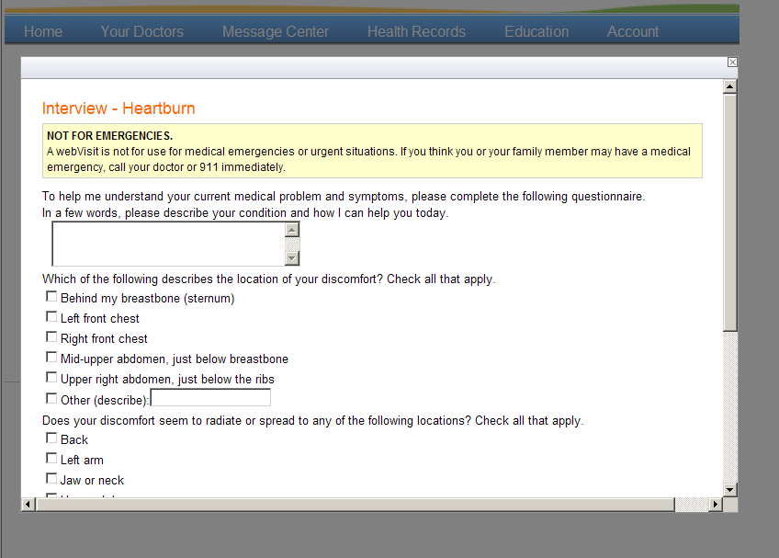
WebVisit Heartburn

Slide 38
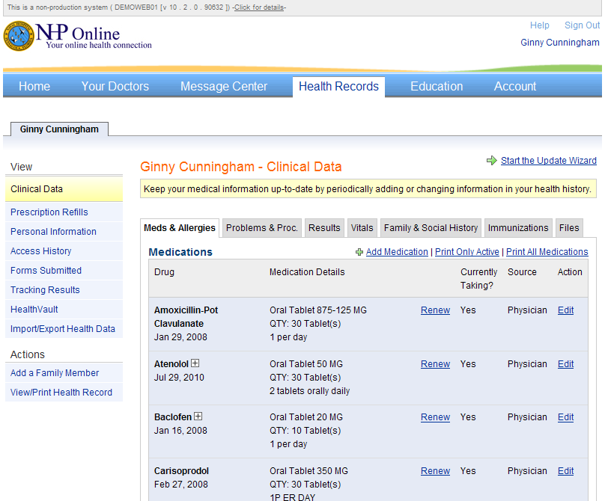
Integrated PHR
Convenient secure repository for your health information

Slide 39
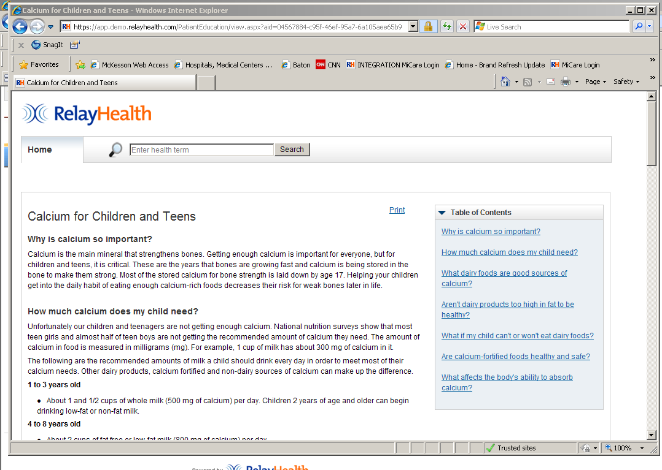
Educational Resources

Slide 40

Lessons Learned
Importance of Navy provider endorsements to drive credibility and adoption at the MTF
Patients will be most responsive to a direct physician invitation
Engage and include your office staff for maximum benefit
One of the key value propositions is the facilitation of referrals
Medical Home needs to be a part of the workflow and accepted before staff will engage in process
Collecting emails for patient invitations can be challenging, but you have to start somewhere

Slide 41

Questions
41

