Slide 1
Role of the CMIO in Navy Medicine
Bob Marshall, MD MPH MISM
Director of Clinical Informatics
BUMED M3/5

Slide 2
Objectives
Define the term
Discuss the Gartner definitions and roles
Define the position in Navy Medicine
Discuss current and future roles in Navy Medicine

Slide 3
What is a CMIO
CMIO = Chief Medical Information or Informatics Officer
A person with a clinical background, who speaks the language of clinicians.
  Oversees the selection, development and implementation of computerized patient record systems.
  Focuses on issues of quality, safety, usability, process improvement and seeks to ensure that clinicians are fully engaged in the entire process.

Slide 4
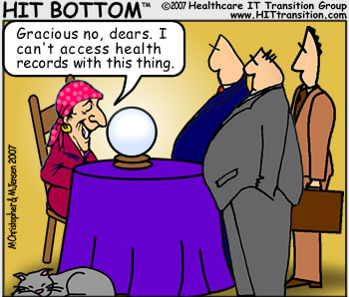
Gartner’s View
Integrated delivery systems and large hospitals should have a physician serving in the CMIO role
CDOs should seek CMIOs with leadership and collaboration skills, who can bridge the clinical community and the IT department
CMIO critical success factors –
  strong, sustained commitment to clinical IT at the top of the organization
  strong chemistry and effective working relationship between the CIO and CMIO
  ability to garner respect and communicate effectively with physicians

Slide 5
Gartner’s View…cont
CMIOs must expand their healthcare administration and finance acumen.
CMIOs should collaborate with CIOs to ensure that effective clinical IT oversight is established and integrated into everything.
CMIOs should prepare for growing management responsibilities, oversight of medical knowledge/order set life cycle management, and quality improvement and clinical research involvement.

Slide 6
CMIO in Navy Medicine
No formally established CMIO…yet
Point paper submitted via M3/5 CoC to establish CMIO in M6 or M3/5
Have de facto CMIO who currently functions in that role for Navy Medicine and TMA/MHS
Based heavily on the Gartner model
Expect formal CMIO within 6 months

Slide 7
Function of CMIO in the Navy
Link between clinical medicine (end users) and technical informatics side
Represents clinical requirements to the technical side and developers
Represents technical capabilities and limitations to the clinical community
Strikes balance between the two and works to ensure overall IM/IT success for all

Slide 8
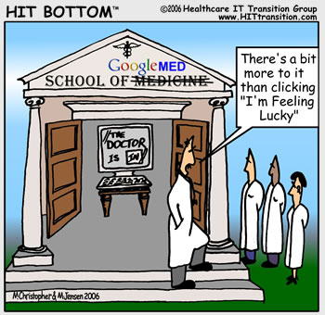

Slide 9
The Future of the CMIO…1 of 4
Continue to be a Medical Officer
Probably work in M6, reporting directly to the CIO/M6 (like a Deputy)
Continue strong relationship with the M3/5 Director of Clinical Informatics
Will accompany M6/CIO to all TMA IM/IT activities and meetings
Provides clinical input for IPWG

Slide 10
The Future of the CMIO…2 of 4
Work with FFC to provide bidirectional clinical involvement with TMIP and other operational IM/IT capabilities
Will provide clinical input to Interagency working groups (supporting CDR Beaubien and her successor)
Work with ECOMS Chairs to ensure IM/IT support and communication with the MTF’s

Slide 11
The Future of the CMIO…3 of 4
Establish CMIO’s at the Regions to work with and support the RISO’s
Advocates for clinician and other end user involvement in any future capability development
Direct liaison to the MHS CMIO and other Service CMIO’s
Works with M3/5 HCS for PI projects at MTF’s

Slide 12
The Future of the CMIO…4 of 4
Responsible to M6/CIO and DSG for implementation of all clinical IM/IT systems
Responsible to M6/CIO and DSG for outcomes of the implementation and training
Identifies and helps to sponsor clinical IM/IT research and development (along with M3/5)
Works with USUHS to develop GME in clinical informatics

Slide 13
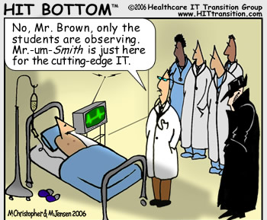
Summary
CMIO is an important role in Navy Medicine
Complements the CIO to provide clinical perspective to IM/IT issues
Need CMIO’s at BUMED and the Regions
Provides internal and external expertise
Gartner’s work provides guidance on current and future roles
Works hand in hand with M3/5 DCI

Slide 14
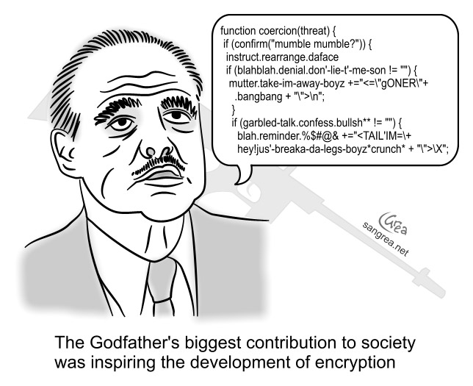
Questions

