Slide 1
Four Quad Scatter Diagram
Short
Quadrant III
Quadrant IV
Easy
Difficult
Quadrant II
Quadrant I
Long

Slide 2
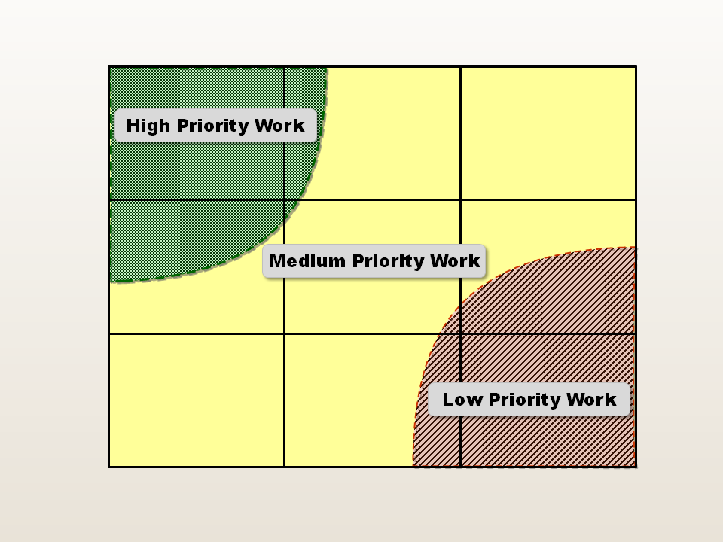
9
8
7
6
5
4
3
2
1
Impact to Organization
1 2 3 4 5 6 7 8 9
Difficulty to Implement

Slide 3
Prioritization Matrix
High
Customer Impact
Medium
Low
Low
Medium
High
Improvement Opportunity
Notes:
Points of view
Product delivery
Time to market
If you use this, you will want to be in the high-high block.

