Slide 1
CMIO Leadership
Bob Marshall, MD MPH MISM CAPT MC USN Ret
CMIO/Informatics Fellowship Director
Madigan Army Medical Center

Slide 2
Learning Objectives
Practical tips on leading other physicians and working with C-Suite Executives
Understand the differences in management and leadership
Learn about the skills necessary to thrive in a leadership role
Learn about strategic/tactical versus tactical only thinking

Slide 3
Leading Clinical End Users
It is not just about physicians
Need allies and clinical champions
Be a clinician first – lead by example
Never lose patience
Focus on the patients and clinical outcomes, not productivity
You are there to help them use the tools better; never be the enforcer
Notes:
Clinical Informatics impacts nearly all areas of a facility. Their products most closely align with clinical support and clinical business support but their skill sets also enable them to help other admin areas as needed and allows them to study and support each team members workflow and needs
Good allies if available at your institution are: Health Outcomes Chief, Nurse Methods Analysts (NMA), and cultivating a knowledgeable POC at Pharmacy, Lab, Radiology, PAD and the Department of Nursing will greatly help. Also work hard to cultivate a good working relationship with your CIO and their team. Informatics and IMD have a symbiotic existence and anything that can be done to reduce friction and increase partnering will be very helpful.

Slide 4
Working with the C-Suite
Ensure your boss understands your job
Get clear expectations from the C-Suite
Be honest, but never say “no”
Get the C-Suite to provide priorities
Communicate often, but not excessively
Identify potential/real problems early
Reassess goals and objectives yearly
Focus on patient care and quality

Slide 5
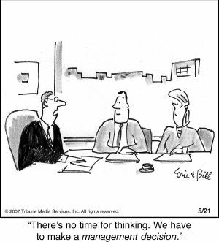

Slide 6
Leadership
Healthcare leadership more complex
CMIO’s cross over leadership groups
Several responsibilities as a leader
Serve as cross-cutting matrix resource
Must partner with others
Must provide vision and strategy while executing tactically
Must provide innovation, while focusing on safety, security, outcomes, income and balance

Slide 7
Management
Normally focuses on work and tasks
Helps organization produce products and services as promised
Most CMIO’s have management experience
Good management is very important to quality, safety and consistency
Management ≠ Leadership

Slide 8
What is the difference?
Stability
Decision-making
Plans around constraints
Short-term vision
Reactive
Minimizes risk
Keeps status quo
Values results
Change
Facilitates decisions
Sets/leads direction
Long-term vision
Proactive
Takes risk
Challenges status quo
Values achievement
Management focus
Leadership focus

Slide 9
Skills for Leadership
Build relationships, understand the culture
Always follow, “Do unto others….”
Remember that respect is earned, but give it freely
Apply the style for the situation
Be sincere, honest and patient focused
Try to never have a “bad day”

Slide 10
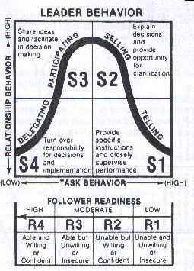
Situational Leadership

Slide 11
SITUATIONAL LEADERSHIP IS NOT
SOMETHING YOU DO TO PEOPLE
BUT
SOMETHING YOU DO WITH PEOPLE

Slide 12
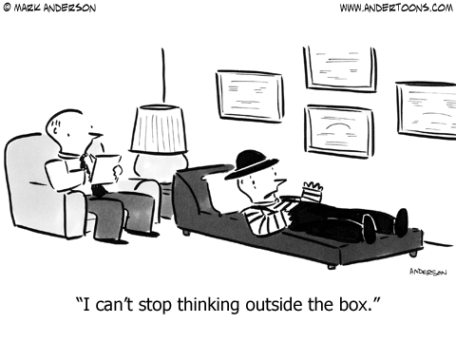

Slide 13
Strategic/Tactical Thinking
Strategic thinking critical for long term organizational success
Strategic thinking is for ALL leaders
As a CMIO, you must think BOTH tactically and strategically
Thinking → Planning and Execution
Should be evidence-based
Avoid “magical” thinking
Notes:
Strategic thinking is aided by staying well informed on industry best practices, goals and strategies being supported by your higher headquarters, and regular meetings with department chiefs and clinical staff to get an understanding of their big needs and goals

Slide 14
Tactical-only Thinking
Focused on the short term
Task-oriented…how do I get the job done?
Rarely thinks beyond the fiscal year
Often deals with “mission criticals”
Exclusive tactical-thinking will not consider the long term effects of decisions

Slide 15
CMIO Thinking
Should incorporate both tactical and strategic thinking
ROI hard to estimate at times, but need to try with strategic thinking
Need to consider decisions made now with effects 3-5 years from now
All Health IT decisions should be based on strategic thinking
Notes:
-Very important to make a business plan for any large project. This will help determine the ROI and also help the CMIO understand exactly what they are asking for in terms of costs, services and the ability to support requirements

Slide 16
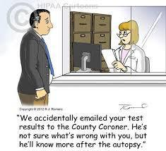

Slide 17
Data Focus vs Clinical Focus
Do not become enamored of and blinded by the data
Data is only as important as its ability to improve patient care and outcomes
Give people the type and amount of data to achieve their goals
Focus both in internal, clinical/fiscal goals and external reporting requirements
Notes:
- Never accept the data at face value. Misinterpretations occur, data entered by humans is prone to errors, and as systems are patched and updated it can impact data integrity. The motto Trust but Verify” is important

Slide 18
Making Decisions
Many factors and influences involved
Remember…tactical/strategic thinking
Use the available evidence
Estimate short-/long-term ROI
Remember the clinical goals…improved clinical outcomes usually means improved fiscal outcomes
Collaboration and consultation helpful
Notes:
-Evaluate the best way to achieve short term and long term goals. When it comes to funding, conducting a pilot generally takes much less money, helps to avoid the DBC need (initially) and can give you the opportunity to verify utility and ROI before a large purchase decision is made.

Slide 19
Closing Thoughts
You are now a leader, but you still have to manage projects/tasks
Think tactically and strategically…at the same time
Clinical focus, data & evidence driven
Know the culture; collaborate
Earn respect by respecting others
Common sense is not that common

Slide 20



Questions

