Slide 1
OCIO/OCMIO Informatics Workforce Development Project
Phase II CMIO Subgroup: Planning Discussion
February 2012

Slide 2
Objectives of today’s discussion
Discuss the role and responsibilities for the CMIO subgroup
Discuss the process for developing the CMIO learning & development program
Confirm next steps

Slide 3
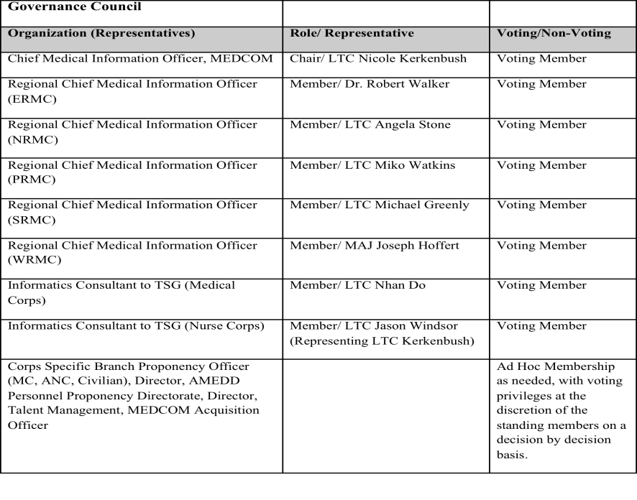
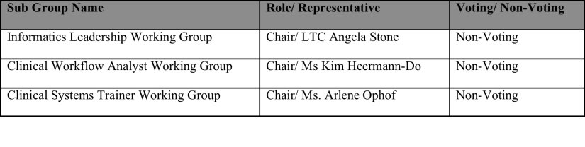
CMIO subgroup responsibilities

Slide 4
Design process
Work step | Lead | Target completion date
Identify subgroup members to assist with the effort; consider individuals who: Are fulfilling a CMIO role today Have awareness and interest in the Workforce Development Project and talent management, in general Have knowledge of existing learning & development actions for CMIO roles | LTC Stone | By 17 FEB
Identify existing learning & development actions for the CMIO competencies and technical skills listed in the role profiles Focus on Practice, Read, Study/Learn actions TIAG/Axiom to provide template for sub-team to document findings | LTC Stone & subgroup members | By 31 MAR Includes weekly review calls every Friday from 1000 to 1100 CT to discuss progress, questions, etc.
Identify gaps in learning & development actions for the CMIO competencies and technical skills listed in the role profiles and ways to fill the gaps | Axiom/TIAG | By 31 MAR
Develop recommended learning & development plan, including recommendations for which elements would be required | Axiom/TIAG & LTC Stone & subgroup members | By 20 APR

Slide 5
CMIO competencies and assessment results
Note: data points for the Deputy CMIO (MTF) role are limited, and therefore caution should be exercised when drawing conclusions based on the data.

Slide 6
CMIO technical skills and assessment results
Note: data points for the Deputy CMIO (MTF) role are limited, and therefore caution should be exercised when drawing conclusions based on the data.

Slide 7
Learning & development program design
For each of the competencies and technical skills captured in the role profiles, we will create a Learning and Development program comprised of 5 components (see below)
Subgroup’s focus
Axiom/TIAG focus

Slide 8
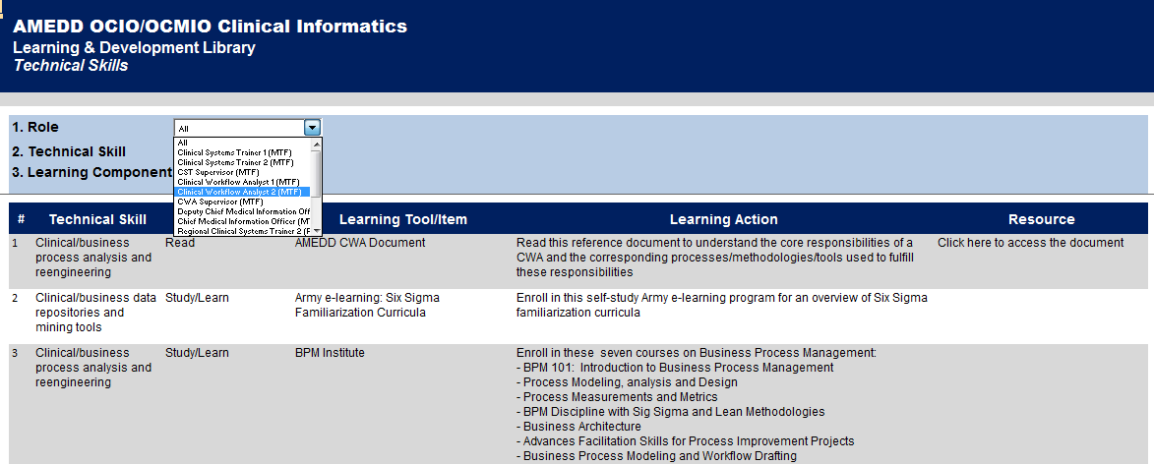
Learning & development library – demo live

Slide 9
Learning & development library input file – demo live
To complete work step #2, the CMIO subgroup will capture the existing Practice, Read, and Study/learn tools in an input file that we can then review as a team at our weekly meetings

Slide 10
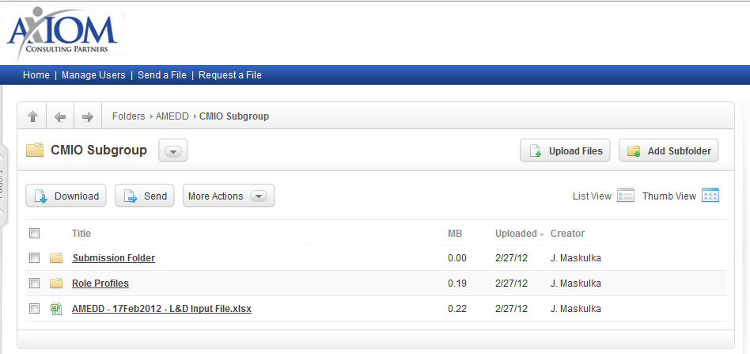
We will use Sharefile to store and share our working documents—Interim Strategy
You will soon receive an email granting you access to a Sharefile site that we will use to share our documents
The Sharefile site contains:
  The 4 CMIO role profiles containing the competencies and technical skills definitions and proficiency requirements
  The learning & development input file
  A submission folder

Slide 11
Next steps
Subgroup members access the CMIO Subgroup Sharefile and familiarize yourselves with the role profiles and the Learning & development library input file
Subgroup members start to populate the input file with existing Practice, Read, and Study/learn solutions for the competencies with greatest gaps
  Results Orientation
  Teamwork
  People Management
  Talent Development
  Change Management
  Resource Management
LTC Angela Stone uploads a consolidated input file with team’s progress by TBD
Subgroup meets with TIAG/Axiom at our next weekly call on TBD to review progress
Make sure to review the role profiles for details on each of these competencies

Slide 12
appendix

Slide 13
Competency Model
Each assessment included the critical competencies identified for a particular role. Competencies comprised of the following four categories and varied by role/level:
Leadership
Supervisory
Functional
Foundational
Leadership competencies define the knowledge, skills, and abilities that informatics leadership must have to drive the maturation of informatics and successfully execute the mission and vision throughout the AMEDD.
Supervisory competencies are required for success in supervisory or lead roles. These knowledge, skills, and abilities enable supervisors to effectively execute the strategy defined by OTSG leadership at the regional and MTF levels.
Functional competencies are the specialized knowledge, skills, and abilities required to achieve results in a particular role. Training and development programs can enhance functional competencies and provide high impact for the organization.
Foundational competencies provide the basic building blocks or necessary requirements for performing the roles and should be demonstrated by all employees. Selection efforts should determine whether or not threshold levels have been achieved.

