Slide 1
Efficient use of Information Systems in Your Clinic

Slide 2
Objectives:
AHLTA centric workflow
Documentation efficiency
Tips and Tricks for better care
Getting paid for what you do…regardless of specialty
Resources you can use

Slide 3
Objectives (cont)
Breakout sessions (AHLTA / Coding combined):
Nurses/Support staff: team documentation, Joint Commission, PHA, open to questions
Providers: documentation efficiency, “Keys for clinicians,” open to questions

Slide 4
Using IM/IT to Improve Efficiency
Well thought out and implemented information management/technology measure can enhance clinic efficiency
IM/IT does not take the place of good planning – well planned & implemented IM/IT cannot make a poor practice good
Poorly planned & implemented IM/IT can do great damage to a well run practice

Slide 5
Common Problems
Takes too long to check patients in.
Don’t have time to complete patient notes and use check-out feature.
Cannot easily accomplish medication reconciliation.
No subjective or patient questionnaire work is done before the provider walks into the room.
Make sure you are documenting in the right clinic.

Slide 6
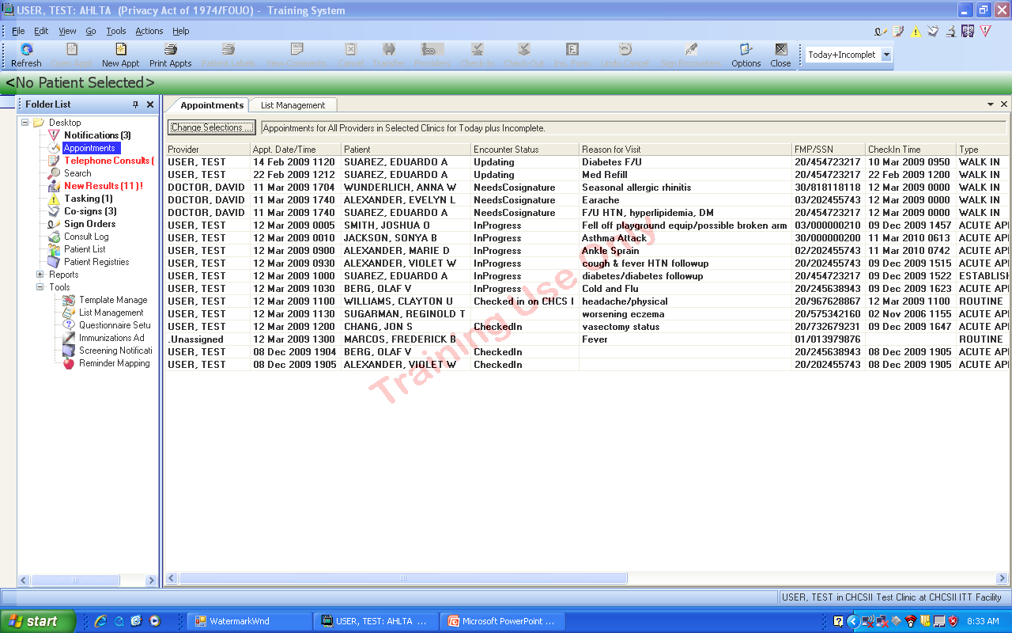
Make sure you know what clinic you are currently documenting care in. It needs to be the correct clinic, or the clinic will get no workload credit.

Slide 7
AHLTA Centric Workflow
Flowsheets
Med management
Paperless communication – Tasking module
Gathering Data
Teamwork

Slide 8
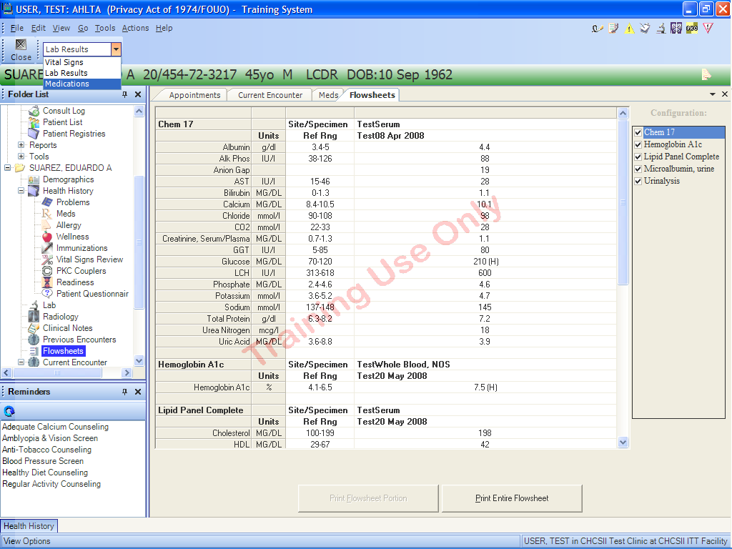
How to print labs, meds, vital signs
From the Flowsheet Module, click on the dropdown list to show the Medication Flowsheet.

Slide 9
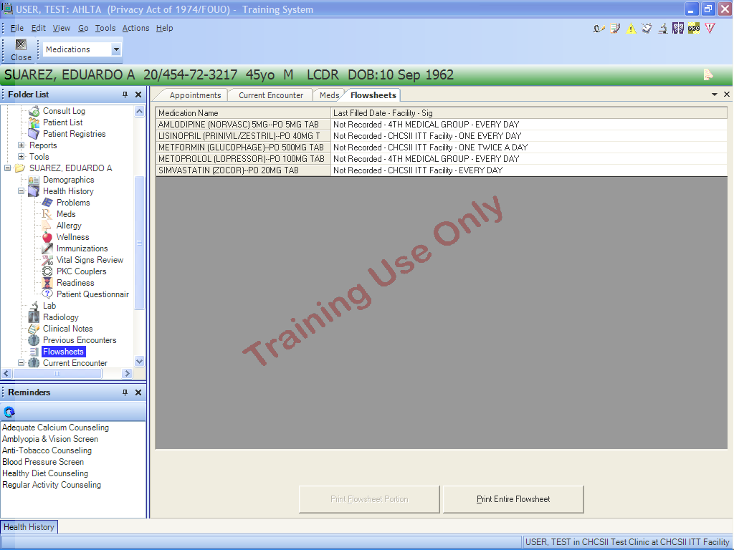
Medication Reconciliation in 3.3…one method
The Medication Flowsheet shows the Last Filled Date, Facility at which it was filled and the Sig. Print the entire flowsheet to give to the patient for medication reconciliation.

Slide 10
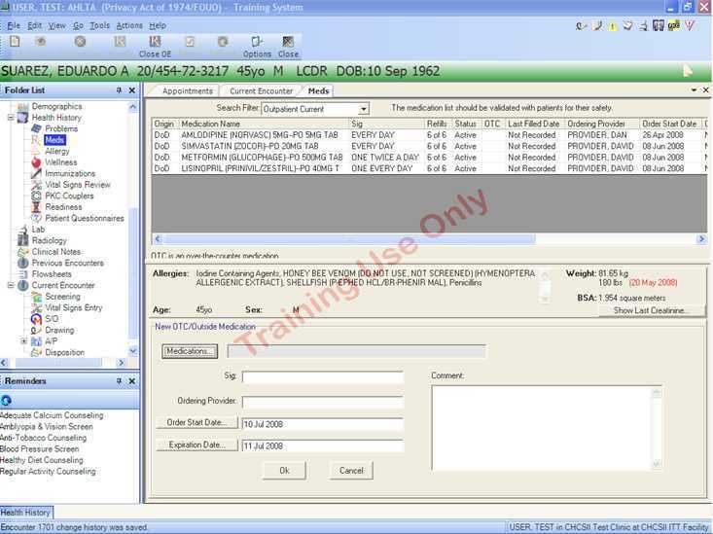
Meds module

Slide 11
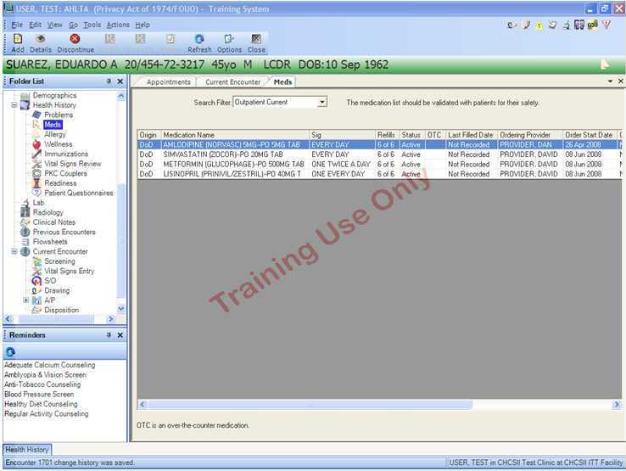
Recommend “All Outpatient” vice “Outpatient Current”
Click on Add (Toolbar) to add a medication

Slide 12
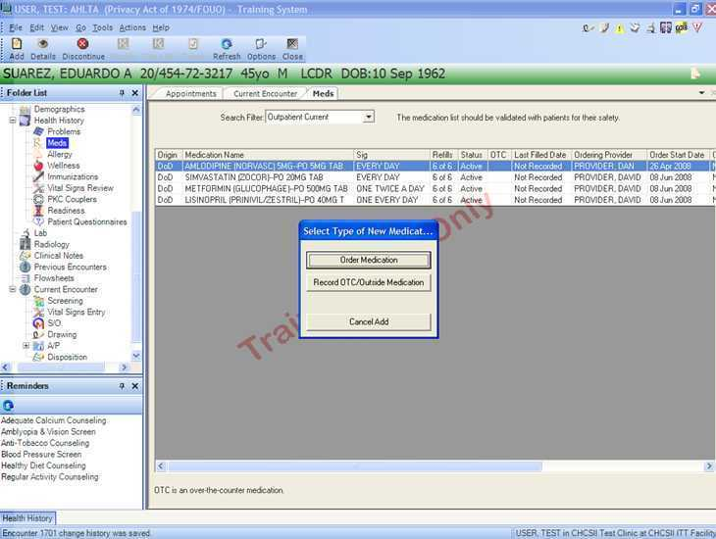
This option box pops up to allow you to order new meds or add OTC/outside meds

Slide 13
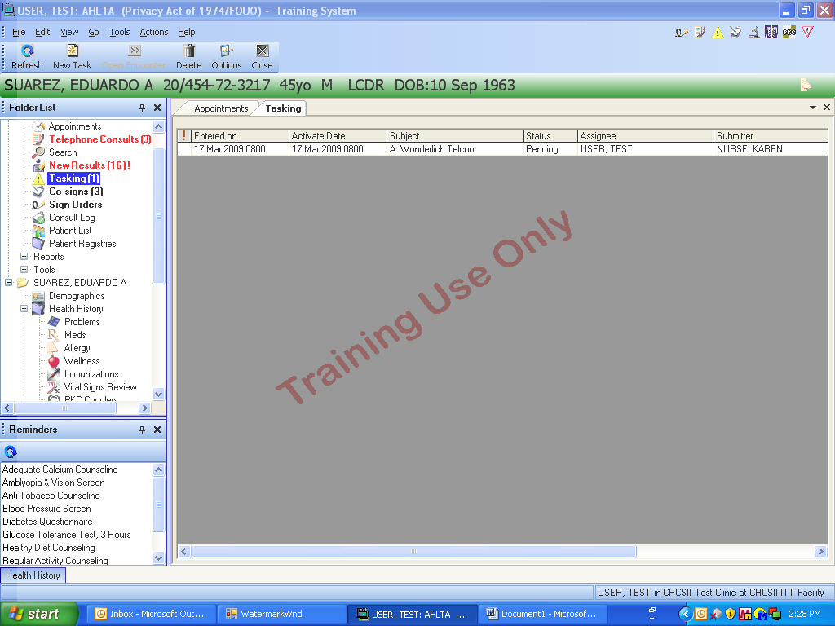
Paperless Communication with Tasking Module
The Taking Module is useful to communicate desires and requirements for action items to HM’s/MA’s, Nurses and other providers.

Slide 14
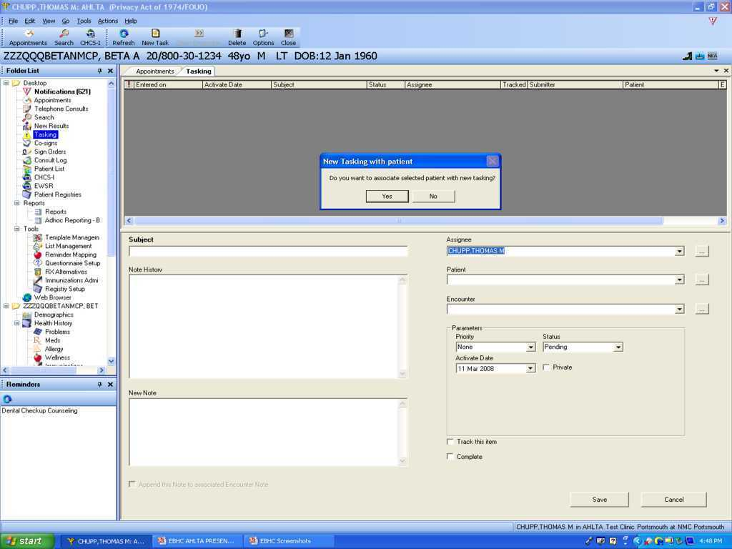
Communications (Tasking cont)
The tasking module allows communication and an audit trail among the team, members. That is the important thing to remember

Slide 15
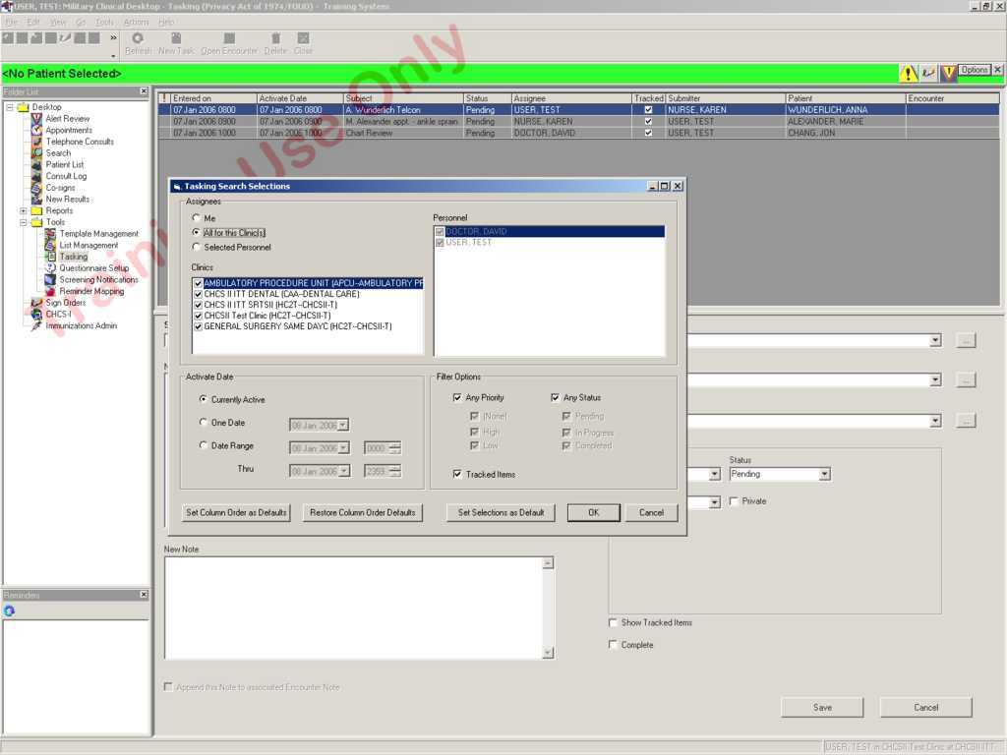
Communications (Tasking)
Tasking Search Selections under the Options Icon (previous slide). Can set as Default.

Slide 16
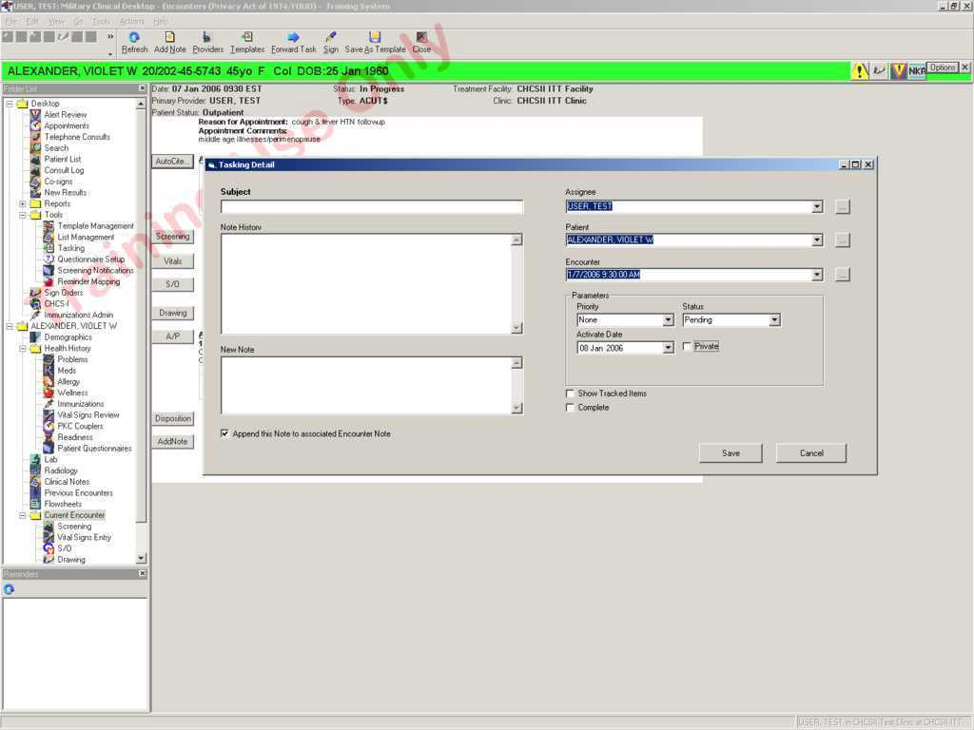
Communications (Tasking)
New Task Window
If Append this Note is selected, note will appear in the Add Note section of the encounter.
If task is marked as Private, task will only display on the submitter and assignee’s Task list.

Slide 17
Gathering Data
Verify demographics and Non-DEERS info
Cell phone number
E-mail address
Screening
Questionnaires
Allergies
Problem list
Family History/PMHx
Wellness and Preventive Care

Slide 18
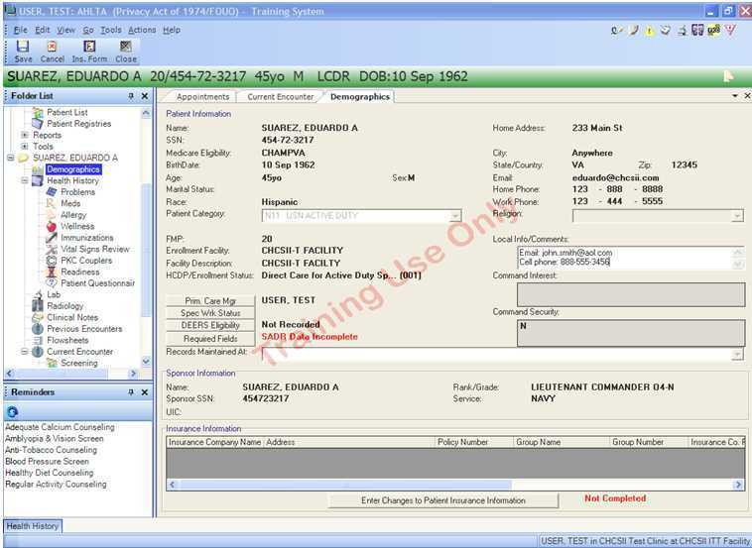
This Local info/Comments box allows you to add cell phone numbers and email addresses

Slide 19
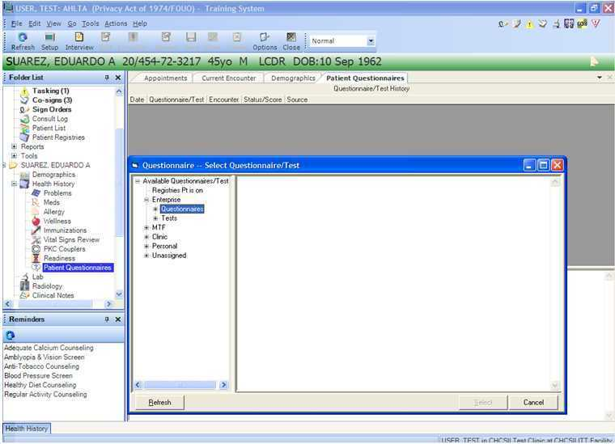
Accessing Questionnaires as part of your check-in processes.

Slide 20
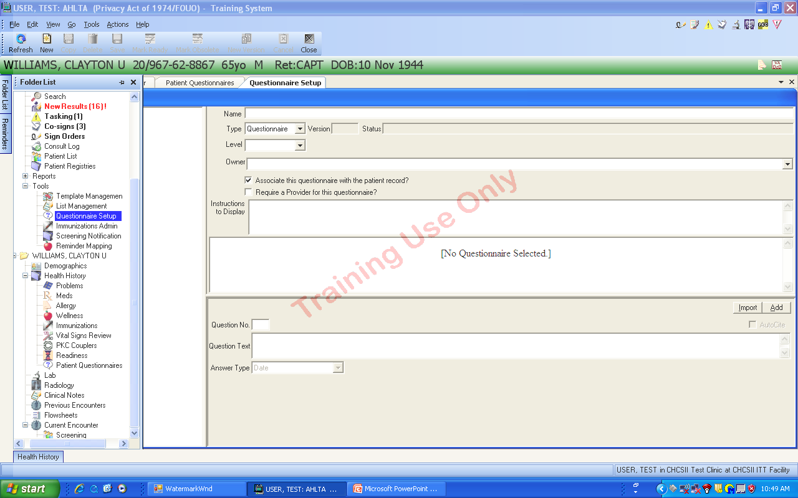
Accessing questionnaires, especially Enterprise Questionnaires, requires that you click on “Questionnaire Setup” in the Folder List to open this screen.

Slide 21
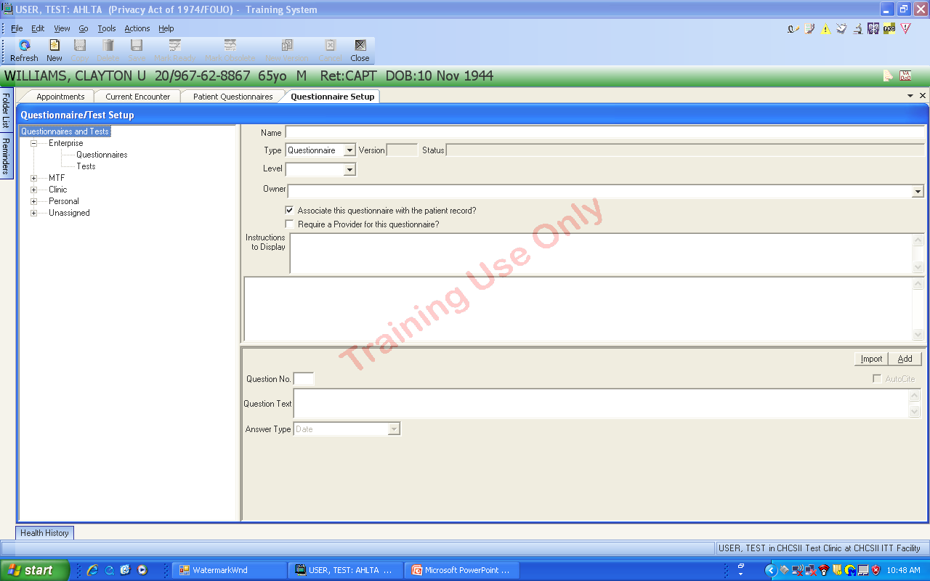
Here is the Questionnaire dialog box for finding or creating a questionnaire. See the blank fields.
The questionnaires can be filed as Enterprise, MTF, Clinic, Personal and Unassigned.

Slide 22
Clinic Teamwork
These three need to visit every clinic and provide advice and training to all end users. Need time and buy-in from the Command and the Department Heads…aka “The Bowes Method”
Team members
Clinic staff
Sustainment trainer
AHLTA Champions
Coder
MID
Team documentation
HM/MA entry (speeds encounters)
Standardized templates
Clinic procedures

Slide 23
Team Documentation
HM/MA Documentation
In addition to vital signs, the HM/MA can do the following team documentation
Chief Complaint
Medication reconciliation
Subjective (as much as possible)
Past History/Family History/Prev Med topics
Even the A/P module for diagnoses and procedures

Slide 24
Building Teamwork
Empowering support staff to be more than vitals techs
Saving time with the use of copy forward and favorite lists
Requires education and training of the HMs/MAs
Teams need to be STABLE!

Slide 25
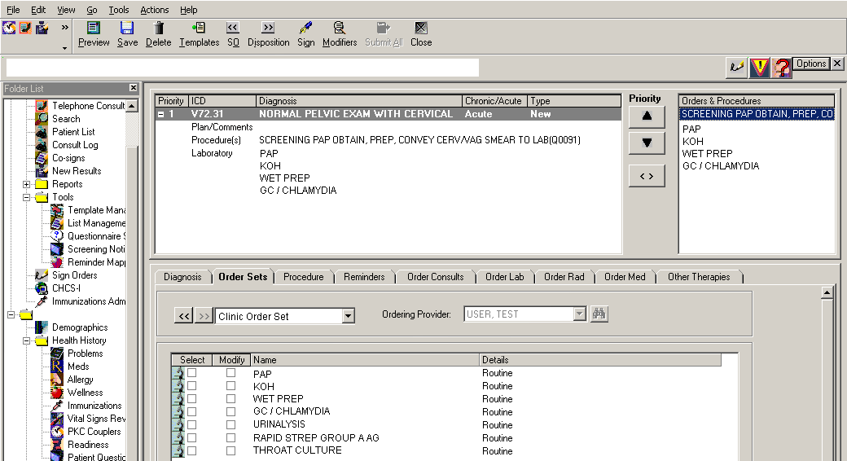
Team Documentation: Clinic Procedures
Single Order set for Support Staff
PAP, KOH, Wet Prep, GC/CT, Rapid Strep, Throat Cx, UA, etc.
They may be able to order these in AHLTA as standing orders
It may be possible
for your support
staff to complete all
of this for you
EXAMPLE ONLY

Slide 26
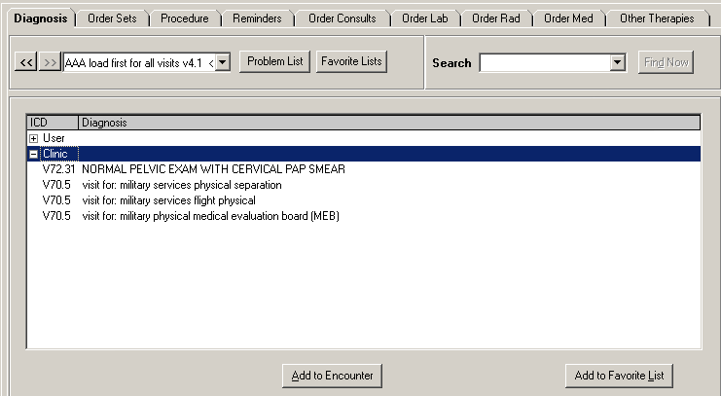
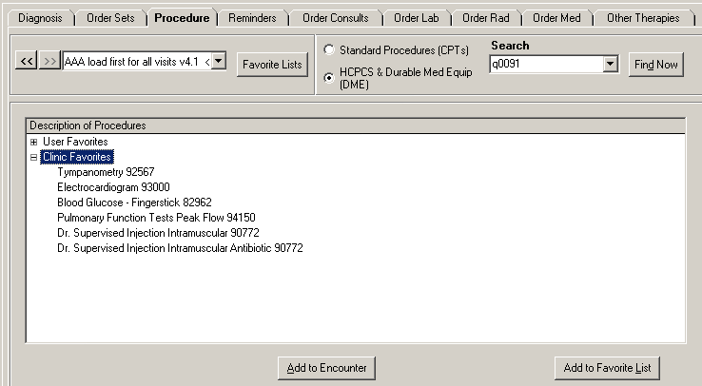
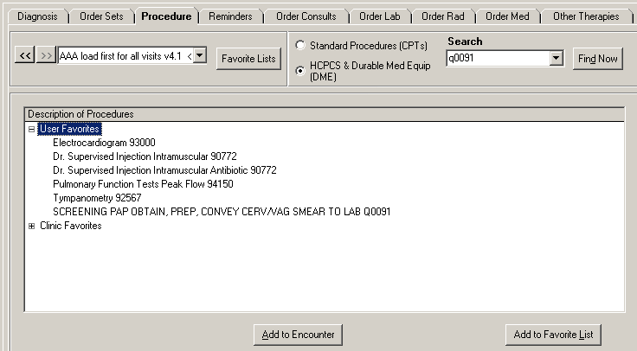
Clinic & Personal Favorites
Use of Clinic Favorites
Most common list of Diagnoses (ex. Normal Pelvic Exam…)
Use them to add Agreed Upon Routine Visits as a verbal order
Most common list of Procedures (Think RVU’s)

Slide 27
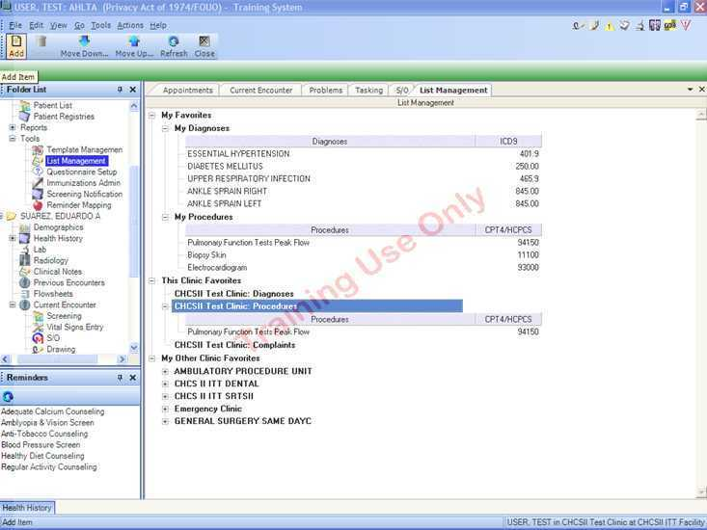
Team members can add items to the Favorites lists right from this module. Anyone (providers, nurses, MA’s, HM’s) with the correct privileges can do so.

Slide 28
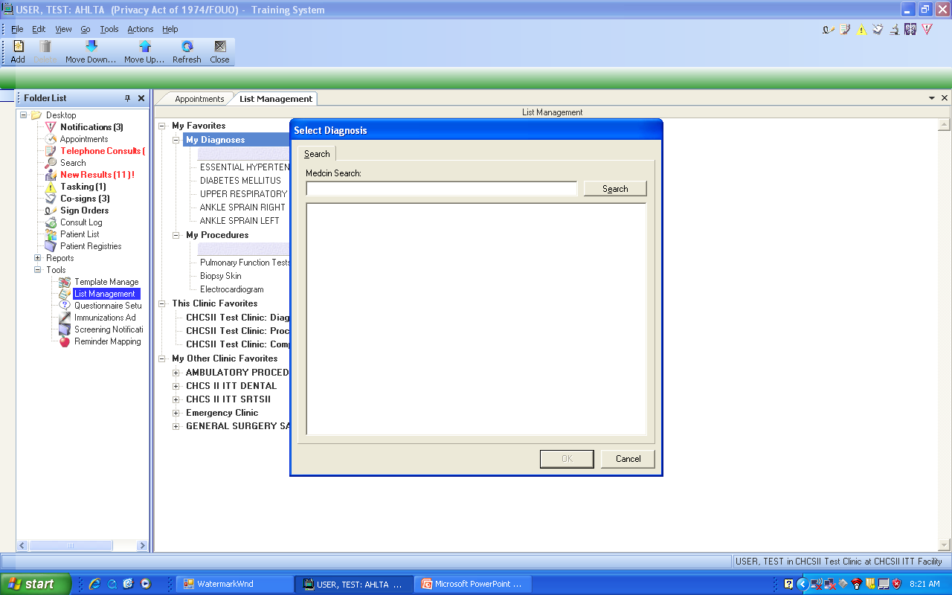
Once you click on the “Add” button in the upper left corner, this dialog box appears.

Slide 29
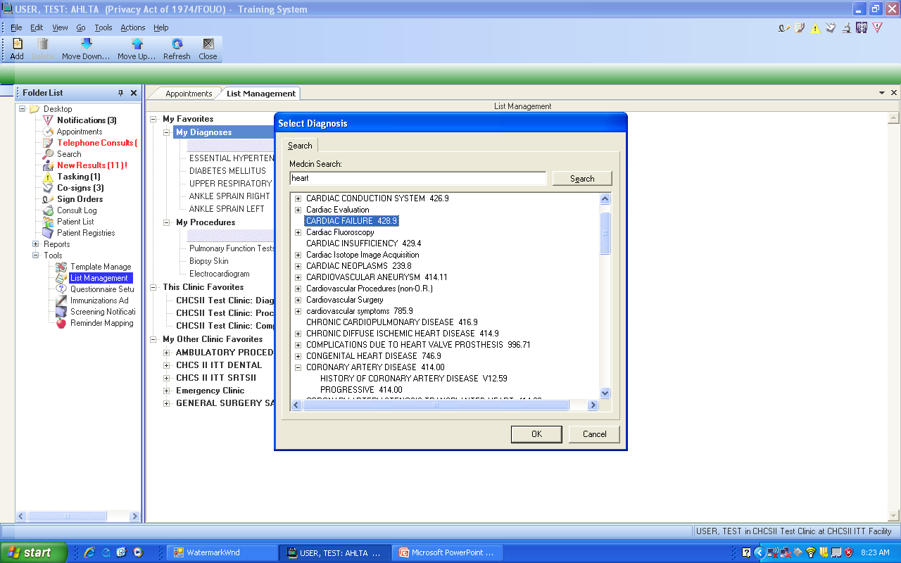
Search for the diagnosis by spelling all or part of the item desired and hit the “Search” button.

Slide 30
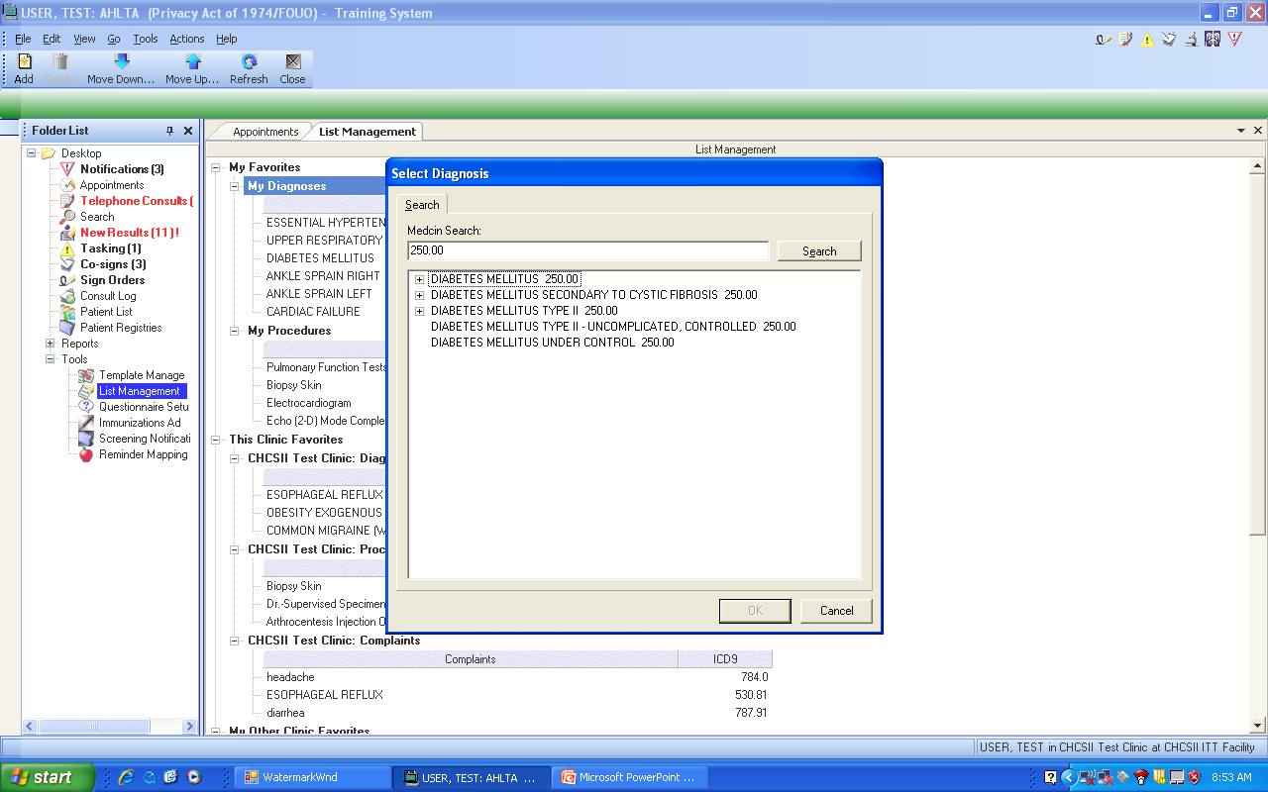
Alternatively, if you know the ICD-9 or CPT codes, you can enter then and hit the “Search” button…as shown.
Once the item has been identified, highlight it and hit “OK” to add it to your list.

Slide 31
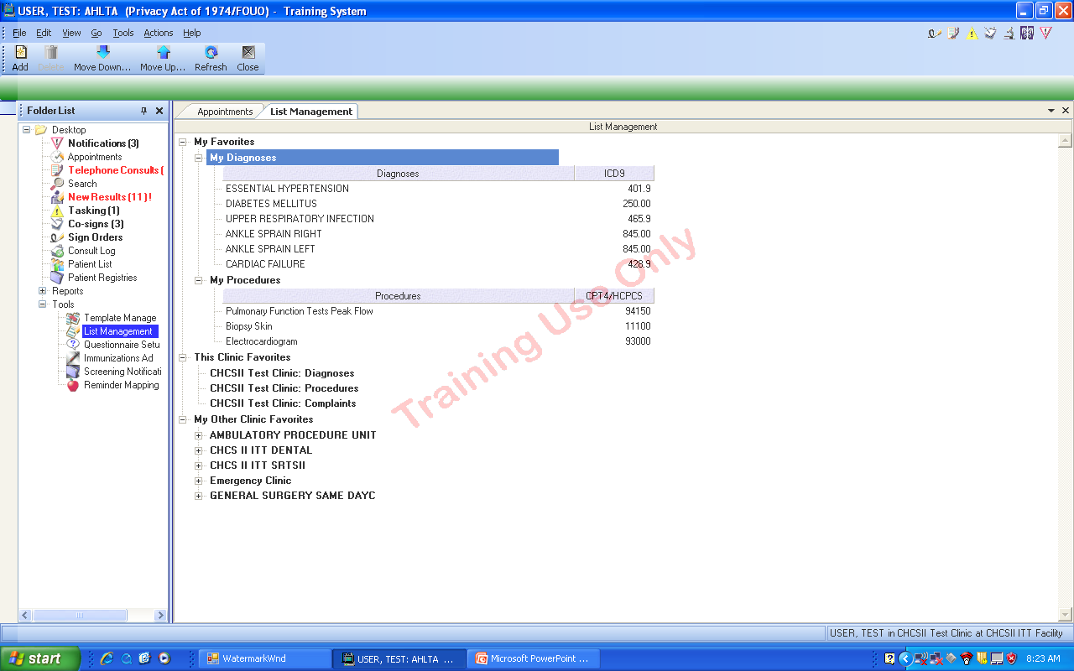
To reorder or move the items in the list, you must use the “Move Down” and “Move Up” icons in the menu list.
The diagnosis has now been added to the My Diagnoses list.

Slide 32
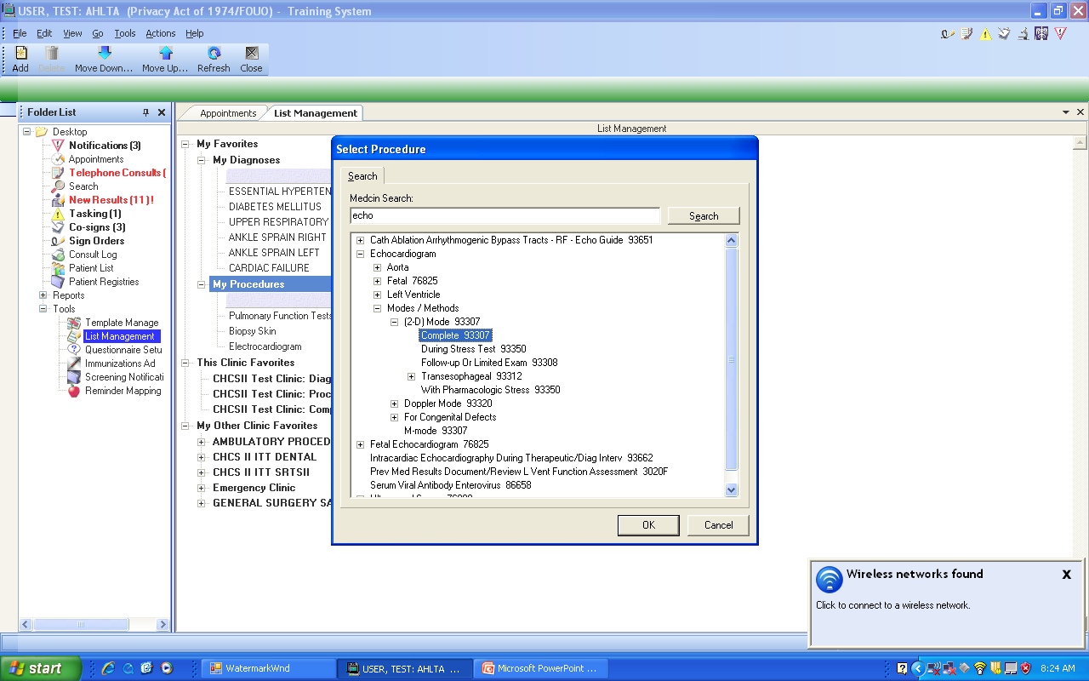
Here is the found item to add to the “My Favorite Procedures” list.

Slide 33
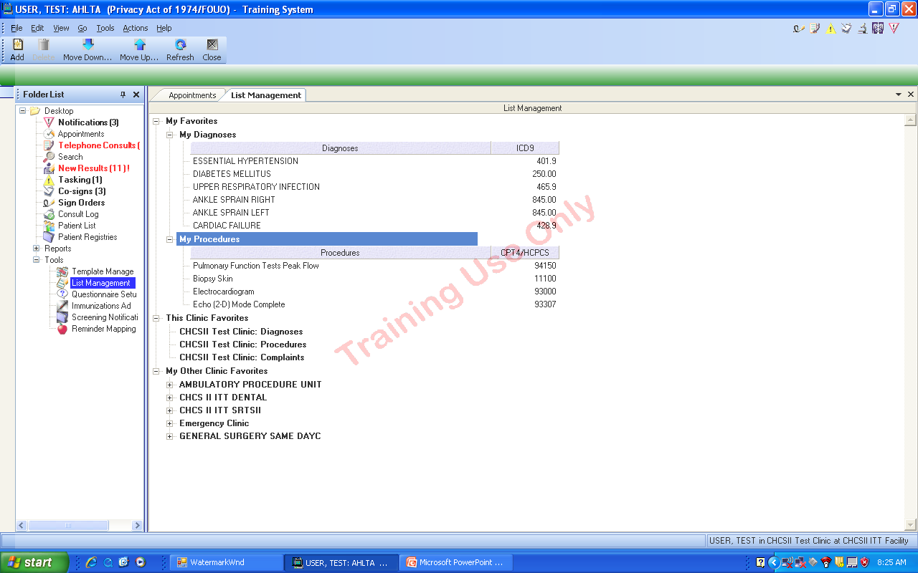
This shows the added procedure under the “My Procedures” heading. Put YOUR favorite procedures here that are not the Clinic’s most common procedures. Put those under “Clinic Favorites” for everyone. This also gives you twice the number of Favorites to choose from and customizes your AHLTA. Another reason is for those items that are excruciating to find.

Slide 34
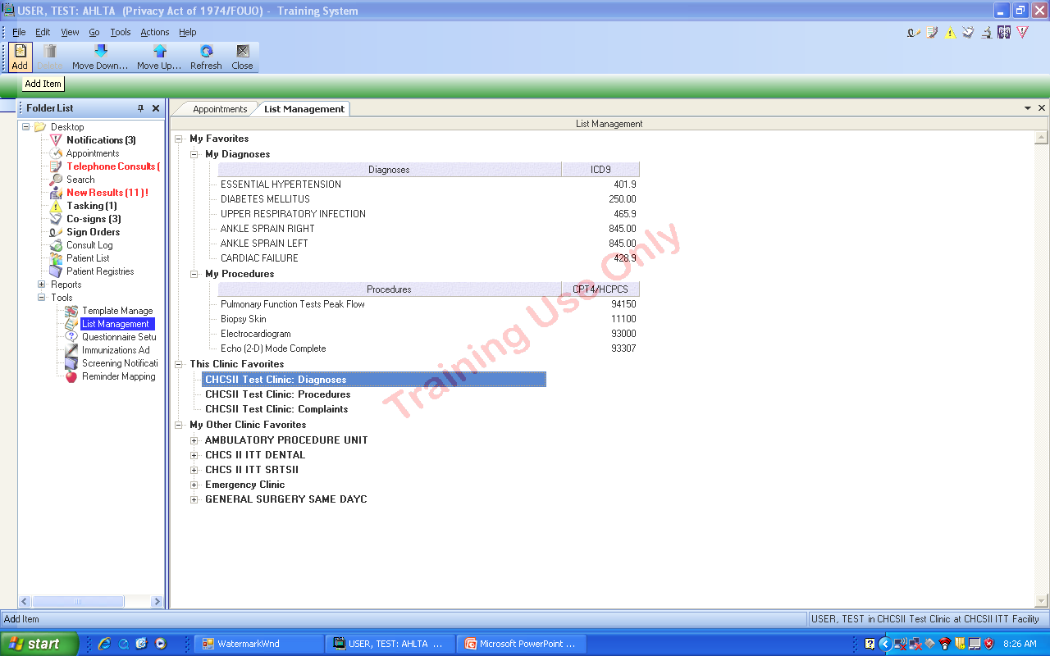
To add Clinic Favorites, highlight the item to have added items…Diagnoses, Procedures or Complaints…and hit the Add button on the upper left.

Slide 35
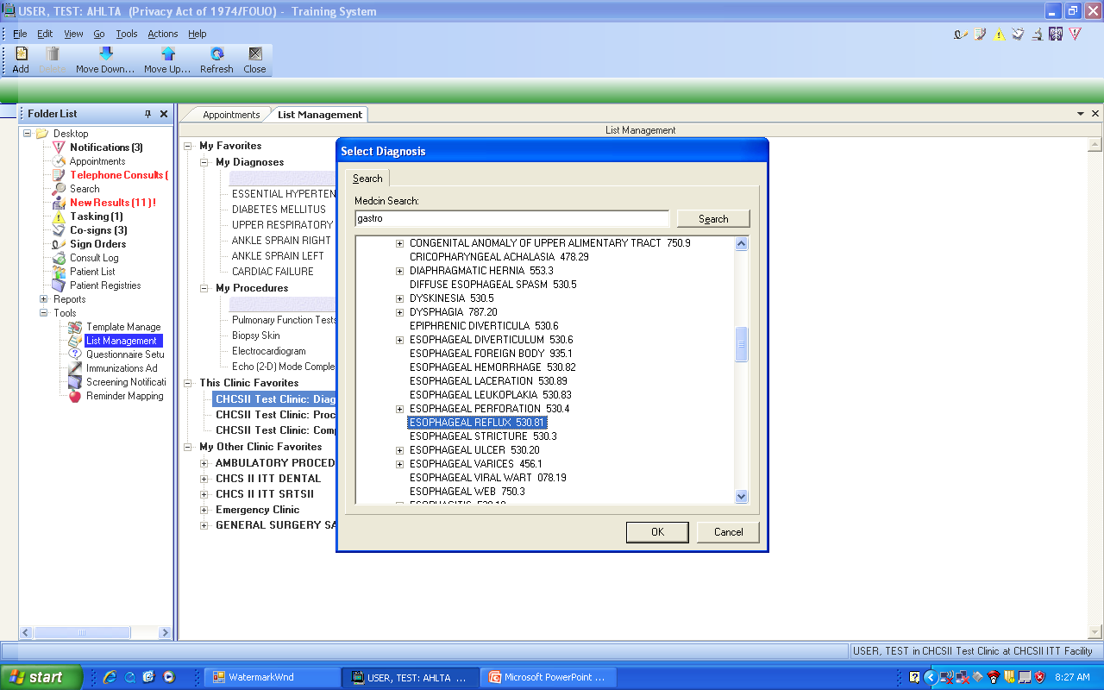
Can use partial words to do the search and hit the button. Click on the item you desire and hit “OK” to add it to the list.

Slide 36
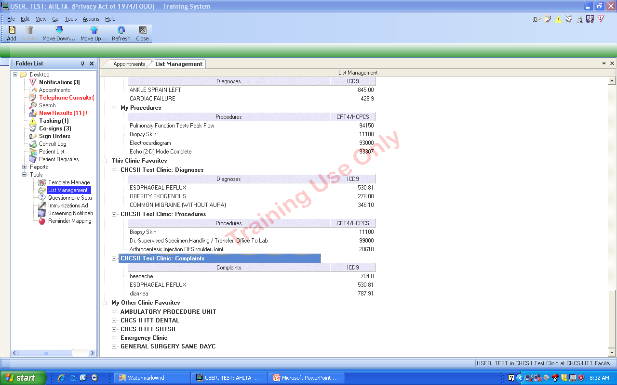
Here is the completed list of Clinic Favorites. Very easy to do. Best to use the most common diagnoses, procedures and complaints based on report from MCSC or CHCS at the clinic level.

Slide 37
Documentation Efficiency
Provider desktop enhancements
Template efficiency
Efficiency tools
Dragon Naturally Speaking
AsUType
Copy Forward
Usability AIM form

Slide 38
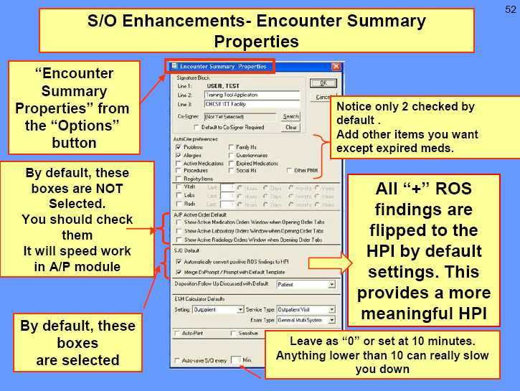

Slide 39
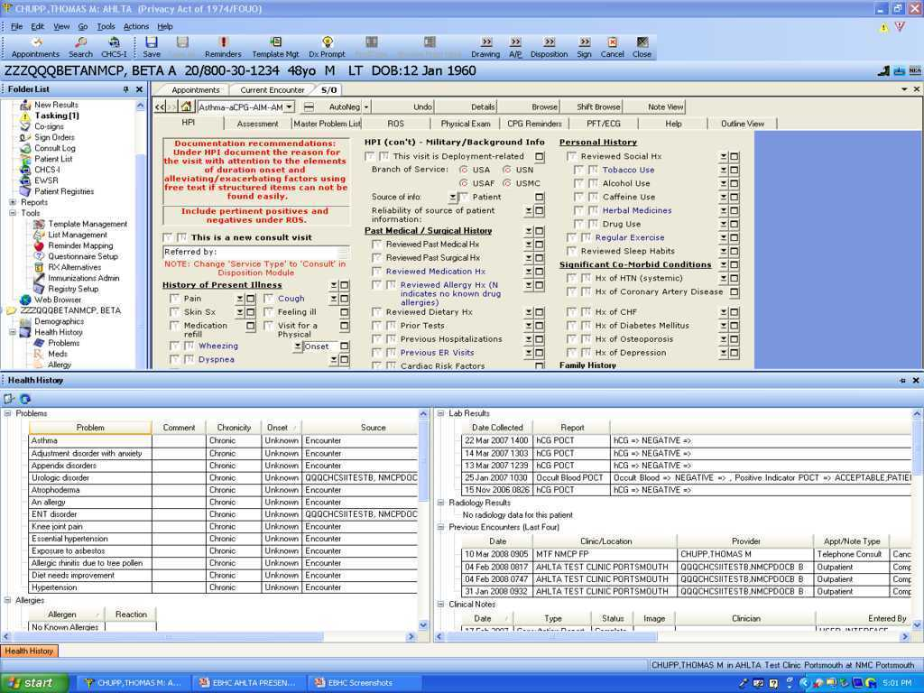
Health History Module
Health history can be tabbed at the bottom for configurable snapshot view…similar in content and presentation to ICDB.

Slide 40
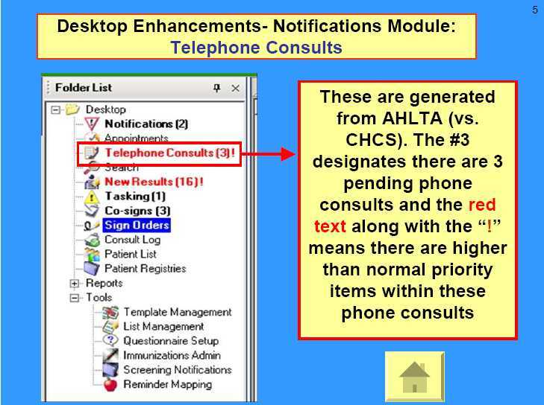

Slide 41
Template Management
Enterprise folders
Default template
Order Sets
Editing/Merging templates – in the breakout

Slide 42
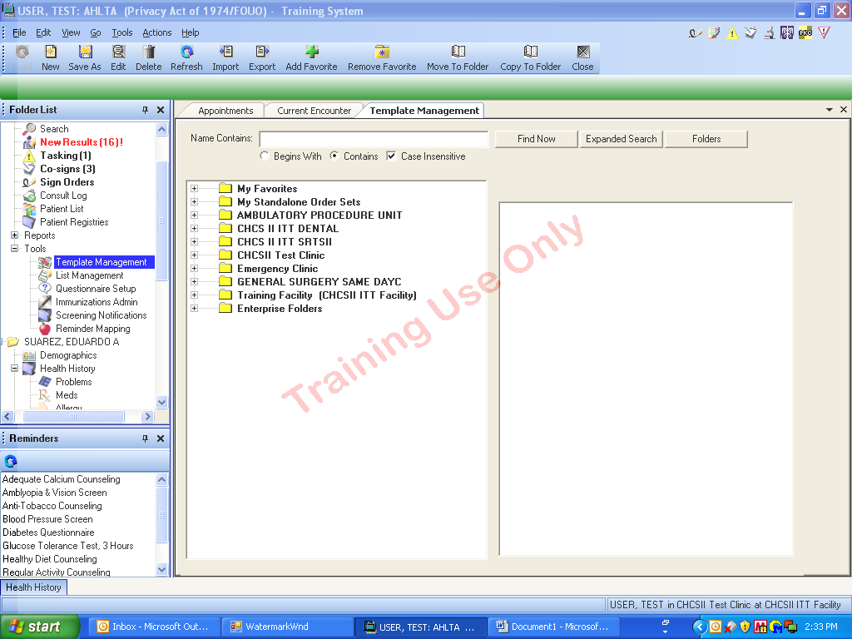
Template Management Tool to find all types
of pre-positioned templates. (AIM + MEDCIN)
AHLTA 3.3 makes template management much easier. Details in the breakout section.
Notes:
An encounter note must be opened for the Template Selections tab to be activated.
Encounter template management is found in the tools folder.

Slide 43
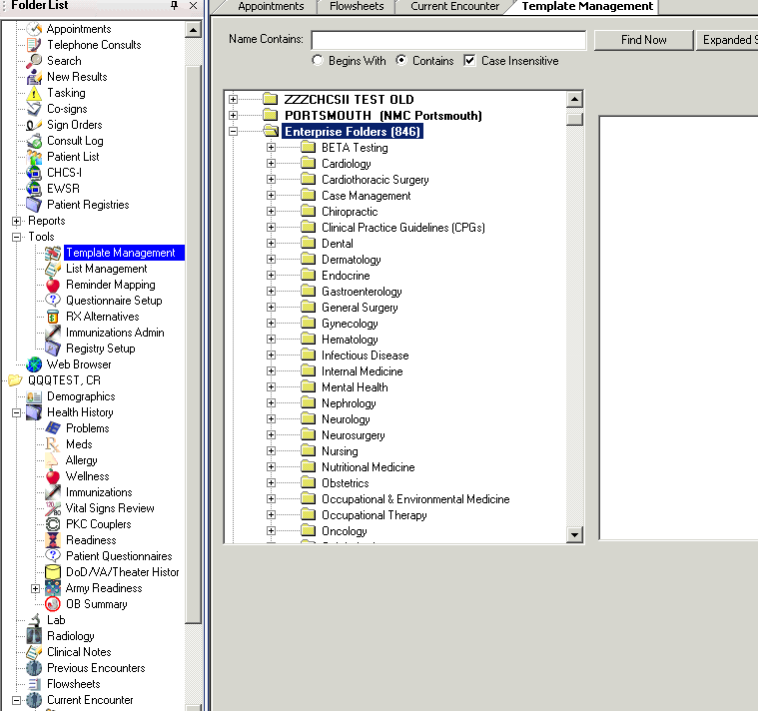
Enterprise Folder with approved, selected templates arranged by specialty.

Slide 44
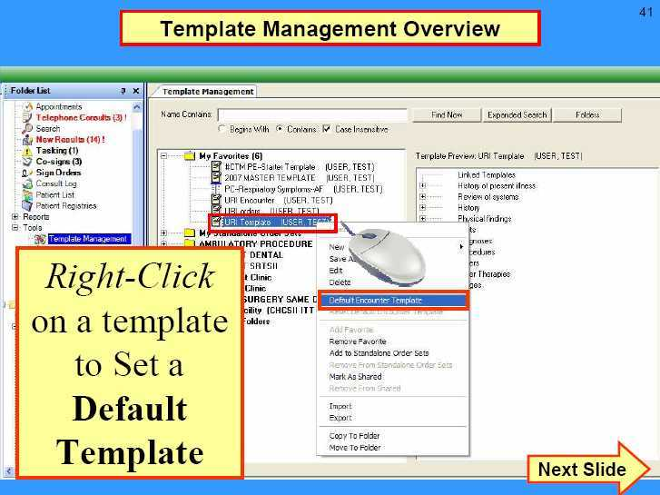

Slide 45
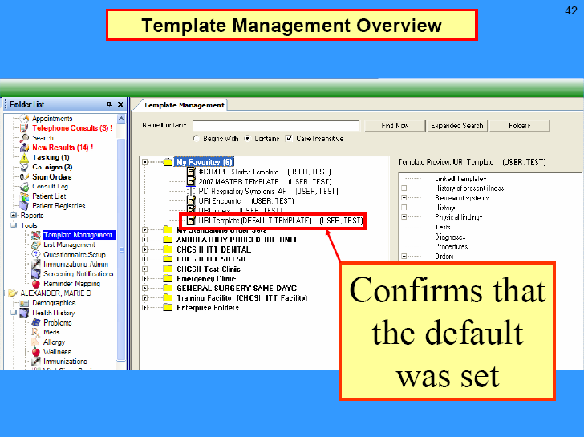

Slide 46
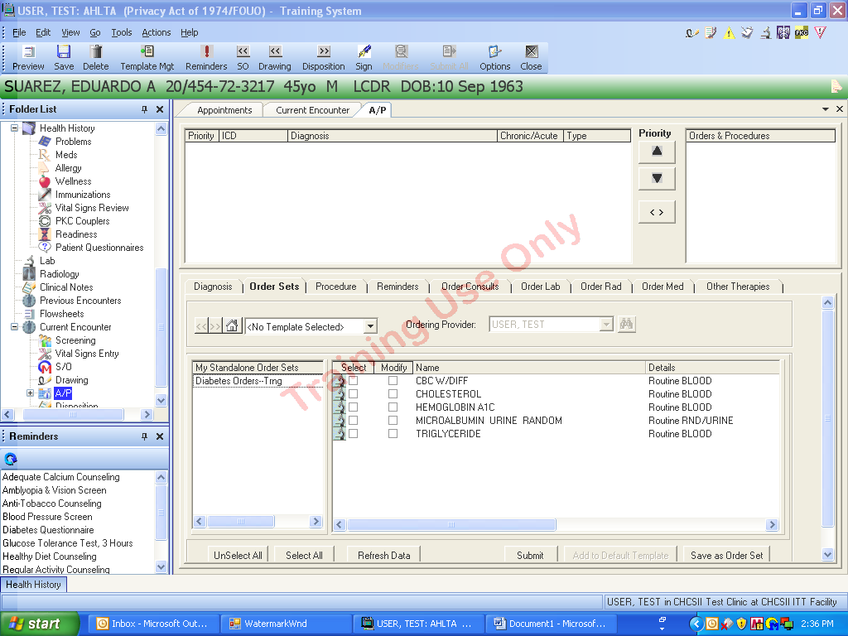
Default Order Set.
Notes:
This is the default order set.

Slide 47
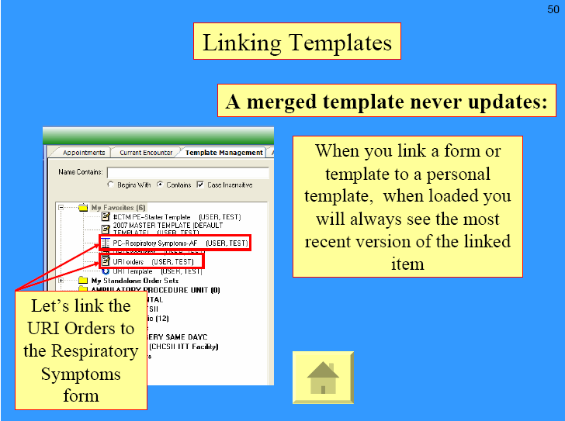

Slide 48
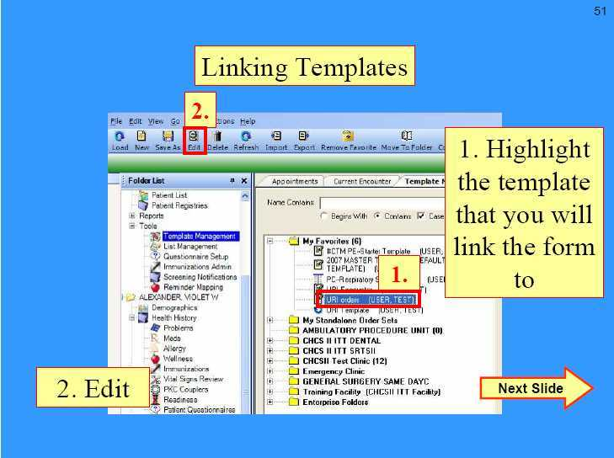

Slide 49
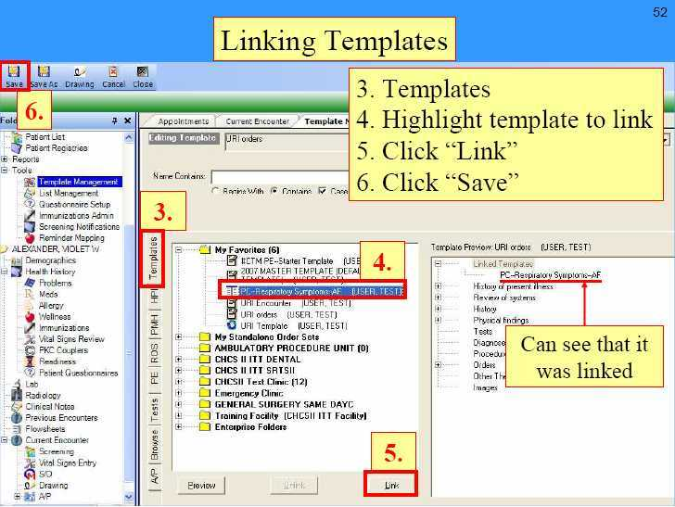

Slide 50

Dragon Use with AHLTA

Slide 51
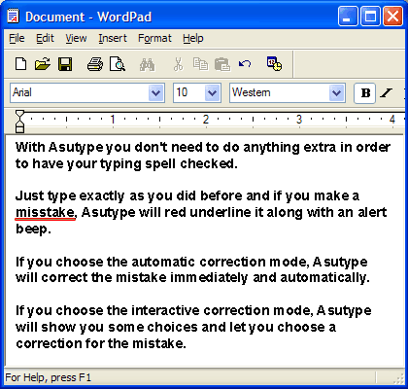
Use of AsUType
Keys to AsUType Use
Medical dictionary
Turn on/off spell check as desired
Use Macros
Macro library at USAFP site
Use your own – almost everyone has them

Slide 52
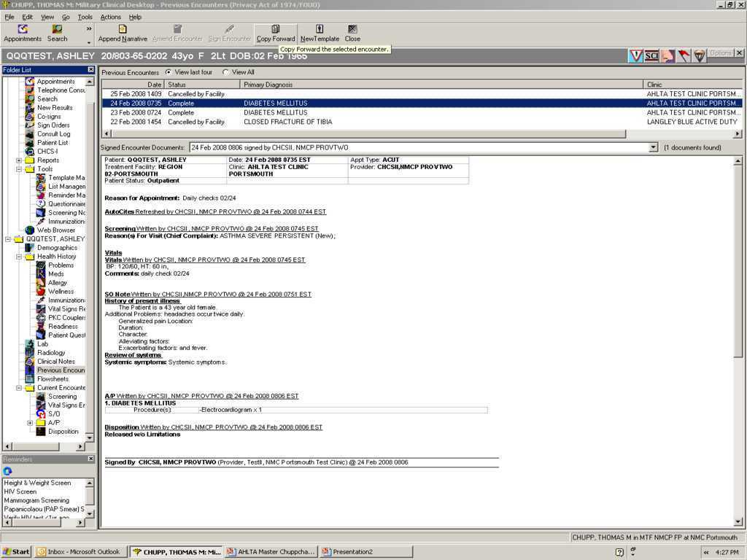
Copy Forward function

Slide 53
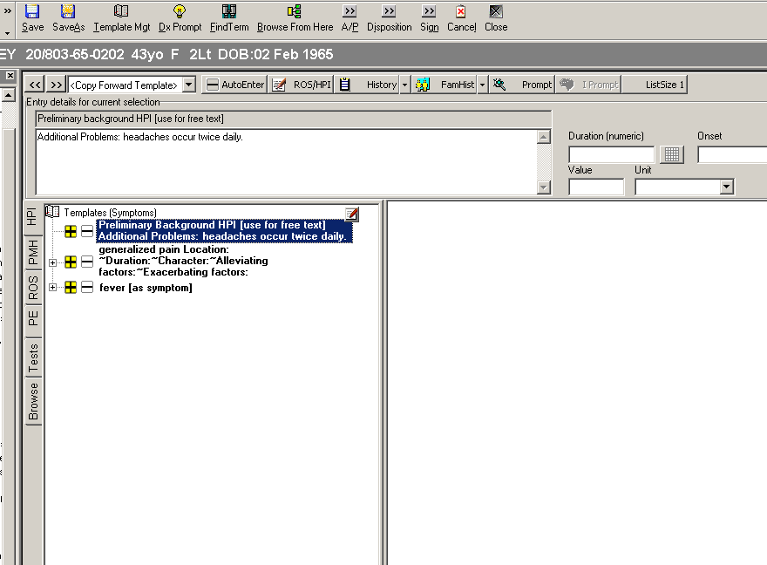
Single click AutoEnter to carry over all yellow highlighted terms into the note.

Slide 54
Usability AIM Form

Slide 55
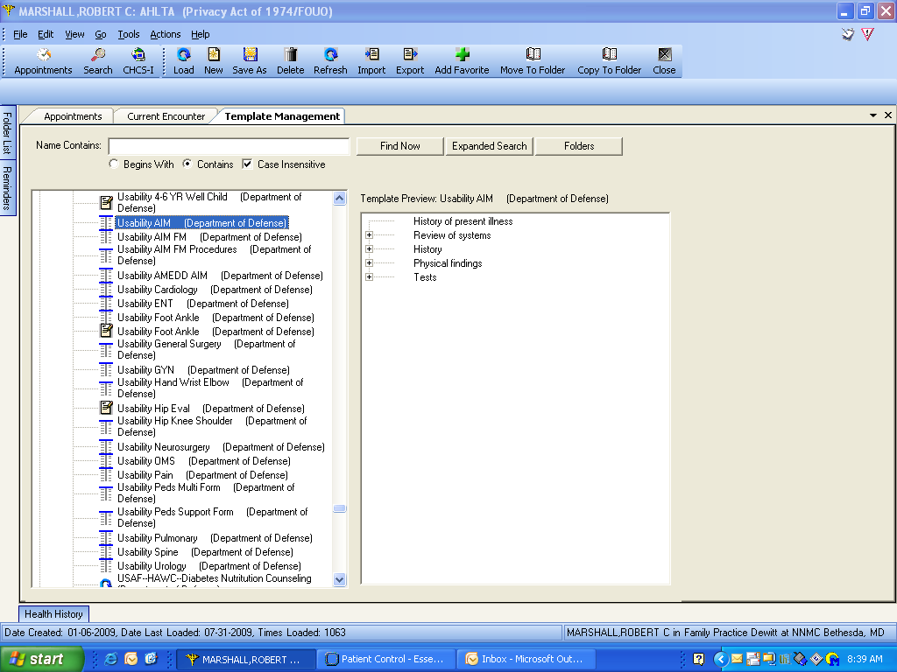
Finding Usability AIM Forms

Slide 56
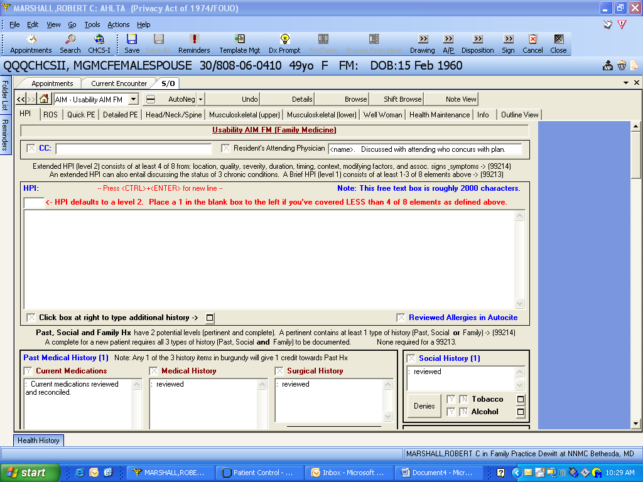
Use the HPI/Screening Tab for Chief Complaint and past history, family history, and social history

Slide 57
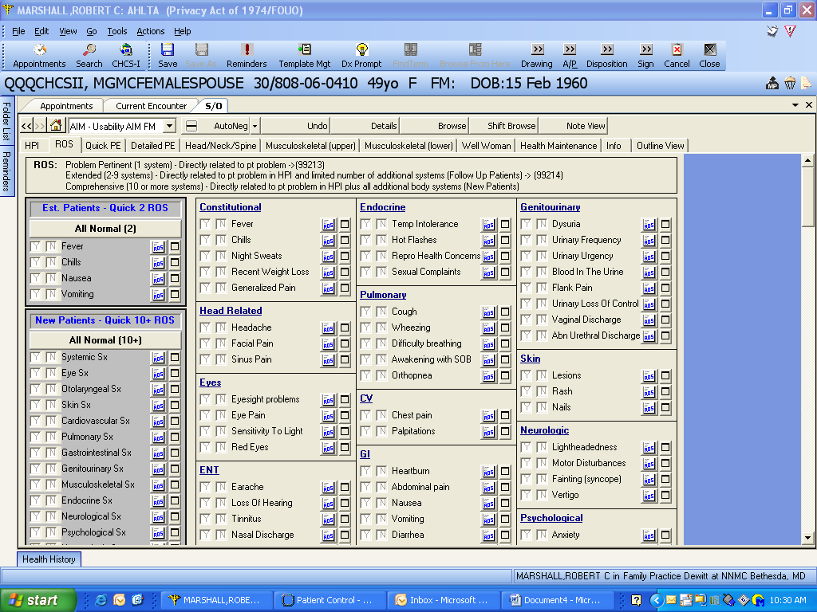
Coding rules are listed at the top.
1 for Problem Pertinent. 2 -9 ROS must be covered for a 99214 (Extended level ROS) from 2 or more different organ systems, etc.
Must be clinically important to get credit!

Slide 58
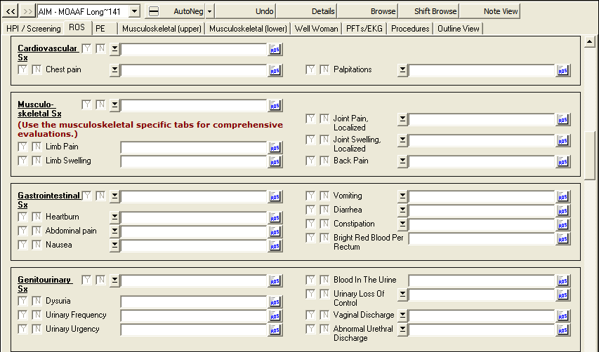
Additional ROS.
Note: the musculoskeletal tabs on this AIM form has more comprehensive musculoskeletal ROS.

Slide 59
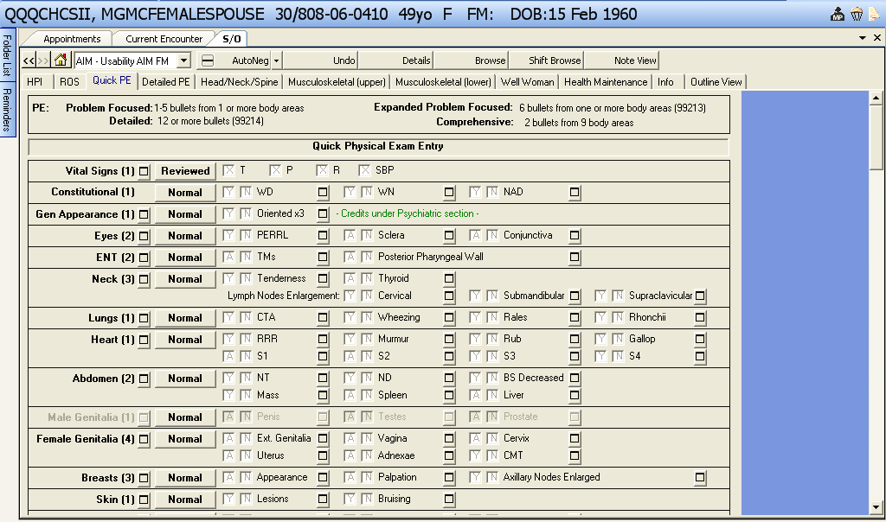
Use the quick entry ‘Normal’ buttons to annotate that all findings listed to the right are normal.

Slide 60
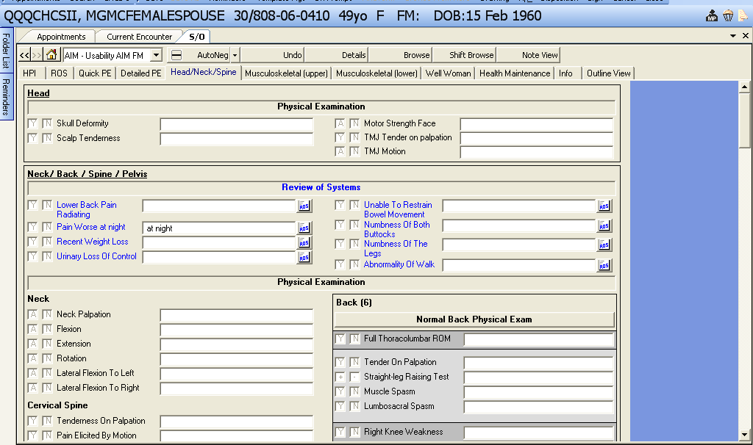
The ROS here helps you document your “Red Flag” items from your low back pain evaluation.

Slide 61
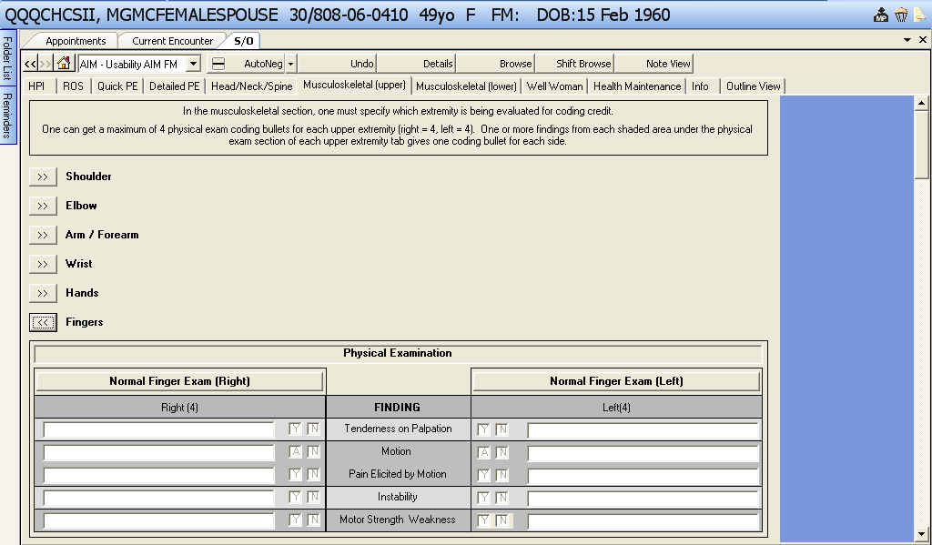
The tab will open up into a review of systems and a physical exam.

Slide 62
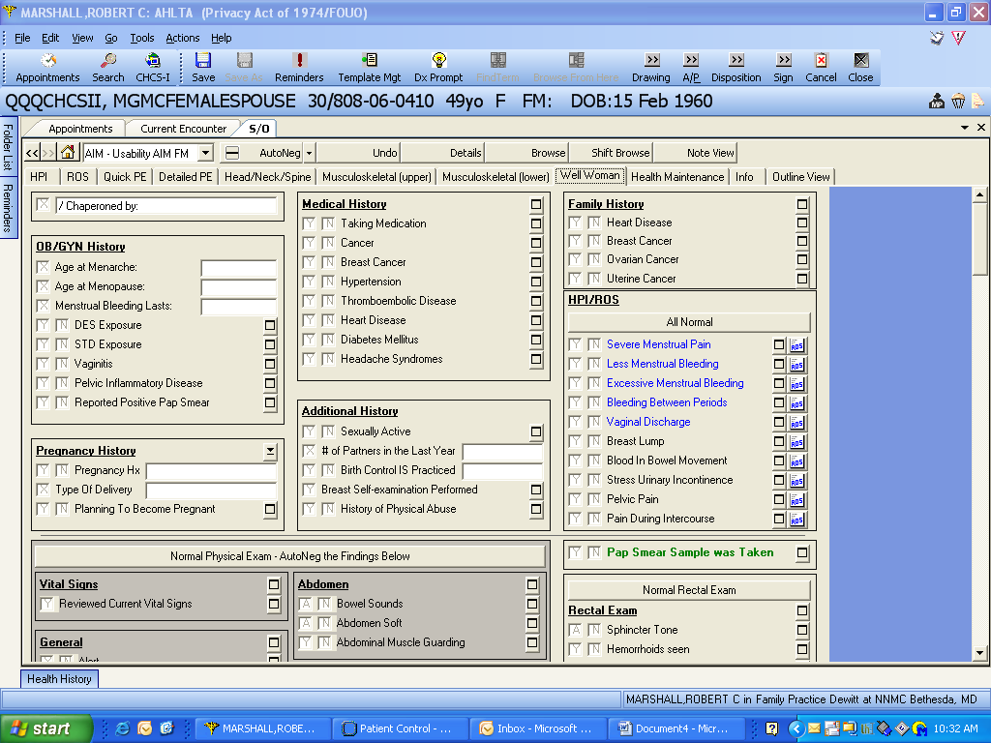
Well Woman Tab: History

Slide 63

This shows the content under the expansion link that allows you to simply edit the existing content to have a completed procedure note in short order.
This shows the upper part of the list for the FM Usability AIM Procedure Form.
There are similar procedure content files for most Usability AIM forms.

Slide 64

This is the lower half of the available procedures on the FM Usability AIM Procedure Form.

Slide 65

Under the GXT/EKG/PFT tab will be these procedures or tests and their content.
Again, clicking on the Arrow box will expand the tab and expose the content. You only need to edit as appropriate.

Slide 66
Getting credit for your work
Specialty E&M coding support
PrevMed pick over Outpatient visit
Choose New vs Existing Patient
Capture ED and inpatient consults
Procedures you do everyday

Slide 67

Open an encounter and click on the Options icon in the toolbar.
Specialty Coding Support

Slide 68

This dialog box opens. Go to the “Exam Type” drop-down and click on the correct type for your specialty.

Slide 69

When you get to the disposition page, the E&M code will reflect the specialty (“Exam Type”) you chose in the Options dialog box.

Slide 70

Prev Med Coding versus standard encounters
Appointments booked in AHLTA as a Wellness visit will default to Preventive Medicine E&M codes. Need to make the wellness component as the primary diagnosis for coding audit purposes.
99213 = 0.92 RVUs; 99391-7 = 1.02-1.71 RVUs
Notes:
No change in documentation, but a change from outpatient service type to Prev Med Eval/Mgmt (well child/well woman) resulted in a change from a level 3 established visit (99213) to the age appropriate Prev Med code (99396) with a significant gain in RVUs. (These visits for babies 99391 = 1.02 RVUs; for over 65 years old 99397 = 1.71 RVU’s!!!). Of course documentation must support this type of visit.

Slide 71

Notes:
Parameters set by system that must be verified and potentially corrected by provider.

Slide 72

The business rules state that a patient is new only if they have not been seen within the MEPRS code during the past three years.
99213 = 0.92 RVUs; 99202 = 0.88 RVUs
Notes:
No change in documentation, but a change from established patient to new resulted in a change from a level 3 established visit (99213) to a level 2 new visit (99202) with a net gain in 0.21 RVUs. (Further documentation of the history is required to justify a level 3 new visit.)

Slide 73
Coding Procedures
Don’t Forget:
PAP Smear (Q0091 – HCPCS)
Clinic lab tests (collection coding)
hCG, rapid strep, injections, vaccinations, biopsy (physician supervised specimen handling – 99000 = 0.05 RVU)
Clinic procedures
ECGs, cryo, cerumen impaction

Slide 74

Tips and Tricks

Slide 75


Slide 76


Slide 77


Slide 78


Slide 79


Slide 80


Slide 81


Slide 82


Slide 83


Slide 84


Slide 85
References
http://www.usafp.org/AHLTA-3_3-Information-FAQs.htm
http://www.usafp.org/USAFP-Main-Feed2.rss
http://www.usafp.org/Dragon-Macro-Library.html
Online classroom training for AHLTA 3.3 https://mhslearn.satx.disa.mil/ilearn/en/learner/jsp/default.htm
http://www.navyahlta.com

Slide 86
Questions??
Notes:
Insert a picture or graphic.
Entertain questions of the group as a whole, delaying provider specific questions to the next part of the presentation.
Next 20 slides are provider specific tips. Consider a break at this point. Require providers to return. Allow any interested non-providers to attend, but release the remainder to the group for an extended break.

Slide 87
Backup Slides

Slide 88

Change all these to 3.3
Default Diagnosis list.
Notes:
This is the default diagnosis list.

Slide 89

Default Procedure list.
Notes:
This is the default procedure list.

Slide 90

Default Therapy list.
Notes:
This is the default Other Therapies list.

Slide 91
How an E&M Code Is Determined Basics of an Outpatient Visit
The visit is made up of 3 components:
[1] Patient History
History of Present Illness (HPI)
Review of Systems (ROS)
Past Family Social History (PFSH)
[2] Physical Examination
[3] Medical Decision Making
Diagnosis/Management Risk
Complexity of Data
Problem Risk
Test Risk
Management Risk
For Established Pts
2 of 3 components are
required to meet the level
for that visit.
For New Pts
All 3 are required

Slide 92
How RVU’s are Determined
A provider’s RVUs are determined primarily by 2 components
Evaluation and Management Code (E&M)
Procedures (CPT and HCPCS codes)

Slide 93


Rules for HPI. Up to 3 elements for a Brief, and an Extended HPI (99214 level) consists of at least 4 of 8 elements from the list.
Tip:
Remember DSMA: D = Duration S = Severity M = Modifying Factors A = Associated Sx’s
DSMA Makes sense on every patient with a chronic disease. And easily done on all visits.
Ex1. Extended HPI: Diabetes for 6 years. He is on oral medications. He is taking his medications, exercising and watching his diet. He has no numbness or tingling in his feet or legs.
Ex2. Extended HPI: Patient complains of dull ache in right ear over the past 24 hours. Patient states he went swimming two days ago. Symptoms somewhat relieved by warm compress and Tylenol.
Note: 95/97 coding guidelines say your staff can enter this for you.

Slide 94
Sample E&M RVU Numbers
New vs. Established (more points for new patients)
Primary Care and Family Medicine are DIFFERENT clinics.
E&M Codes New/EST
99212 (Prob Focused) 0.45/0.45 RVU
99213 (Expanded Prob Focused) 0.88/0.67 RVU
99214 (Moderate Complexity) 1.34/1.10 RVU
99215 (High Complexity) 2.67/1.77 RVU

Slide 95
Sample E&M RVU Numbers
Preventive Medicine Visits New/EST
99381/91 (Prev Med 0-1 yo) 1.19/1.02 RVU
99382/92 (PM 1-11 yo) 1.36/1.19 RVU
99385/95 (PM 18-39 yo) 1.53/1.36 RVU
99386/96 (PM 40-64) 1.88/1.53 RVU

Slide 96
What About Procedures?
Correct documentation of procedures are ESSENTIAL!
Procedure RVU’s are added to the E&M code
Ex: Visit for impaired hearing (E&M 99213 RVU = 0.67) + ear wax removal (RVU = 0.61). TOTAL = 1.28 RVU
IMPORTANT: Providers can receive credit for procedures done by ancillary staff.

Slide 97
What About Procedures?
A Properly Coded Well Woman Exam can yield big RVU’s:
E&M Prev Med visit (99395) = 1.36 RVU
Procedure: Screening Pap Smear (HCPCS Q0091) = 0.37 RUV,
1.73 RVU for a 30 minute appt.

Slide 98
Sample Procedure RVUs
Circumcision 1.81 RVU
Ear Wax Removal 0.61 RVU
Excision of Skin Tags 0.77 RVU
I&D Abscess 1.17 RVU
Punch Biopsy 0.81 RVU
IV Fluid, 1 hour 0.17 RVU
Nebulizer Treatment 0.32 RVU
EKG Reading 0.17 RVU
Cryotherapy of skin 0.76 RVU
Screening Pap by Physician 0.37 RVU
IM/SC Injection 0.17 RVU
Oxygen Sat Reading 0.04 RVU

Slide 99

Preventive Medicine Visits
There are different E&M codes for preventive medicine visits (well woman, well child).
These visits usually result in more RVU’s and assume a comprehensive history and physical. These are age based which CHCS II does automatically calculate
Again, you have to manually select this, by selecting PREV MED EVAL/MGT from drop down menu.
A 99214 (Outpt visit, existing patient) = 1.1 RVU
A 99395 (Prev Med visit, existing patient) = 1.36 RVU
A 26% RVU increase!!!

