Slide 1
Use of Copy Forward For Past Medical History in the Tri-Service (or COMPASS) AIM Form
Workflow Integration & Business Process Reengineering Division
Office of the Chief Information Officer
AFMSA/SG6
19 Jan 2011

Slide 2
Critical Assumptions
You must Copy Forward from a compatible AIM form (same form, same version)
For example, you started using the Tri-Service AIM form (or COMPASS Core 2.0 AIM) on 10 Jan 2011, then you can Copy Forward from previous encounters dated 10 Jan 2011 forward. 9 Jan 2011 (and prior) encounters will NOT Copy Forward correctly
DO NOT ENTER S/O UNTIL AFTER COPYING FORWARD PRIOR ENCOUNTER
DO NOT MAKE EDITS IN THE COPY FORWARD TEMPLATE
DO NOT ENTER INFORMATION FROM THE MEDCIN LIST TEMPLATES AND THEN ATTEMPT TO COPY FORWARD INTO THE TRI-SERVICE AIM (or COMPASS AIM) FORM (i.e., PFSH information must be entered into the Tri-Service AIM form and not in the Medcin List Templates)
If these conditions are NOT met, then you must highlight areas with mouse in the Previous Encounter and use ‘Ctrl C’ command and then ‘Ctrl V’ to paste into the new encounter (using Notepad to park multiple pastes will save time when going back to paste into the current encounter)

Slide 3
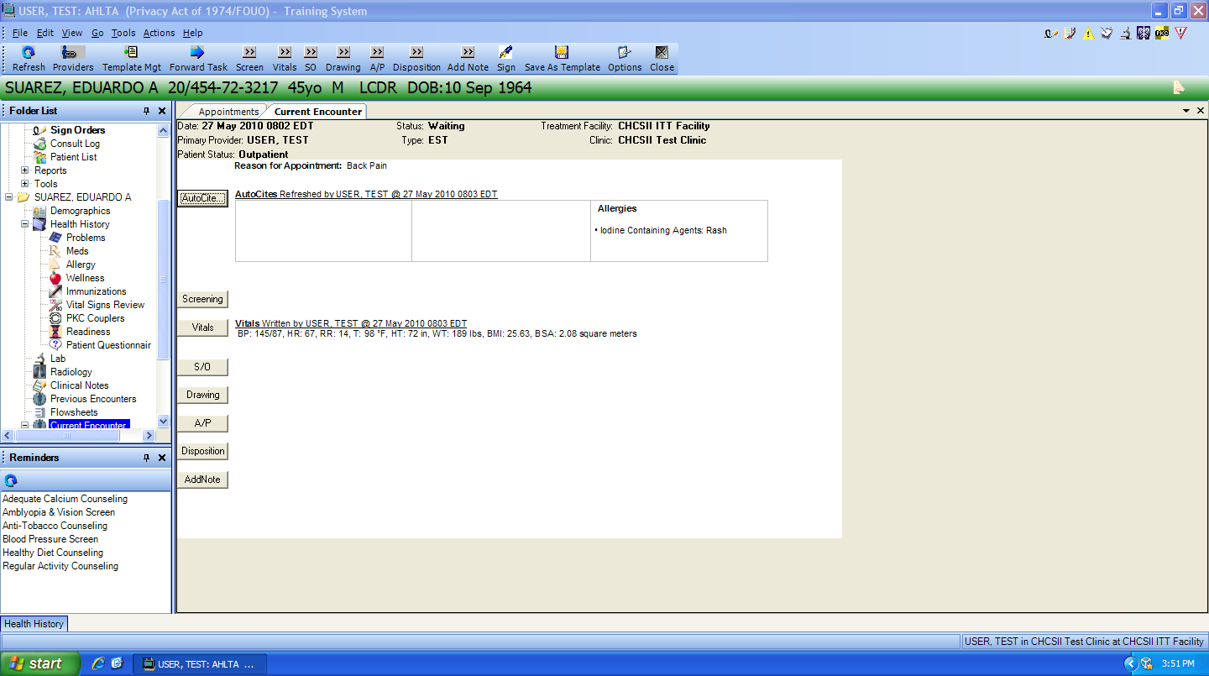
Double-Click on Patient in Appt view -this takes you to the view on this slide
NOTE: DO NOT OPEN S/O UNTIL AFTER COPYING FORWARD PRIOR ENCOUNTER!!

Slide 4
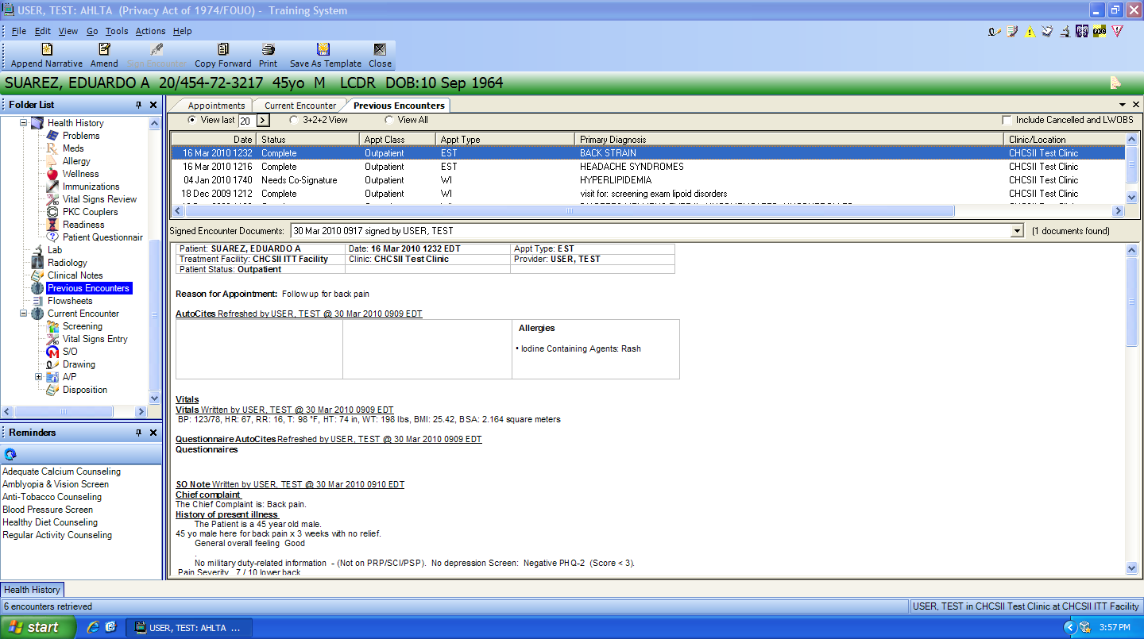
Select Previous Encounter to Copy Forward (click on previous encounters, scroll through them to find the one you want; it needs to be from your clinic), click “Copy Forward”

Slide 5
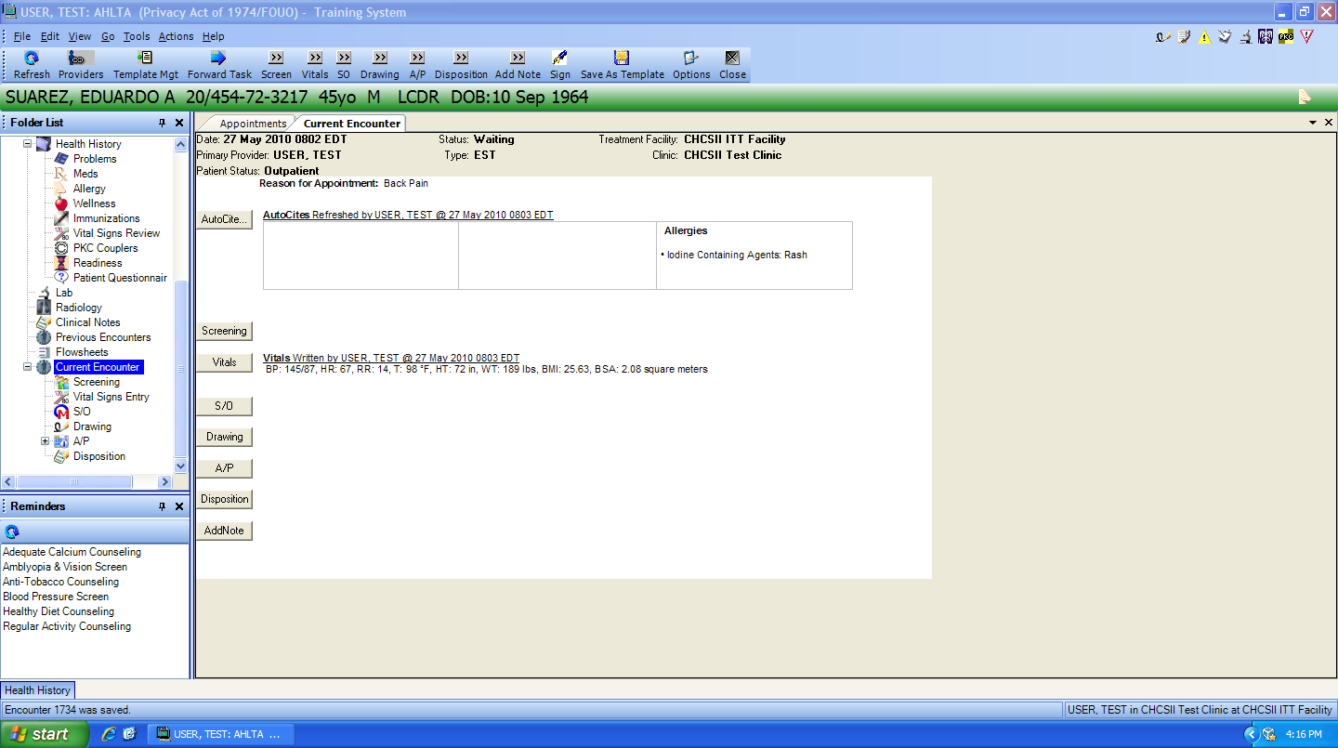
Now click on “Copy Forward” –AHLTA returns to the screen on this slide, then click on “S/O”

Slide 6
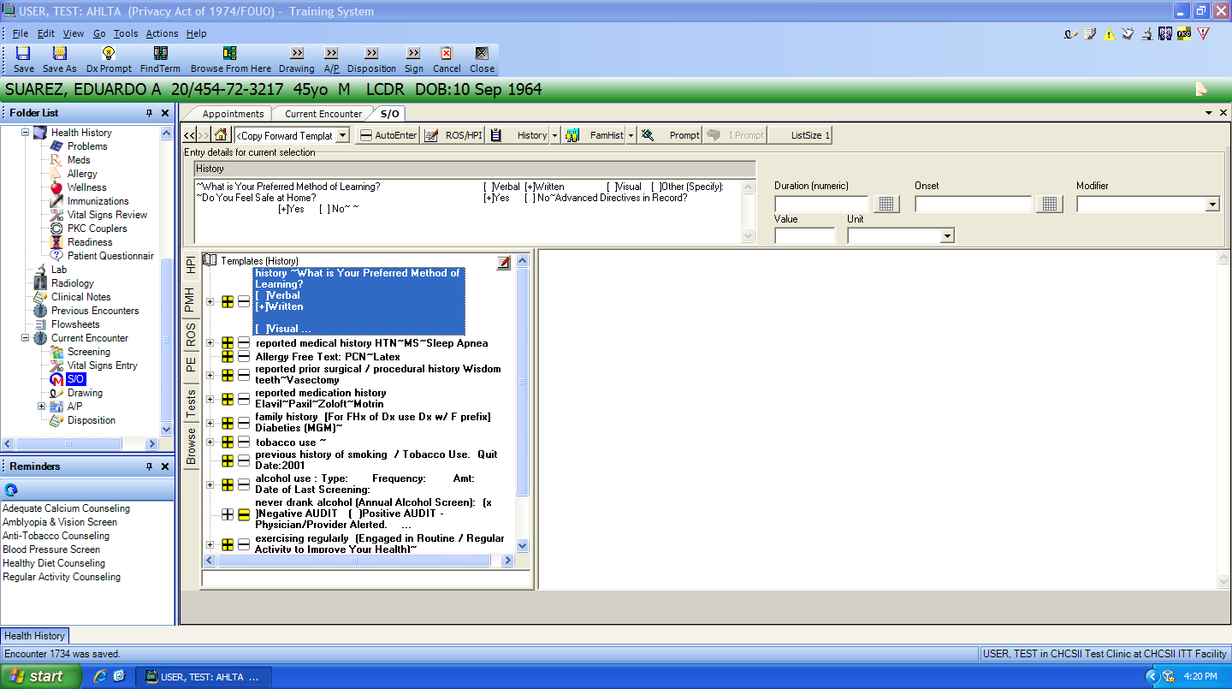
Notice “Copy Forward Template" below the patient’s name as the template. Select PMH Tab, note “yellow boxes” by pertinent items
Copy forward ONLY from the PMH tab unless specifically directed to do otherwise

Slide 7
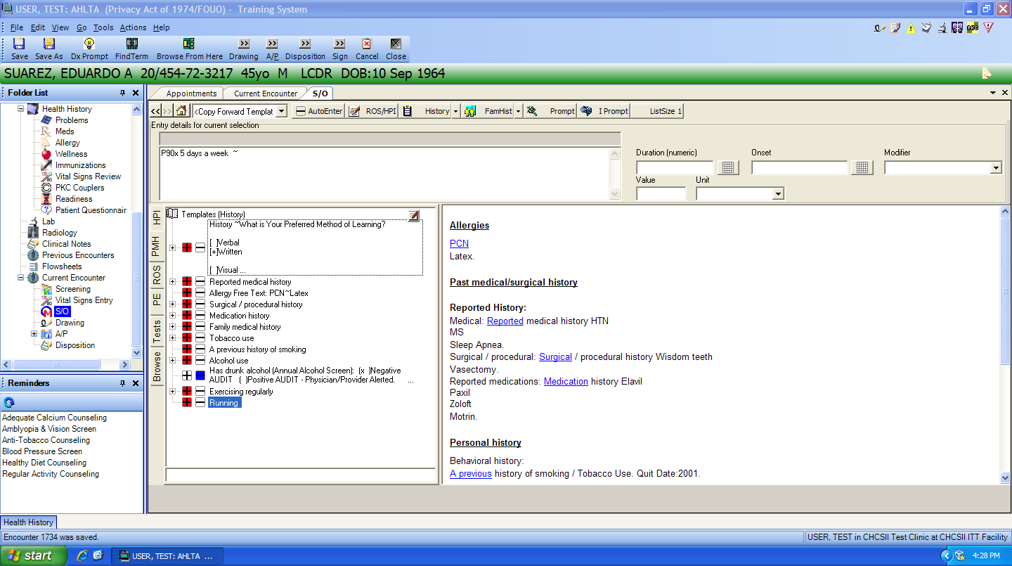
Select “AutoEnter” and all of the yellow boxes are entered into AHLTA.
DO NOT MAKE ANY EDITS WITHIN THE COPY FORWORD TEMPLATE!
NO EDITS HERE!!
NO EDITS HERE!!

Slide 8
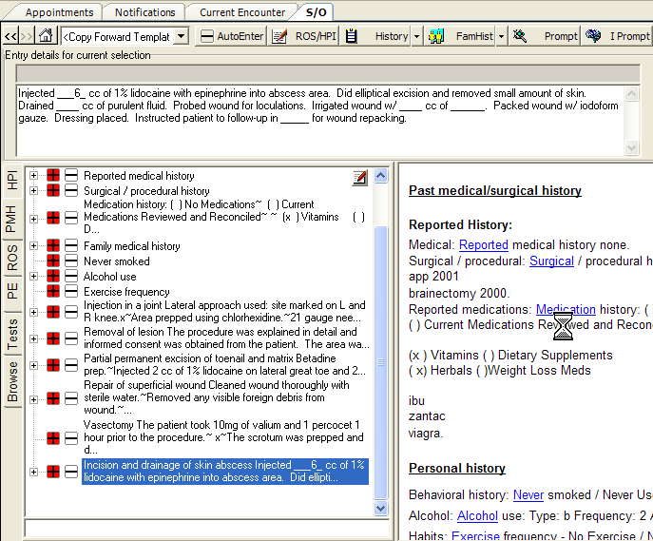
Here is an example of various procedures that have been done on a patient documented with the COMPASS Procedure AIM form. It was decided to copy forward from this note. After “AutoEnter” has been selected, the yellow “+” will change to red “+”. These must be selected to clear them otherwise they will be copied forward as well.

Slide 9
2. Now, select your Compass Encounter Template or COMPASS AIM form from the drop down Favorites window, and you’ll see the items you copied forward.
NO EDITS HERE!!
NO EDITS HERE!!

Slide 10
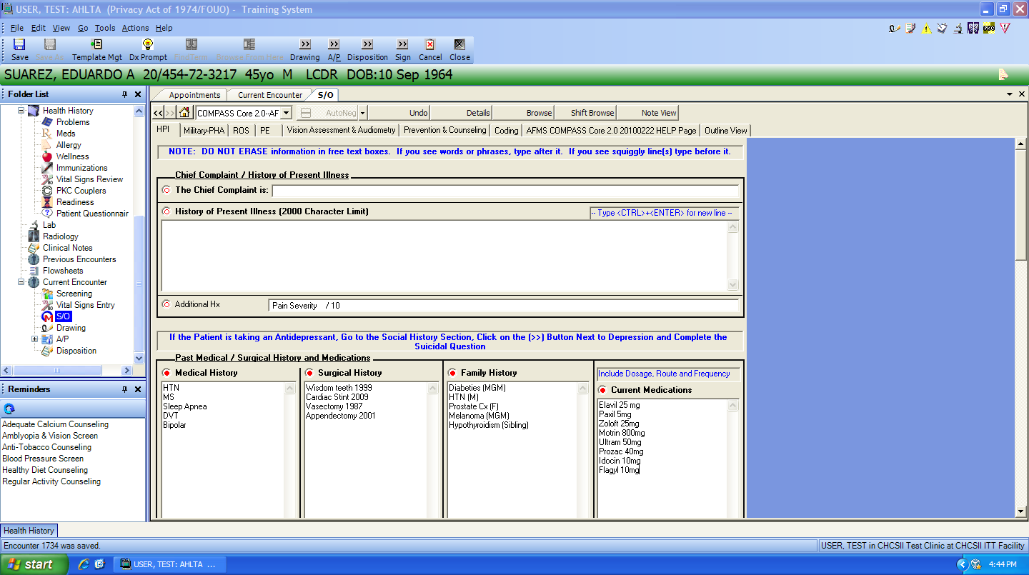
YOU CAN EDIT IN THIS TEMPLATE
Remember: You MUST review the fields copied forward within the AIM template and update this information for today’s visit
MAKE EDITS IN HERE

Slide 11
Backup slides

Slide 12
Tutorial on Copy & paste in AHLTA (the “hard Way”)

Slide 13
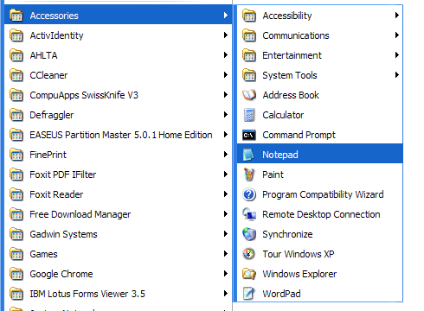
Step 1. In Windows, go to “Programs”, then “Accessories” then select “Notepad”. Notepad serves as a parking lot for multiple pastes from AHLTA so it will not be necessary to go back and forth from Previous Encounters to AHLTA

Slide 14
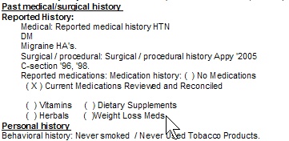
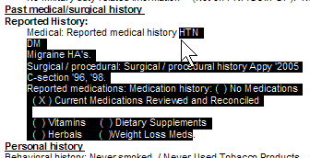

Step 2. Bring up the “Current Encounter” view for the patient needing the previous encounter information copied and then Go to “Previous Encounters” folder and select the note that you want to copy from
Step 3. Use your mouse and position the pointer at the bottom and to the right of where you want to begin copying (yes, this is opposite from the usual way to copy with a mouse- remember, it’s AHLTA!) and then drag to the left and up. Hit “Ctrl C” on your keyboard- this copies the selection. Now, select Notepad and put cursor in it and then hit “Ctrl V” on keyboard and this pastes into Notepad. Go back to the Previous Encounter and copy whatever else needing transfer to patient’s note today. In this example, Family history was chosen next and copied in same manner and then pasted into Notepad just like above.
Finish copy here
Start to copy here

Slide 15
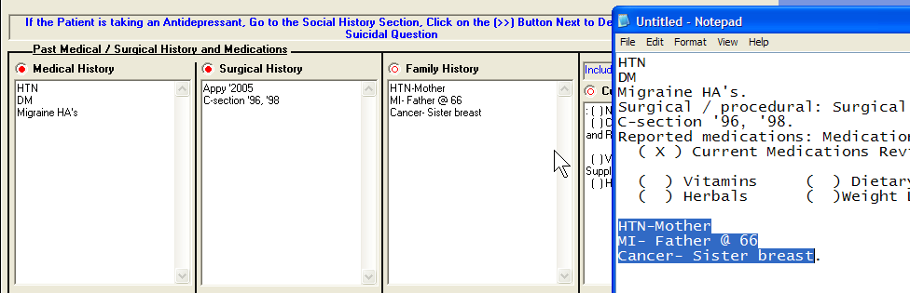
Step 4. Now several selections have been copied to Notepad which await pasting into appropriate sections of today’s AHLTA note. Now begin selecting the various sections of the notes from Notepad and with “Ctrl C” and “Ctrl V”, place into the proper places in AHLTA
These have already been copied & pasted from Notepad
This demonstrates use of “Ctrl C” and then “Ctrl V”

