Slide 1
eProfiles via AHLTA How To

Slide 2
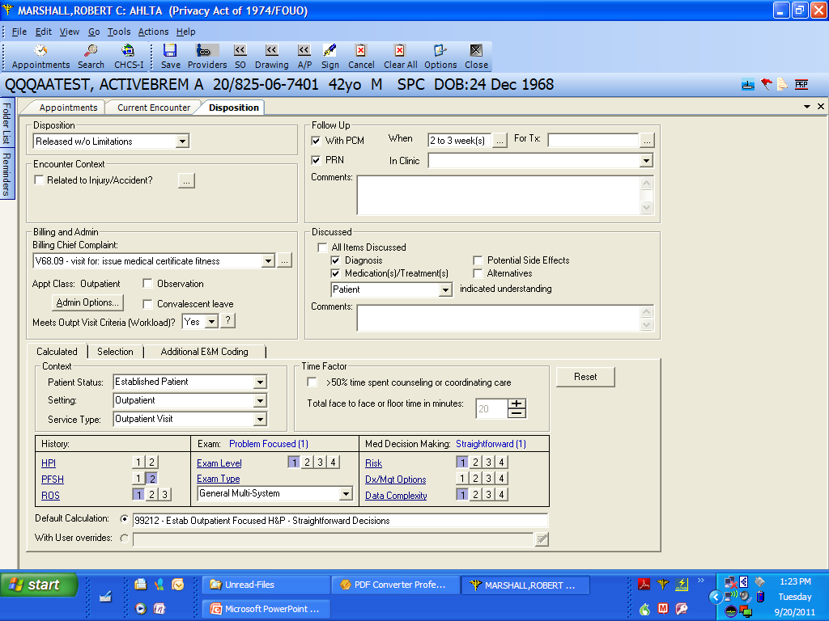
When you go to the Disposition screen in AHLTA, you can use the drop-down menu here to specify condition at release.

Slide 3
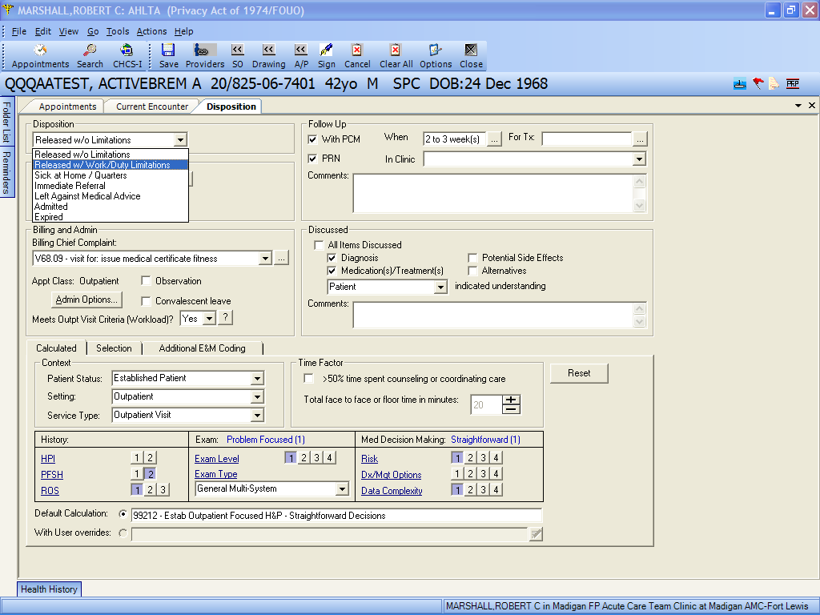
If you use the disposition “Released with Work/Duty Limitations”, you must provide the patient a Profile…Temporary or Permanent.

Slide 4
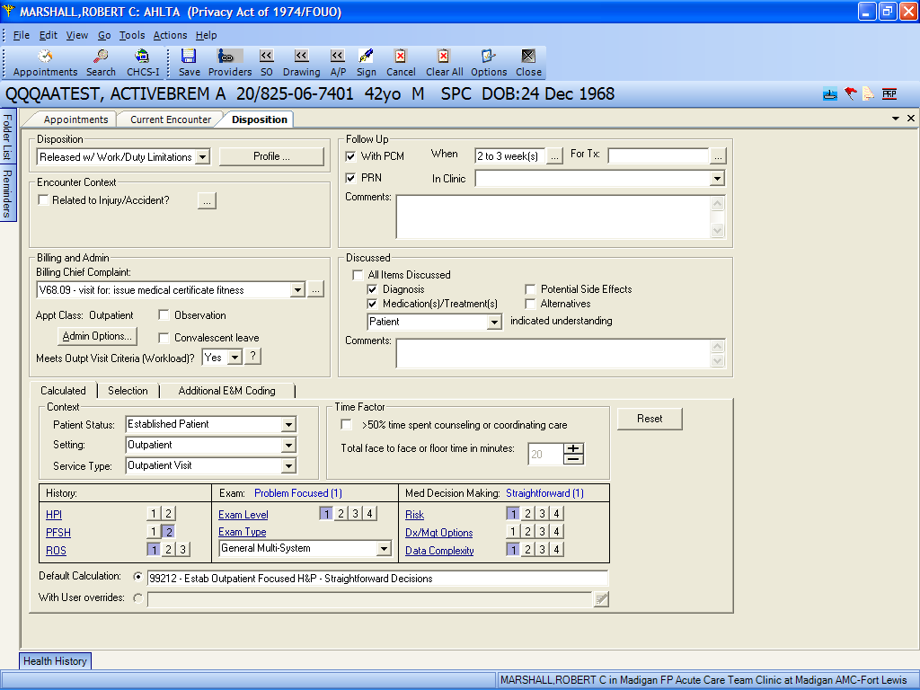
Previously, you could click on this box to create a Profile within AHLTA. That is no longer allowed in the AMEDD. You must use the eProfile system.

Slide 5
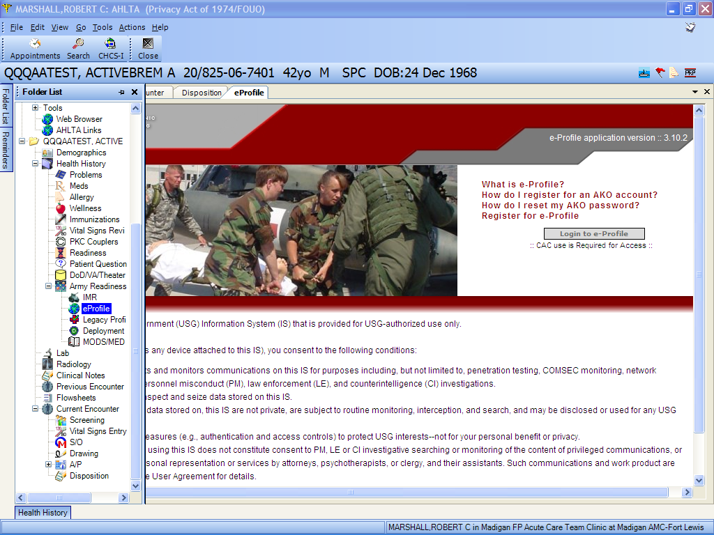
To access the eProfile system , you can go here in the Folder List or use the menu method on the next slide. This screen pops up inside AHLTA. If you have not previously registered for eProfile access, you must do so before you can use the system.

Slide 6
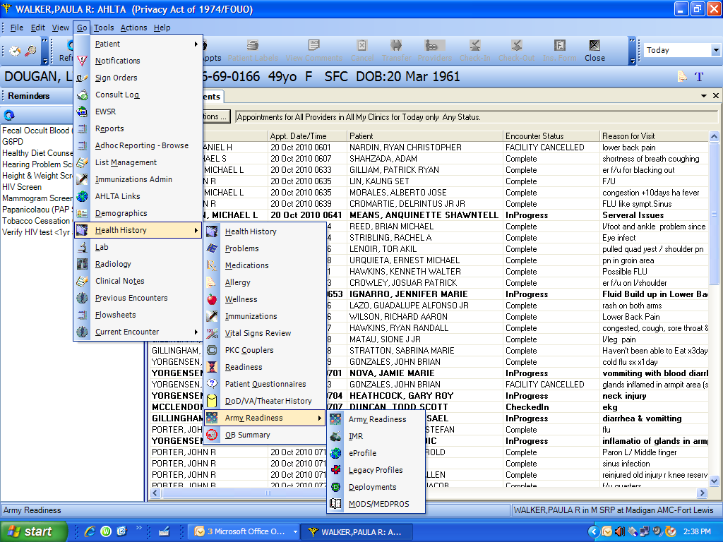
I am already registered for eProfiles
From the top menu, click on Go → Health History → Army Readiness → eProfile to open the eProfile web window

Slide 7
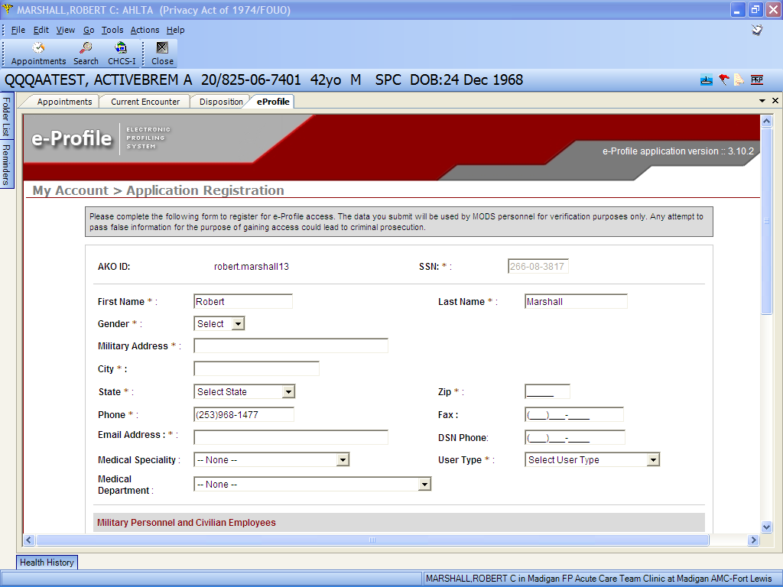
Skip this page if you are already registered for eProfiles
If you have not yet registered to use the eProfiles application, you will use this screen to do so. This is for both Active Duty and civilian users.

Slide 8
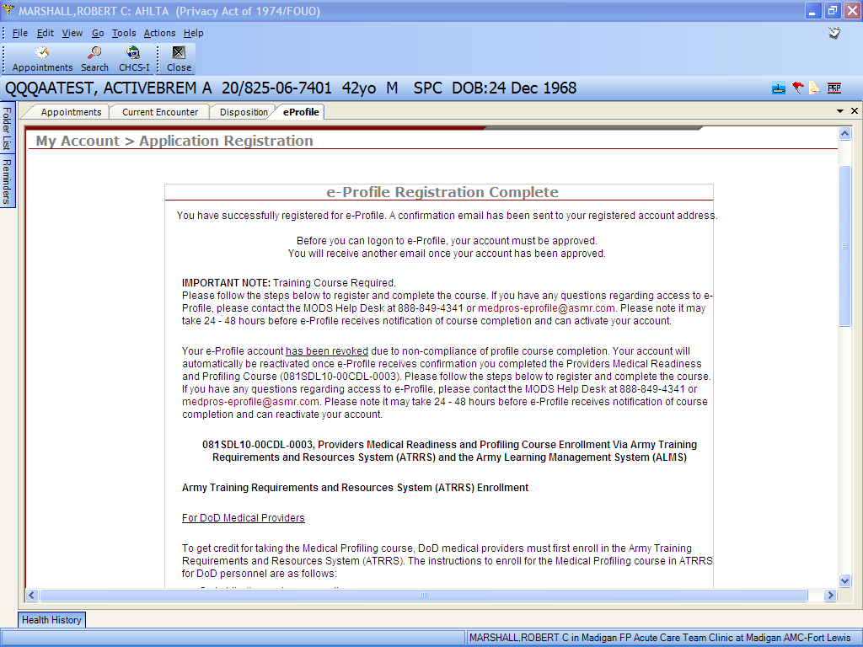
Skip this page if you are already registered for eProfiles
Once registration is complete, you must go through online training before you can access the system. It may take up to 24 hours to gain access to training and/or the system.

Slide 9
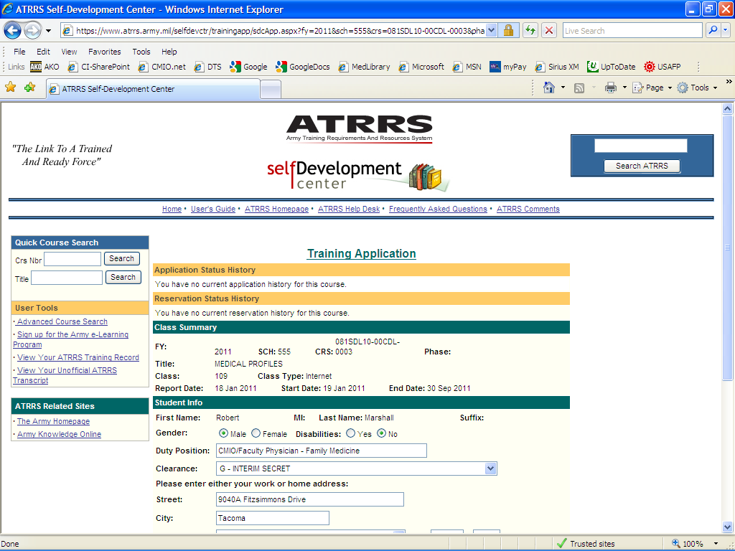
Skip this page if you are already registered for eProfiles
This is the page to apply for the Medical Profiles training.

Slide 10
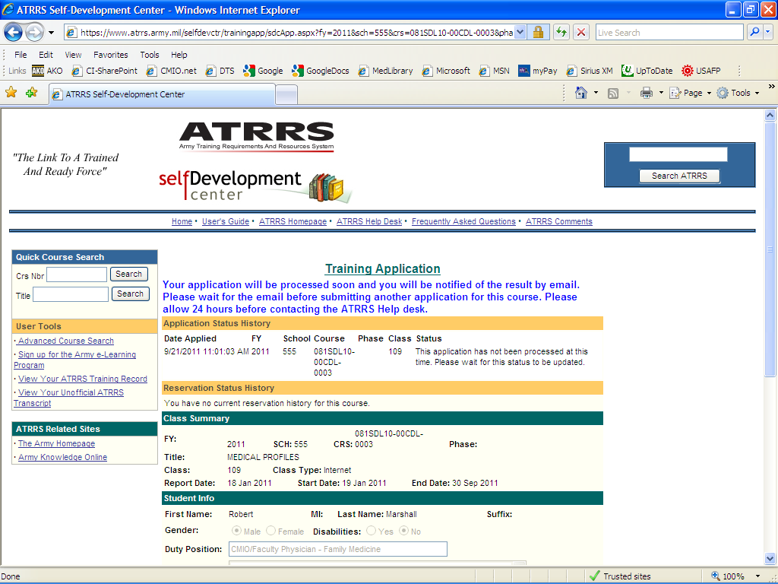
Skip this page if you are already registered for eProfiles
As noted, it may take up to 24 hours (usually less…like 1-3 hours) to gain access to the course at the ALMS site.

Slide 11
Once you have successfully registered for eProfile access and completed training, you will be granted access to the application. You will come back to this screen and log in using your CAC.

Slide 12
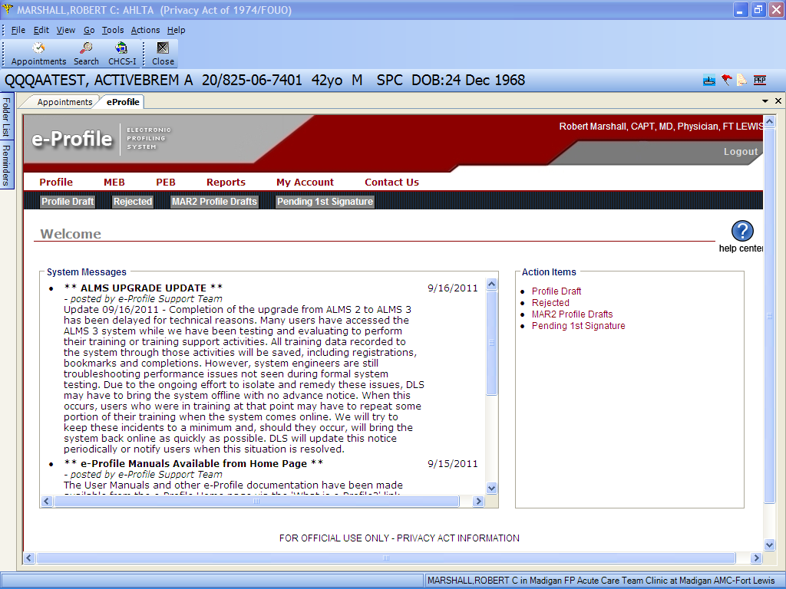
Once you have gone through the several screens to log in, you will come to this page, which has several menu items, System Messages and Action Items. In most cases, you will click on the Profile menu item.

Slide 13
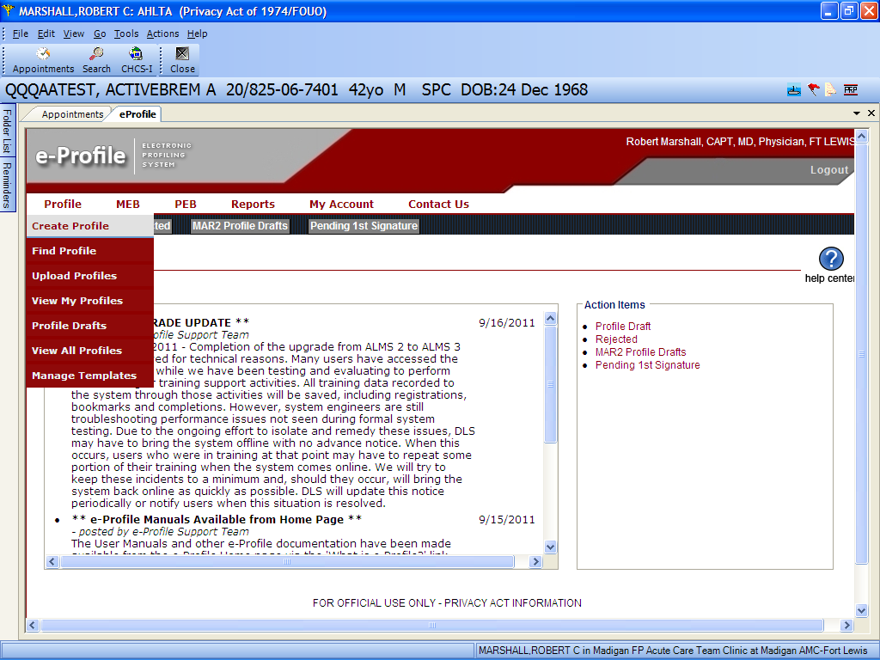
A drop-down menu with multiple choices will appear. In most cases, you will use the Create Profile choice as highlighted.

Slide 14
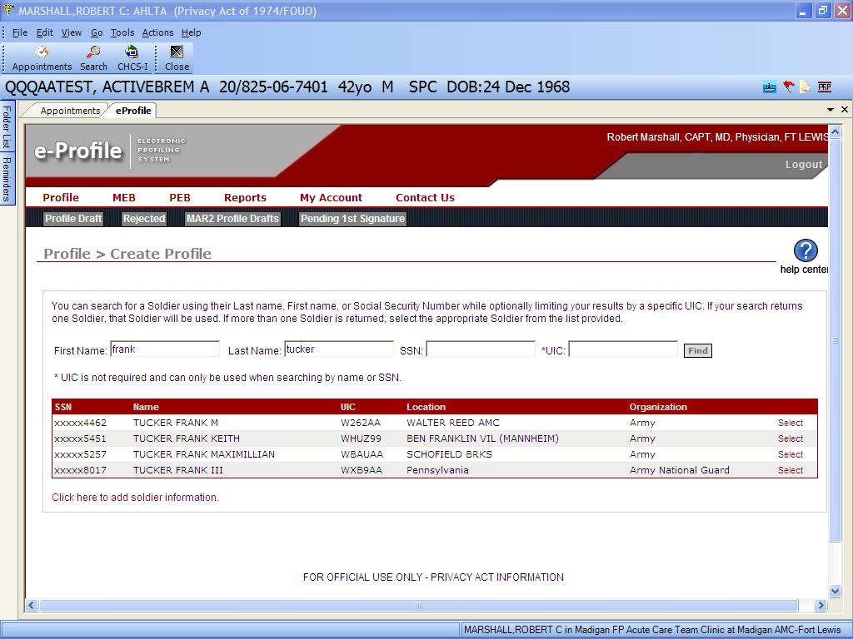
This menu will appear, allowing you to search for a soldier by name +/- UIC, SSN +/- UIC or Name + SSN +/- UIC. The list will show all potential matches.

Slide 15
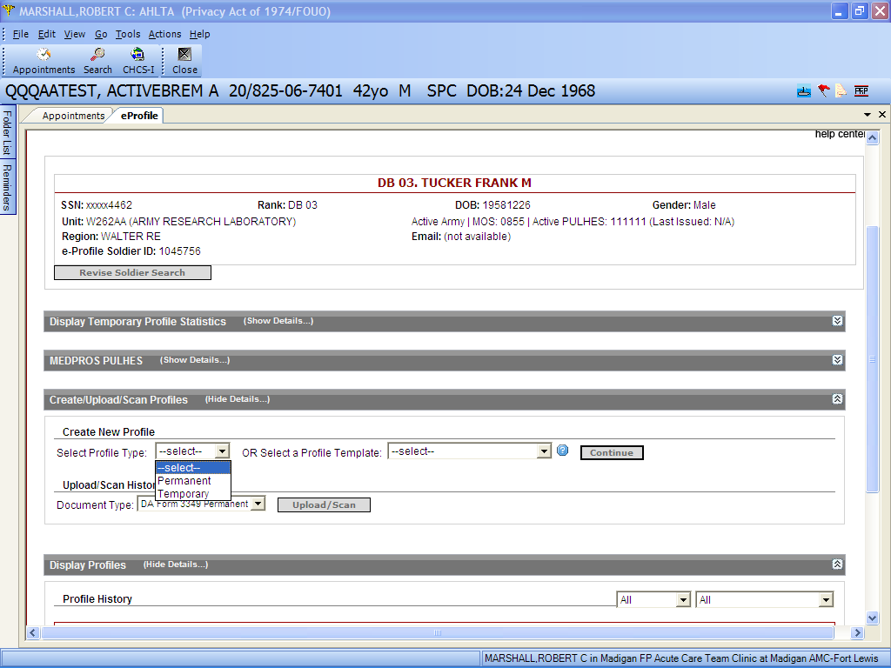
Once you have chosen your patient to profile, this initial screen appears to allow you to pick a previous profile or to create a new profile based on profile type or by using an existing profile template

Slide 16
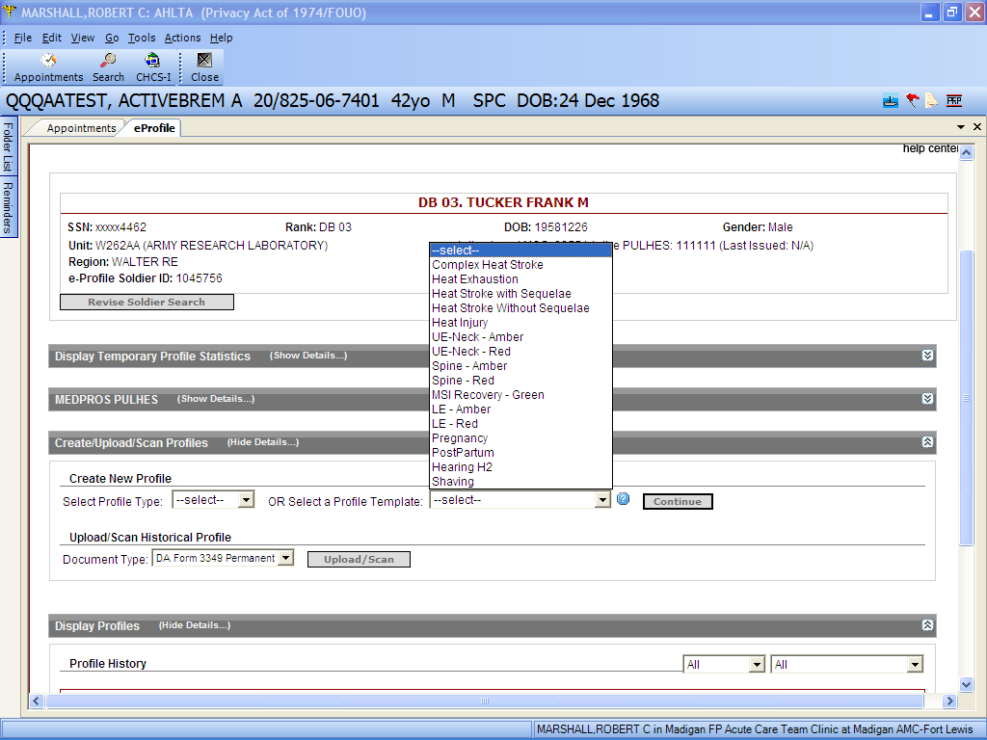
Here is the list of existing profile templates. This covers many of the typical reasons for and types of profiles.

Slide 17
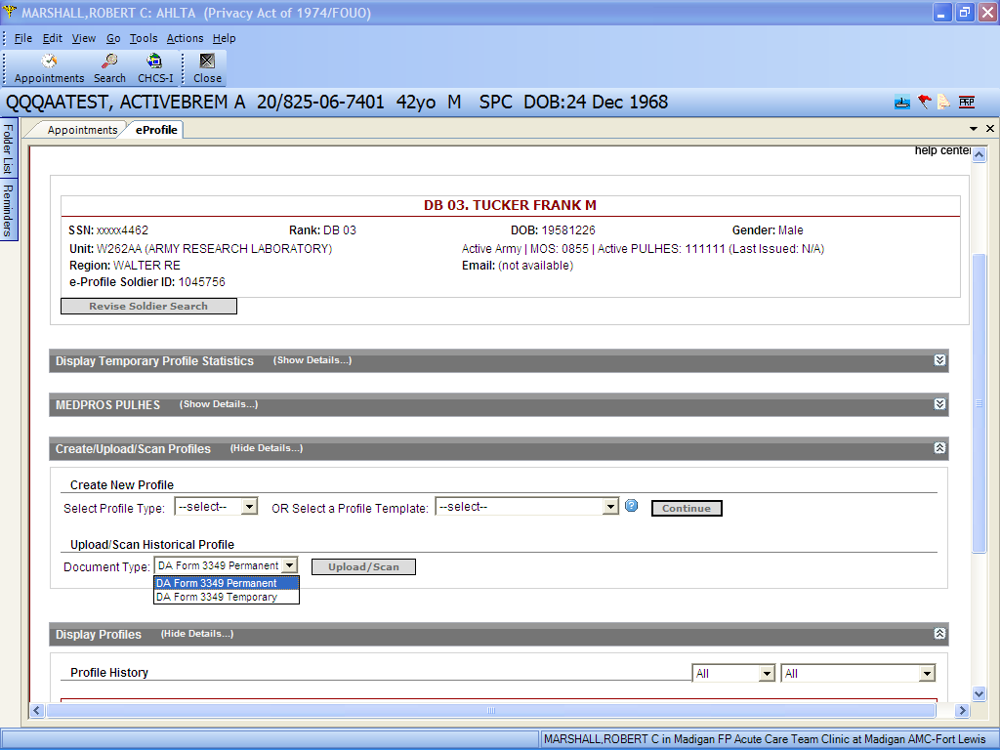
If you have an existing paper or AHLTA legacy profile, you can upload or scan it into this system using this dropdown and button

Slide 18
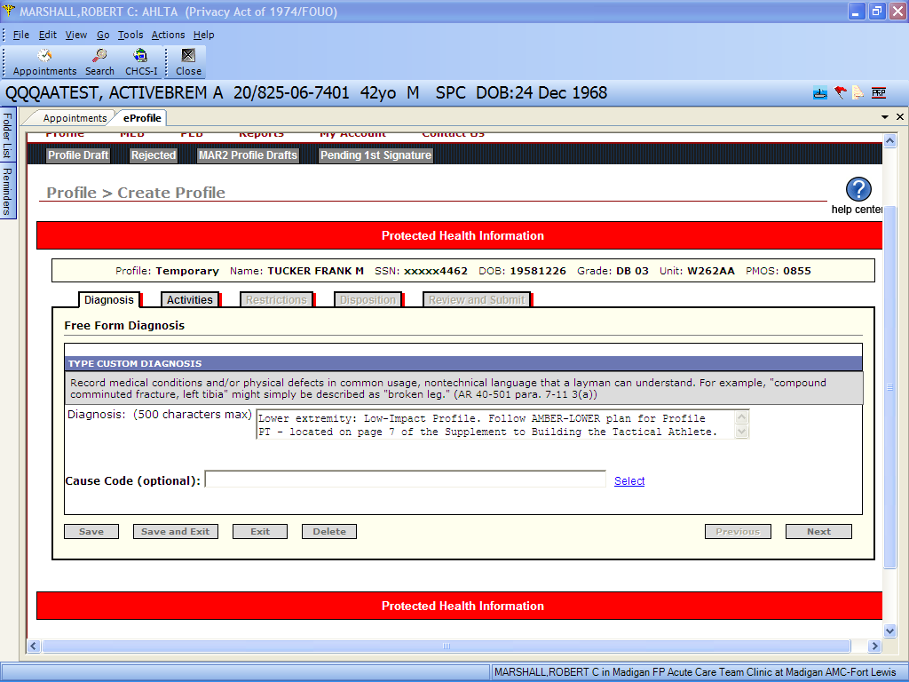
There are five tabs/sections to complete for each profile. You must complete each one and hit the next button to go to the next section. Other actions are available from the buttons on the bottom.

Slide 19
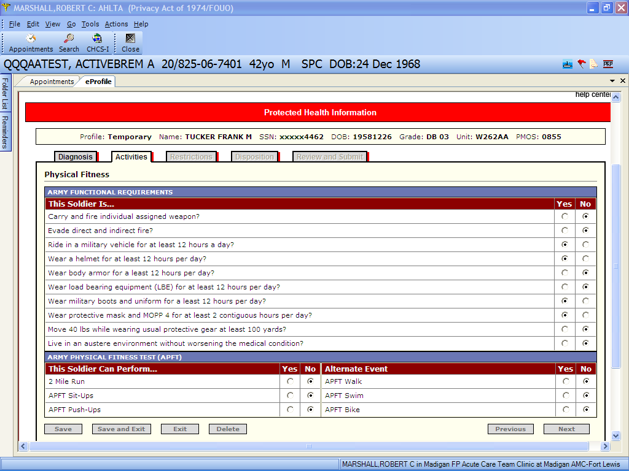

Slide 20
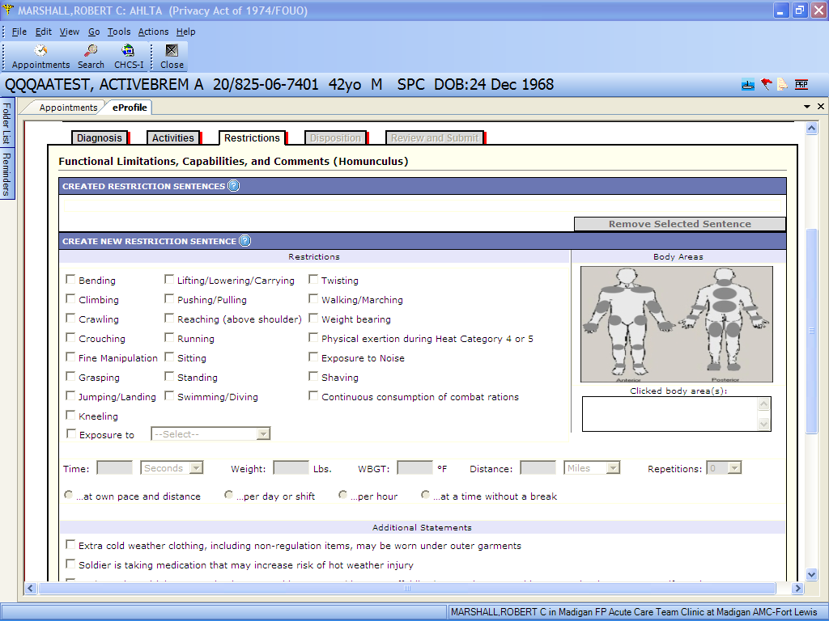

Slide 21
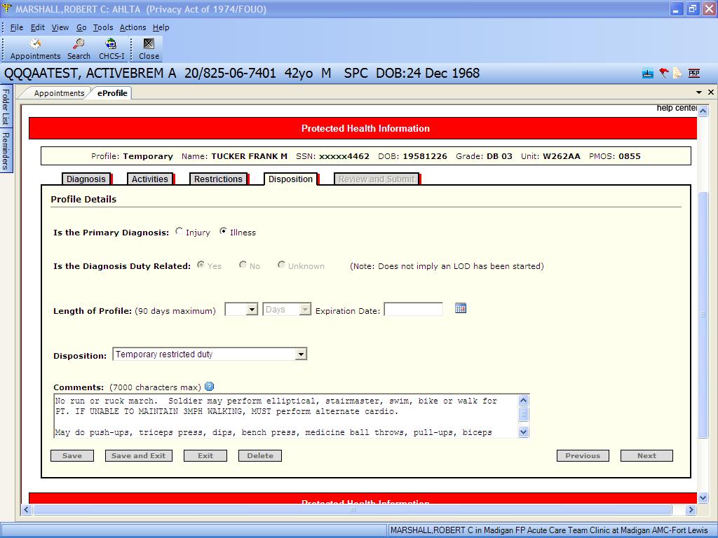
Before you can leave this section, you must provide an expiration date for the profile. The length is automatically calculated.

Slide 22
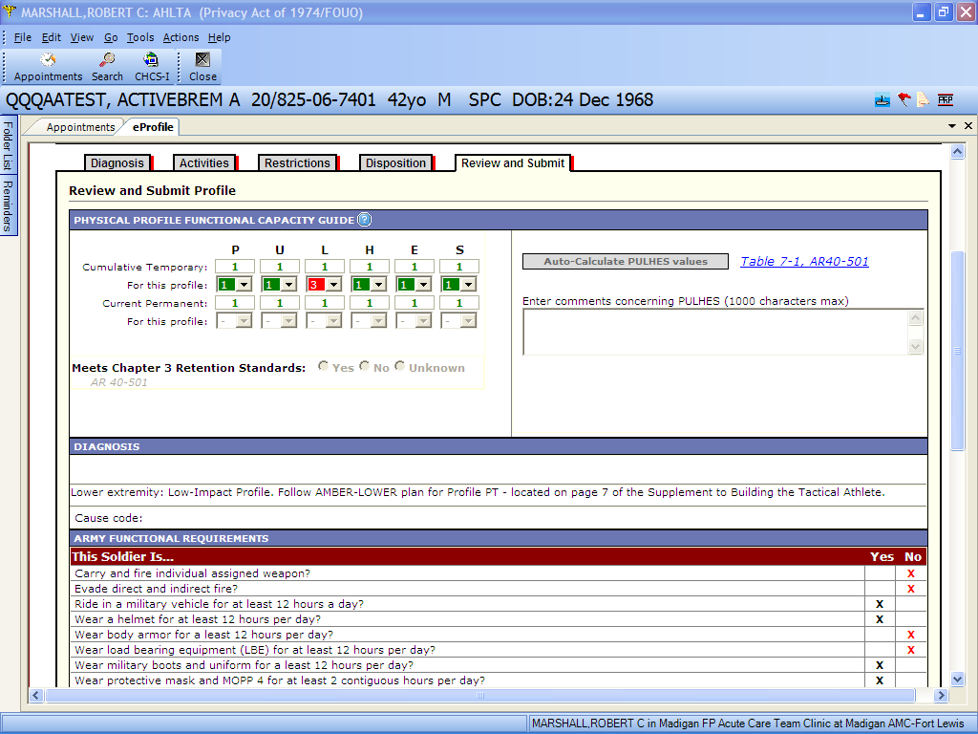
This is the review and submit page. You can use the template PULHES values or auto-calculate based on what you entered/changed. You can also add comments. Scroll down to submit.

Slide 23
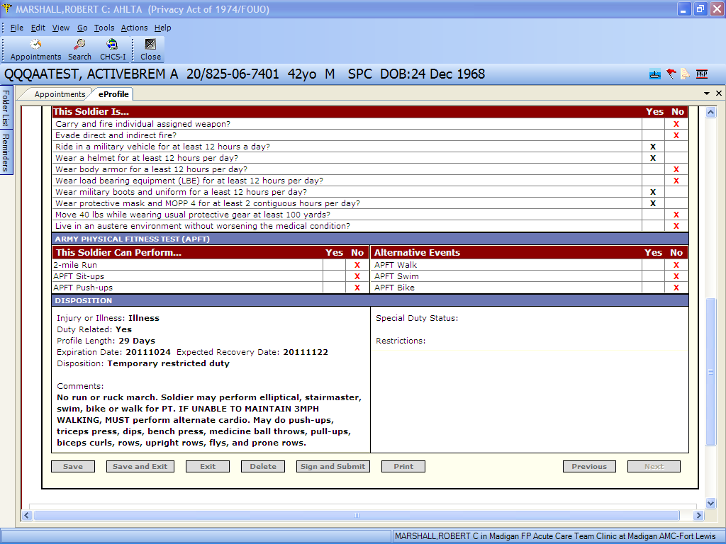
Once you have reviewed the profile and are satisfied, you have multiple action options. The minimum should be to Sign and Submit and Print a copy for the soldier.

Slide 24
Final Words
The AHLTA-based profiles are no longer permitted
For questions regarding eProfiles (including problems), please go here: paula.walker1@us.army.mil
eProfiles templates are created and managed centrally – if you feel you need new central templates, please contact Ms. Walker
You can edit and save templates locally, but they will not be shared outside your personal list

