Slide 1
Problem List Management in A/P Module
The fastest and easiest way to manage your patients’ Problem List

Slide 2
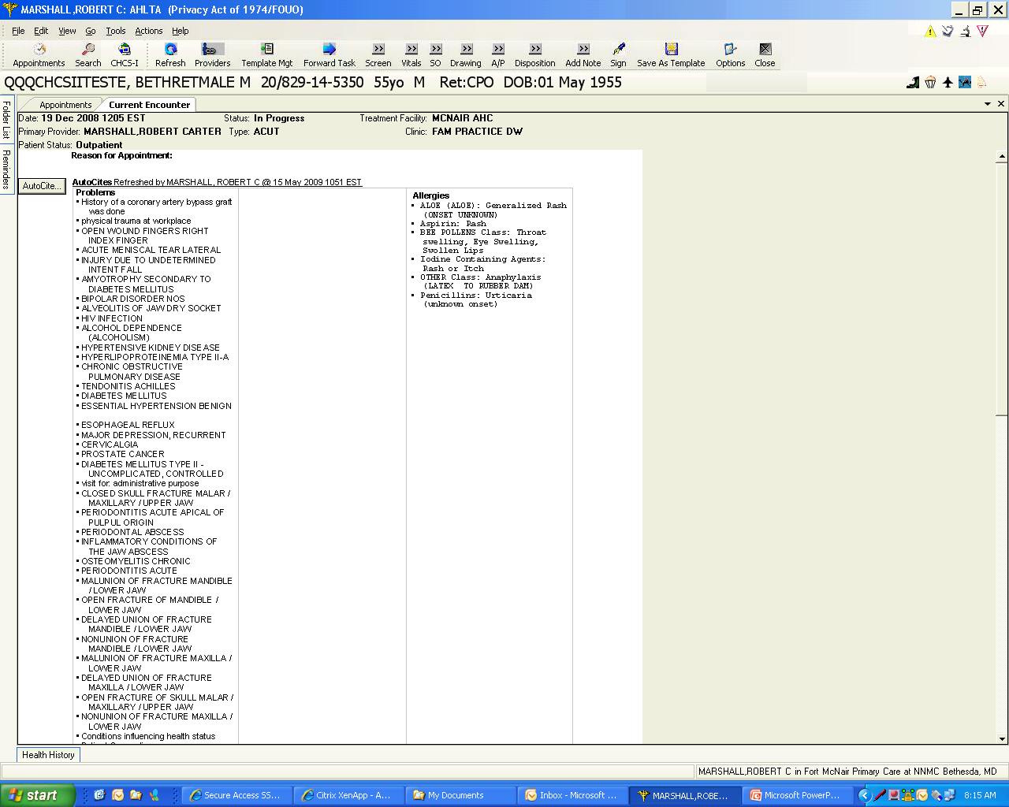
This is a prime example of an out-of-control Problem List that needs management. This could take forever with the Problems Module. However, there is a faster and easier option.

Slide 3
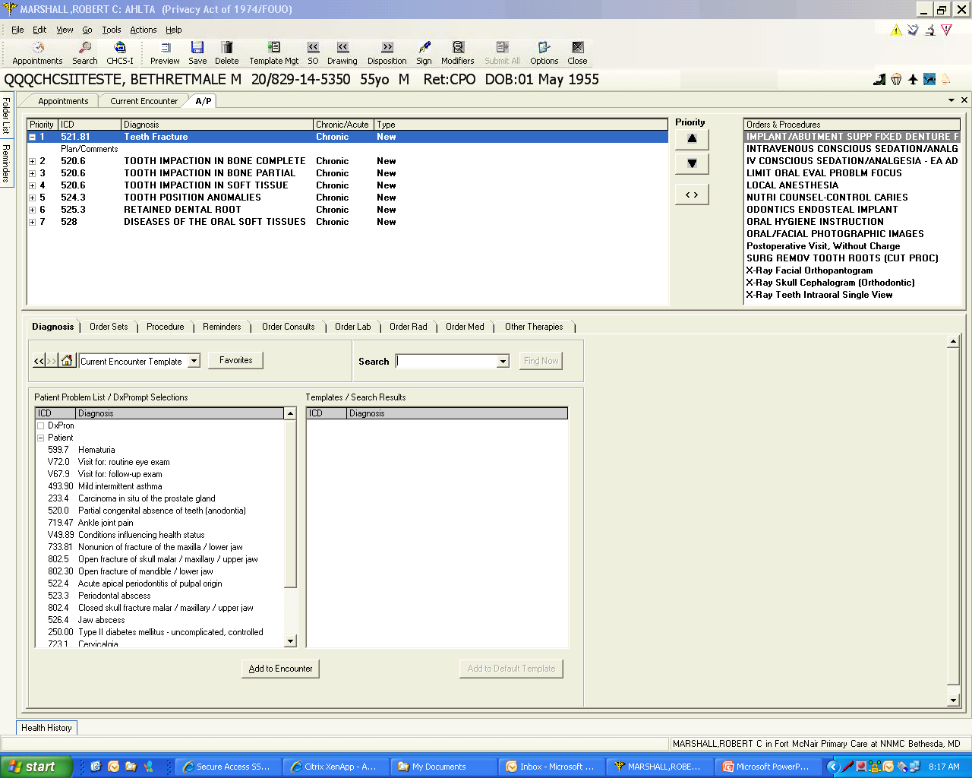
In AHLTA 3.3 and above, the Problem List can be easily managed from the A/P Module. On the left is the patient’s Problem List.

Slide 4
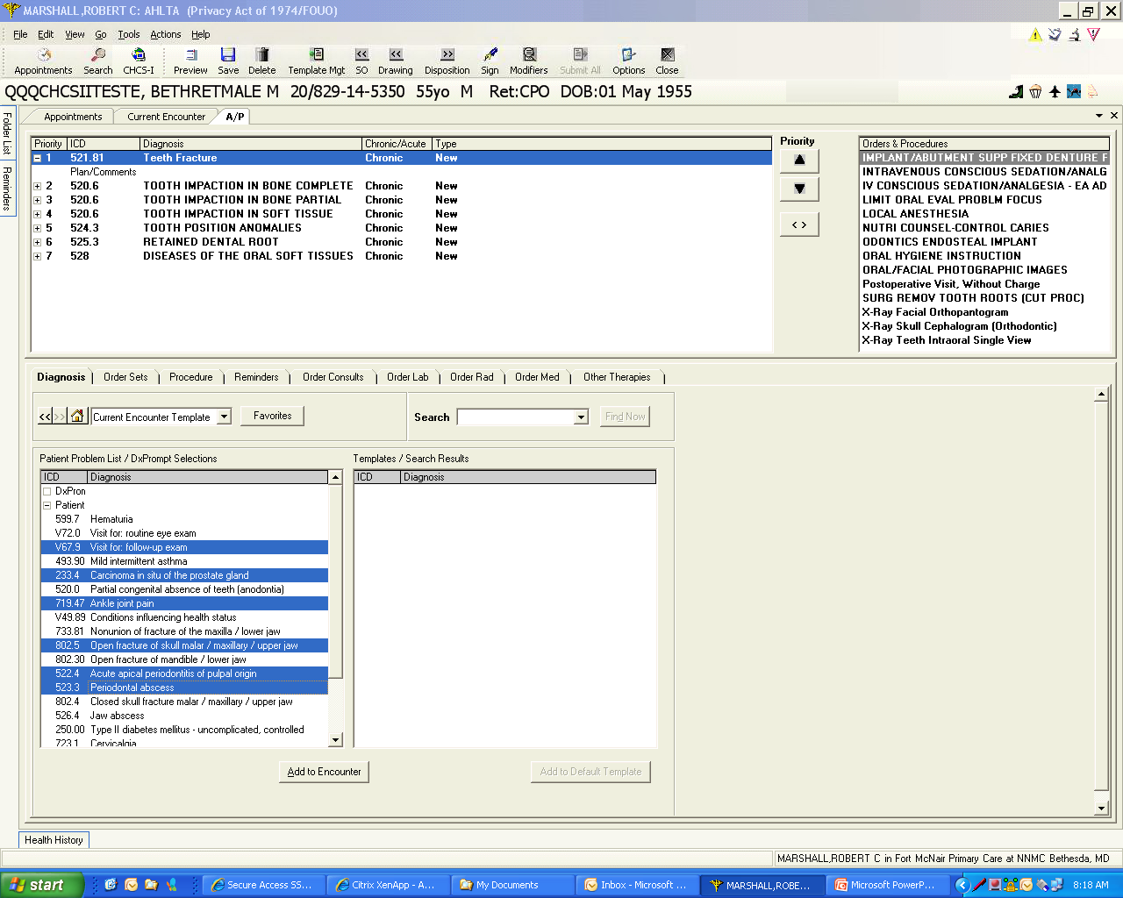
By depressing Ctrl on the keyboard and simultaneously left mouse clicking on any problem, you can quickly select non-continuous problems for management.

Slide 5
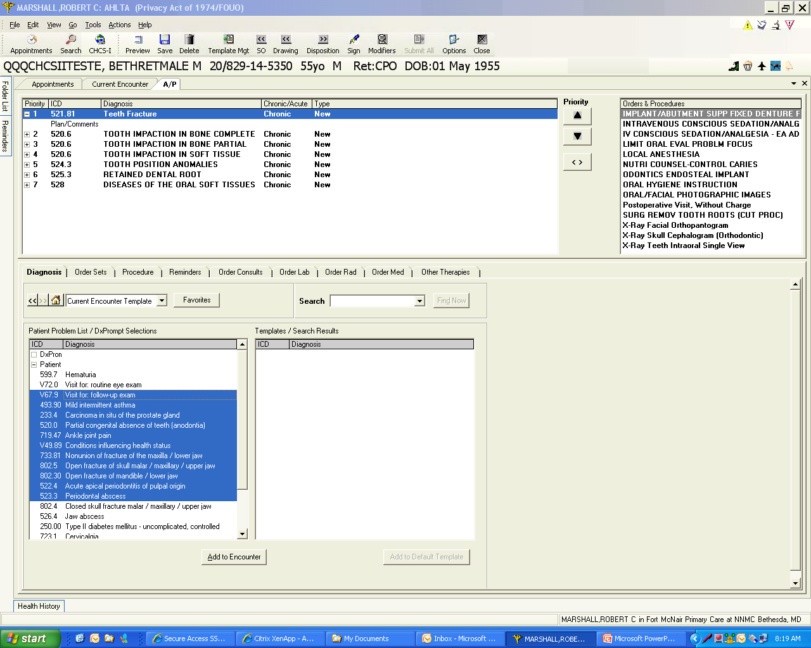
By depressing Shift on the keyboard and left clicking with the mouse, you can rapidly select any number of continuous problems to manage. Click on the top item; depress Shift; click on the bottom item. All are highlighted.

Slide 6
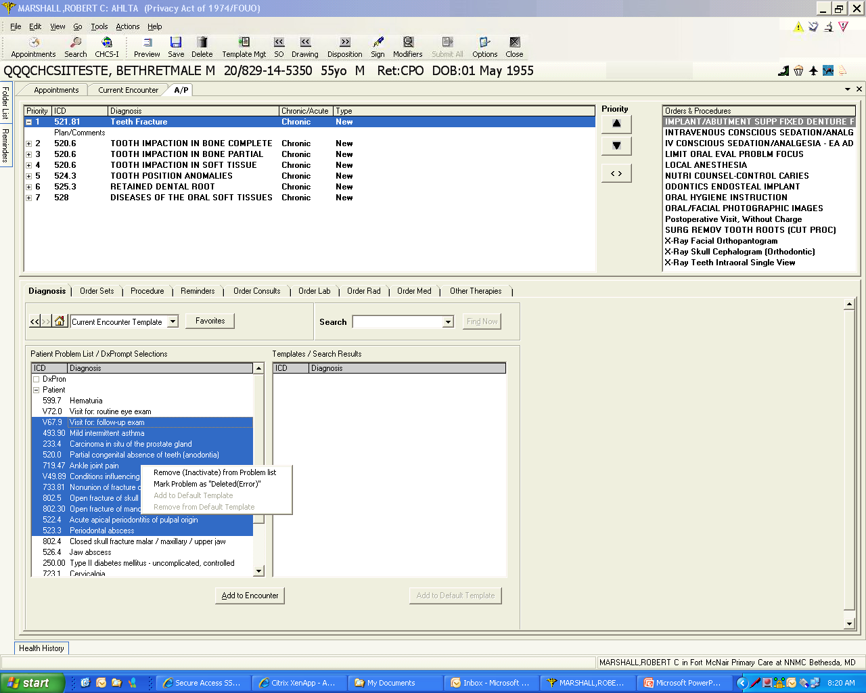
By now right mouse clicking over one of your highlighted items, a pop-up menu appears that allows you to Remove (Inactivate) from Problem List or completely deleting the highlighted items…all at once.

Slide 7
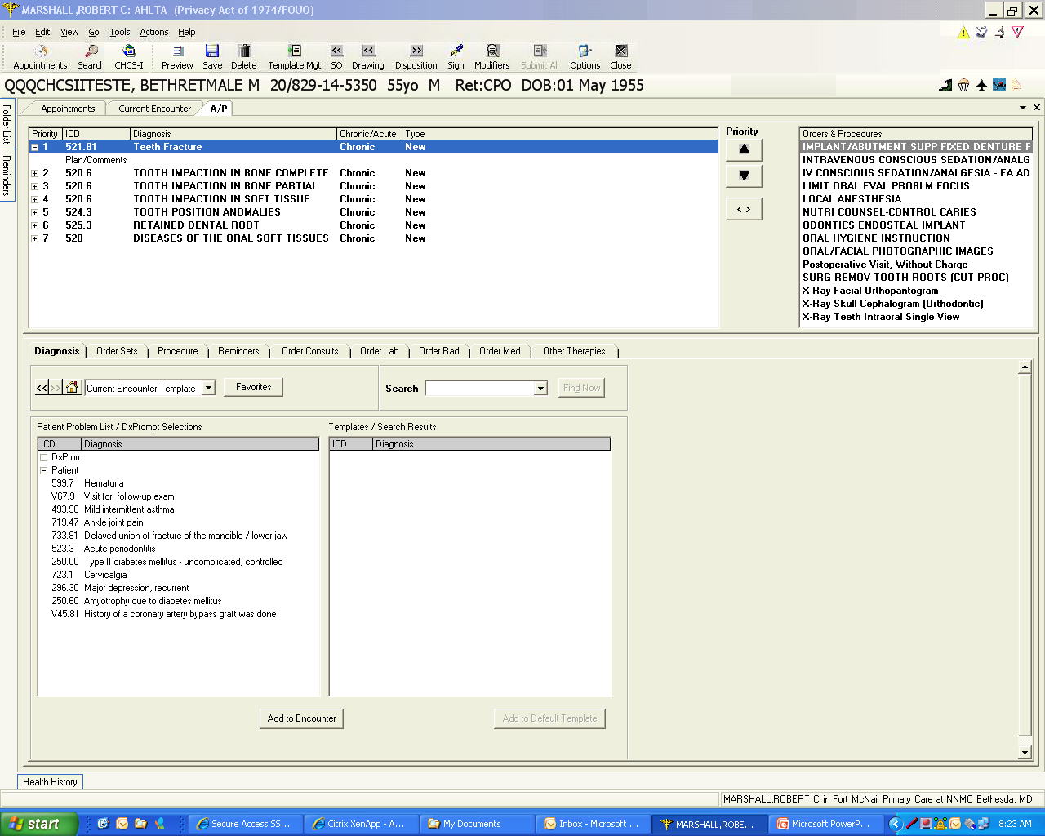
Here is your patient’s Problem List after the quick list management process. It is now much more manageable and accurate. This is very rapid and very easy to do.

