Slide 1
Disaster Planning with AHLTA
What to do to document care and get workload credit when AHLTA goes down.

Slide 2
Objectives
Discuss reasons for AHLTA downtime
Discuss how to prepare for AHLTA down times
Documentation and coding during AHLTA down times
Documentation tools
What to do with generated AHLTA encounters without documentation
Points of contact and resources

Slide 3
Reasons why AHLTA goes down
Loss of network between MTF and LCS* site (ex. Between 29 Palms and Camp Pendleton)
Failure of the CDR or a FEPS**
CHCS I failure
MTF network failure
  *LCS – local cache server
  **FEPS – front-end processing server

Slide 4
Preparing for AHLTA Down Time
Prepare file boxes and hanging file folders
Make manila folders for SF600’s, lab chits, x-ray chits, SF513’s, etc…place in hanging folders
Have the boxes stationed at convenient locations in the clinic
Pull the manila folders out and place them in the exam rooms if AHLTA goes down

Slide 5
Documenting during down times 1 of 2
If not in fail-over mode, must document on paper or wait until AHLTA comes back up
If on paper, document care on SF600 and place in chart
Once AHLTA comes back up, complete A/P Module and sign encounter
  This provides signed encounter, but it will require manual coding for workload credit

Slide 6
Documenting during down times 2 of 2
If documenting completely on paper
  Document care on SF600, including A/P and signature
  Place document in paper chart
  Complete coding bubble-sheet for coders
In fail-over mode, continue to document, code and sign normally
  When the CDR comes back up, the LCS will forward the documentation for credit and storage

Slide 7
Documentation tools
Paper SF 600 (the old way of documenting)
SF 600 overprints
  Replaces the AHLTA note
  Requires placement in the paper record
  May be scanned into AHLTA
Worksheets
  Relevant data for later documentation into AHLTA
  Can be configured for TELCONs as well

Slide 8
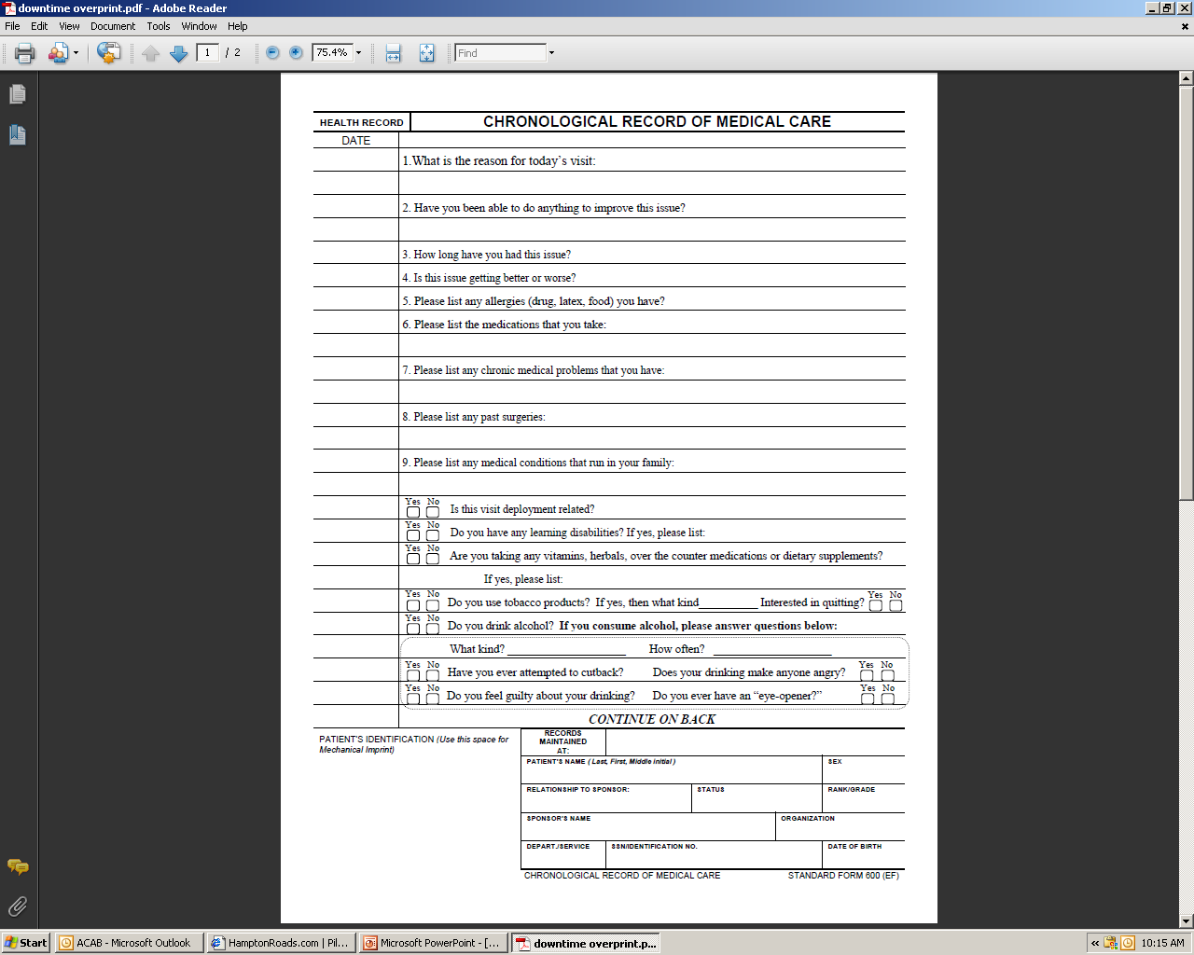
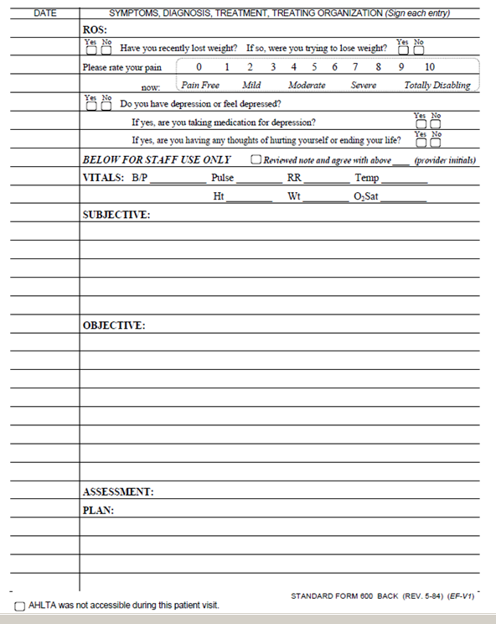
SF 600 Overprints

Slide 9
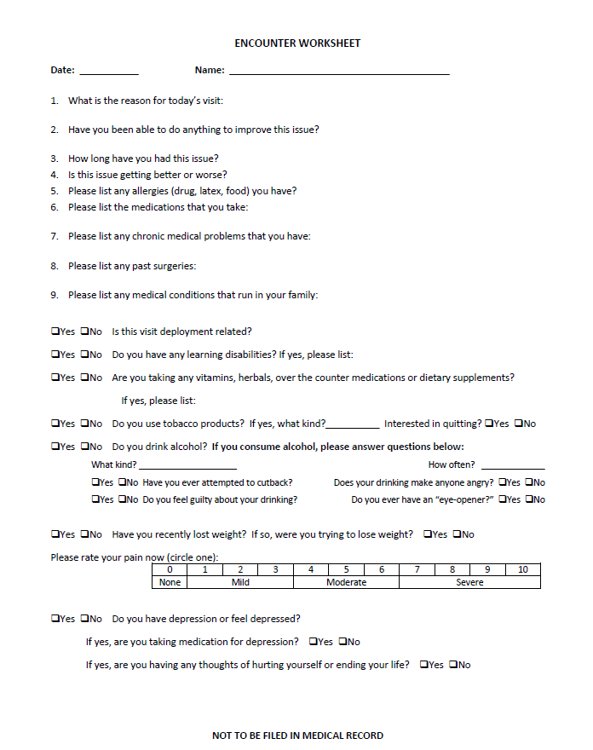

Slide 10
Dealing with undocumented AHLTA appointments
No need to cancel the appointment
Leave it alone
It will be automatically removed from the system
If you have documented A/P and signed it, the encounter is complete
Either way, there is nothing more to do

Slide 11
Points of Contact
NAVMEDEAST
  CDR Tom Chupp, NMC Portsmouth
  LCDR Mike Williams, NH Pensacola
NAVMEDWEST
  CAPT Michael Hoffer, NMC San Diego
  CDR Reid Holtzclaw, NH Bremerton
NCA
  LCDR Mike Feeser, NMC Pax River

Slide 12
Resources
AHLTA Guidance Document
  See AHLTA Downtime Guidance Appendix
USAFP Website
  http://www.usafp.org/

