Slide 1
Clinical Notes
A summary of how to create and find Clinical Notes in AHLTA.

Slide 2
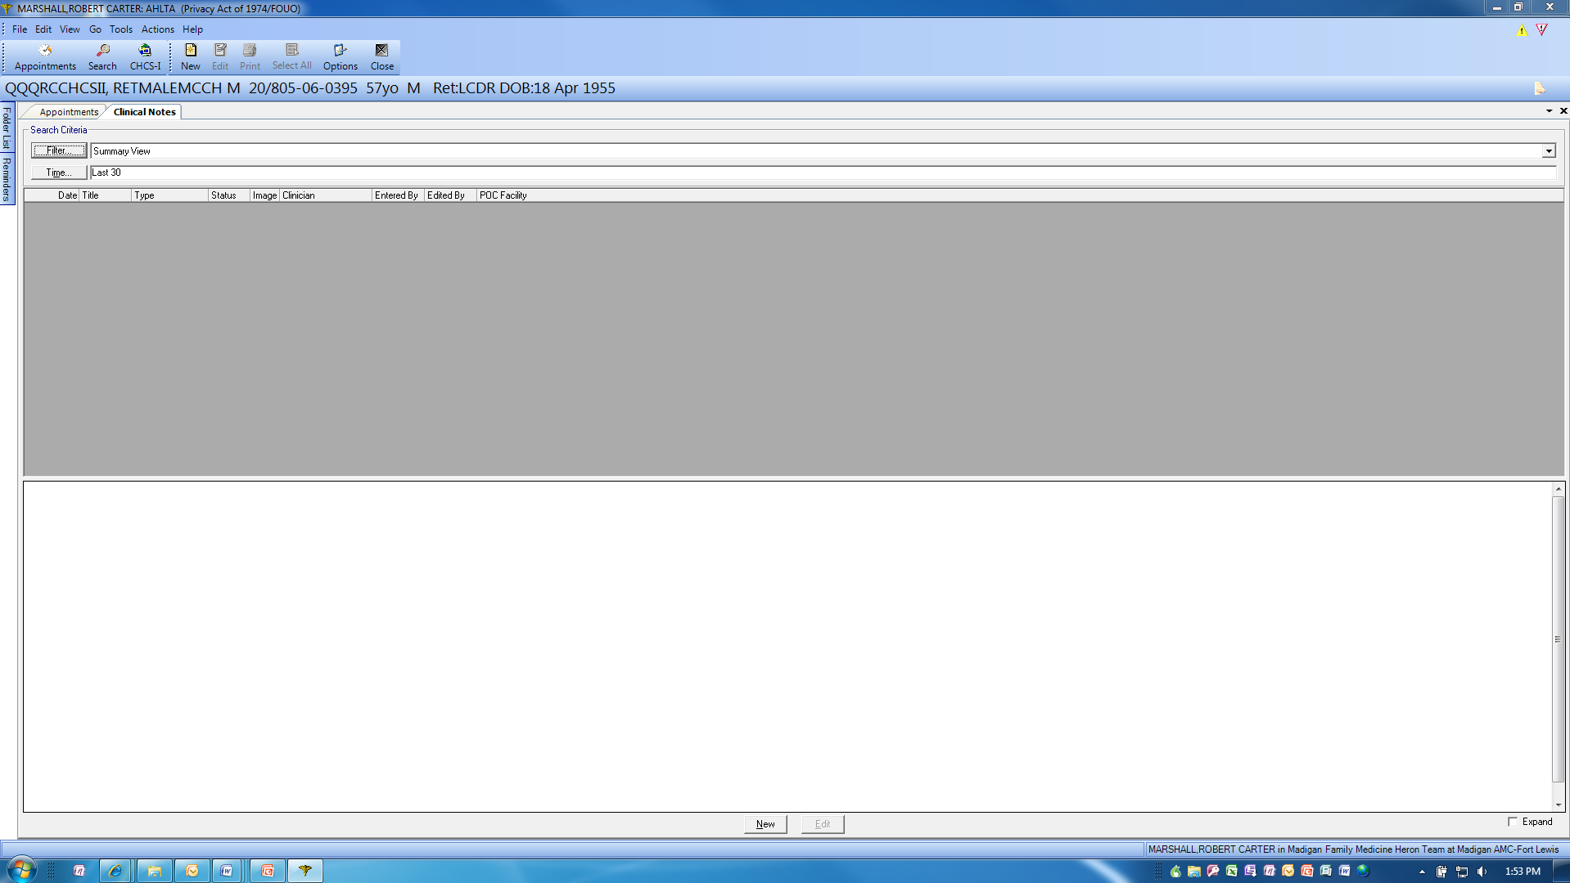
This is the screen view when you open Clinical Notes. Please note the column headings. You can sort on any of them.

Slide 3
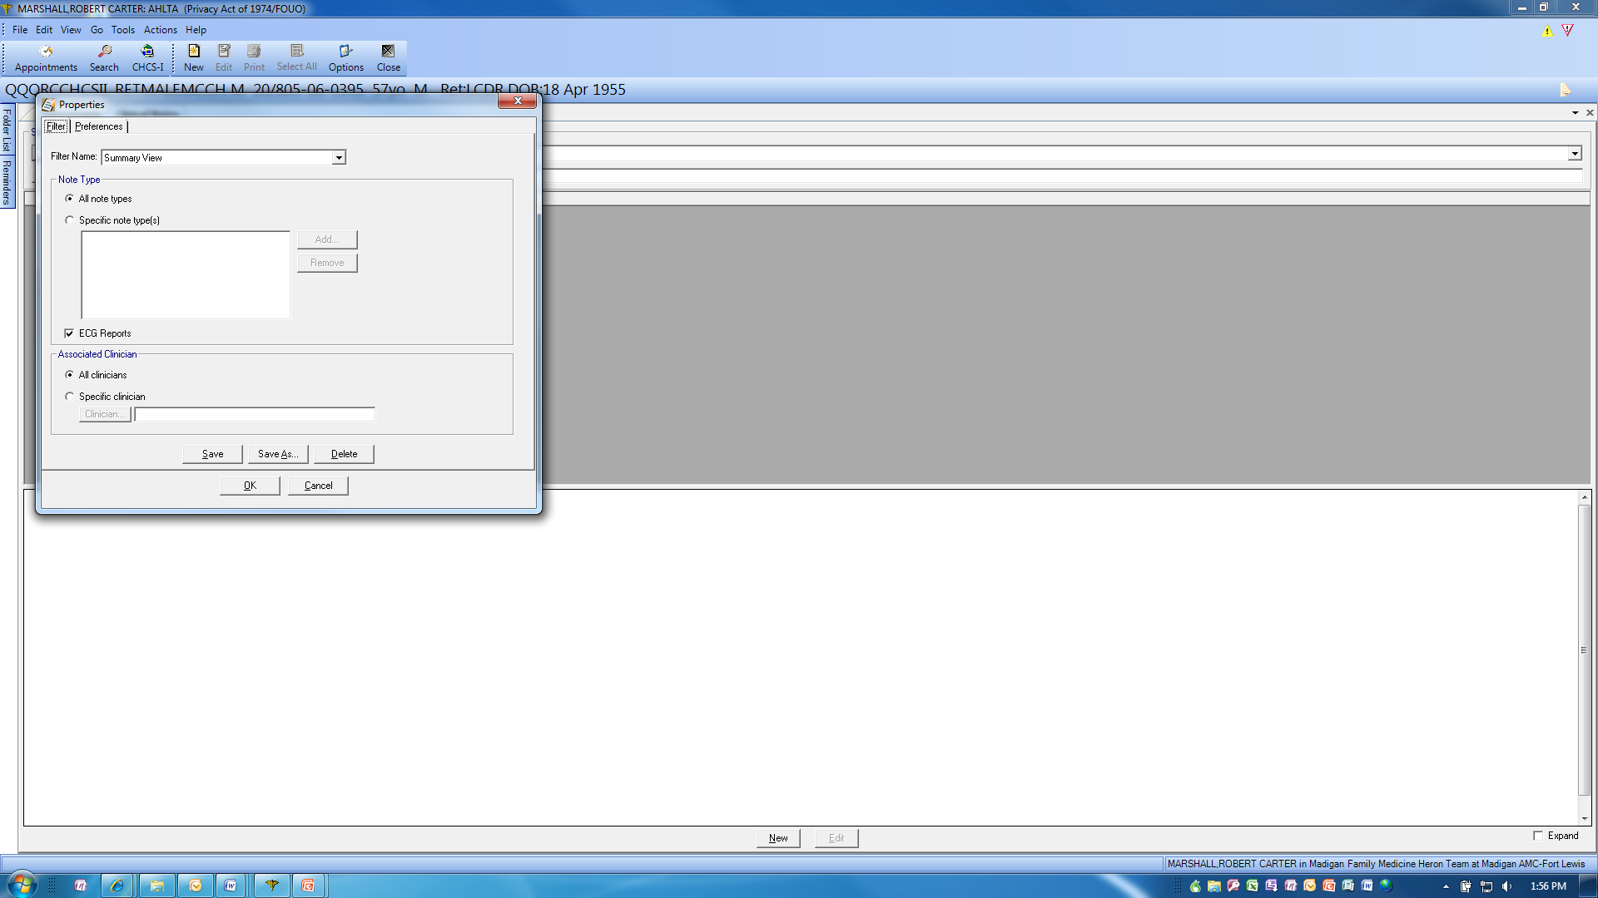
When you click on “Options”, this is the initial dialog box that appears. This gives you a lot of flexibility in how the lists of Clinical Notes are displayed…so you can find what you want/need quickly. This is Tab 1 of two.

Slide 4
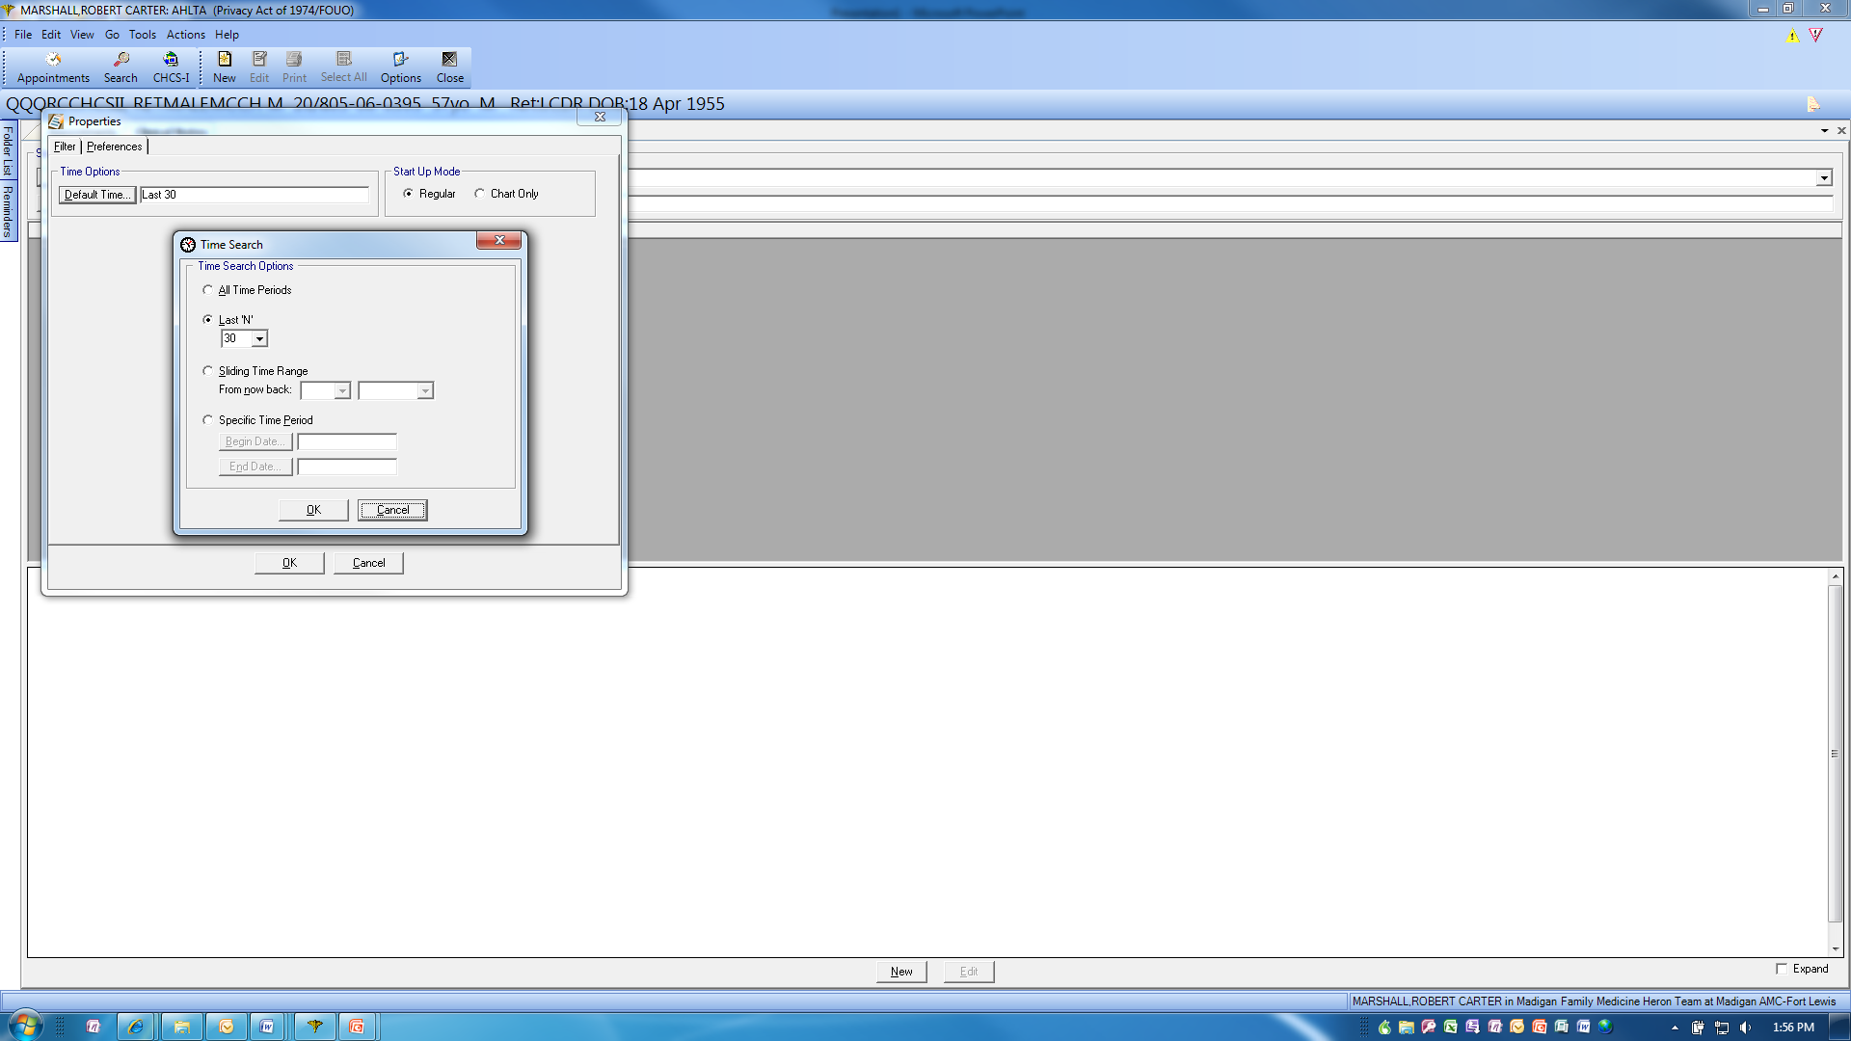
When you click on Tab 2, Preferences, the options are “Default Time” and “Start Up Mode”. When you click on the “Default Time” button, this dialog box appears. You can be very granular about what to display given these myriad preference choices. Makes it much easier to find older notes, regardless of the source.

Slide 5
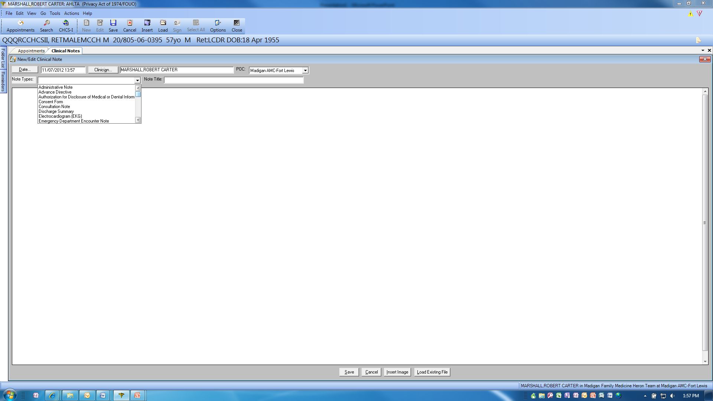
When creating a new Clinical Note, this is the initial dialog box with the “Notes Types” expanded to show the top few choices.

Slide 6
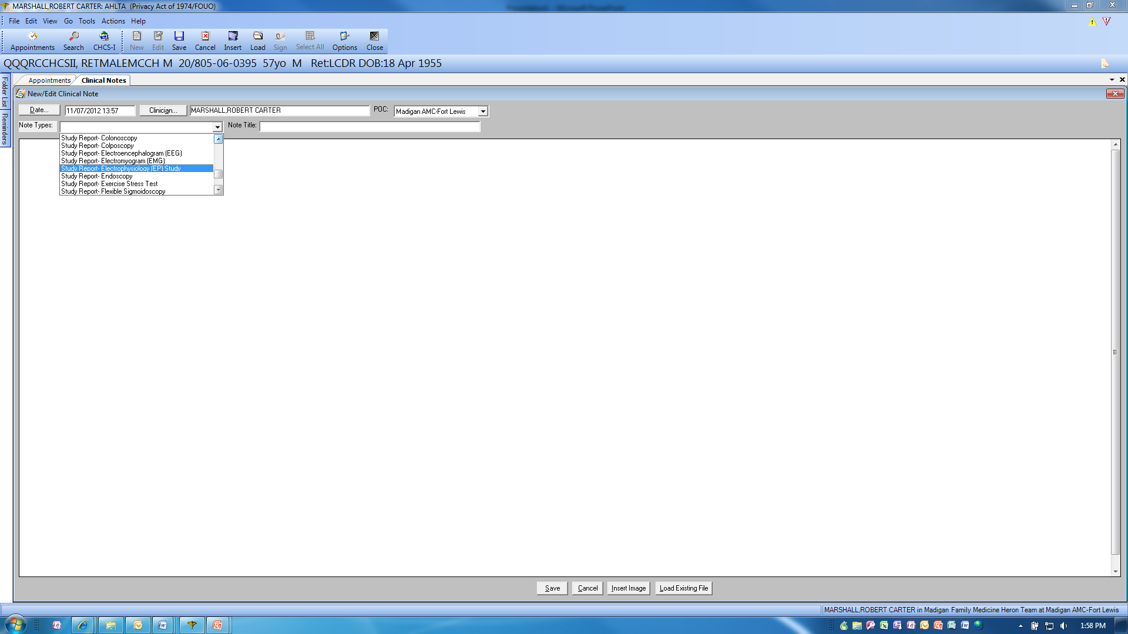
Here, we have scrolled down the “Note Types” list to show more choices. Would encourage you to take a look to see how many there are, and the variety they represent. If you see one that is not included, but should be, please let your AHLTA POC know (clinical or technical).

Slide 7
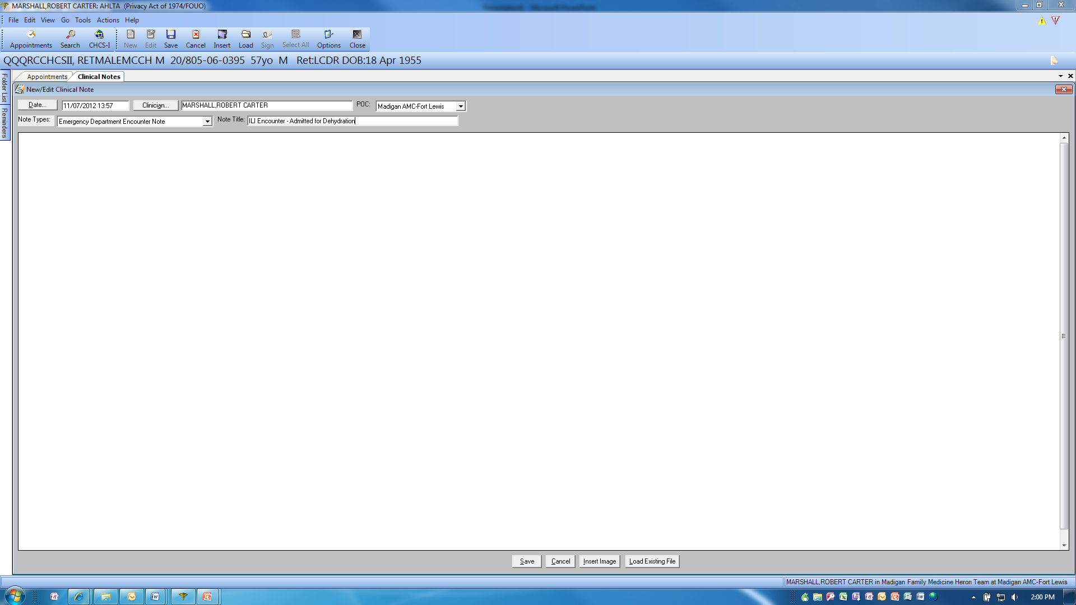
After selecting your “Note Type”, you will want to title the note so others can find it easily. The easiest way to do this is with a standardized naming convention style guide. Here is just one example of how one might define that style guide. The next page shows another potential solution.

Slide 8
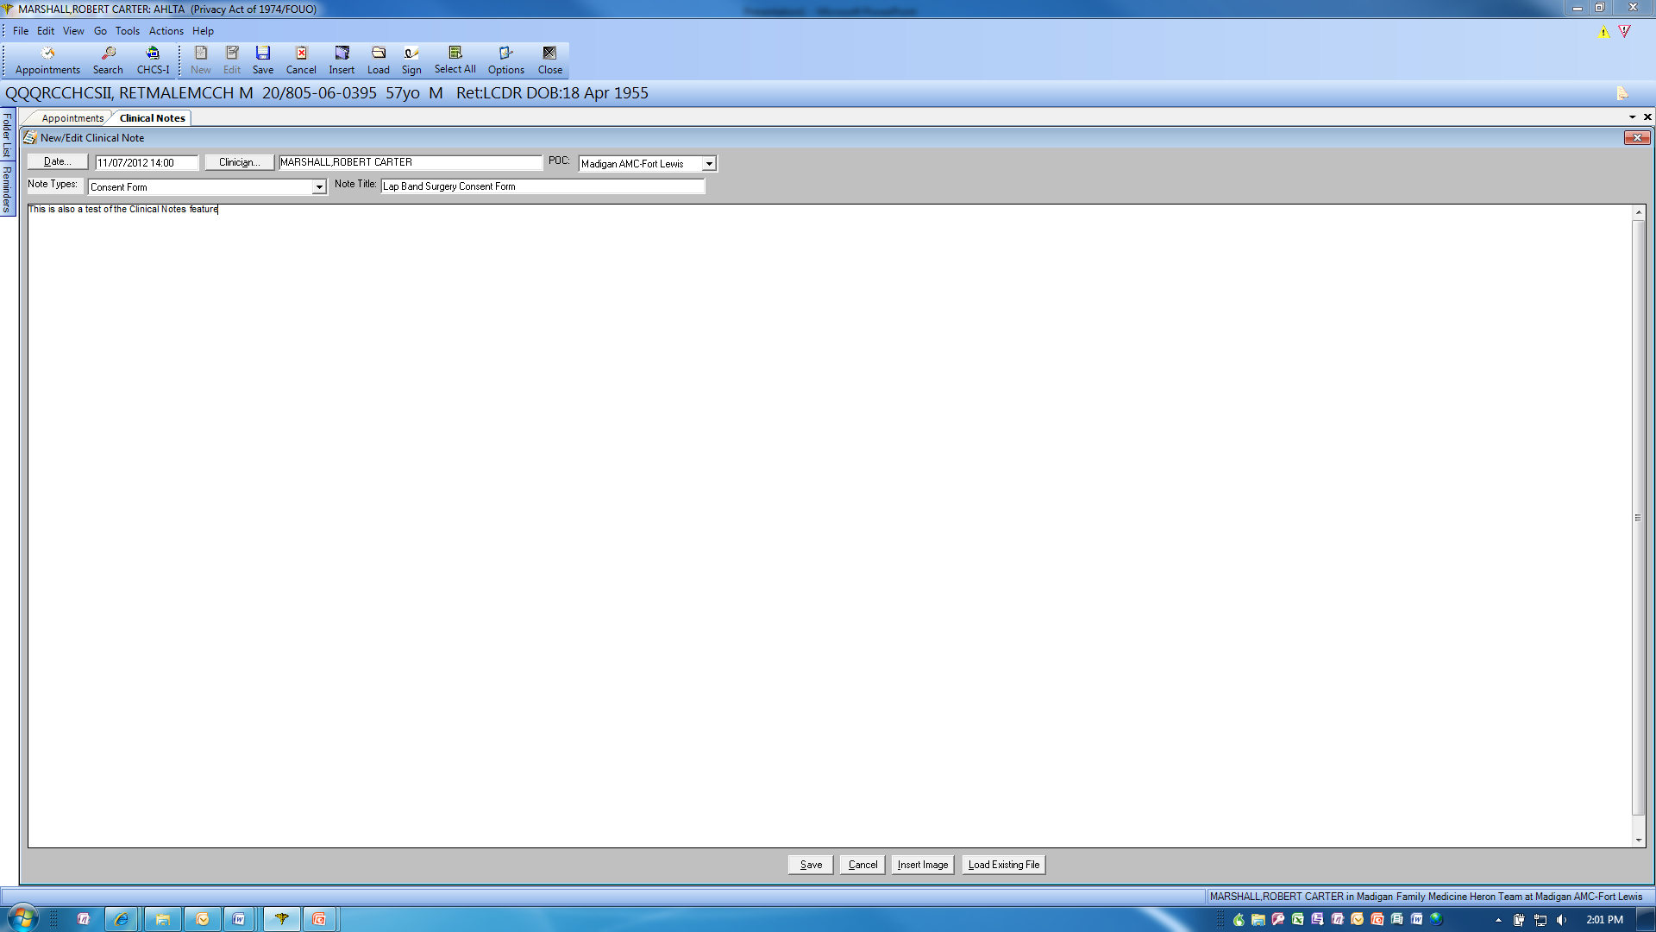
Here is one for eConsents that you scan into AHLTA. Given the variety of note types and the style guide, Clinical Notes is a much more usable and powerful toll than it used to be.

Slide 9
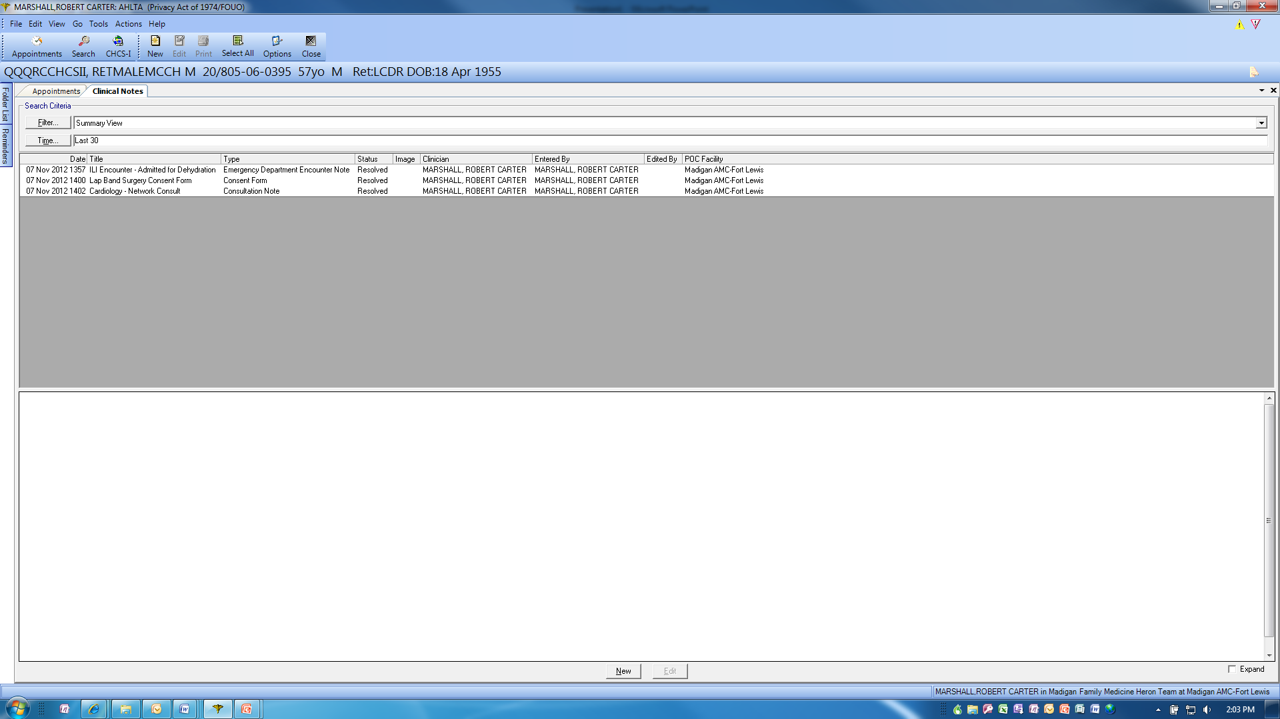
Here is a set of test Clinical Notes to show one possible display and note properties. Just click on any column heading to reorder the display in ascending or descending order.
One can easily see how a standard naming convention/style guide would make this even easier…which would obviously improve the intrinsic value of Clinical Notes in support of patient care and care coordination.

Slide 10
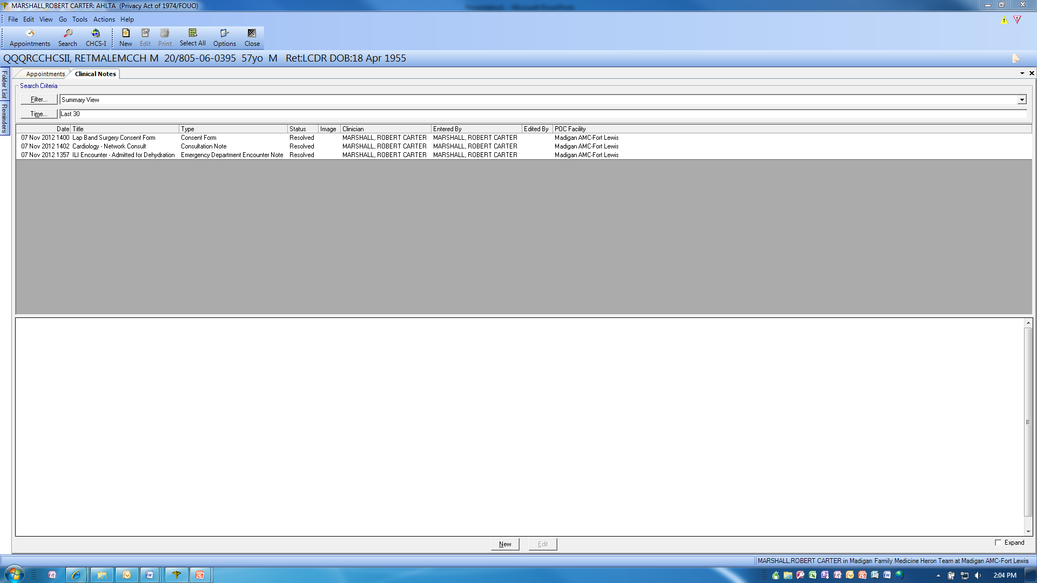
This is just to show the ease and power of column sorting by simply clicking on the headers.
This, in combination with a “naming style guide”, will make it very easy to retrieve older Clinical Notes, those related to a specific problem and those from a specific location (Network Consult, ED visit, Discharge Summary, etc)..

