Slide 1
Updating and Using Check-out Data
Bob Marshall, MD MPH MISM Chief, Clinical Informatics (CMIO)

Slide 2
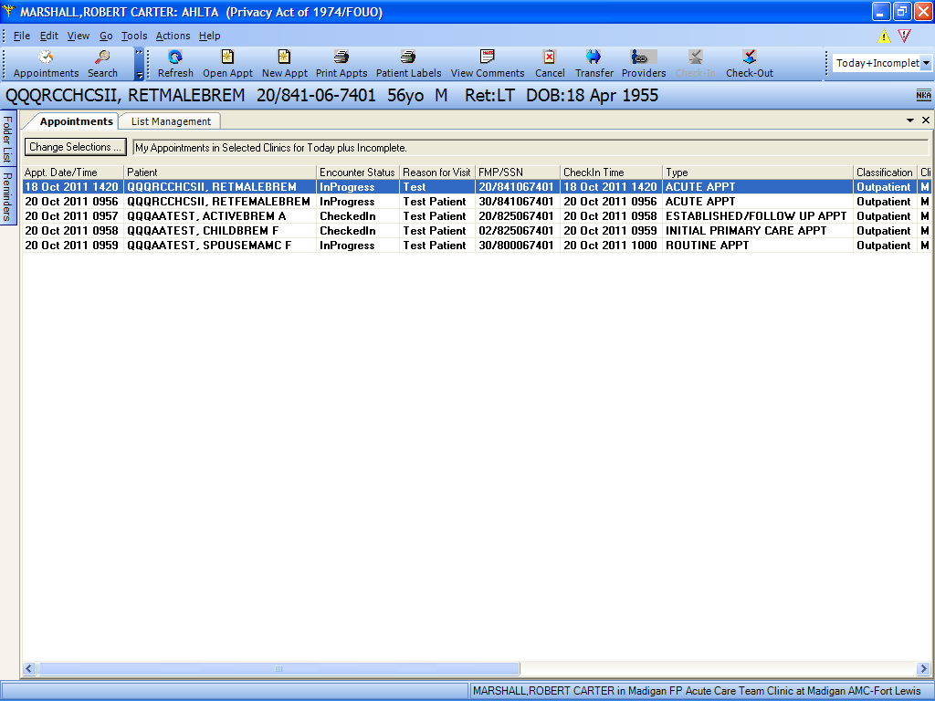
Select a patient in order to access the Check-out data update command

Slide 3
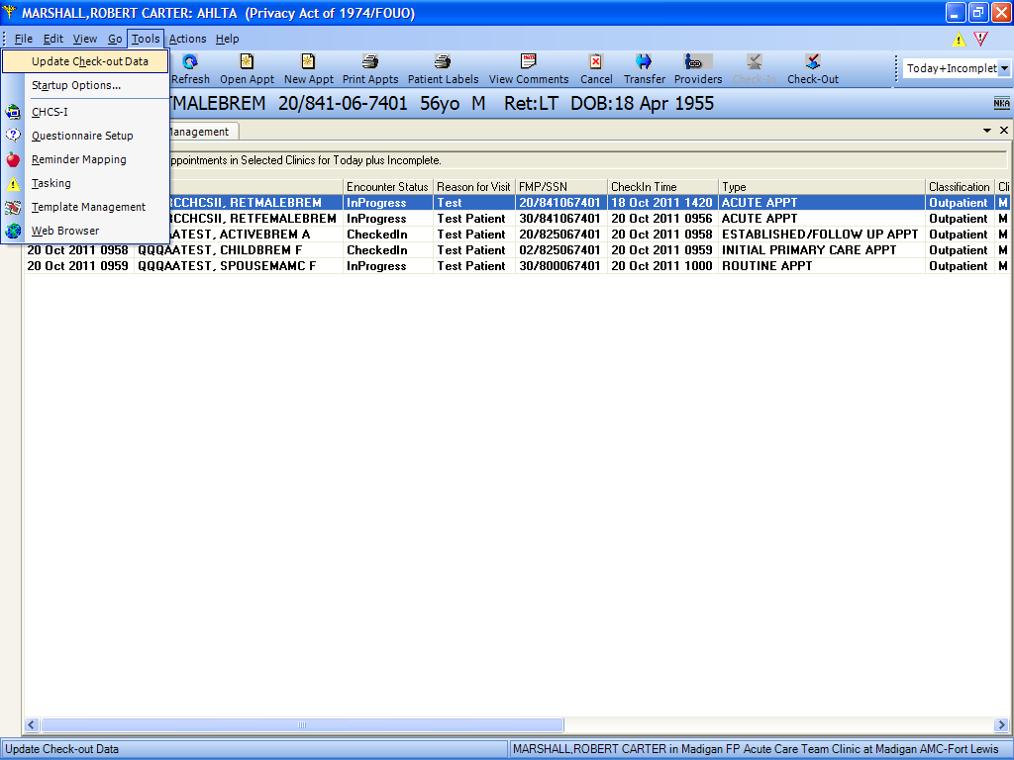
Under Tools, select Update Check-out Data (or select Alt-T →h) to edit/modify the check-out information

Slide 4
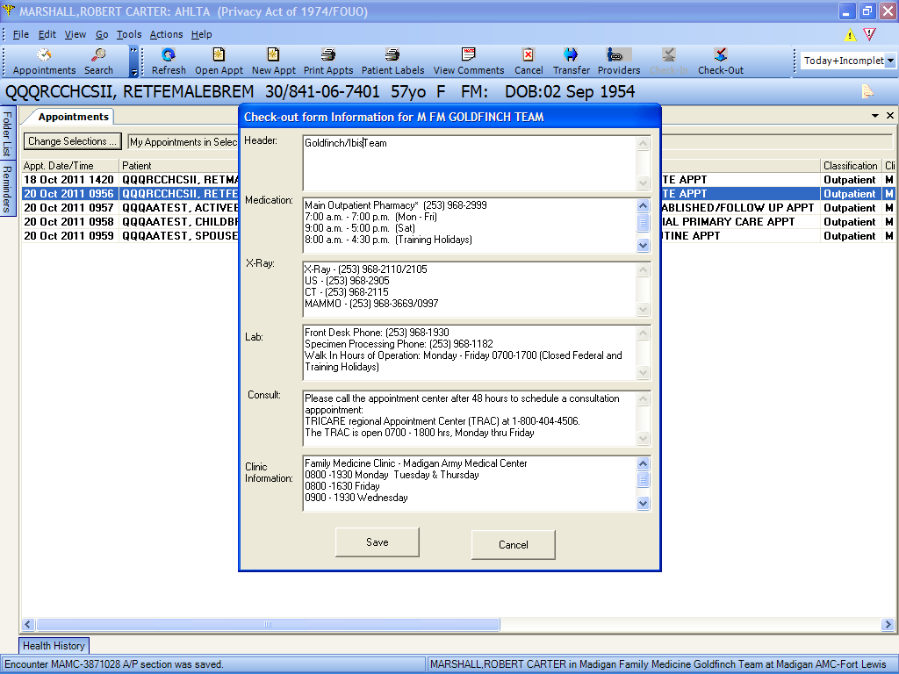
Add information for the patients to use once they leave the clinic. Here, there are phone numbers and hours. Could also put directions if pertinent.

Slide 5
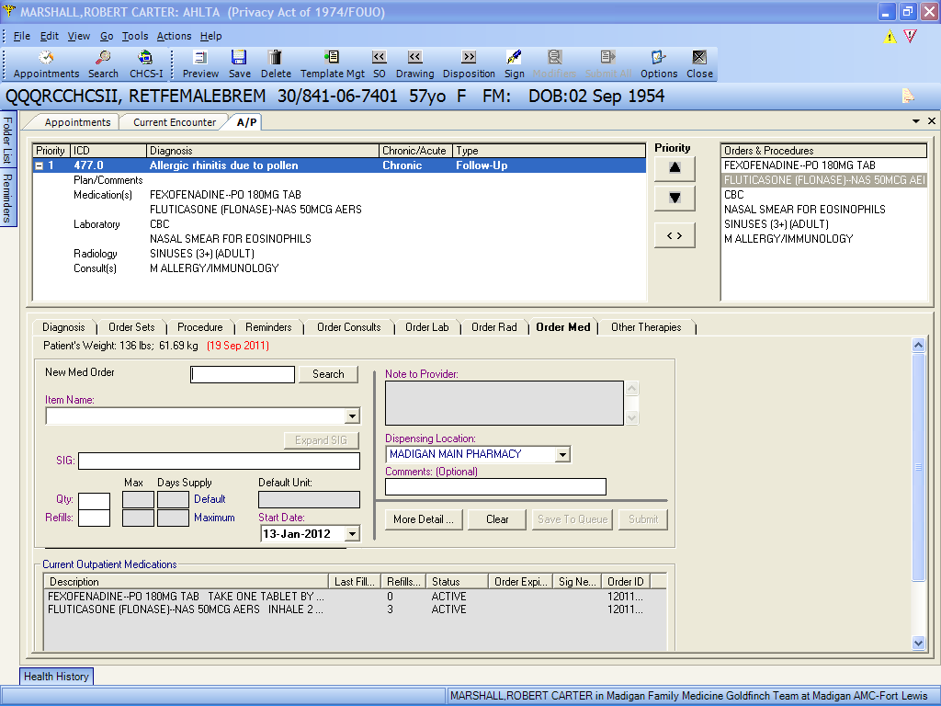
Once you have put in any orders for the patient, close the A/P Module and the Current Encounter. Click on the Check out icon with the patient highlighted.

Slide 6
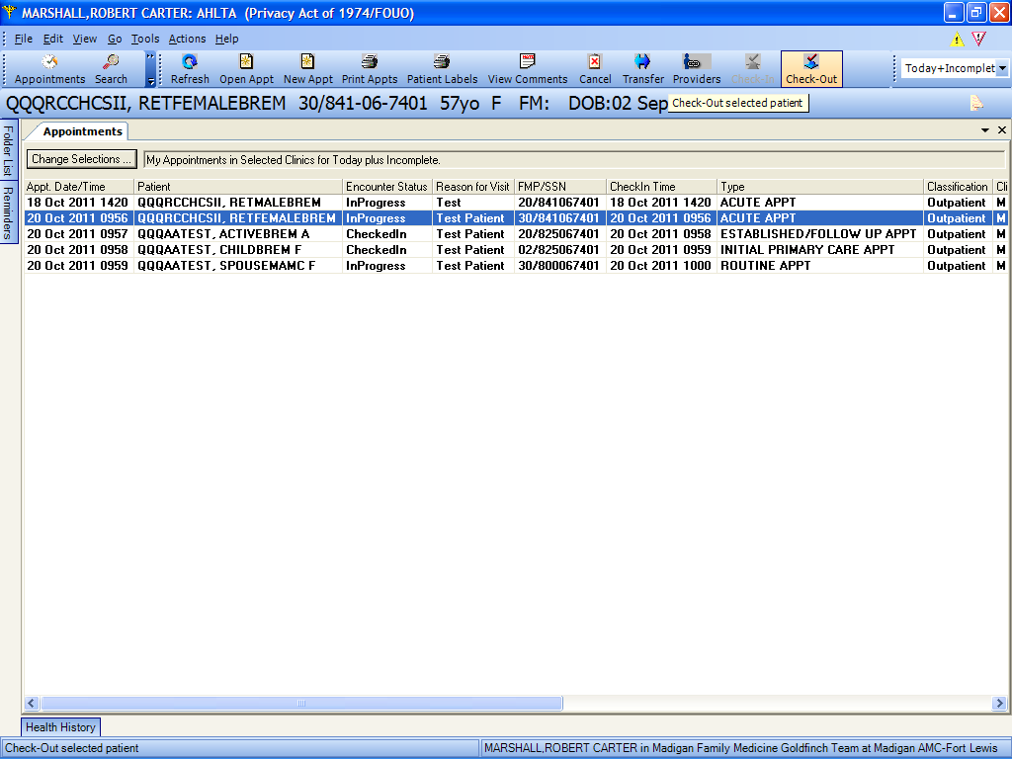
With the patient/appointment highlighted, click on the Check-Out icon.

Slide 7
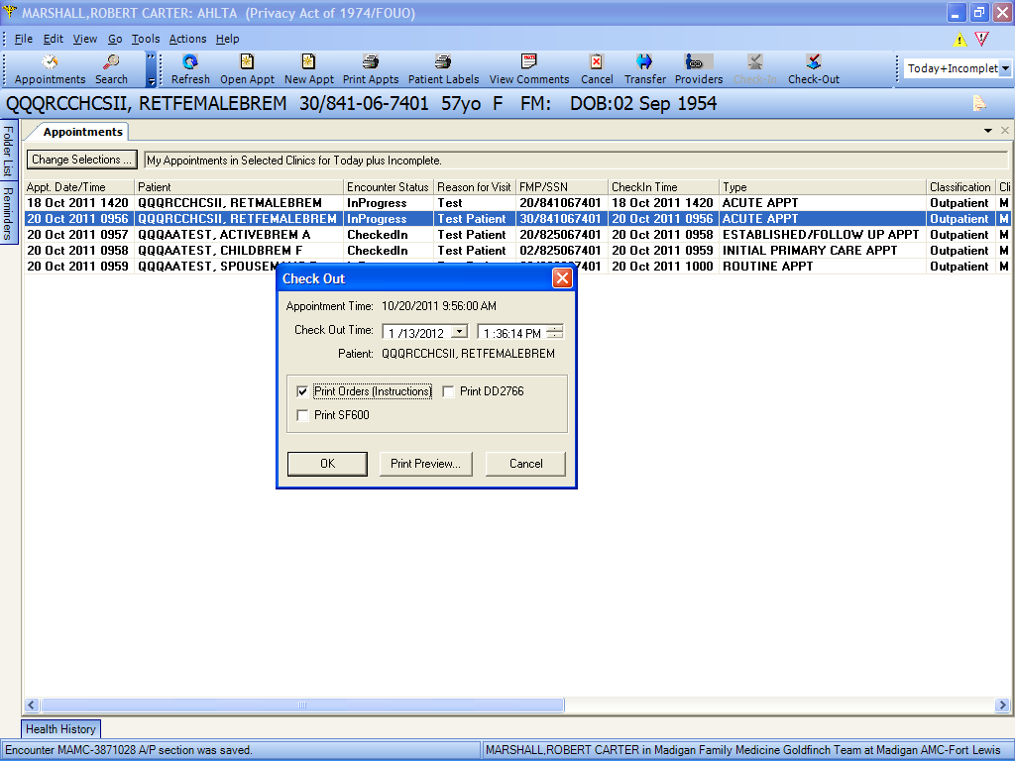
This dialog box appears. For the desired check-out sheet, check the Print Orders box and either OK (to print) or Print Preview to look at the sheet prior to printing to printer or PDF

Slide 8
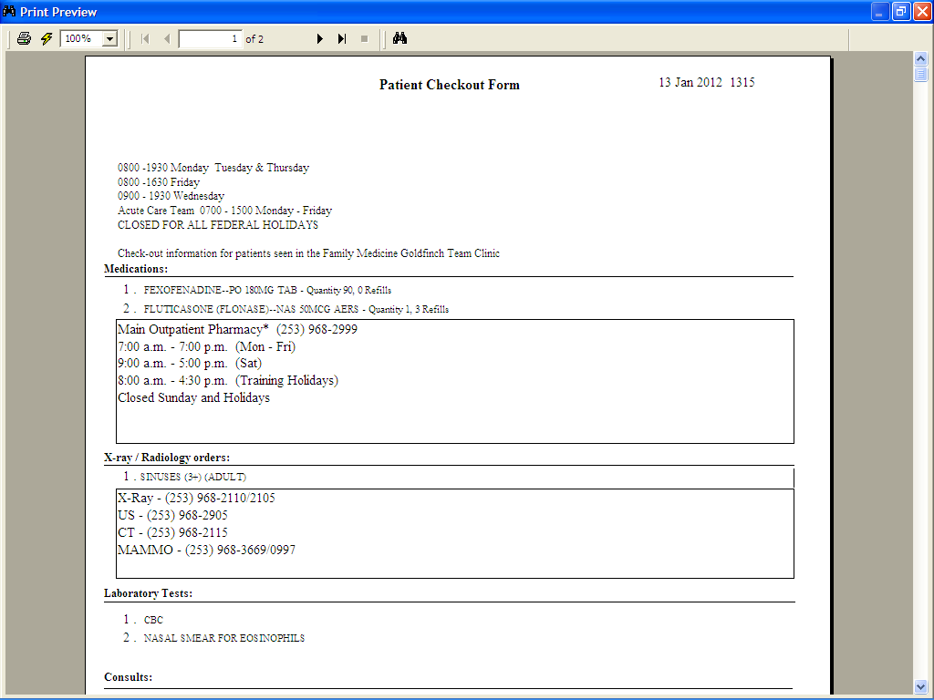
This is what the Check-out sheet looks like with Pharmacy, Lab (missing here), Radiology and Appointment information. This could be hours, phone numbers, directions or whatever.

