Slide 1
Check-Out Function

Slide 2
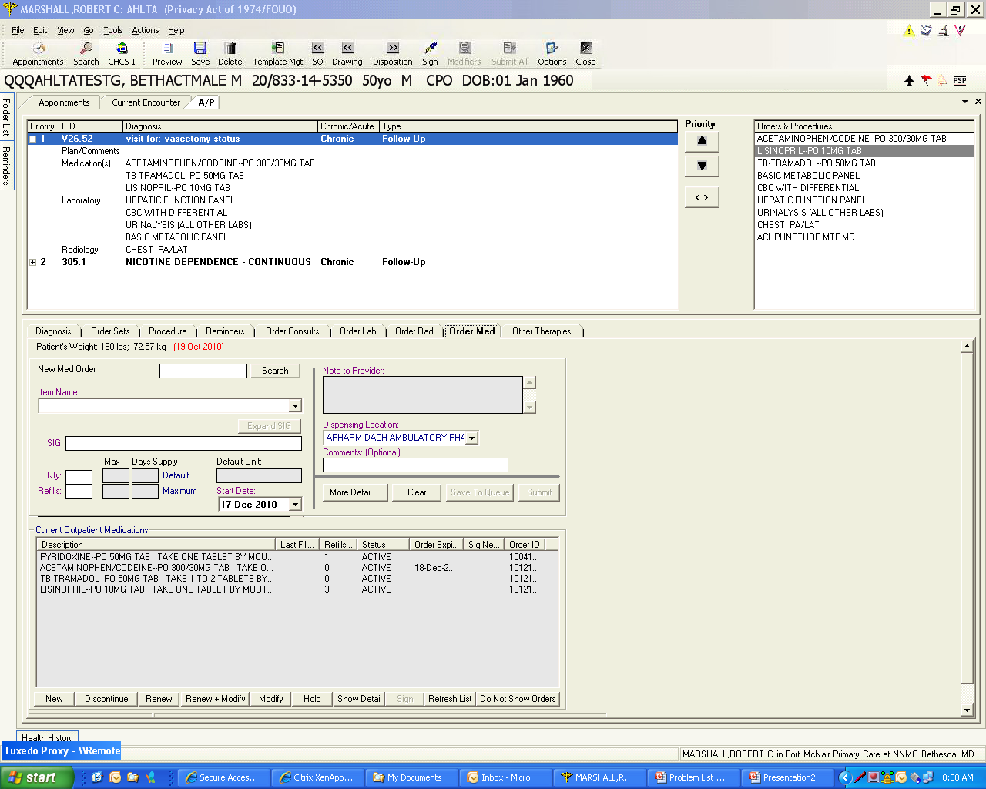
Here I have ordered a number of things for my patient…labs, meds, rads and consults

Slide 3
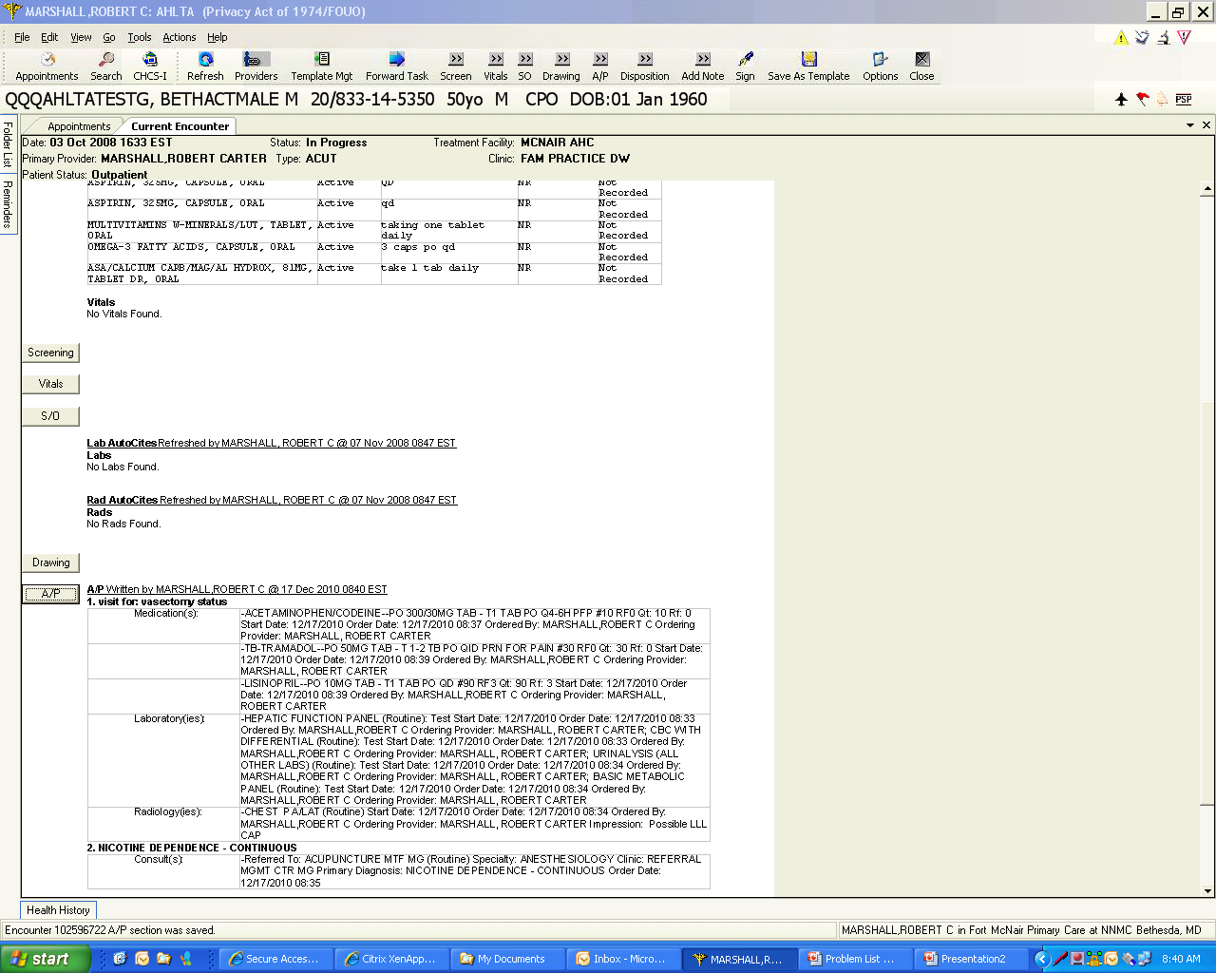
This shows that the encounter is open and orders have been submitted. It is also very clear that the patient’s visit is not completely documented or dispositioned (or signed).

Slide 4
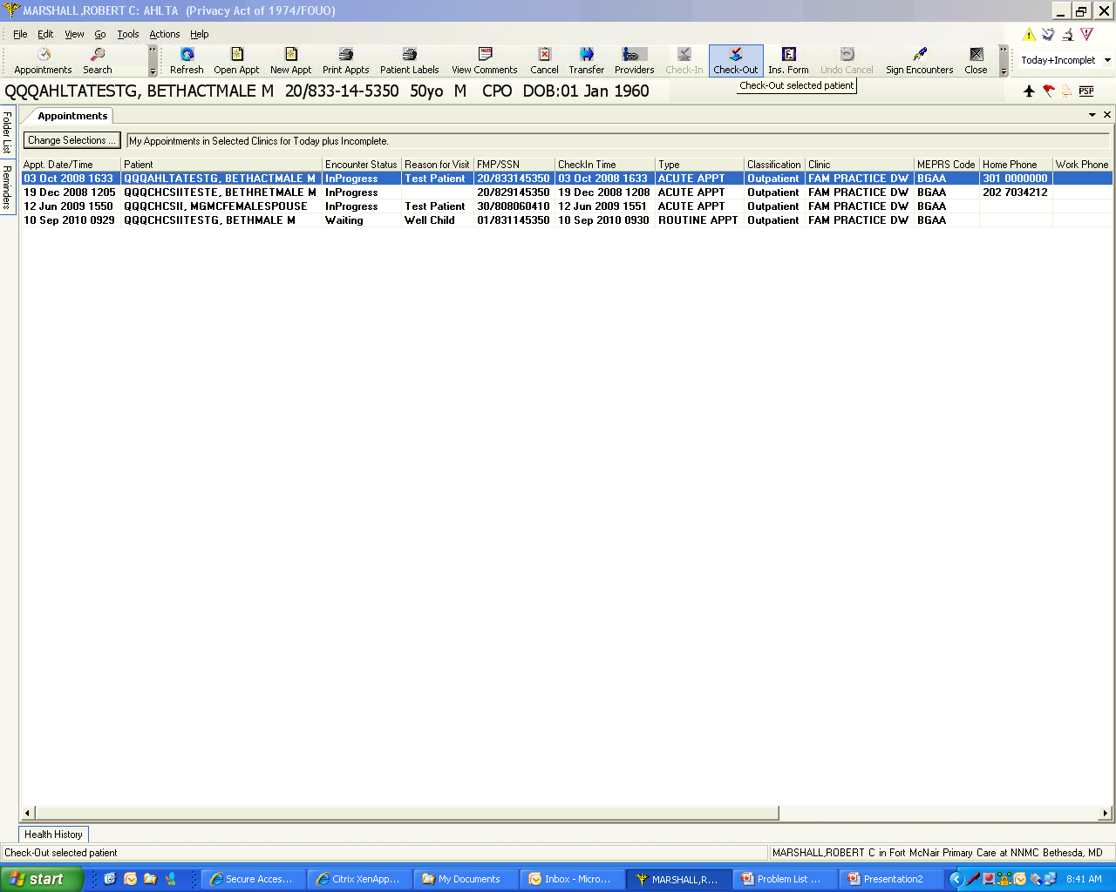
AHLTA has always had a Check-out capability, but in 3.3, it is now available without having to disposition the patient and sign the chart first.

Slide 5
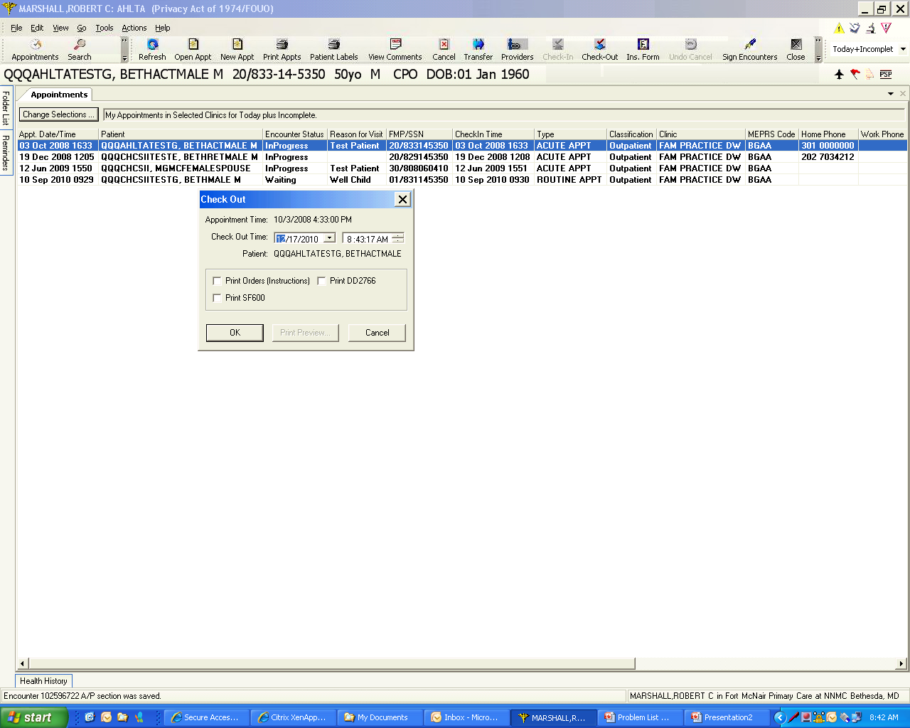
When you left mouse click on the “Check-Out” icon, this dialog box pops up providing options. In this “How To”, we will use the “Print Orders” feature.

Slide 6
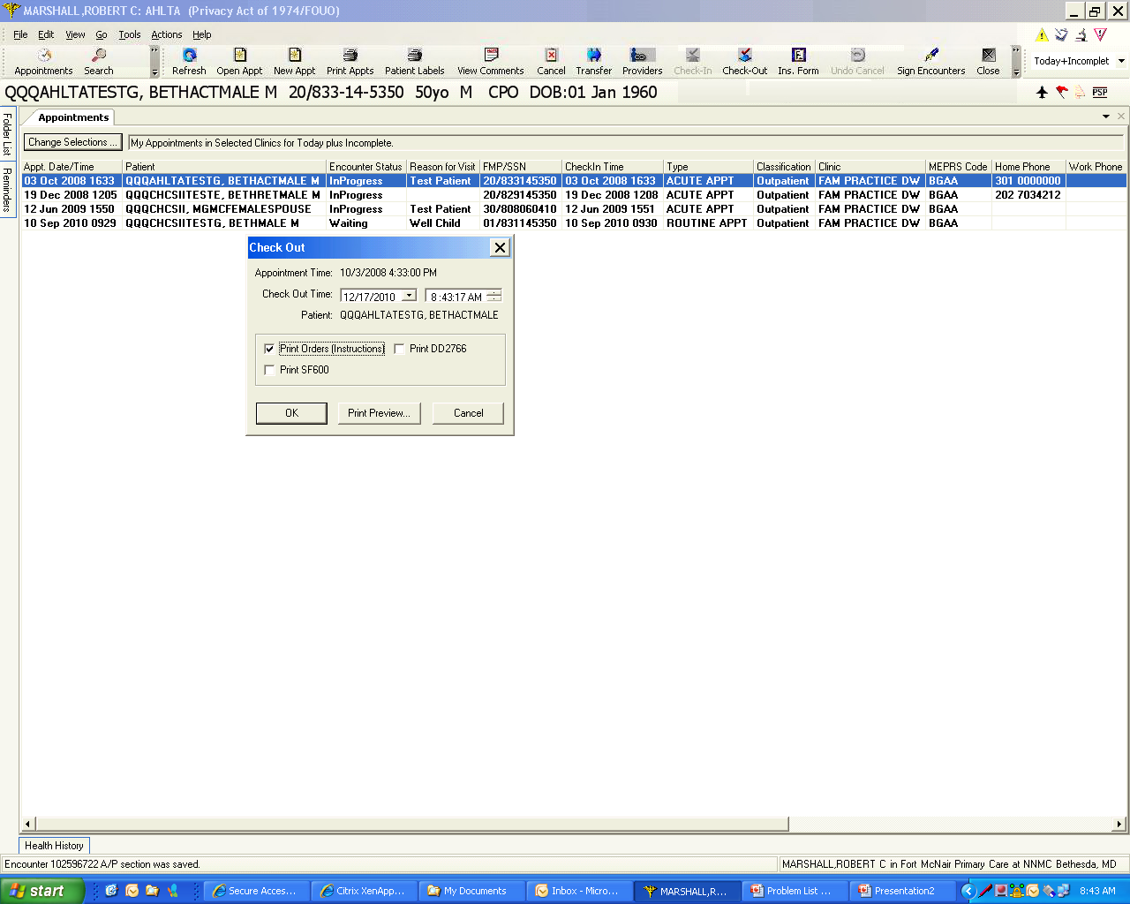
Click the “Print Orders” check box and either hit “OK” or “Print Preview”. If you hit “OK”, it will print to your AHLTA designated default printer. Here, the default is today’s appointment…which is the usual.

Slide 7
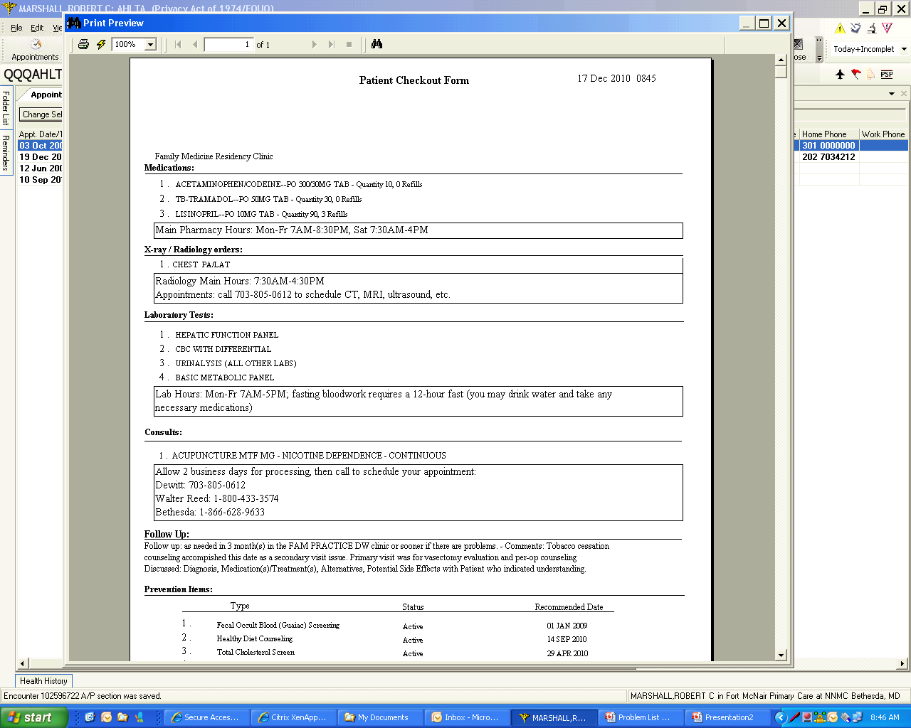
This is what the Patient Checkout Form shows…date and time, all of today’s orders, instructions to the patient, follow-up and Preventive Items. You can combine this with the 508 from CHCS or the printed and commented Medication Flowsheet for up-to-date medication reconciliation.

