Slide 1
Army Readiness Modules in AHLTA

Slide 2
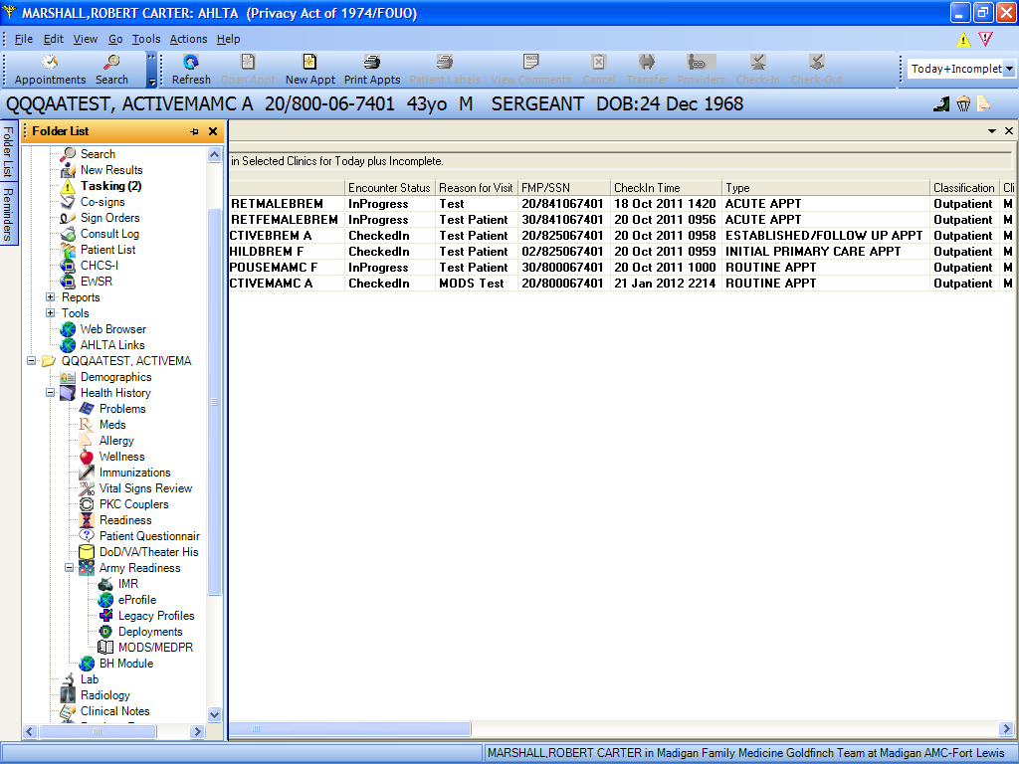
Readiness Modules are found under the Folder List as shown. Click the “+” sign next to “Army Readiness” to expose all the Module links.

Slide 3
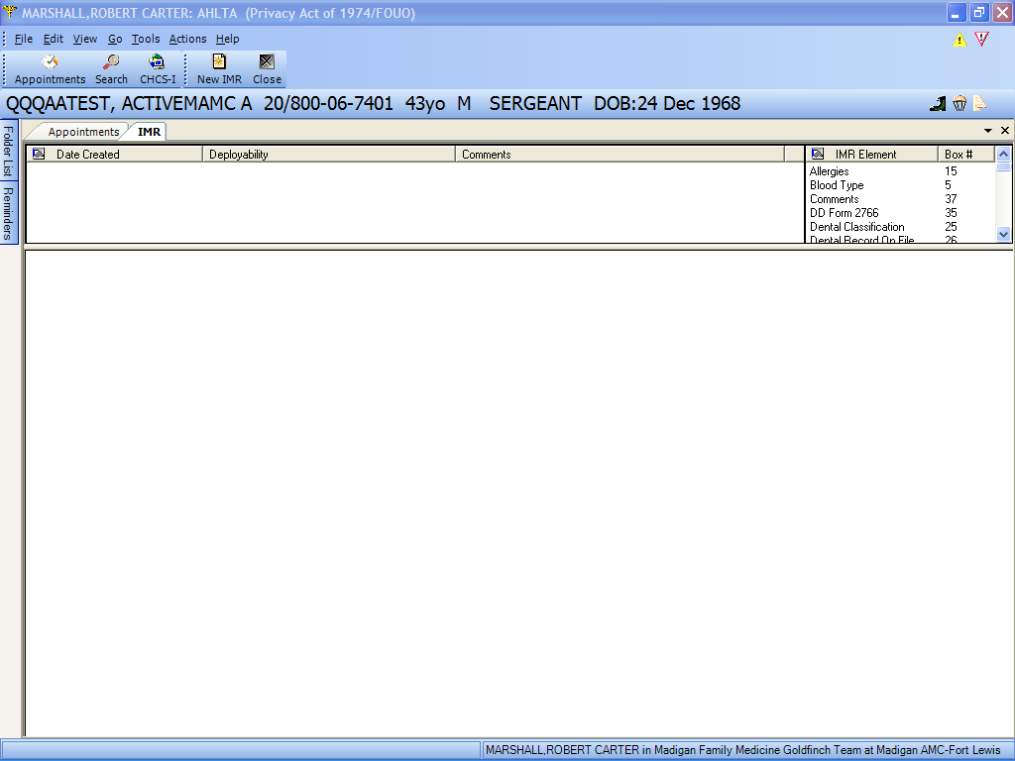
Clicking on “IMR” opens this Module. It displays existing IMR data in the right window and any existing IMR’s in the left window.
Clicking on an existing IMR in the left window will display the data in the bottom window.
Click the “New IMR” icon to create a new IMR and import the available data elements.

Slide 4
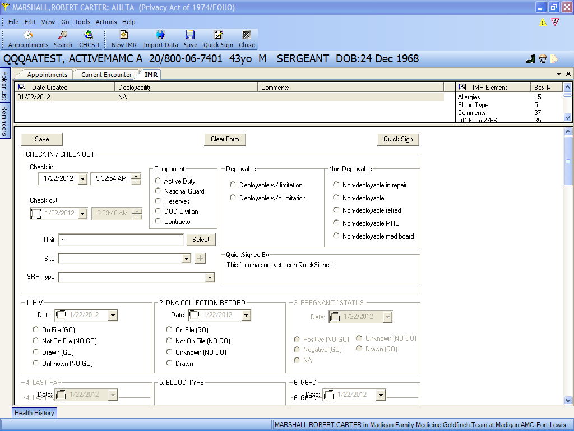
Once you click on “New IMR”, all available data elements are imported and the form generated for you to complete, save and/or “Quick Sign”

Slide 5
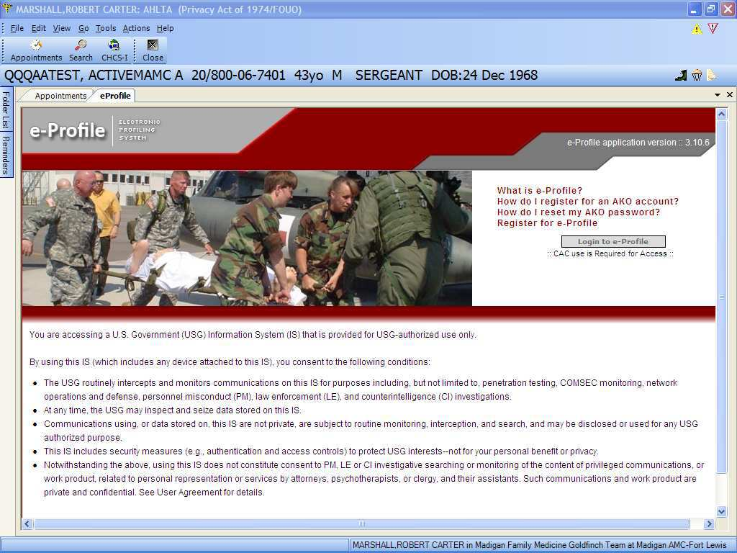
If you click on the eProfile link, you are taken to this external site in the AHLTA Web window. You must complete training to access this site. The eProfile is done online and submitted directly to MODS . This Module uses CAC login.

Slide 6
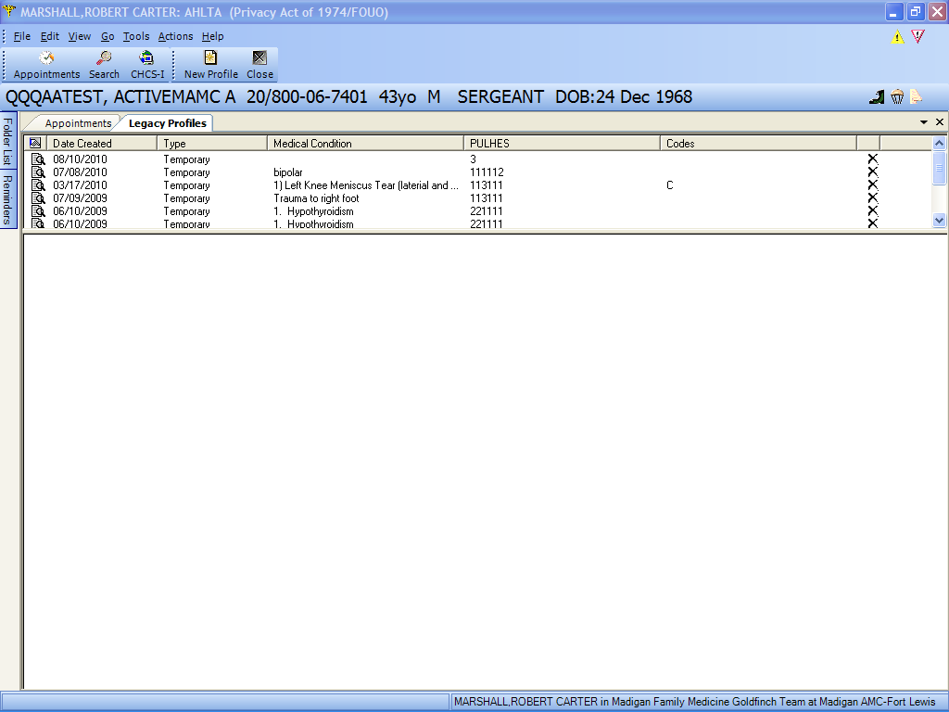
If you click on “Legacy Profiles” this tab opens. From here, you can review all previous profiles that were entered electronically.

Slide 7
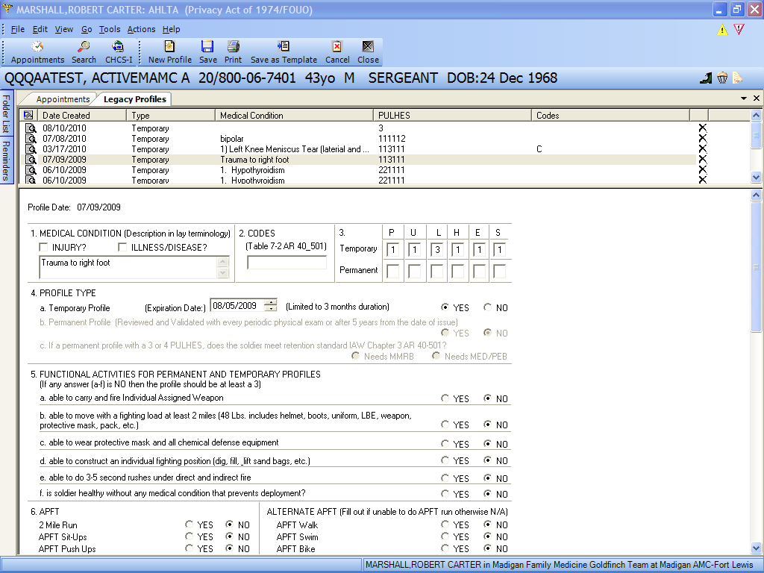
Clicking on any of the existing profiles will show that complete profile in the bottom window.

Slide 8
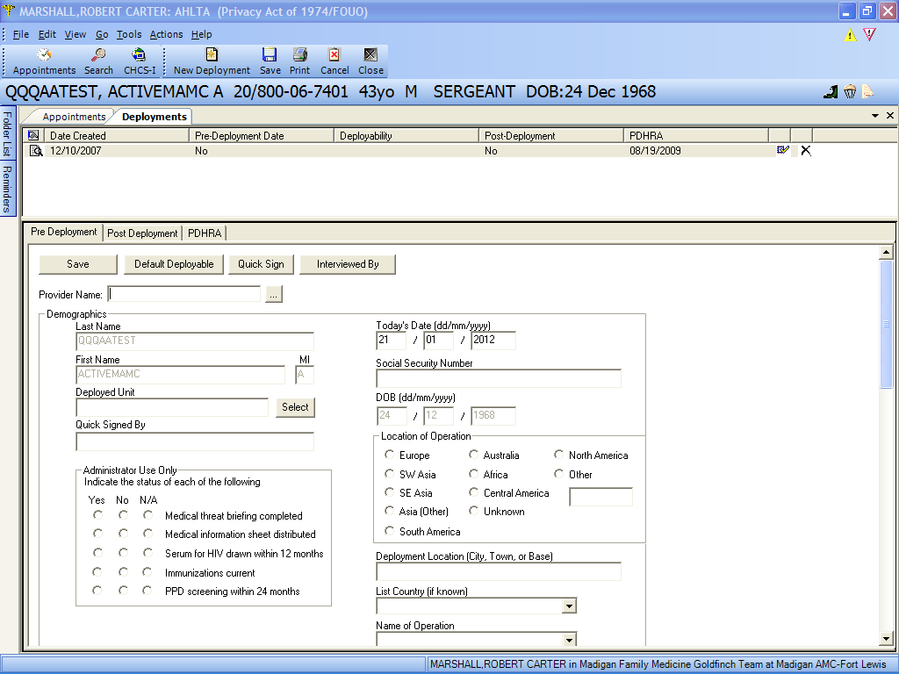
Clicking on the “Deployments” Module with open this tab. From here, you can start a New Deployment, complete a post-deployment assessment or a PDHRA.
This is the pre-deployment sub-tab.

Slide 9
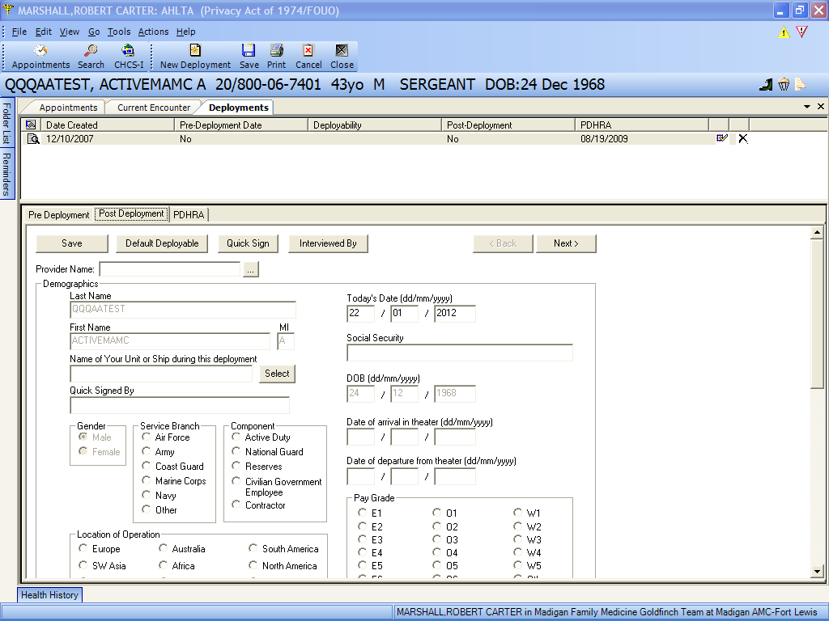
This is the post-deployment sub-tab.

Slide 10
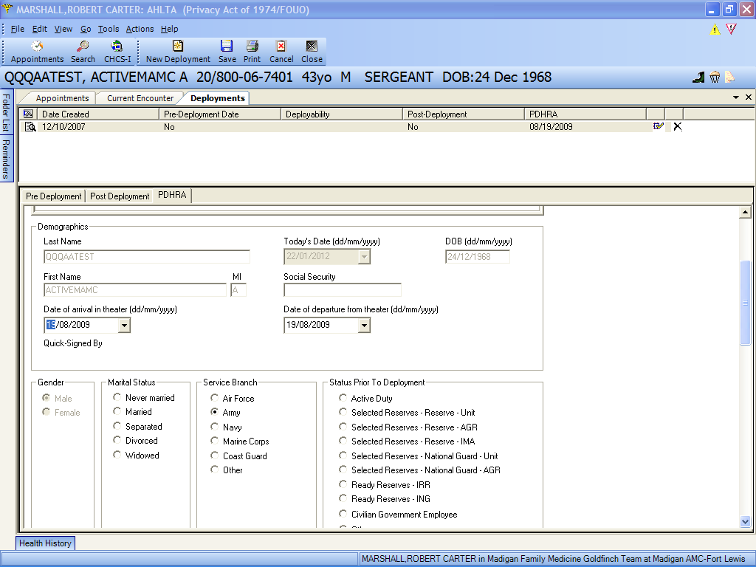
This is the PDHRA sub-tab

Slide 11
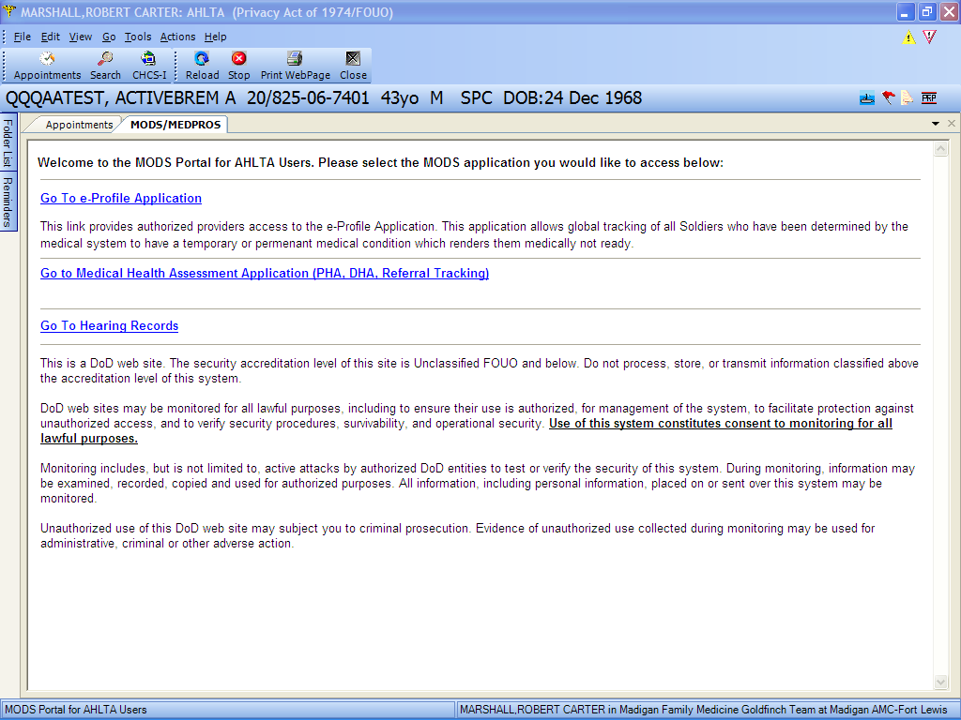
If you click on the MODS/MEDPROS link, this window opens for direct access to MODS and various MODS Modules as shown. This also requires CAC login.

Slide 12
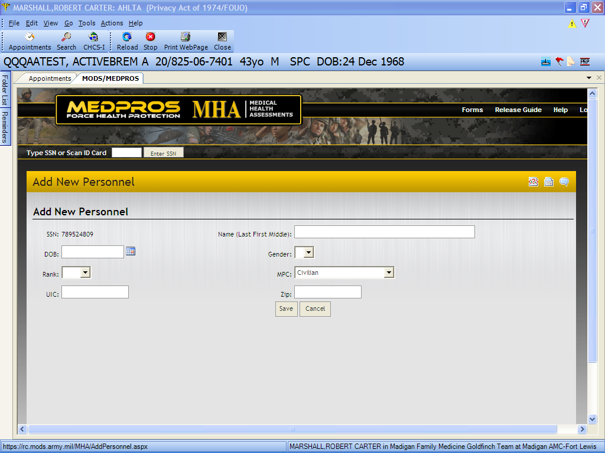
Since this is a test patient, he is not entered into the MHA system. From here, you can add patients.

Slide 13
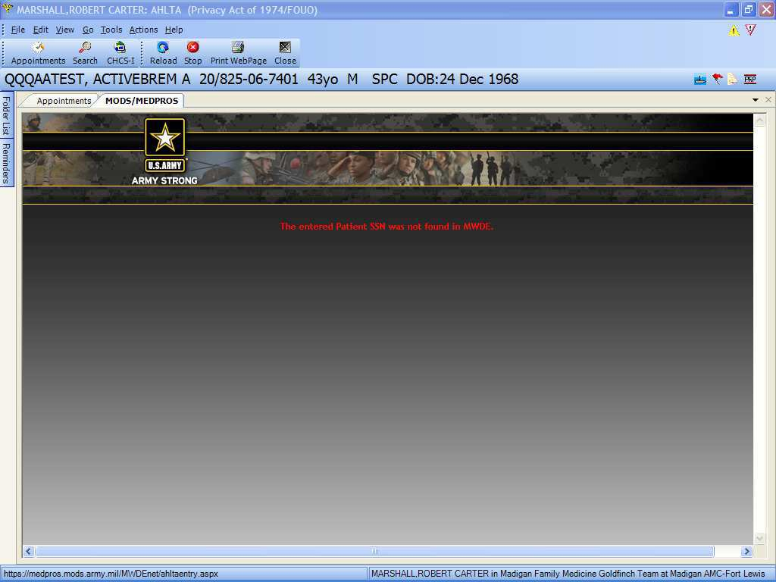
The Hearing Records link from the MODS Module opens this window. Any existing audiograms would display here.

