Slide 1

OPEN BUT NOT CHECKED IN
How To Administratively Close:
-No Show
-LWOBS
-Cancelled By Patient
Presented By: Cara D. Lee, Clinical System Instructor
Email: cara.lee@amedd.army.mil
Blackberry: (253) 302-1018
FINAL REVISION: 6 Nov 2012

Slide 2

Admin Close Button in AHLTA
Allows user to create status of “ADMINISTRATIVLEY CLOSED”
in AHLTA without writing over to CHCS
Will not overwrite any coding in ADM of CHCS
Can be undone if implemented/selected in error
FUNCTION AVAILABLE, BUT ONLY UPON REQUEST FROM ESD
Call ESD and request the “Admin Close” button in AHLTA
A ticket will be sent to the local AHLTA administrator
User will be notified via Outlook email when button activated.
GUIDANCE— Request for specific staff only
Personnel responsible for CHCS End of Day report

Slide 3
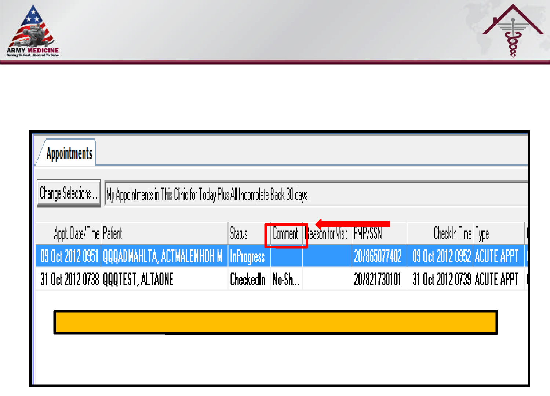
ADJUST COLUMN ORDER IN AHLTA
Drag “Comment” column next to “Status” column in Appointment Module
4
3

Slide 4
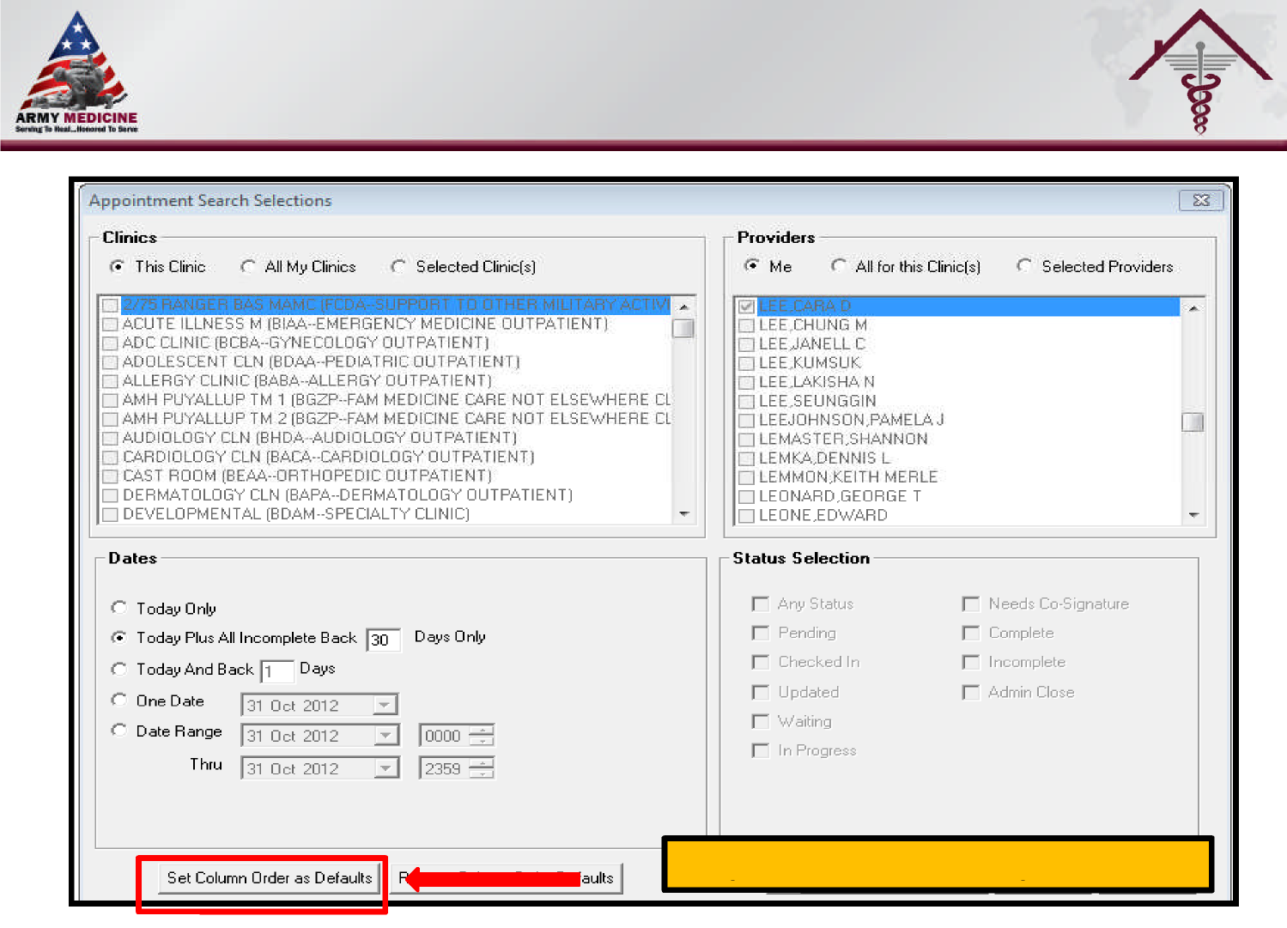
Set your column order as your default
4

Slide 5

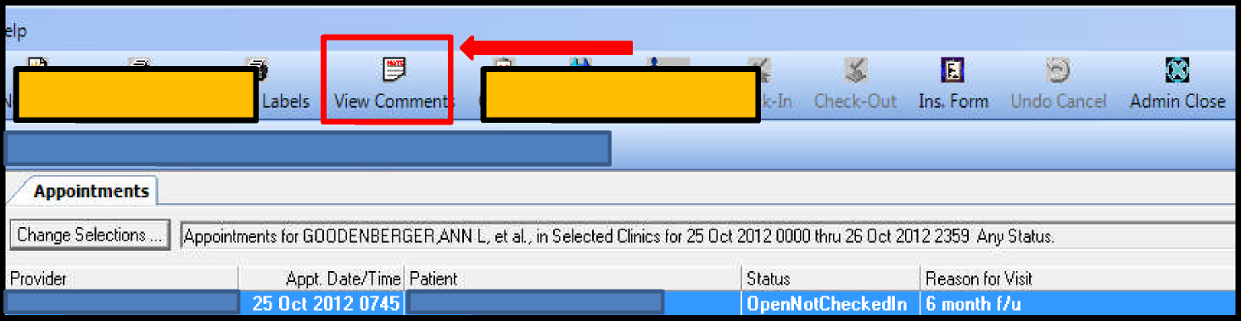
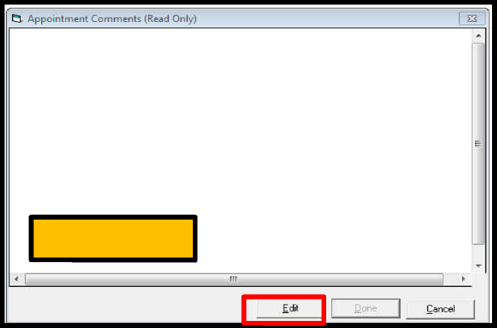
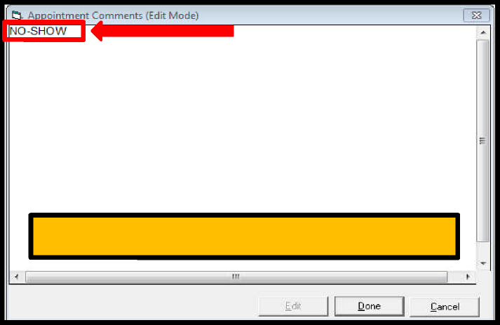
ADMIN CLOSE A SPECIFIC ENCOUNTER
1. Select Patient
2. View Comments
3. Select Edit
4. Enter accurate appointment status
Staff MUST enter WHY appointment is being closed WITH initials
Example: No-Show/CDL, LWOBS/CDL, Cancel by Patient/CDL, etc.
This facilitates data quality checks when required between AHLTA and CHCS
4
Notes:
Staff MUST enter why appointment is being administratively closed in AHLTA as well as initials (Example: No-Show/CDL, LWOBS/CDL, Cancel by Patient/CDL, etc)
This facilitates data quality checks when required between AHLTA and CHCS

Slide 6
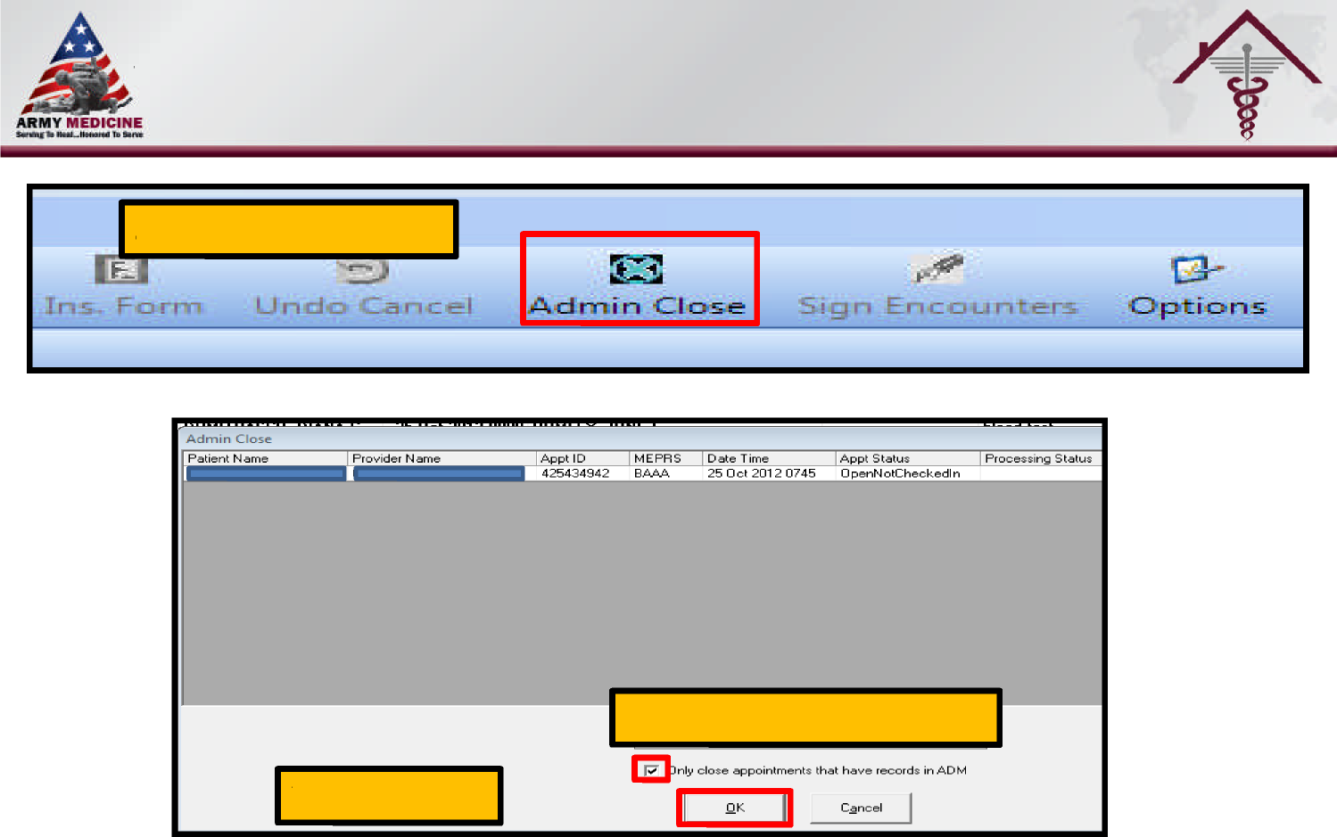
ADMIN CLOSE A SPECIFIC ENCOUNTER
5. Select Admin Close
6. De-Select ADM option
7. Select “OK”
8. CHCS-EOD report can now be updated appropriately
6

