Slide 1
OPEN BUT NOT CHECKED IN
How To Administratively Close:
    No Show
    LWOBS
    Cancelled By Patient
Presented By: Cara D. Lee, Clinical System Instructor
Email: cara.lee@amedd.army.mil
Blackberry: (253) 302-1018

Slide 2

Admin Close Button in AHLTA
1. Allows user to create status of “ADMINISTRATIVLEY CLOSED” in AHLTA without writing over to CHCS
2. Will not overwrite any coding in ADM of CHCS
3. Can be undone if implemented/selected in error
FUNCTION AVAILABLE, BUT ONLY UPON REQUEST FROM ESD
Call ESD and request the “Admin Close” button in AHLTA
A ticket will be sent to the local AHLTA administrator
User will be notified via Outlook email when button activated.
GUIDANCE— Request for specific staff only
Personnel responsible for CHCS End of Day report

Slide 3
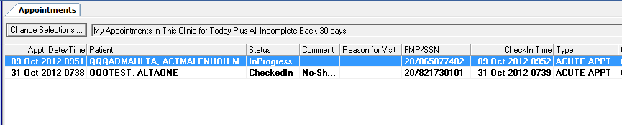
ADJUST COLUMN ORDER IN AHLTA
Drag “Comment” column next to “Status” column in Appointment Module

Slide 4
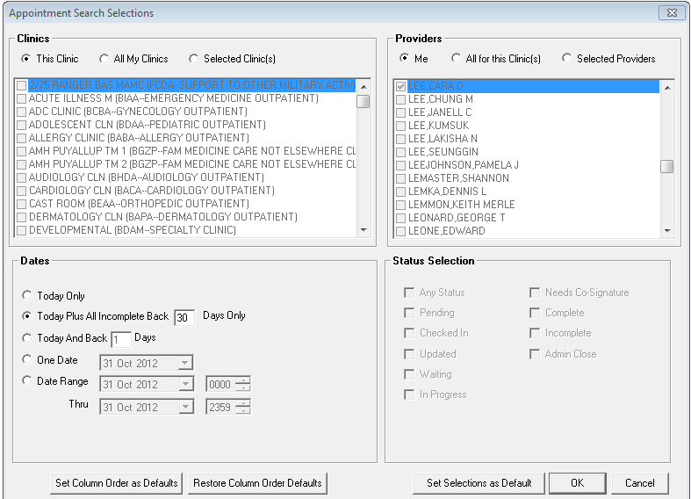
Set your column order as your default

Slide 5
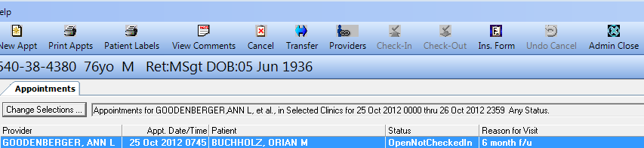
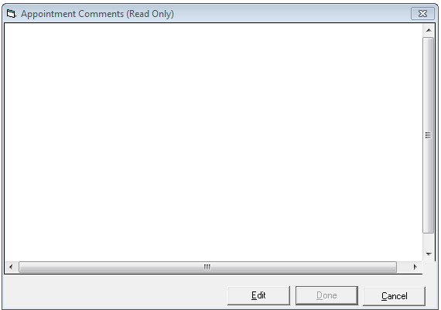
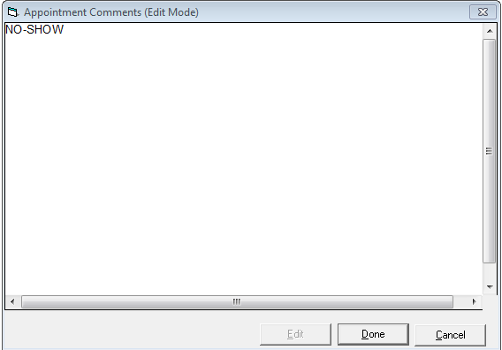
ADMIN CLOSE A SPECIFIC ENCOUNTER
1. Select Patient
2. View Comments
3. Select Edit
4. Enter accurate appointment status

Slide 6
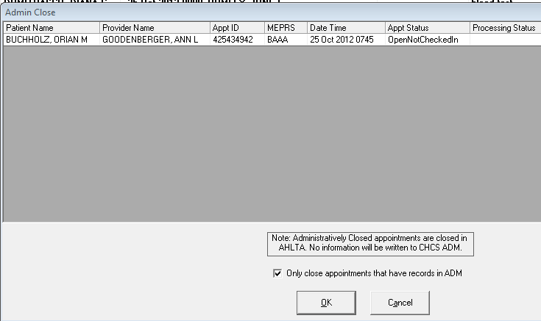
ADMIN CLOSE A SPECIFIC ENCOUNTER
5. Select Admin Close
6. De-Select ADM option
7. Select “OK”
8. CHCS-EOD report can now be updated appropriately

