Slide 1



VB Users Club
MAPS Advanced Scripting Macros
Ron Yeaw
Meeting #2 (07 Sep 2011)

Slide 2
Agenda
Visual Basic Overview
Learn to import and utilize existing VB Code
Create a VB form
Begin work on an IV Start/Stop Time form
  Import Basement code
  Draw layout of form
  Create buttons and text boxes
  Paste in AHLTA code
  Compile text statements from form
Review current status and next months goals

Slide 3
Visual Basic Overview
Visual Basic is a programming language
Visual Basic for Applications is a subset of VB for MS Office
Visual Basic differs from most languages in that
  It is “Visual” in nature
  It is “Object Oriented”
  It is designed for the casual user
Visual Basic’s visual interface is a similar comparison to CHCS and AHLTA. AHLTA uses a VB front end and its events are triggered. CHCS uses a text interfaces to fire off code.
Notes:
Low learning curve
Non-linear Programming
Instead of sequential, more of a choose your own adventure approach
No table of contents, a collection of chapters of object code.
Difference between CHCS and AHLTA (point and click), minus the Tier 1 errors
Why have Dragon when all you want is macros
Dragon focuses on every part of the screen and is memory intensive as AHLTA

Slide 4
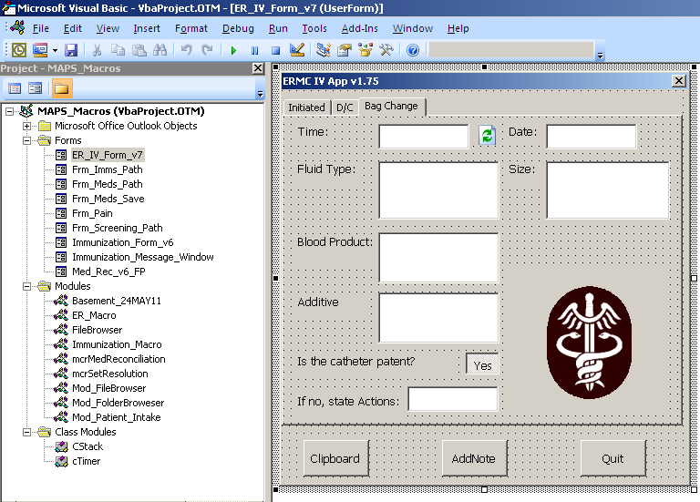
IV Start/Stop Macro

Slide 5
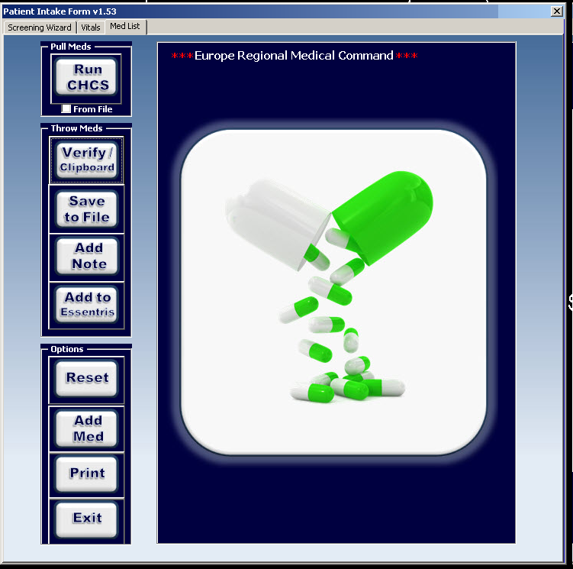
VBA Core Functions
AppActivate
SendKeys
fWait
CASE
Setting Variables
Using If/Then’s
Basement Commands
  fTracer
  fGetUserLastName
  fCheckForWindow
  fActivateWindow
Notes:
BACKSPACE {BACKSPACE}, {BS}, or {BKSP}
BREAK {BREAK}
CAPS LOCK {CAPSLOCK}
DEL or DELETE {DELETE} or {DEL}
DOWN ARROW {DOWN}
END {END}
ENTER {ENTER} or ~
ESC {ESC}
HELP {HELP}
HOME {HOME}
INS or INSERT {INSERT} or {INS}
LEFT ARROW {LEFT}
NUM LOCK {NUMLOCK}
PAGE DOWN {PGDN}
PAGE UP {PGUP}
PRINT SCREEN {PRTSC}
RIGHT ARROW {RIGHT}
SCROLL LOCK {SCROLLLOCK}
TAB {TAB}
UP ARROW {UP}
F1-F16 {F1}-{F16}
SHIFT = +
CTRL = ^
ALT = %

