Slide 1



VB Users Club
MAPS Advanced Scripting Macros
Ron Yeaw
Meeting #1 (03 Aug 2011)

Slide 2
Intro to Using VBA
Outline purpose of the VB Club
Provide an overview about Visual Basic
Give a tour of the VB for Applications software that is on your own machine
Show proof of concept examples
Discuss possible group project to work towards as we develop our VB skills

Slide 3
Outline Purpose of the VB Club
Result of request from Williamsburg CST conference
  Demo
Introduction to Visual Basic
  Pros and Cons compared to Dragon & AUT
  Overall VB Concepts
Using Visual Basic for Applications to develop Macros
Course will be a primer, ground up approach to VB development assuming no previous programming knowledge
  8-10 core tricks to solve *every* AHLTA macro
  Code can be copy and pasted with ease
  Custom graphics can be inserted easily
Notes:
Williamsburg
Macros
Show sample
Methodical process
Giant universe, but I’m going to show you how to make a par that down to the 6 or 7 commands you need

Slide 4
Visual Basic Overview
Visual Basic is a programming language
Visual Basic for Applications is a subset of VB for MS Office
Visual Basic differs from most languages in that
  It is “Visual” in nature
  It is “Object Oriented”
  It is designed for the casual user
Visual Basic’s visual interface is a similar comparison to CHCS and AHLTA. AHLTA uses a VB front end and its events are triggered. CHCS uses a text interfaces to fire off code.
Notes:
Low learning curve
Non-linear Programming
Instead of sequential, more of a choose your own adventure approach
No table of contents, a collection of chapters of object code.
Difference between CHCS and AHLTA (point and click), minus the Tier 1 errors
Why have Dragon when all you want is macros
Dragon focuses on every part of the screen and is memory intensive as AHLTA

Slide 5
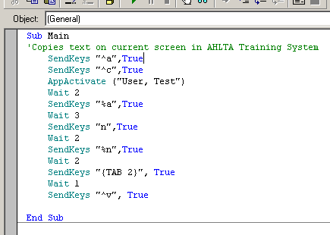
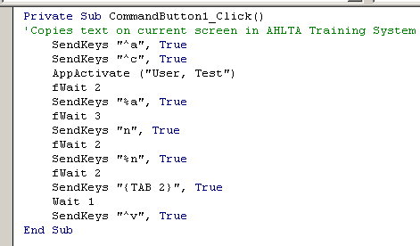
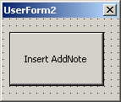
Visual Basic vs Dragon
Dragon is voice activated vs “event” activated
VB is free and requires no additional license
VB has very little memory requirements
Dragon medical macros *are* VB macros
Notes:
Dragon uses a subset of Visual Basic and adds two or three of its own commands (SendDragonKeys, HeardWord)

Slide 6
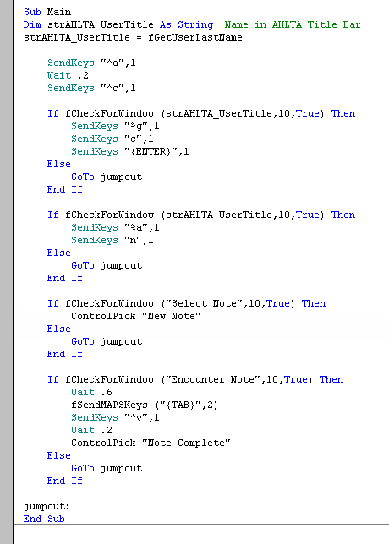
Visual Basic vs Dragon
VB offers more control
Solves macro problems:
  AHLTA User Name
  Arbitrary waiting
  Window focus
  Error Handling
70% Effective
98% Effective
6

Slide 7
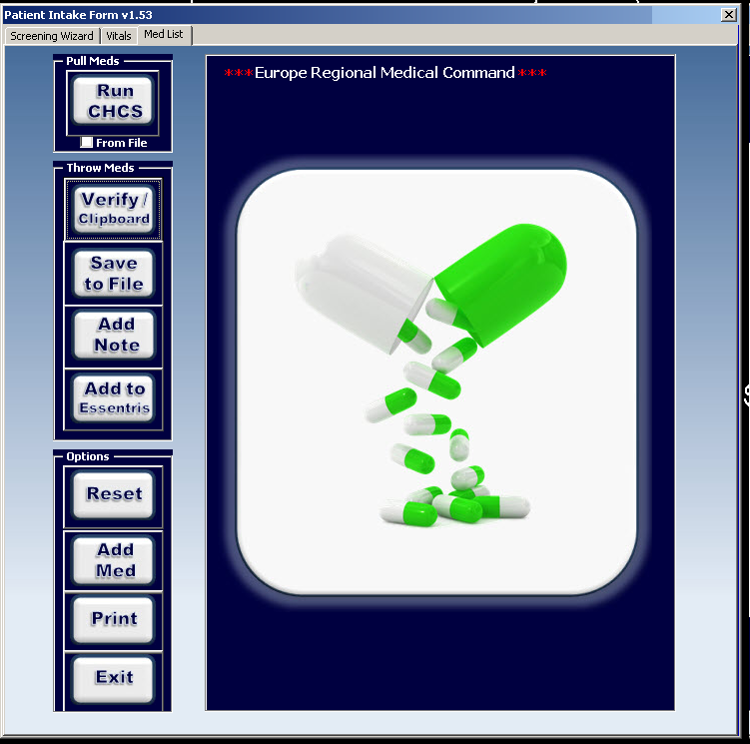
VBA Core Functions
AppActivate
SendKeys
fWait
CASE
Setting Variables
Using If/Then’s
Basement Commands
  fTracer
  fGetUserLastName
  fCheckForWindow
  fActivateWindow
Notes:
BACKSPACE {BACKSPACE}, {BS}, or {BKSP}
BREAK {BREAK}
CAPS LOCK {CAPSLOCK}
DEL or DELETE {DELETE} or {DEL}
DOWN ARROW {DOWN}
END {END}
ENTER {ENTER} or ~
ESC {ESC}
HELP {HELP}
HOME {HOME}
INS or INSERT {INSERT} or {INS}
LEFT ARROW {LEFT}
NUM LOCK {NUMLOCK}
PAGE DOWN {PGDN}
PAGE UP {PGUP}
PRINT SCREEN {PRTSC}
RIGHT ARROW {RIGHT}
SCROLL LOCK {SCROLLLOCK}
TAB {TAB}
UP ARROW {UP}
F1-F16 {F1}-{F16}
SHIFT = +
CTRL = ^
ALT = %

Slide 8
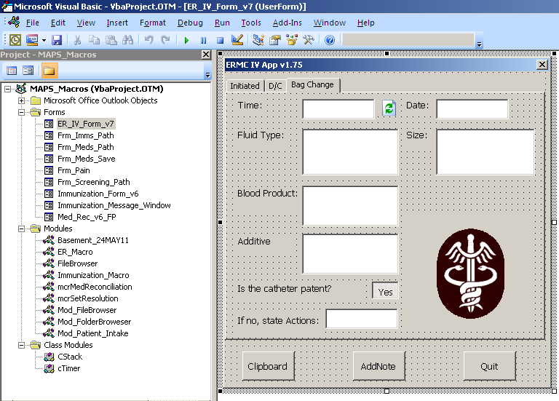
VBA Tour & Examples
Creating a VB form
Creating simple code for that form

Slide 9
Teaching Project
Add Note AHLTA
Using Labels & Text Fields
Rock/Paper/Scissor
Suggestions?
Encounter Macro Widget
Training survey generator
Recreating one of Ron’s current macros
Possible Club Project

