Slide 1
Adding the National Provider Identifier to Network Consults

Slide 2
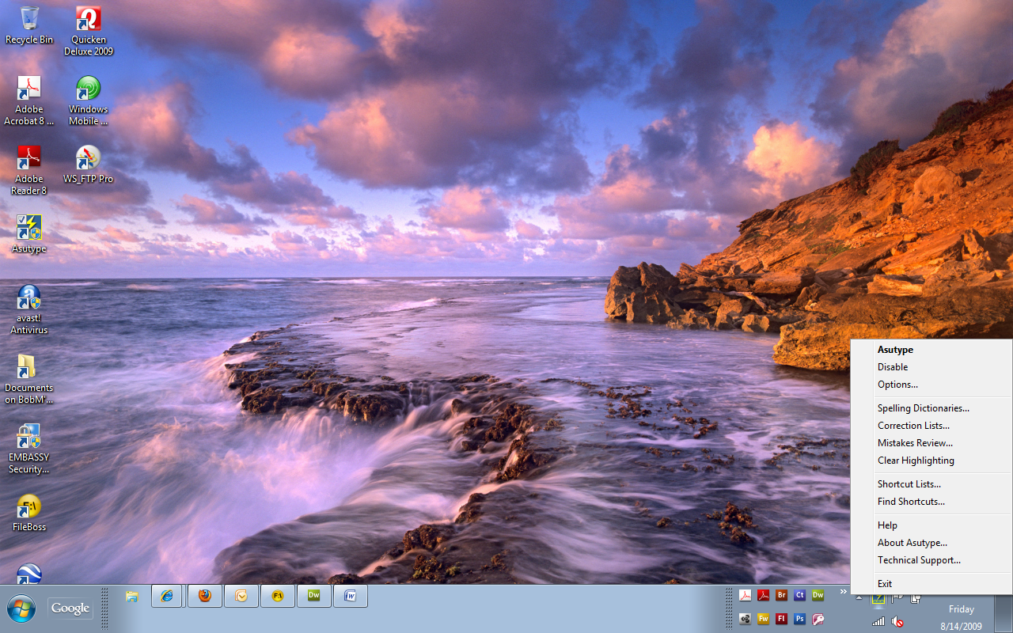
Right click on the icon in the toolbar (red arrow) and then left click on “Asutype” in the pop-up dialog box (pink arrow) to open AsUType.

Slide 3
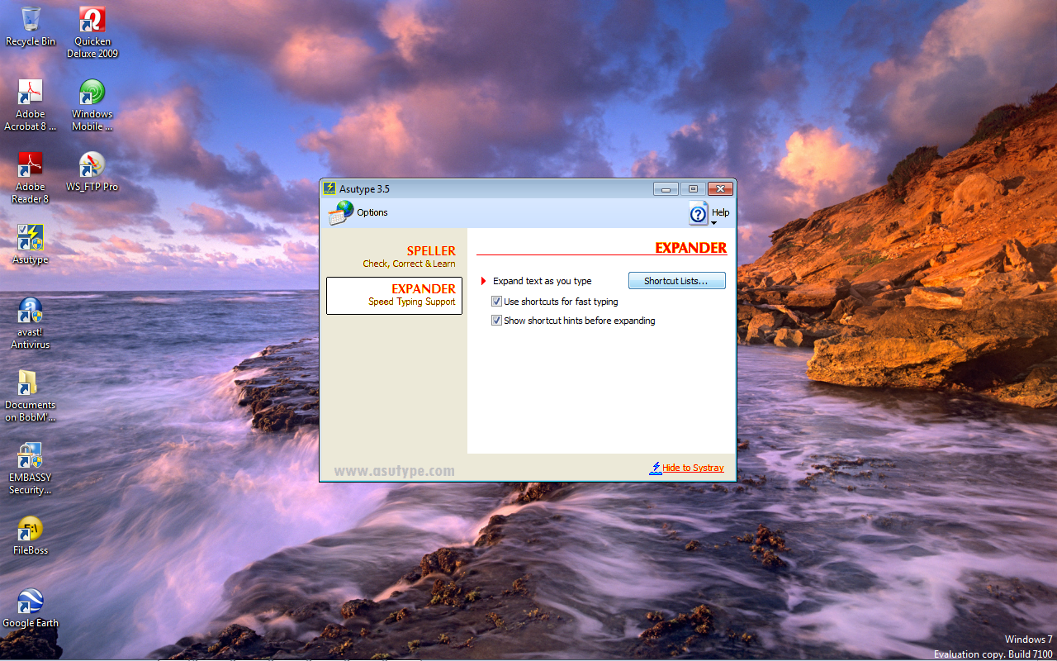
Left click on “Expander” (pink arrow) and then left click on “Shortcut Lists” (red arrow)

Slide 4
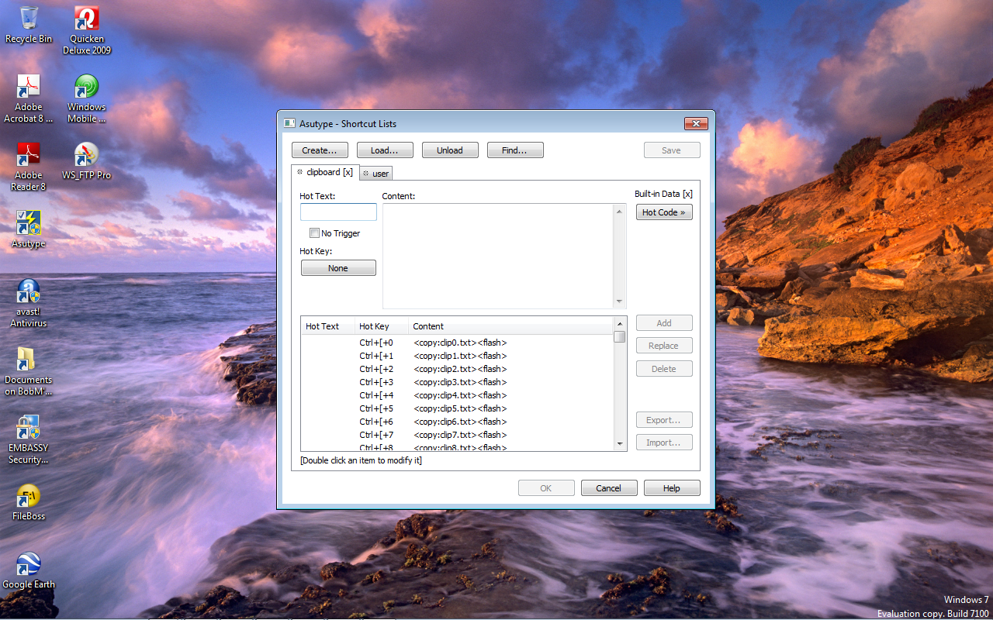
This dialog box opens ready for you to import text or simply type directly into the “Content” box

Slide 5
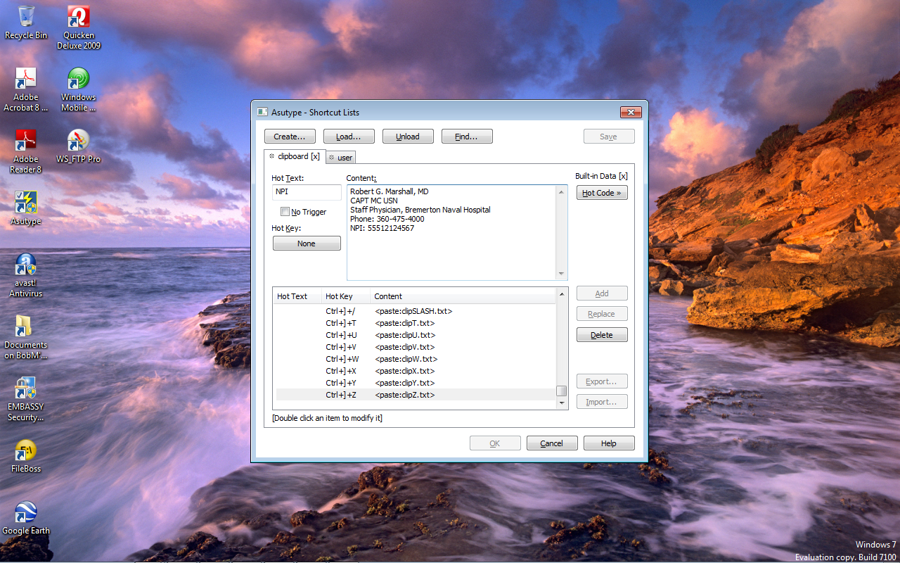
Click the tab for “user” to add this to your list. Place a shortcut name in the “Hot Text” box (pink), add your content into the “Content” box (red) and hit Add (purple) to add the shortcut to your list.

Slide 6
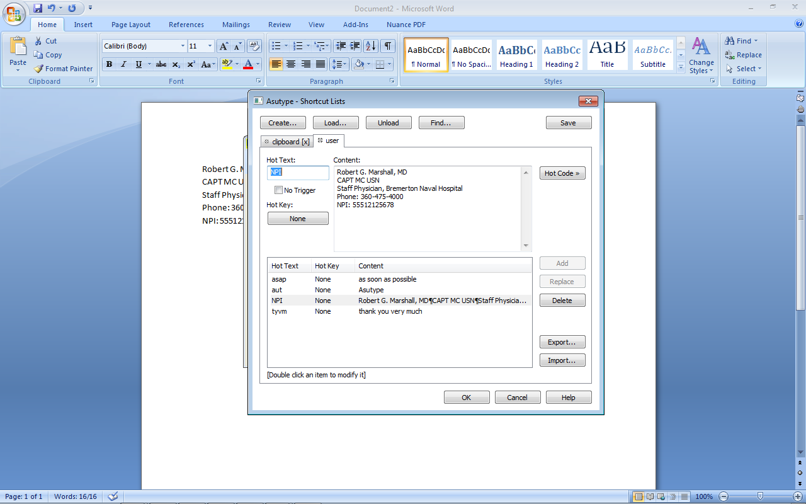
The new shortcut has now been added to the “user” list (which should be you) for later use. All you have to do is type in the “Hot Text” wherever you want the content to appear…in this case, in Network consults.

Slide 7
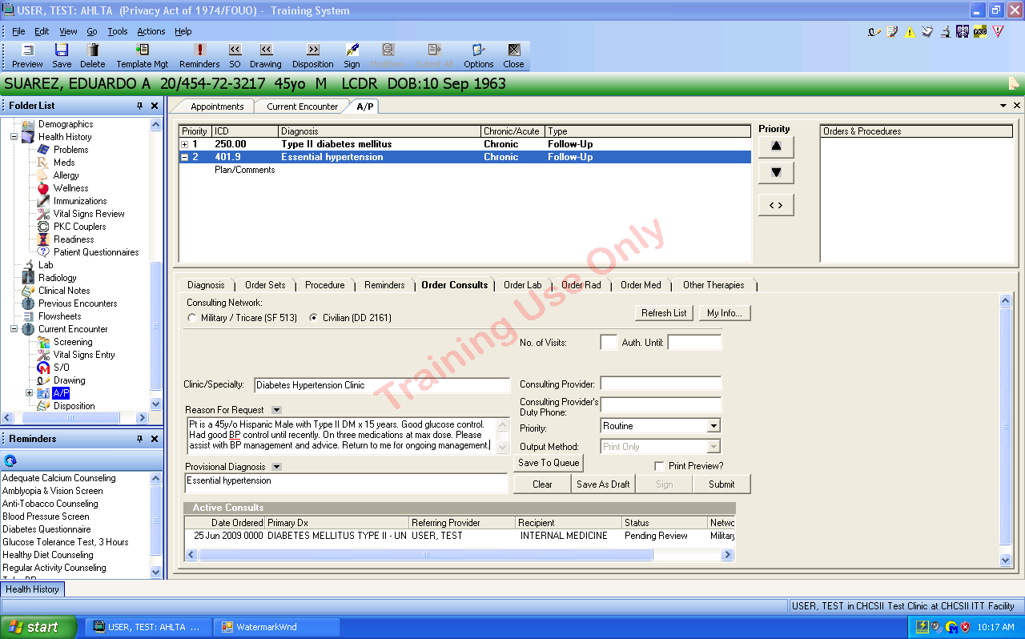
In the A/P Module, click on the appropriate radio button to write a civilian consult… see pink box.
Write the consult as you want it to appear… see dark red box.

Slide 8
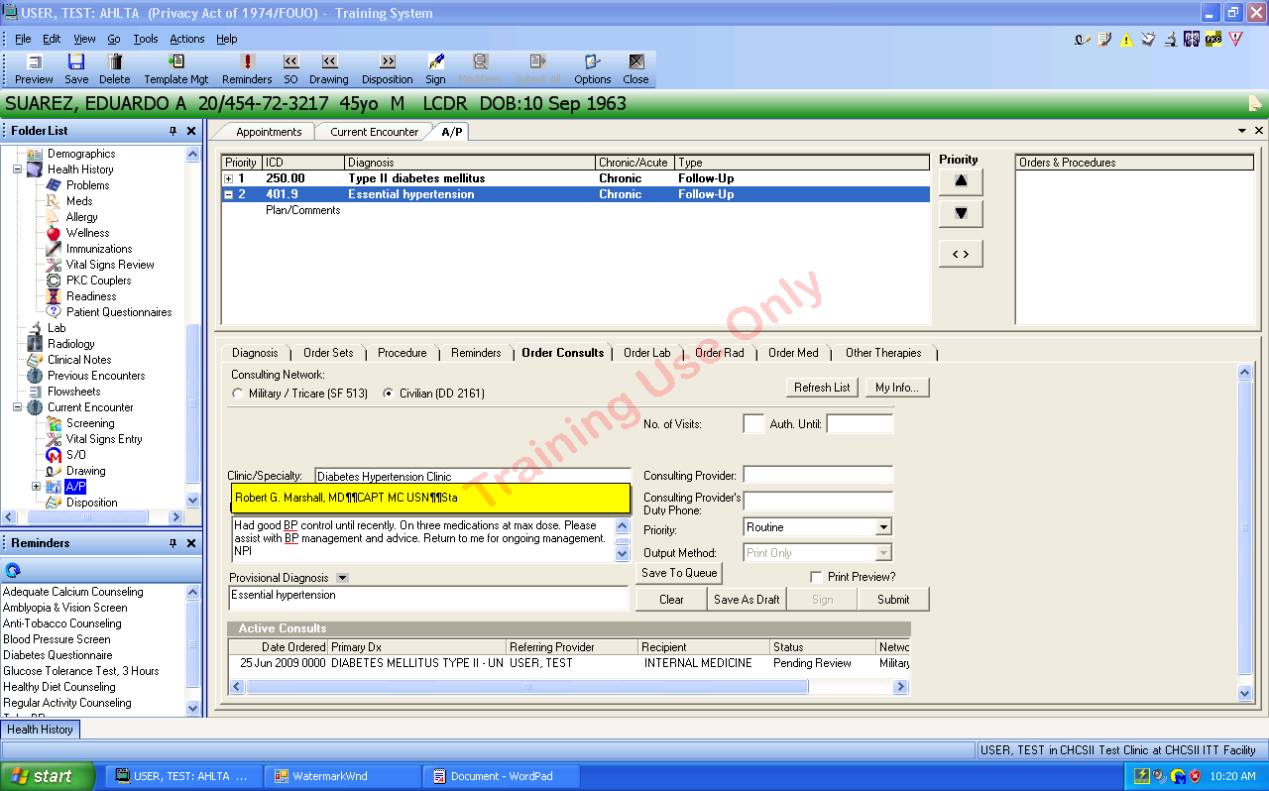
2. Asutype will pop up this dialog box telling you that it recognized the Hot Text and the initial contents of the text macro.
1. Type in the Asutype Hot Text where you want it to appear in the consult… based on directions from PAD.

Slide 9
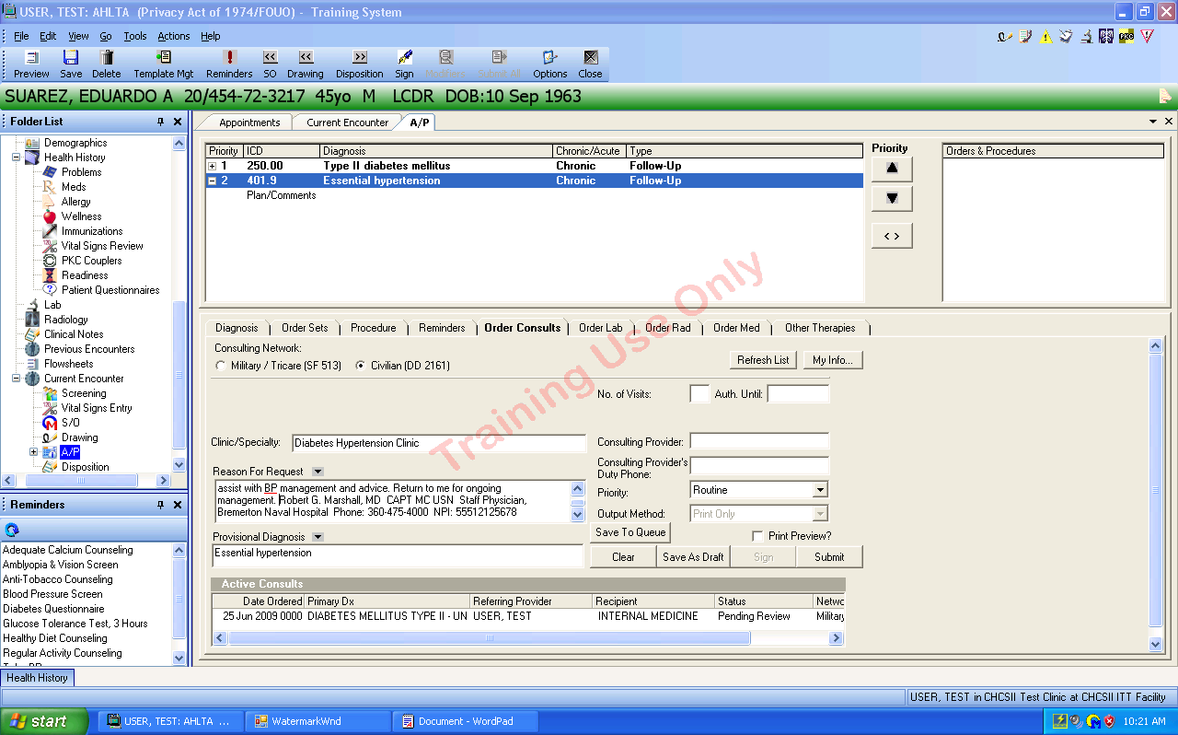
At exactly the point where you placed the Hot Text, Asutype will insert the contents of the shortcut /macro.

Slide 10
Questions
If you have any questions about using Asutype in AHLTA or Essentris, please contact CDR Dave Shapiro (on the Global Address List) or your Regional AHLTA/Essentris Clinical Champion.
You can also find additional tutorial and help information within Asutype or on the USAFP Web site (www.usafp.org).

