Slide 1
PHA Documentation & Coding
Family Medicine Dept.
Karen Kanakaole
&
Christina Guardiola-Holcomb

Slide 2
What is a PHA?
Periodic Health Assessment
Completed annually for all Active Component and Select Reserve Soldiers/Sailors/Airmen
An integral part of the Individual Medical Readiness System
Provides electronically recorded annual assessment of every ADSM’s ability to deploy anywhere in the world
ADSM - Active Duty Service Member
Notes:
This is just a brief explanation of what a PHA is and how it affects the service member(s).

Slide 3
The HPI needs to reflect:
- that the reason for the visit is for completion of a PHA.
- any condition/problems that will be addressed during the PHA visit.
The Physical Examination needs to reflect:
- any/all hands-on exams that are completed during the visit, addressing all issues documented in the HPI.
Assessment/Plan needs to reflect:
- documented medical decision(s) and plan for all issues addressed in the HPI and physical examination.
Disposition needs to reflect:
- accurate discharge status of the patient.
Notes:
If the chief complaint is not what the admin staff entered, per DoD coding guidelines (3.1.1.1), the corrected chief complaint must be documented.
As you will see in the examples…there should a continuous flow that starts from the HPI and ends with the disposition.
Physical Exam:

Slide 4
MEDPROS/MODS
PHAs: Although the history and/or physical exams for PHAs may be completed in MEDPROS, the information has to be cited in the AHLTA note. In this situation, a provider may document “Refer to MEDPROS for history and/or physical exam”; if the MEDPROS documentation supports the coding assigned for the AHTLA encounter, it will be considered acceptable for the CARA audit.
Under current guidance, if the MEDPROS documentation does not support the coding assigned for the AHLTA encounter, it will be marked incorrect for purposes of the CARA audit.
Notes:
Basically, what this says is…if you do anything in MEDPROS and/or MODS that is not documented in your AHLTA note…you must refer to where this additional information can be found and that statement must be within the body of your AHLTA note.

Slide 5
What E&M code do I use?
PHA
99499 -
Non face-to-face record review, no exam, no counseling, reviewed by provider
99420 -
Face-to-face record review, no exam, no counseling, reviewed by provider
99401 -
Face-to-face encounter, no exam, counseling provided to an individual,
approximately 15 minutes
99402
Face-to-face encounter, no exam, counseling provided to an individual,
approximately 30 minutes
PHA + condition/problem
Appropriate PHA E&M (above) + 99201-99215 (w/ modifier 25)
Face-to-face record review, hands-on exam for a condition/problem that was addressed and documented during the PHA visit .
Notes:
Here we see the most common codes associated with PHAs. Most commonly found when records are audited is 99420, face to face record review, no exam, no counseling, reviewed by provider. We also realize there might be a times when counseling is done at these encounters; in which case 99401 and 99402 can be accessed. Of emphatic importance to adhere to the guidelines; time and the elements of the conversation must be documented in the encounter. These specific counseling codes are distinct from other E/M service as they are for risk factor reduction services. They are for person/s without a specific illness but might require counseling on lifestyle modification for risky behavior, preventive counseling based on family history and occupational exposure.

Slide 6
Coding Guidance
On the previous slide, we see the most common codes associated with PHAs.
Most commonly found when records are audited is 99420, face to face record review, no exam, no counseling, reviewed by provider.
There might be times when counseling is done at these encounters; in which case 99401 and 99402 can be accessed.
It is important to adhere to the guidelines; time and the elements of the conversation must be documented in the encounter.
These specific counseling codes are distinct from other E/M service as they are for risk factor reduction services.
They are for person/s without a specific illness but might require counseling on lifestyle modification for risky behavior, preventive counseling based on family history and occupational exposure.

Slide 7
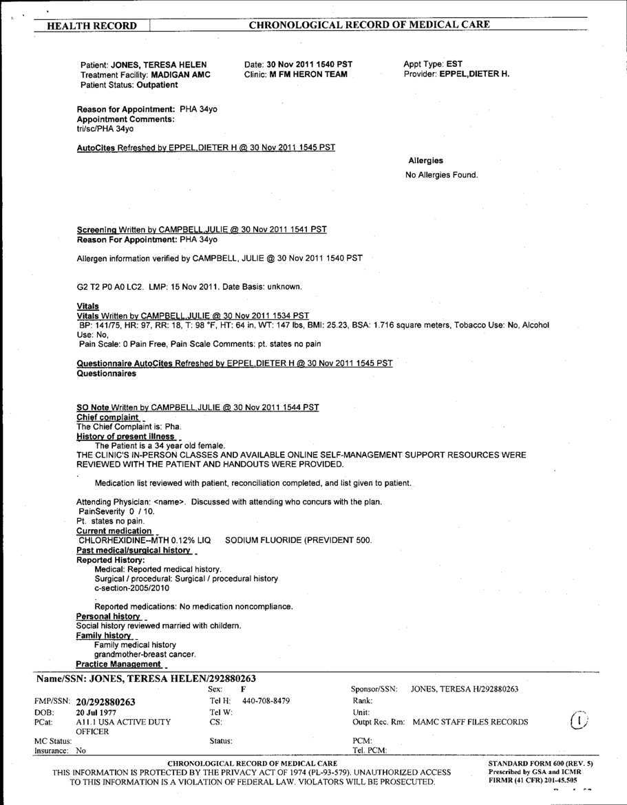
Sample 1
Notes:
Here’s an example of a PHA encounter with no hands-on and no addition issues are address and no risk factors identified and no counseling was done.

Slide 8
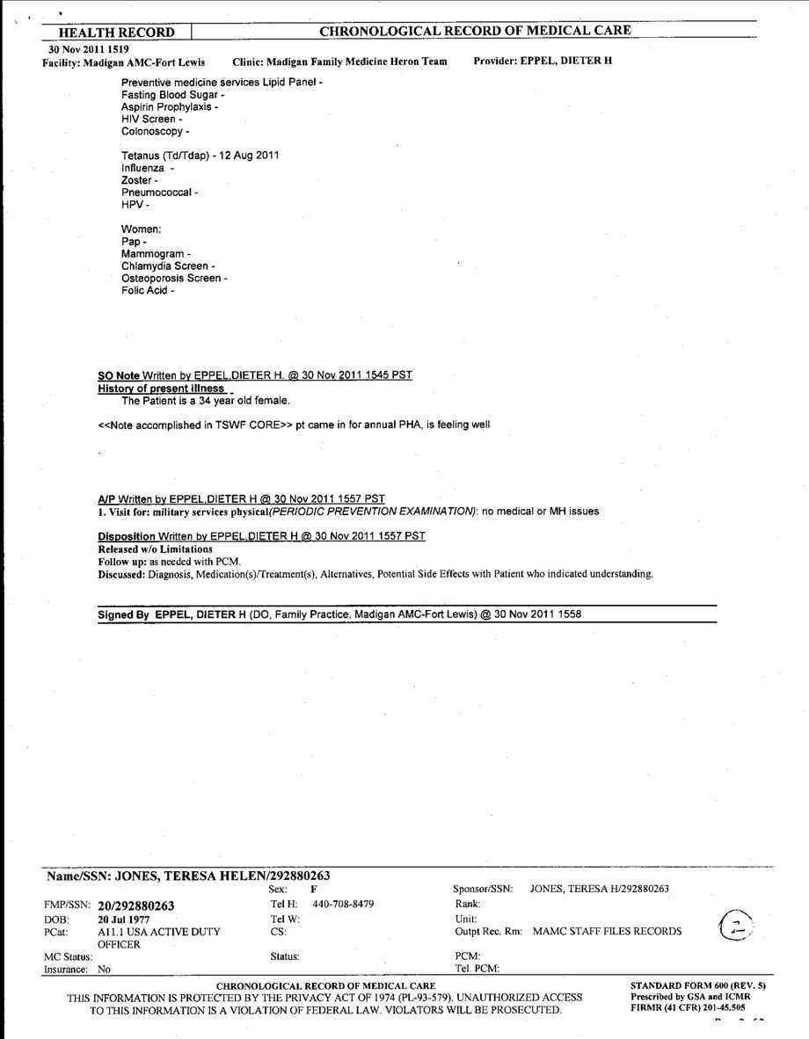
No hands-on exam
What
E&M
Code?
99420
Notes:
Going off of the handout with the description of all the codes…what E&M code would you assign to this particular encounter?

Slide 9
How to manually change your E&M type…

Slide 10
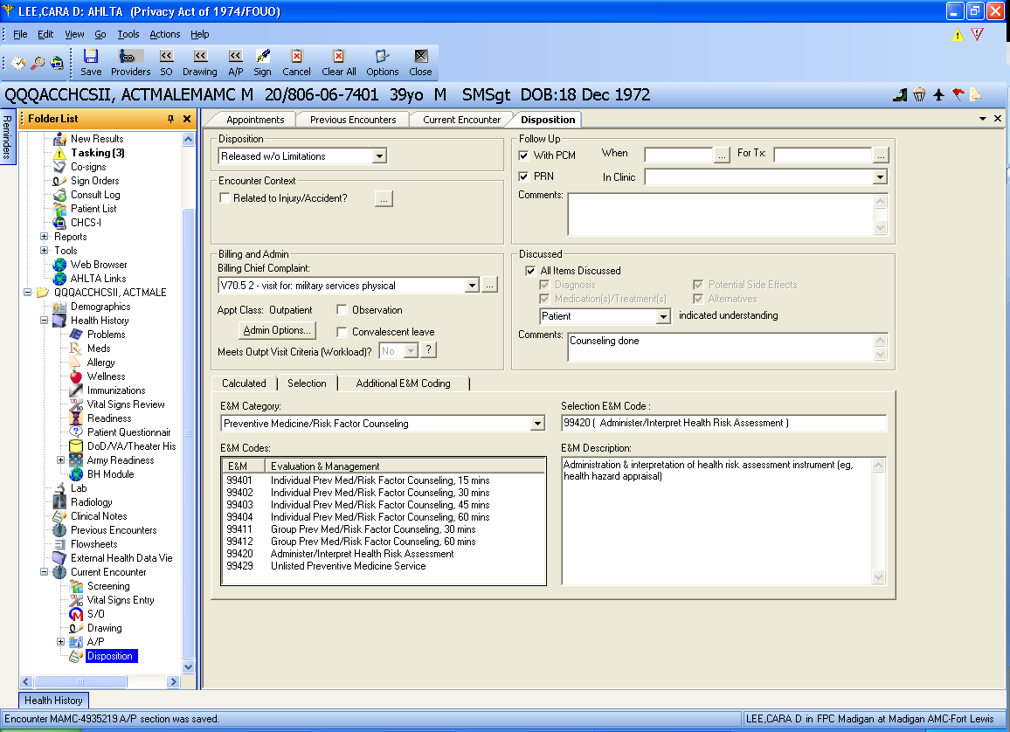
-To manually change the E&M code to the correct one…
In the disposition module…
click on the “selection” tab (#1)
click on the E&M category dropdown box (#2)
then choose the E&M code that you need (#3)
-If a second E&M is not needed, you can then go directly to the “sign” box in the top toolbar
1
2
3
Notes:
To manually change the E&M code to the correct one…
In the disposition module…click on the “selection” tab (#1) – click on the E&M category dropdown box (#2) – then choose the E&M code that you need (#3)
If a second E&M is not needed, you can then go directly to the “sign” box in the top toolbar

Slide 11
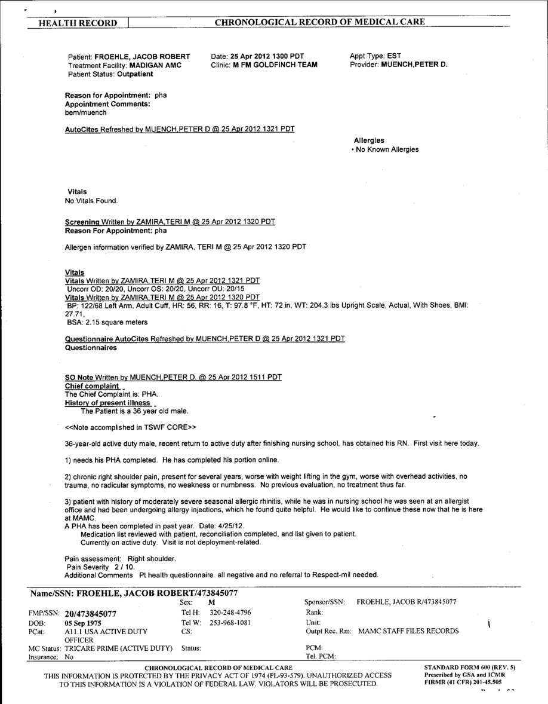
Sample 2
-Here’s another example of a PHA encounter.
-Notice that a visual acuity was done and results are documented.
-You can see how the cc is reflected in the HPI .
-Additional issues are identified and addressed
Cc and HPI correspond
Additional issues identified
Notes:
Here’s another example of a PHA encounter.
Notice that a visual acuity was done and results are documented.
You can see how the cc is reflected in the HPI .
Additional issues are identified and addressed.

Slide 12
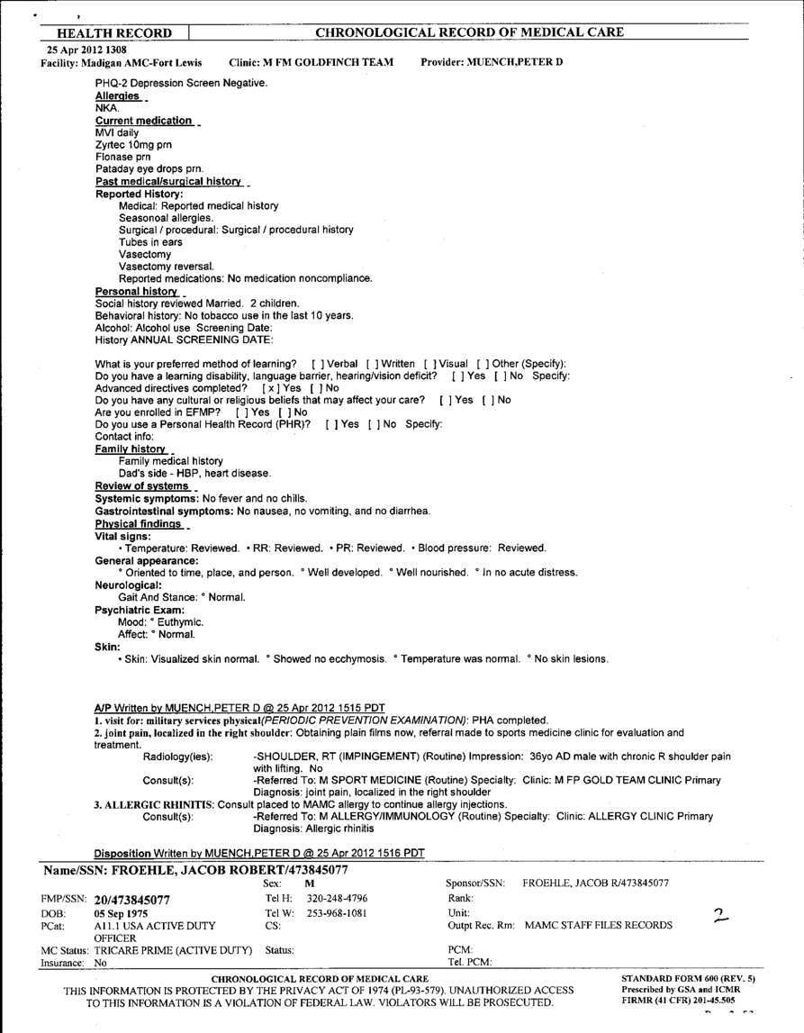
-A hands-on physical exam is done and documented.
-Correct dx coding for this encounter include those indicated above…the code for the PHA, R shoulder pain and allergic rhinitis as they were identified and addressed in the A/P.
-The only thing missing from this is the CPT code for the visual acuity (99173). -That code would be associated with the PHA dx code as it is part of the physical.
Dx codes:
V70.5 2 + R shoulder pain and allergic rhinitis.
Visual acuity CPT code could have been added and linked to the physical dx here
Notes:
A hands-on physical exam is done and documented.
Correct dx coding for this encounter include those indicated above…the code for the PHA, R shoulder pain and allergic rhinitis as they were identified and addressed in the A/P. This is the thread we were referring to earlier; starting in the HPI and following through the A/P.
The only thing missing from this is the CPT code for the visual acuity (99173). That code would be associated with the PHA dx code as it is part of the physical.

Slide 13
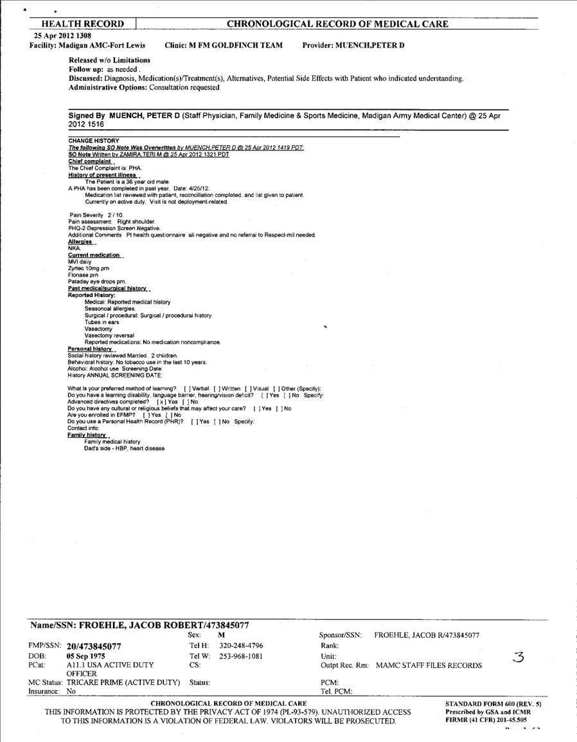
99420 +
99213 w/ mod. 25
What
E&M
Code?
Notes:
Patient status is accurately noted.
Ok…again…what E&M code(s) would you use for this encounter?

Slide 14
How to add 2nd E&M code with Modifier 25…

Slide 15
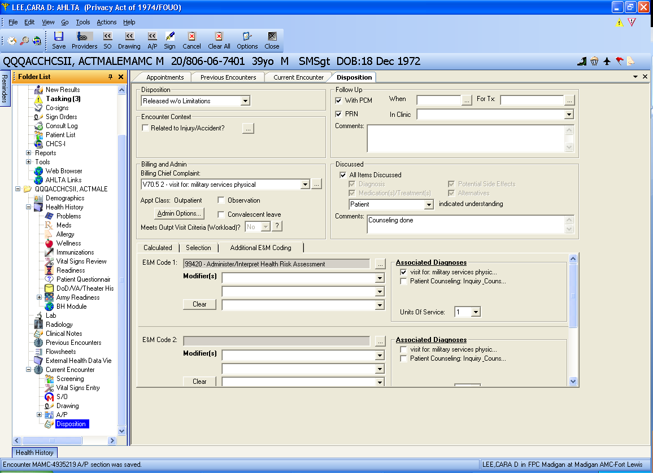
-Follow the instruction given early to apply your first E&M code.
-After you’ve done that, the next step is to add the 2nd E&M code with the modifier 25.
-The modifier 25 is applied because it indicates a problem/illness/condition was addressed and documented in addition to the PHA.
-First, click on the “additional E&M coding” tab.
-You then click on the little box next to the “E&M Code 2” box.
1
2
Notes:
Follow the instruction given early to apply your first E&M code. After you’ve done that the next step is to add the 2nd E&M code with the modifier 25. The modifier 25 is applied because it is indicating that an additional problem/illness/condition was addressed and documented in addition to the PHA.
First, click on the “additional E&M coding” tab. Then you click on the little box next to the “E&M Code 2” box.

Slide 16
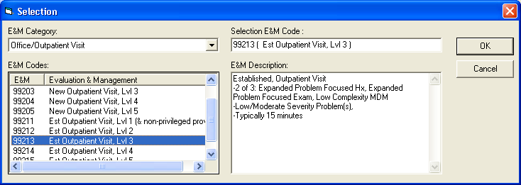
-This is the box that pops up.
-You will again click on the E&M Category drop down box (#1)
-Pick the appropriate E&M based on the documentation of your additional workup (aside from the PHA information).
-You can see the E&M code that you pick/highlight now appears in the right side. This is the 2nd E&M code that will be embedded.
-Click OK.
1
2
Notes:
This is the box that pops up. You will again click on the E&M Category drop down box (#1)
Pick the appropriate E&M based on the documentation of your additional workup (aside from the PHA information).
You can see that the E&M code that you pick/highlight now appears in the right side. This is the 2nd E&M code that will be embedded.
Click ok.

Slide 17
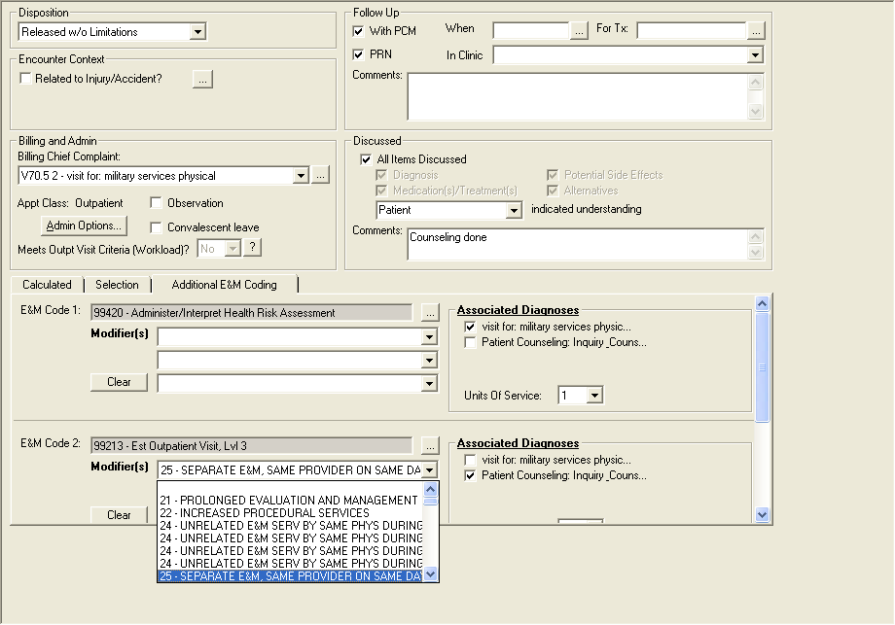
-Click on the dropdown box under the E&M code 2, where it says “modifier” in bold lettering
-Pick “25-Separate E&M, Same provider on same day”
-Notice that you should associate the diagnosis/diagnoses with the relevant E&M code.
-In this case, the 99420 is associated with the “visit for military services physical” which is V70.5 2
-The 2nd E&M code is associated with the shoulder pn and the allergic rhinitis (pretend that’s what those associated dx’s say on the 2nd E&M).
Notes:
You can see both E&M codes here. Now you need to add the modifier 25 to the second E&M (because that’s the separate/additional information).
Click on the dropdown box under the E&M code 2, where it says “modifier” in bold lettering
Pick “25-Separate E&M, Same provider on same day”
Notice that you should associate the dx’s with the what goes with each E&M code. In this case, the 99420 is associated with the “visit for military services physical” which is V70.5 2 and the 2nd E&M code is associated with the shoulder pn and the allergic rhinitis. (pretend that’s what those associated dx’s say on the 2nd E&M)

Slide 18
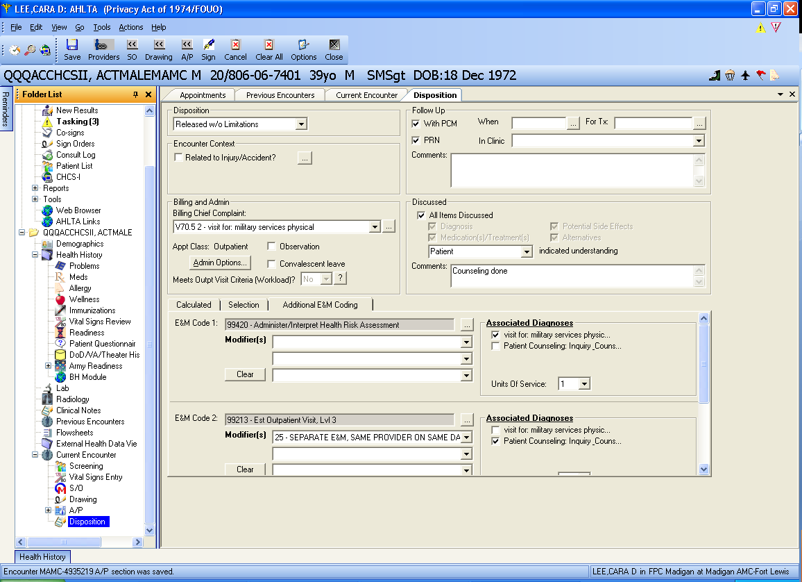
Notes:
This is what it will look like…and now you just have to sign it to close it.

Slide 19
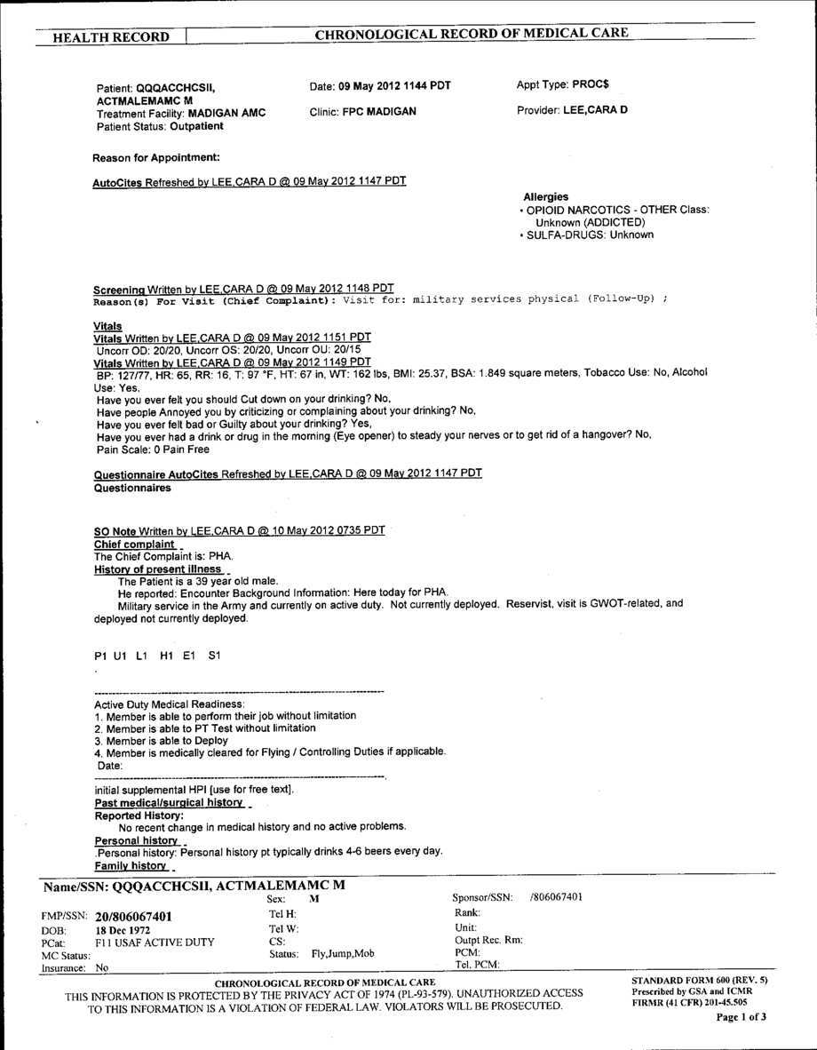
Sample 3
-visual acuity was done and documented
-Cc correlates with HPI
Notes:
There are a few things we’re going to point out on this example. It shows the following…
visual acuity was done and documented
cc corralates with HPI

Slide 20
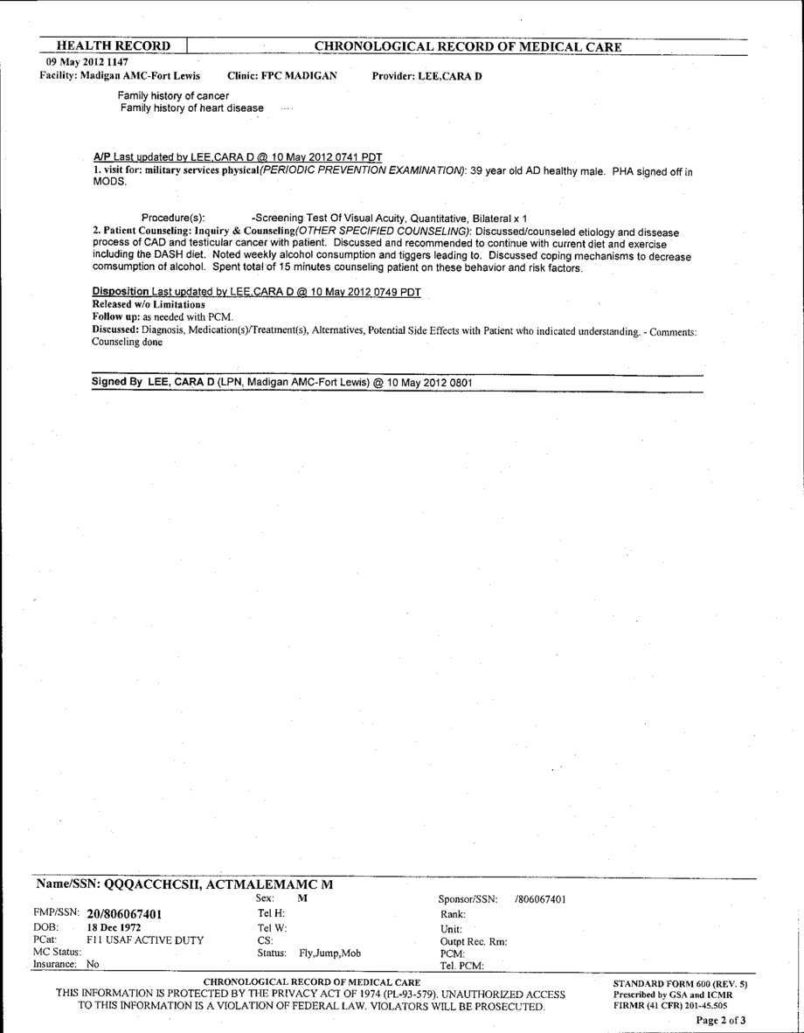
Dx:
V70.5 2 + V65.49 X
Counseling specifics and time MUST be documented
-A positive family hx of diseases is noted.
-Everything that we’re pointing out will be of significance in the coding…
-In the A/P you will notice the dx for the PHA and the counseling for risk factor reduction/behavior modification is related the positive family hx and his noted alcohol use.
-Patient status is correctly identified in the disposition.
Brief, non-descriptive statements like; “Counseled on condition, diagnosis, or treatment alternatives” are not acceptable documentation in and of itself.
What
E&M
Code?
99401
Notes:
A positive family hx of diseases are noted.
Everything that we’re pointing out will be of significance in the coding…
In the A/P you will notice the dx for the PHA and
The counseling for risk factor reduction/behavior modification is related the positive family hx and his noted alcohol use.
Patient status is correctly identified in the disposition.
Ok…what E&M code goes with this encounter.

Slide 21
Conclusion
99420 most common code
99401/02 may be accessed if counseling is documented
Counseling must include time and elements of the conversation
99201-99215 E/M codes may be accessed for condition(s)/problem(s) were addressed during the PHA visit.
Don’t forget to add modifier 25 if you have a second E&M code.
Notes:
Here’s a summary of what we talked about today for PHAs. Any questions?

