Slide 1
Clinical Informatics – An Introduction
Bob Marshall, MD, MPH, MISM, FAAFP, FAMIA Program Director, DoD/MAMC Clinical Informatics Fellowship
1

Slide 2
Terminal Learning Objectives
Overview of Clinical Informatics systems and capabilities
Overview of the benefits of using data to answer important questions
Overview of the research process
Identifying a QI/PI topic

Slide 3
Definition of CI
Discipline at the intersection of information science, computer science, and health care
Deals with the resources, devices, and methods required to optimize acquisition, storage, retrieval, and use of information in health and biomedicine

Slide 4
Clinical Informaticians
Transform health care by:
analyzing, designing, implementing, and evaluating information and communication systems to
enhance individual/population health outcomes, improve patient care, enhance care coordination and strengthen clinician-patient relationships

Slide 5
Clinical Informaticians 1
Use their knowledge of patient care combined with their understanding of informatics concepts, methods, and health informatics tools to:
assess information/knowledge needs of health care professionals and patients,
characterize, evaluate, and refine clinical processes,
develop, implement, and refine clinical decision support systems, and

Slide 6
Clinical Informaticians 2
lead or participate in the procurement, customization, development, implementation, management, evaluation, and continuous improvement of clinical information systems.

Slide 7
Domains/Components of Clinical Informatics
EHR – inpatient, outpatient, ED
PACS
PAD/Coding
Business Intelligence/Data Analytics
Implementation and sustainment
Laboratory/Pharmacy/Blood/OR management
Operational care/Readiness
Clinical Workflow Analysis
Disability/Retirement
Usability/User Experience

Slide 8
Healthcare Metrics/Business Intelligence

Slide 9
Healthcare Metrics and CI 1
Health IT systems generate large amounts of data
Data can be direct care data (clinic notes, x-rays, labs, etc), administrative data (coding/RVU’s, patients seen, access to care, etc) or derived data (time to be seen, patient satisfaction, referral patterns, etc)
Metrics are only as good as the input data quality
Clinical and administrative systems must be easy to use and assist the end user in documenting accurately

Slide 10
Healthcare Metrics and CI 2
Dashboards and other reports can be generated for any level of user
For AO’s/NCOIC’s, the focus is on clinic/department management and productivity
However, AO’s/NCOIC’s must remember to address people issues…staffing, team composition/personality, staff satisfaction, customer service

Slide 11
Healthcare Costs and Clinical Informatics 1
Growing evidence that Health IT systems, properly implemented and used, can lower healthcare costs
Improved population management for chronic diseases
Care coordination/HIE – eliminating redundant tests, early identification of problems
Medication/Orders safety – legible, auto-calculation of dose
Clinical decision support – still nascent, but improving

Slide 12
Healthcare Costs and Clinical Informatics 2
Regardless of the Health IT tools, that does not eliminate the need for humans to practice safe, good quality medicine – blind dependence on and acceptance of electronic information is not good medicine
Telemedicine and remote home monitoring can markedly reduce healthcare costs while improving quality

Slide 13
Using Data Wisely
Get all the data you need, but avoid extraneous data
Obtain data in the format you need for analysis
Ask for help identifying the data you need to prove your point/obtain your outcomes
Research often need PII/PHI – IRB/HIPAA
QI/PI should be able to use de-identified or aggregate data without PII/PHI
For QI/PI, usually need before and after data for the same period of time
SPSS is available from the Medical Library

Slide 14
Research and Clinical Informatics

Slide 15
Research and CI
Clinical informatics can provide tools to help with clinic and department management
Allow clinic/department leaders to view data at various levels of granularity, allowing them to make evidence-based decisions
Health IT systems, in conjunction with clinical workflow analysis, can help departments/clinics run more efficiently while providing high-quality care and excellent access for patients
For DOD, clinical informatics tools can help departments/clinics overcome weaknesses in current electronic health records

Slide 16
Business Intelligence and Research Support
Clinical Informatics has access to lots of data – AHLTA, CHCS, Essentris…even some VA data
You can use that data for research and QI/PI projects
Submit a BITS (Business Intelligence Tracking System) request for what data you need
Will be assigned a data analyst to go over that request, properly identify the data and format
You will get your data rather quickly in a format you can use

Slide 17
Quality Improvement/Process Improvement

Slide 18
QI/PI Overview
Quality Improvement is a formal approach to the analysis of performance and systematic efforts to improve it
There are numerous models used
Each model is a means to get at the same thing: Improvement
Each represents an ongoing effort to make performance better
In medical practice, the focus is on reducing medical errors and needless morbidity and mortality

Slide 19
Defining Quality 1
The definition of quality often depends on the stakeholders
Stakeholders are people with some stake or concern in the process
Stakeholders can be internal or external
In service industries, customer satisfaction is often the primary measure

Slide 20
Defining Quality 2
While healthcare is a service industry, the major focus of QI in healthcare is patient safety
Other important healthcare QI topics include: workflow/throughput (efficiency) and clinical outcomes/proxies

Slide 21
What QI is NOT
The terms quality improvement and performance improvement are sometimes used interchangeably
Performance Improvement means a change in the system performance
In Healthcare, this is often used to refer to administrative systems, as contrasted to QI as impacting the actual quality of healthcare

Slide 22
QI versus Research 1
The distinction between QI and research is an important one
There is a spectrum, and it can be blurry sometimes, but there are some key points (with legal implications!)
QI:
Intent is to improve current practice. For internal use only.
By definition, the data is confidential.
Action is within existing standards of care.
Institutional Review Board (IRB) approval is not necessary.

Slide 23
QI versus Research 2
Research:
Intended to create generalized knowledge
Desire to publish or present
Testing new methods
Needs IRB approval

Slide 24
FOCUS
Find a process to improve
Organize a team
Clarify the current process
Understand cause of variation
Select the process improvement (PDCA)

Slide 25
PDCA
Plan the process
Do the improvement, data collection and analysis
Check the results and lessons learned
Act by adopting, adjusting or abandoning the change

Slide 26
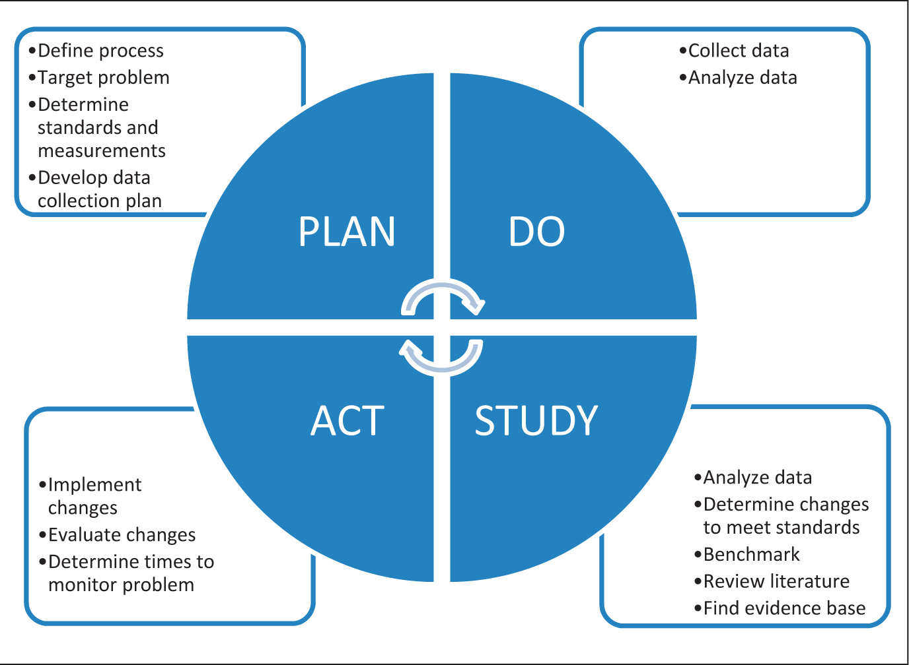

Slide 27
Identifying PI/QI Opportunities
QI/PI opportunities can occur anywhere
Just have to keep your eyes and ears open
Common areas for QI/PI include workflow, handoffs/transition of care, essentially any process where efficiency, effectiveness and error occurrence can be improved

Slide 28
Identifying a Specific PI/QI Topic
Transition of care from inpatient or ED to outpatient
Handoffs between operational forces medical and garrison medical
eProfile system
SRP – for both Active Duty and Reserve units
Transition of ADSM to the VA

Slide 29
Literature Search/Review

Slide 30
The Literature Review
The literature search can seem a daunting process, but there are some simple steps which can help you plan and manage the process:
Pick your research question
Plan your search
Evaluate and record your results
Review your search plan
Synthesize your results

Slide 31
What is your question?
Define the question
Create a chart with possible key words
Stay focused
Some examples:
What is the effect of total lab automation on patient outcomes?
Key Words: total, lab, automation, patient, outcomes
What is the optimal treatment approach for resistant hypertension
Treatment, resistant, hypertension, aldosterone, renin
Notes:
FIRST begin with . . . . .
Clear idea of what you are researching
Keeps you focused – on track - too often we get sidetracked with other things that are interesting
ALSO researchers differ in their terminology
if you search only one term you may miss out
for example:
Unmarried fertility = out-of-wedlock childbearing = single mothers = non-marital births
So important to have a search strategy….

Slide 32
Develop a Search Strategy
To prepare for your search:
Define your topic – write down your research question
Identify what type of literature you are looking for e.g. primary research in journal articles, systematic reviews, research reports, policy documents, books, etc.
Identify sources to search – databases, Google Scholar, individual organizations' websites, library catalogues etc.

Slide 33
Develop a Search Strategy cont.
More Search Preparation
Develop keywords / search terms that are logical and relevant to your search (see more on keywords below)
Think about scope of topic / search restrictions – anything related to your topic that you wish to exclude
Design a means of recording what you find (keep records)

Slide 34
Approaches to a search
Systematic – you try to find all relevant material
Retrospective – you find the most recent material and work backwards
Citation – you follow up references from useful articles, books and reading lists
Targeted – you restrict your topic and focus on a narrow area of the literature
In practice, most people use a mixture of approaches.

Slide 35
General Rules
Start broad and then narrow
Fine line between too broad and broad enough – e.g. diarrhea versus clostridium difficile versus clostridium difficile colitis
Stick to the last 5-10 years unless a rare topic
Try to include one recent review and one recent CPG/systemic review/metaanalysis, if available
Read the abstract and make a decision (Information Mastery skills)

Slide 36
Evaluating and Recording Results
As you find materials, record the outcomes of your search plan
This will save you time and effort if you need to re-run a search or locate references at the end of your project
Record the full reference of everything you find, as it:
ensures good academic practice by acknowledging other people’s ideas
gives more authority to your arguments
shows the scope and breadth of your research
avoids plagiarism

Slide 37
Questions

