Slide 1
Social Media and Medicine
Bob Marshall, MD MPH MISM FAAFP
Faculty, DoD Clinical Informatics Fellowship
Adapted from lecture by Yazan Kherallah

Slide 2
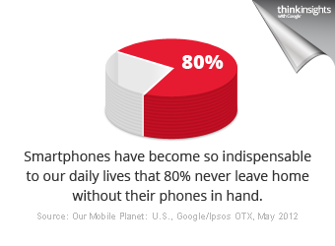
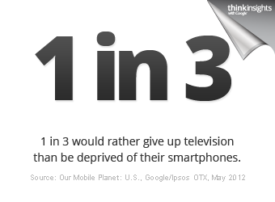
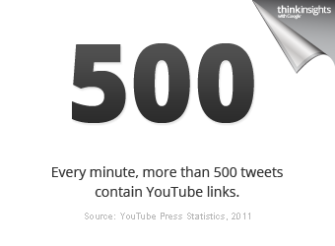
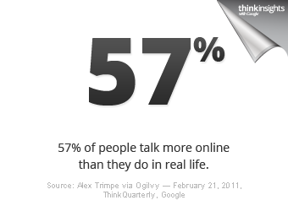

Slide 3
Outline
Social Media Definition
Social Media Landscape
Social Media Facts and Statistics: 2013
Professional Use of Social Media
Use of Social Media in Research
Strategies for Putting Social Media in Practice
Challenges, Guidelines & Regulations

Slide 4
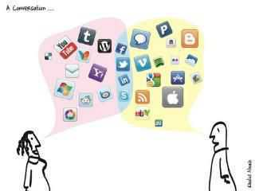
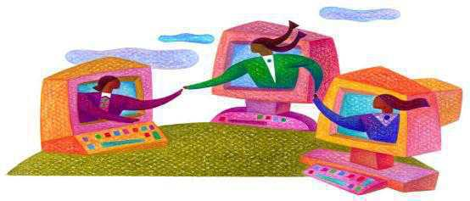
What is Social Media?
“Media used for social interaction, using highly accessible and scalable communication techniques …
to turn communication into interactive dialogue.”
Princeton University Social Media Policies,
Princeton University Office of Communications
http://www.princeton.edu/communications/services/social-media/061611_Princeton_Social_Media_Policies.pdf
Notes:
Before we go further, let’s quickly define what social media and social networks are.
This definition, used by permission, is contained in Princeton’s Social Media Policies, published by the Princeton University Office of Communications. The key here is social media’s purpose – interactive dialogue.

Slide 5
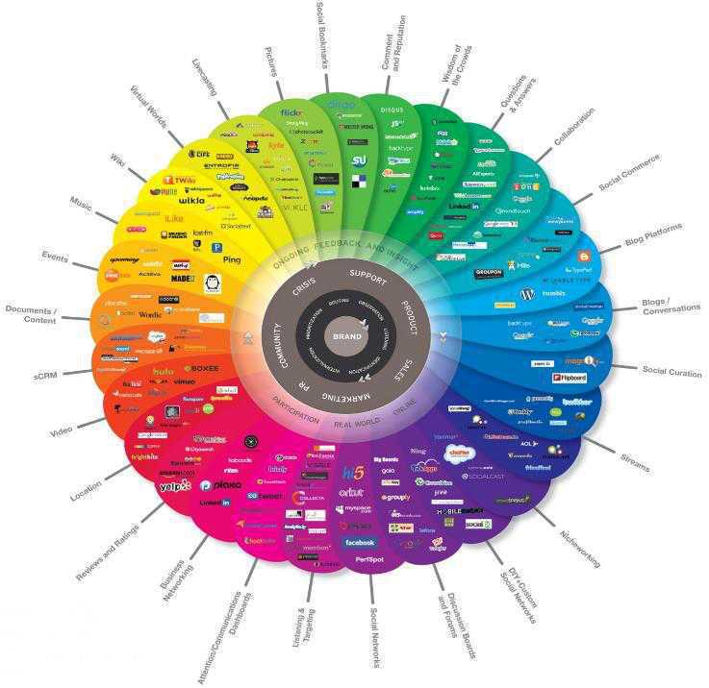
Social Media is…
The Conversation
Notes:
This image has become the iconic illustration of all the different types of social networking sites. There are thousands of sites that qualify as social networking sites. You will see this in almost all presentations that are introductory to social media and networking. We are not covering a tiny fraction of those.

Slide 6
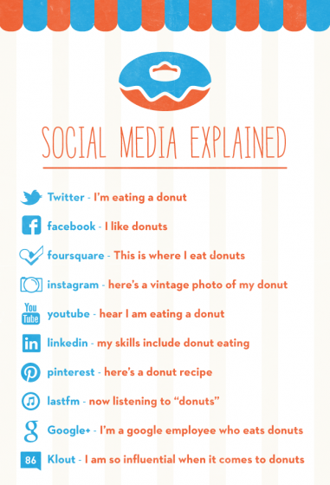

Slide 7
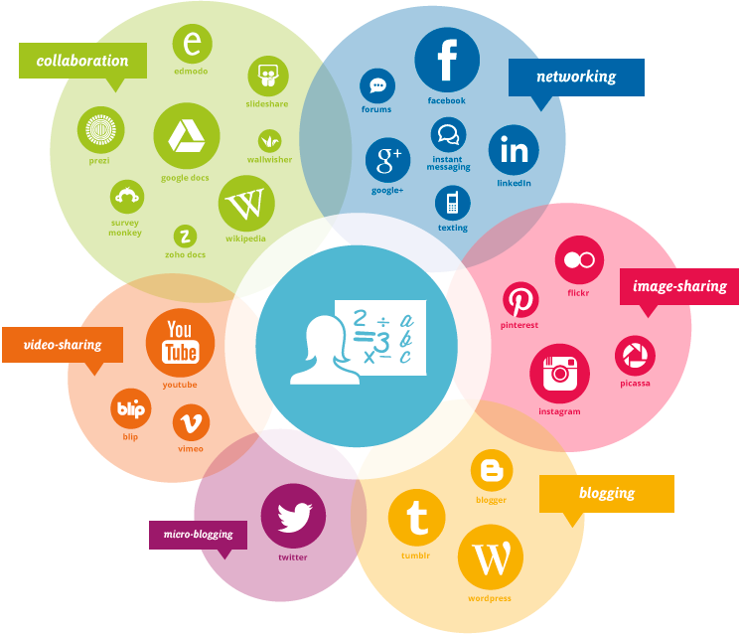
Social Media Landscape
Virtual Words

Slide 8
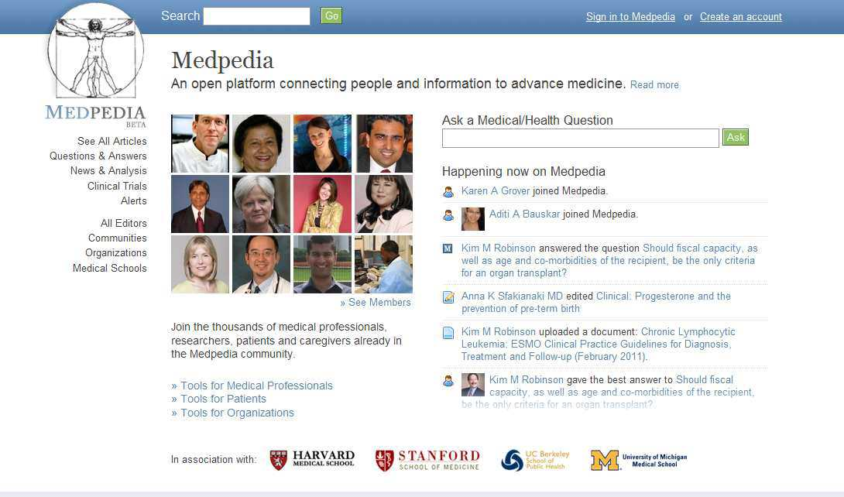
Medical Wiki
Wikipedia vs Medpedia: The Crowd beats the Experts
Closed as of January 2013

Slide 9
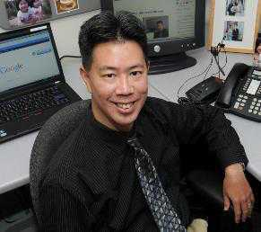

Slide 10
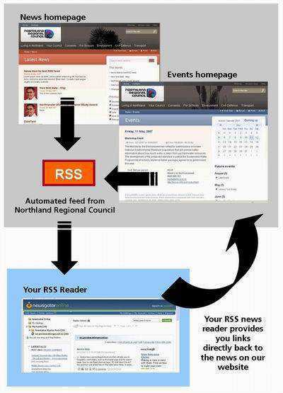
RSS Feeds
RSS (Rich Site Summary) is a format for delivering regularly changing web content. Many news-related sites, weblogs and other online publishers syndicate their content as an RSS Feed to whoever wants it
Keep you informed!
Associations, medical journals
Outlook and Gmail options
Smart phones
Set up to get one
Click on icon
Notes:
Blogs and Wikis have been around a long time. As has the ability to have notices of content posting sent via RSS feed to either your Outlook or Gmail accounts. I have several blogs RSS fed to my Outlook, so I can look at them. You can also follow blog postings on your favorite sites using Twitter. …..I am so confused.

Slide 11
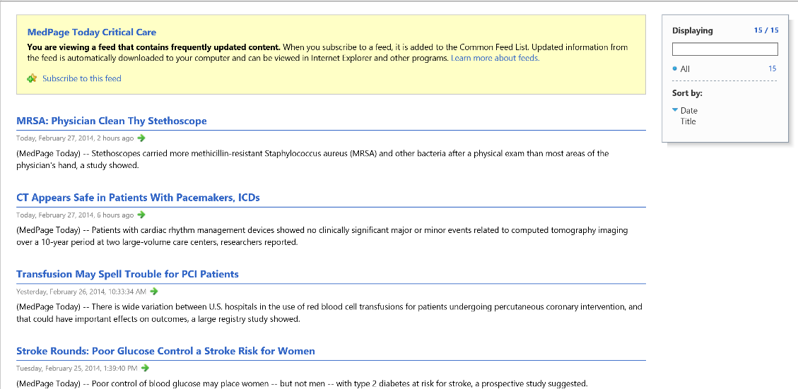

Slide 12
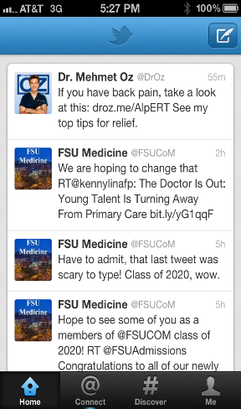
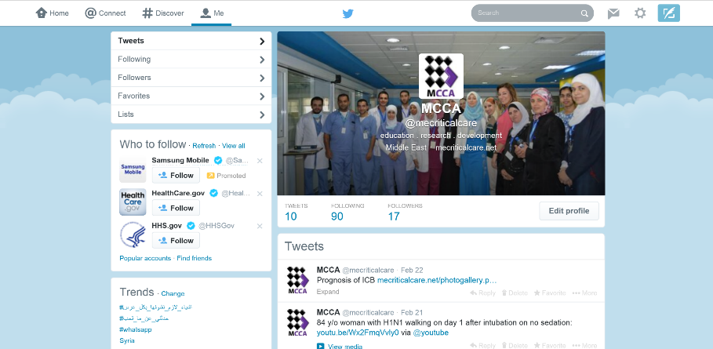
Micro-blogging
Twitter
Twitter is an online social networking and microblogging service that enables users to send and read "tweets", which are text messages limited to 140 characters: What are people talking about?
Notes:
Microblogging – changing the world. The revolutions in the middle east have been fueled by citizens connected by Twitter. First responders at disasters resort to communicating via Twitter to overcome barriers of communications between agencies/jurisdictions.
Every morning, the news announcers tells me what is trending, and they are referring to Twitter feeds. What are people talking about?

Slide 13
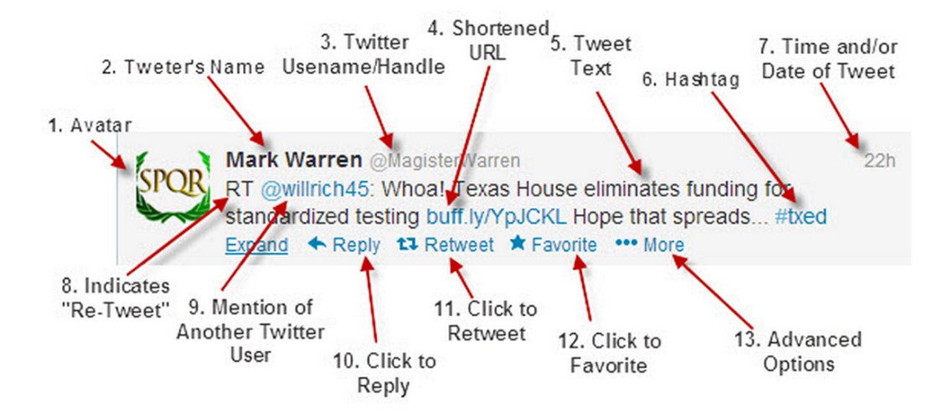
Micro-blogging
Twitter-anatomy
“Tweet” Members send and read text-based posts of up to 140 characters (Tweet, n or v)
Notes:
For docs interested in learning more about social media, be sure to check out #mdchat @MD_chat, the ‘tweetchat’ founded and principally moderated by @PhilBaumann. Tuesdays at 9 PM, ET

Slide 14
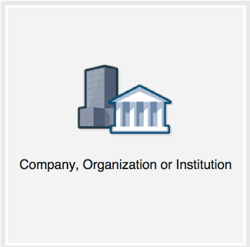
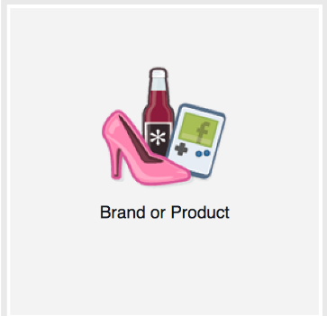
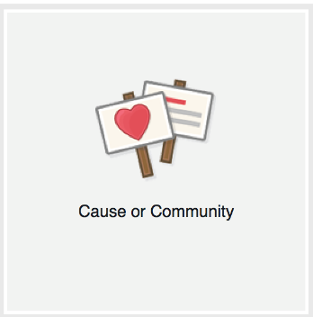
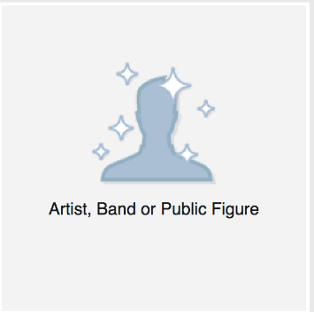
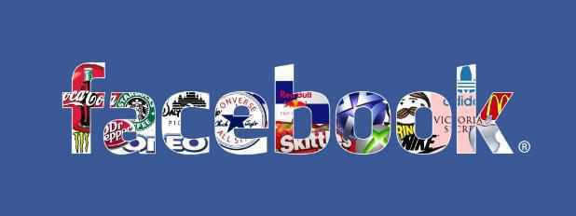
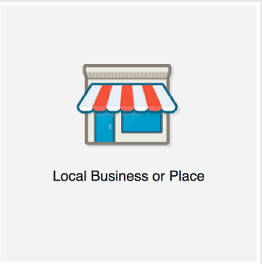
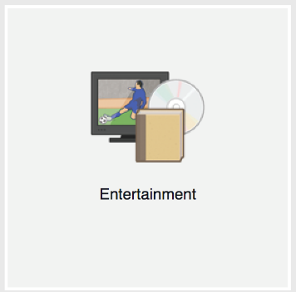
Networking
Facebook – LinkedIn – Google+
Notes:
Online community for fans of a business, product, or celebrity
Provides a platform for comments, photos, videos, and other links.
The number of “likes” a page receives is the number of users who have added that page to their list of favorites.
“Check-ins” are the number of fans who have physically been present at the location of the business
Comments are any content that has been posted by a user onto the Facebook page.
“Shares” refer to any post that has been re-blogged from the Facebook page onto an individual’s own Facebook page.

Slide 15
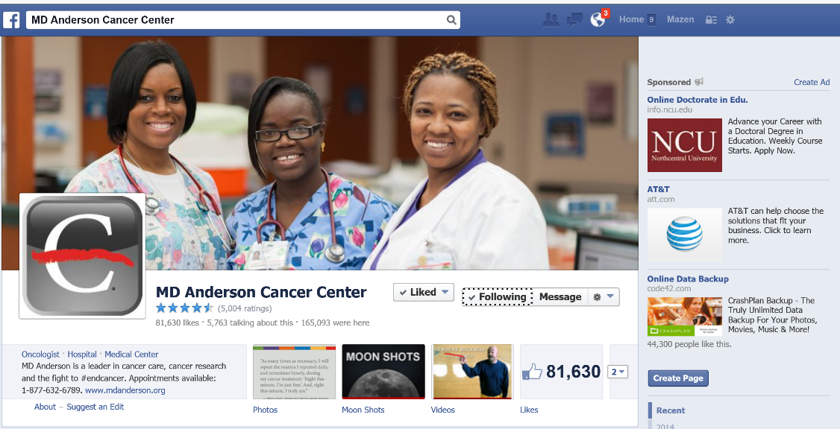
Notes:
The largest social media site was set up for individuals. For your clinic, you must have a personal account, then you create a page for your clinic. You don’t friend a Page, and generally, you open the page up to everyone. People can subscribe to the page, and Like the page. People can post messages to a page, and these can be set up to be moderated or not.

Slide 16
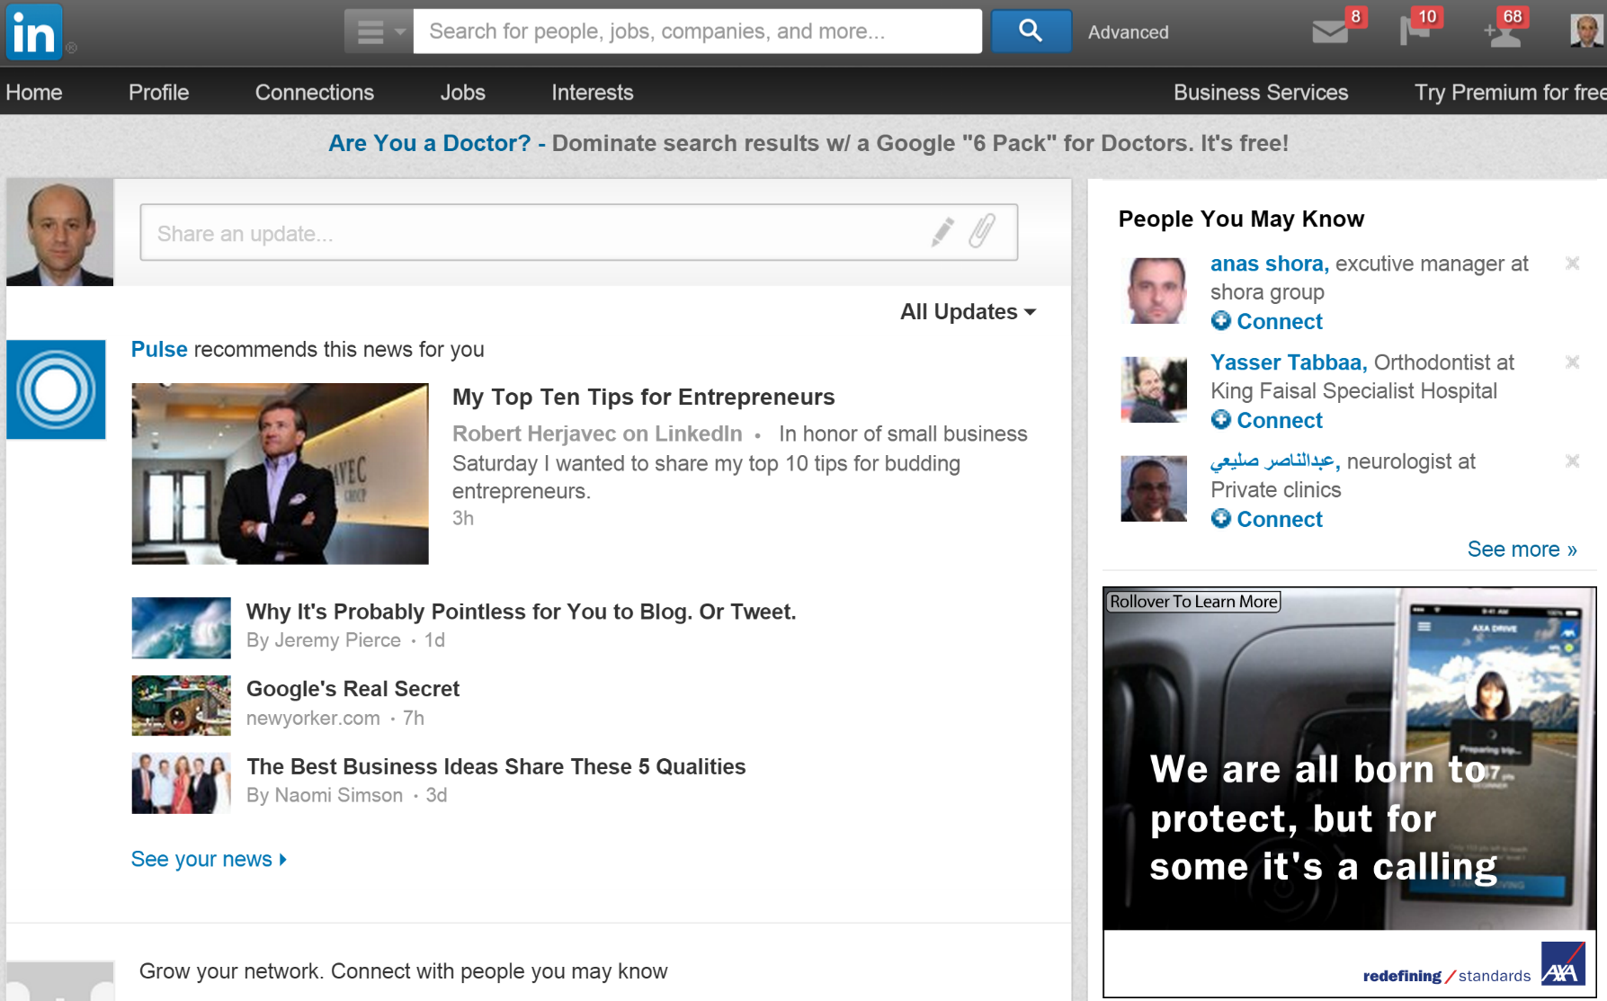
Networking
LinkedIn – Facebook – Google+
professional occupations
endorse each other’s expertise
look for a job, or hire someone!
groups with common interests
Notes:
Image is linked to Linkedin.com.
This site is used mostly for professional resume sharing. If you are looking for a job, anticipate changing jobs, or hiring someone with real credentials to fill a job, this is the spot. Groups are starting to form with common interests and are creating discussions. People endorse each others expertise.

Slide 17
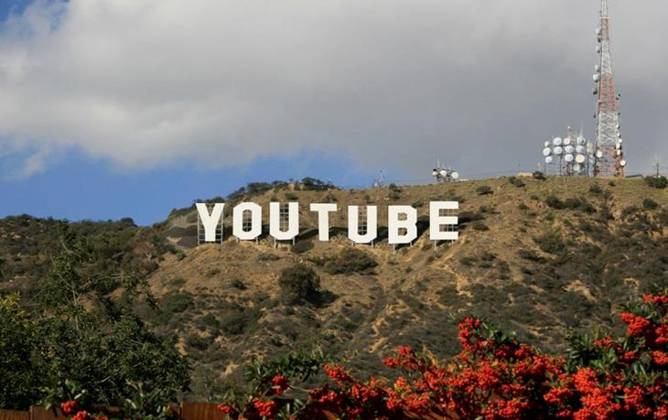
Video-sharing
Youtube
Over 2 Billion videos viewed per day
YouTube Mobile 100 million views per day
Over 72 hours of videos are uploaded per minute
The base age demographic for YouTube is 18-54
Video Sharing Platform
Channels - a curated list of videos posted by a specific member/association/institution/journal
Patient education videos/animations
Source: YouTube Statistics: 25 Jawdropping YouTube Facts, Figures & Statistics http://www.reelseo.com/youtube-statistics/#ixzz1st3uFVMS
Notes:
The reason they can’t find all the copyright violators themselves is because of the sheer number of videos posted on the site every hour.
YouTube Mobile alone gets over 100 million views per day. That is the app on my iPhone.
More than half the videos on YouTube have been rated or commented on by users.

Slide 18
Video-sharing
YouTube
Notes:
The second largest social media site allows users to post videos. Viewers can rate and comment on those videos, the creation of curated lists of video clips called Channels. Educational institutions are posting videos to be used in classes. Copyright is out the window here. Youtube tries to purge copyrighted materials posted without permission, like the clip I am using a little later, but rely on users to alert them to these postings.

Slide 19
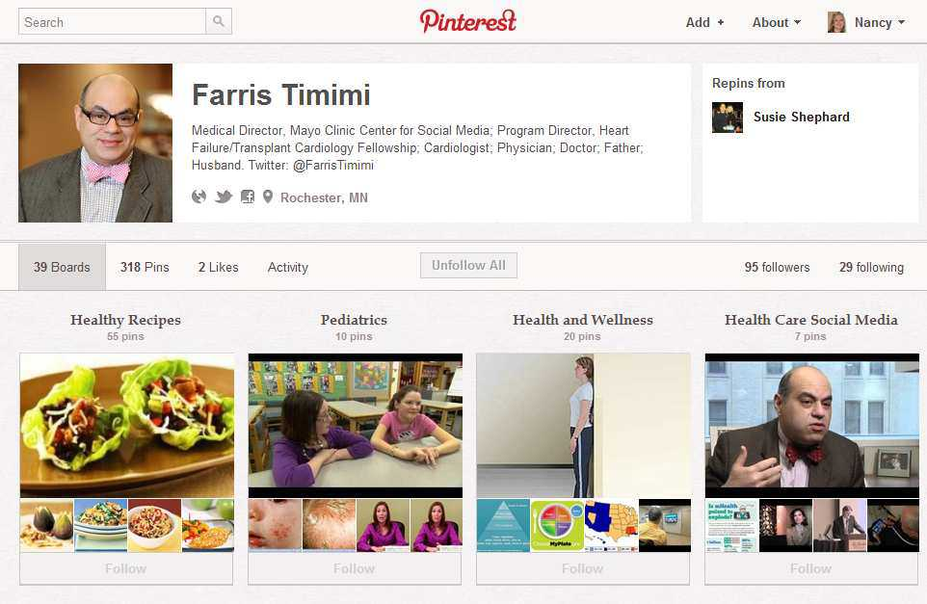
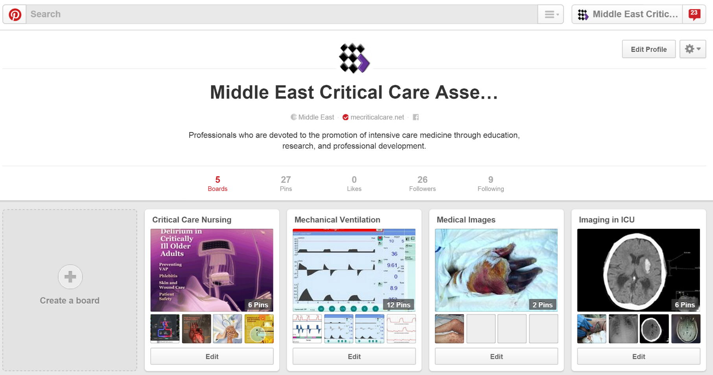
Image-sharing
Pinterest – Instagram – Picasa
pinboard-style photo-sharing
create and manage theme-based image collections
Events
Interests
Hobbies
"re-pin" images to their own pinboards, or "like" photos from other pinboards
Notes:
{Linked to Farris Timimi’s Pinterest page.}
The popularity of this relatively new site is growing exponentially. It may die out just as fast or find that the purpose, which was really at the start just to share media/pictures/videos, linked to content elsewhere, grouped by topic called “Boards”, has some use for educations, business, or healthcare. It is morphing as we speak into a content delivery as well as image delivery/sharing site.

Slide 20
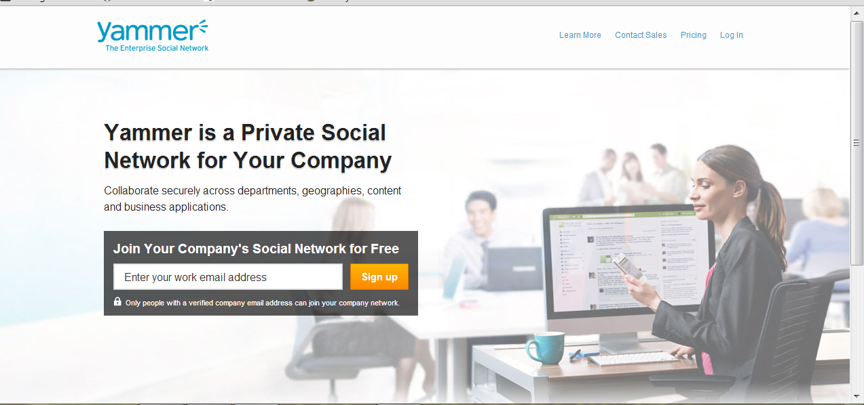
Physicians Networking
Yammer – Doximity – Sermo
Notes:
The college has licensed Yammer to serve as our controlled access social media platform. This allows students and faculty to chat, post, create groups, just like Facebook or Twitter except that it is within the walls of the FSU CoM community only. You either have to have a CoM email account or be invited to join by someone with a CoM email. So clinical faculty can be added. We need to get anyone who wants to participate to give us their email account and we will invite them to join. If you remember, long ago, someone had to invite you to get a gmail account.

Slide 21
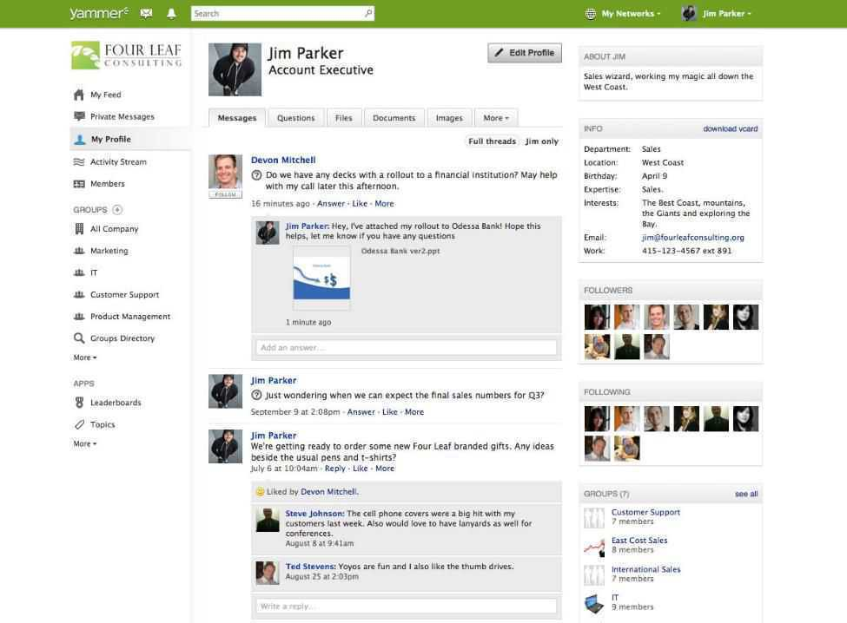

Slide 22
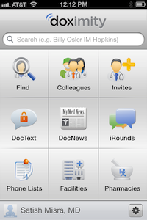
Physicans Networking
Doximity – Yammer – Sermo
HIPAA-compliant.
The Private Network for Physicians.
Doximity.com
Free for doctors on iPhone, Android and web.
Alumni groups.
Notes:
Doximity.com: site only for doctors, Article: http://www.imedicalapps.com/2012/06/doximity-physician-social-networ/
Ozmosis: site only for doctors, this one helps you connect to others in the industry. You can get answers and opinions from your peers, and share insights of your own.
DoctorsLounge: Hang out with other doctors online. An awesome resource, and an interesting place to hang out. Research symptoms, get additionally opinions and connect with doctors who share your specialty.

Slide 24
Physicians Networking
The largest online physician community
Sermo – Doximity – Yammer
patient cases
discuss and debate topics
compete on clinical challenges
share their medical expertise
improve global healthcare.

Slide 26
Social Networking by the Numbers
Facts and Statistics: 2013

Slide 27
Major Social Media Sites #s
Facebook: 1B+ users (CNET, Oct 2012)
YouTube: 1B+ monthly users (YouTube, April 2013)
Twitter: 500M+ users (TechCrunch, June 2012)
LinkedIn: 200M+ users (LinkedIn, April 2013)
Google+: 343M+ users (Forbes, December 2012)
Foursquare: 20M+ users (Digital Spy, April 2012)
Notes:
This data changes daily.
Twitter has over 500 billion users, tweeting over 340 million tweets per day. Also reported 288 billion active users. Stats are difficult to nail down because they change so rapidly.
YouTube has monthly users based on viewership.

Slide 28
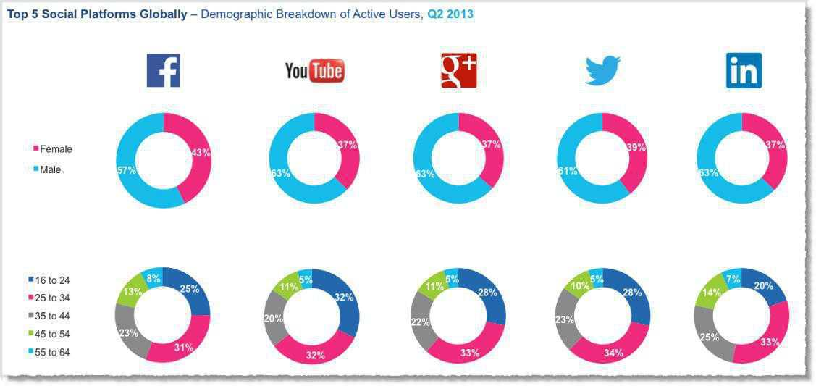
LinkedIn is the most popular for older users

Slide 29
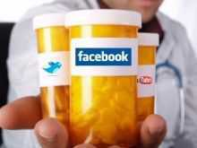
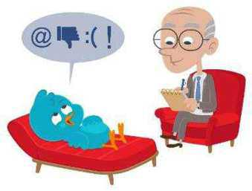
Professional Use of Social Networking
Organizational, Physicians and Patients Perspectives

Slide 30
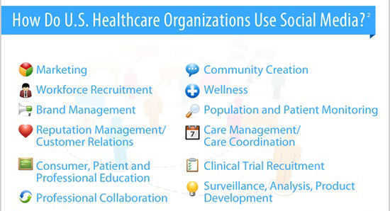
Organization Use of Social Media

Slide 31
Hospital Use of Social Media

Slide 32
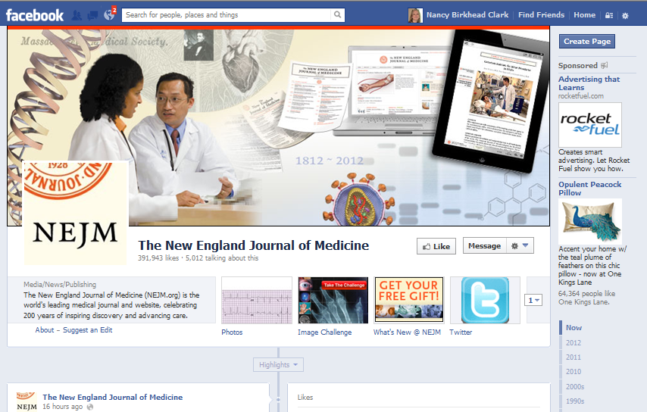
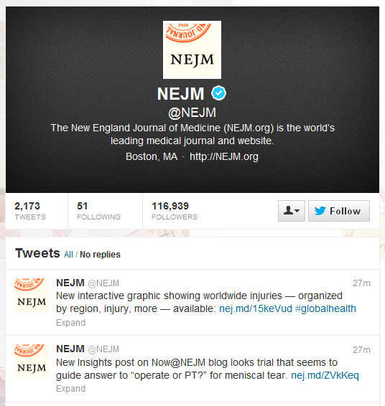
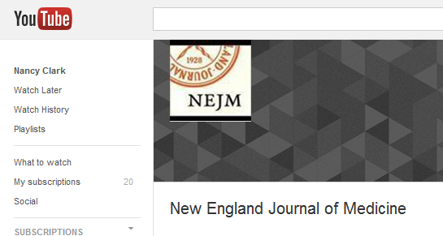
Journals on #HCSM
Notes:
Once you Like a journal, you are shown any posts on their site in your Facebook feed. These include articles as well as quiz of the day questions with images like EKGs and photos, microscopic …. On Twitter, you can follow any of your favorite journals to get news and announcements of articles. On Youtube, they have educational videos. Even an RSS feed can be considered a form of digital/social media.

Slide 33
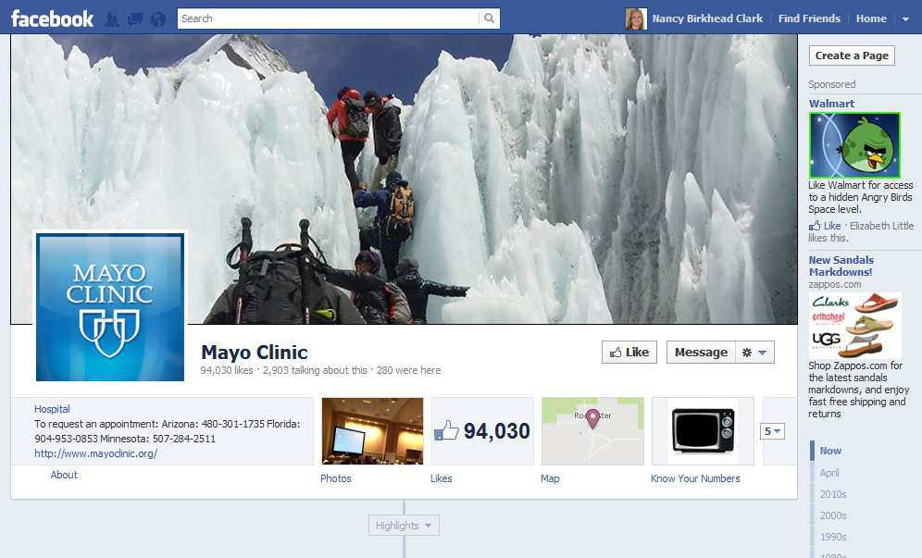
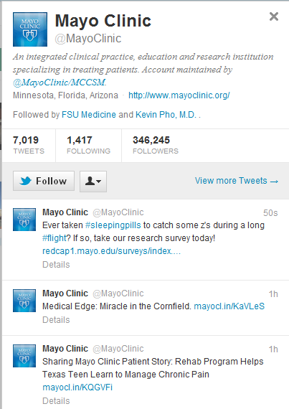
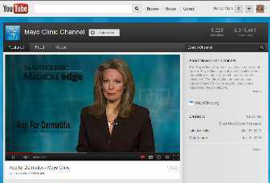
Healthcare Institutions on #HCSM
Notes:
Mayo has not only embraced SM, they have become leaders nationally in the SM movement in healthcare.

Slide 34
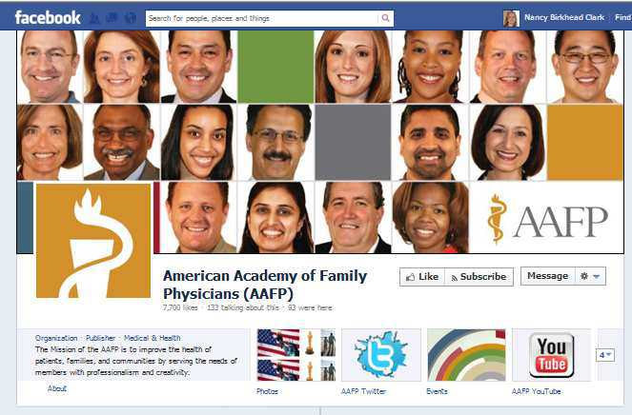
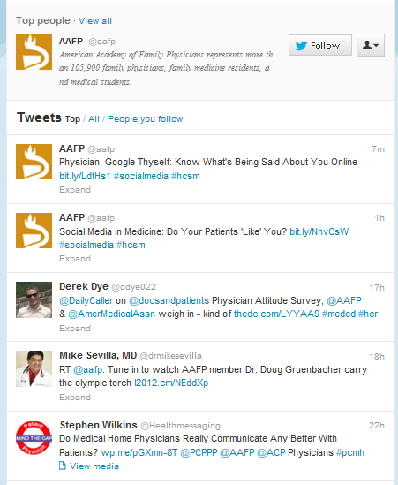
Major Associations on #HCSM
Notes:
Here is another example, of the use of social media by a healthcare organization.

Slide 35
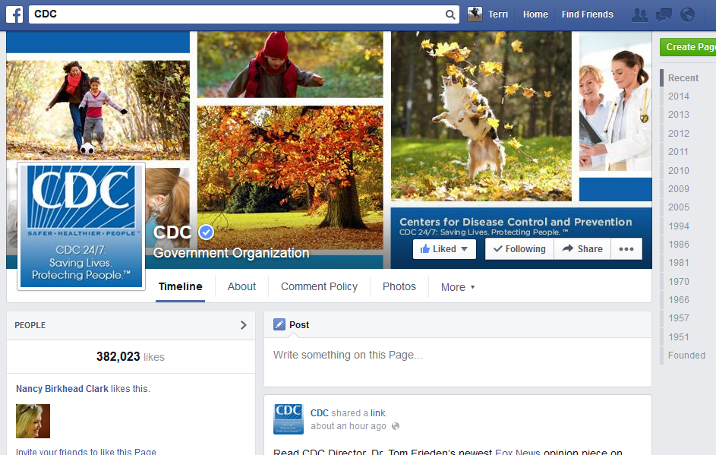
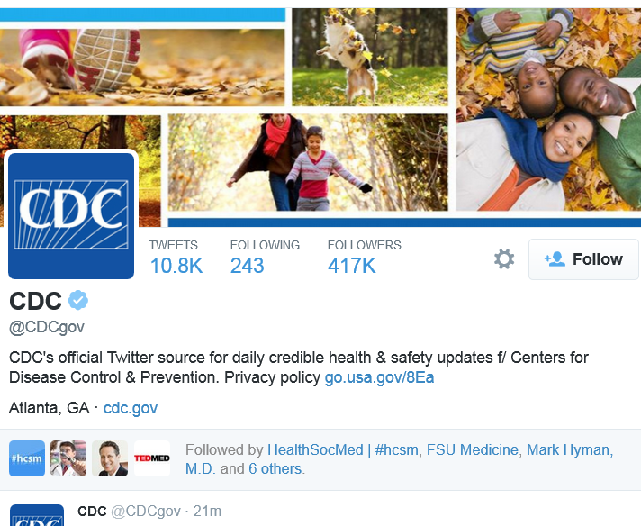
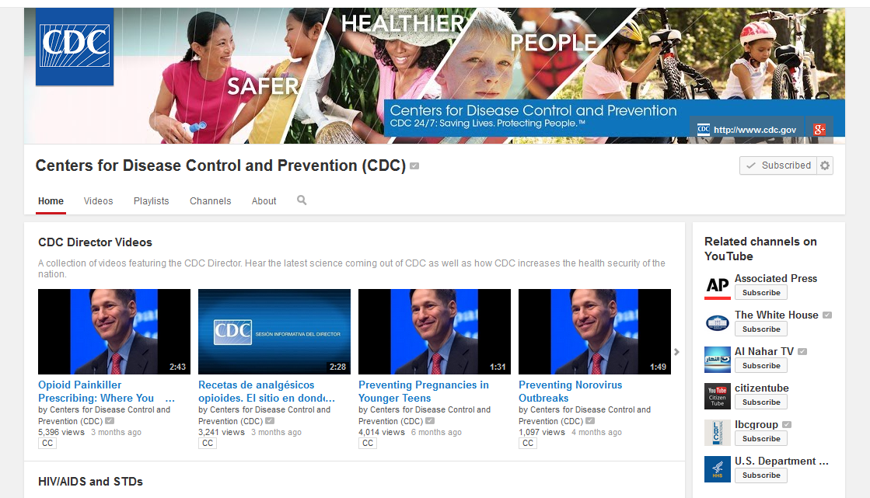
Government Agencies on #HCSM
Notes:
Here are the CDC Facebook, Twitter and YouTube sites. Notice the consistent branding on each. This makes any posting instantly identifiable as the CDCs.

Slide 36
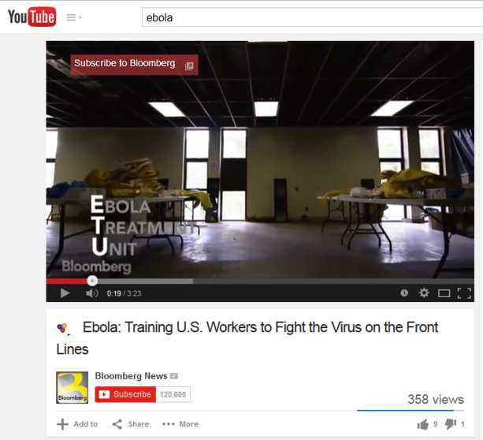
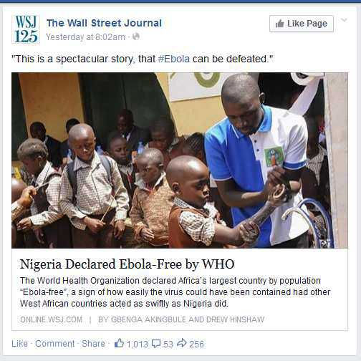
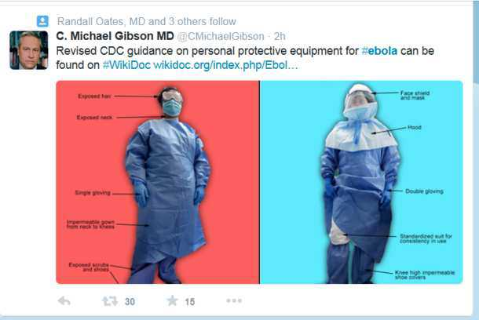
#Ebola on #HCSM
Twitter
Facebook
Youtube
Notes:
Searching for a condition in any of the social media sites, such as the hashtag Ebola gives you the latest news from multiple sources like the WSJ, Bloomberg, or a physician.

Slide 37
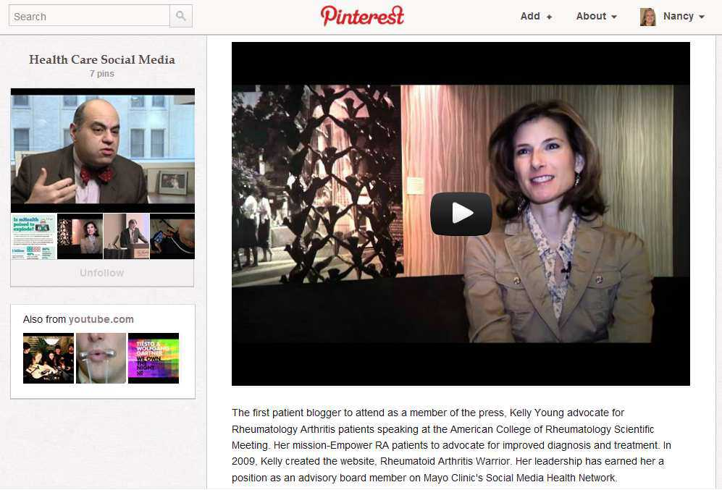
Rheumatoid Arthritis
Notes:
Here is a video of a doctor who suffers from and treats patients with RA, who created a social networking web site for patients with RA. (show about 1 minute of this).

Slide 38
Social Media for Chronic disease
Awareness
Support
Education
Diabetes Social Media Advocacy (DSMA) http://diabetessocmed.com/
Notes:
http://diabetessocmed.com/
Diabetes Social Media Advocacy (DSMA) is involved with and promotes social media in all its forms to empower people affected by diabetes and to connect them with each other to foster support and education. In the Beginning: The Online Community Through platforms such as facebook, YouTube, podcasts, blogs, and online communities such as Diabetesdaily, TuDiabetes and dLife, people participate in the informal network known as the Diabetes Online Community (DOC). The virtual community is one of the first and largest to champion social media for chronic disease awareness, support, and education.

Slide 39
Potential Physician Use of Social Media
Establish, Manage and Protect professional reputation
Market practice and recruit patients
Recruit research subjects
Perform research
Connect with patients and practice
Promote public health & education
Learn and share medical information and knowledge
Notes:
It mostly boils down professionally to these five-six practical uses of social media.
We will talk about each of these, one at a time.

Slide 40
Physician Use of Social Media

Slide 41
Marketing Your Practice
Notes:
This is the new yellow pages.

Slide 42
The patient-doctor relationship and online social networks: results of a national survey
Bosslet GT et al. J Gen Intern Med. 2011 Oct;26(10):1168-74. doi: 10.1007/s11606-011-1761-2.

Slide 43
Patient Medical Use of Social Media
Find a local doctor, read and write reviews of doctors
http://vitals.com
http://healthgrades.com
Caregiver social support groups
Caregivers for elderly, family members with chronic disease
Find health information - 80% of internet users gather health information online
Social media is the new word-of-mouth
Find support groups for chronic disease and other health issues:
Awareness, support, education
Lifestyle and health maintenance support
Diet plans
Track exercise …
Notes:
By participating in free review websites such as Healthgrades, Vitals, and even Yelp, you can help maximize your website rankings and ultimately the number of patients visiting your site.

Slide 46
Peer-to-peer Healthcare
Percentage of Patients Finding Others with Similar Problems Online
Fox, Suzannah. Peer-to-peer Healthcare. Pew Internet Survey Results. http://pewinternet.org/Reports/2011/P2PHealthcare.aspx

Slide 47
Patients Like Me
Notes:
Crowd-sourcing surveillance of disease/conditions/drug side effects. This site is for-profit. However, it is designed to collect and share outcomes data on specific treatment experiences from patients as well as help patients with conditions share their experiences with other patients.

Slide 49
Patients Share Experiences
Health Research Institute. Social media “likes” healthcare: From marketing to social business. April 2012.
Notes:
Patients are very likely to share information about their hospital stay, medications, medical insurance company, and their doctors.

Slide 50
Sharing Health Data for Better Outcomes on PatientsLikeMe
Massagli M et al. Sharing health data for better outcomes on PatientsLikeMe. J Med Internet Res. 2010;12:e19

Slide 51
Grief and Community Support

Slide 52
Health Tap (Physician-patient social network)
Notes:
San Francisco-based HealthTap (@HealthTap) has unveiled a major overhaul of its physician-patient social network with a new significant focus on mHealth. The update includes a suite of new apps for the iPhone, iPad, Android and the web.
Since its launch last year, HealthTap has raised $14 million from investors including Mayfield Fund, Mohr Davidow Ventures, Eric Schmidt’s Innovation Endeavors, Esther Dyson, and more. HealthTap was founded by Ron Gutman (@RonGutman), formerly the CEO of WellSphere, and curator of TEDx Silicon Valley.
HealthTap already offers its ePatient users access to a directory of 1 million physicians across the country, and has now launched a new Q&A service with 12,000 participating US-licensed physicians, which patients can use to securely send HIPAA compliant text messages to physicians with the option to include images, health records, and more.
The initial text costs $10 and each follow-up message costing $5/each after one freebie, which is certainly more than a typical SMS conversation, but also certainly less than an average office visit. Patients are also free of the hassles associated with office visits, such as wait-time, travel, etc.
Each of these 12,000 doctors has a built-in quality score associated with their name and profile the company bills as a sort of medical equivalent of a FICO Score, which incorporates both publicly available information and peer reviews from other doctors.
New features include:
■Up-to-date and personalized health information: Follow topics, doctors, and questions to stay current on the issues that matter most to you.
■ Transparent doctor-to-doctor ratings: View each physician’s “DocScore,” a FICO-like quality score for doctors that incorporates publicly available data and doctor-to-doctor peer review. Doctors also rank each other on expertise within specific topics.■Directory of over one million doctors: Use simple, everyday language to find the best doctors in the HealthTap network and in the world’s most comprehensive mobile doctor directory.
■In-person virtual appointments: Connect with doctors in person using in-app appointment requests, direct messaging and phone calls.
■Secure private digital health file: Have full control of your personal health records, available and transferable anytime, in a secure and private environment.
The new mobile application will also add new features to the HealthTap service, including:
■Private Health Conversations: Ask specific questions to the doctor of your choice in a HIPAA-secure environment from your iPhone, iPad, Android device, or PC
■Connect with a doctor of your choice instantaneously: See who’s “online now” and message them privately and securely
■Store and safely share rich health media: Share health records, photos, and documents with doctors securely and privately.

Slide 55
Detecting influenza epidemics using search engine query data
Ginsberg J. et al. Nature. 2009 Feb 19;457(7232):1012-4. doi: 10.1038/nature07634.

Slide 56
A 12-Word Social Media Policy
Don’t Lie
Don’t Pry
Don’t Cheat
Can’t Delete
Don’t Steal
Don’t Reveal
Don’t endorse as a matter of course.
Supervisors: Don’t initiate an employee friend request at your own behest.
Separate your circle of friends from patients you mend.
Corporate logo in your username is a no go.
Adding a disclaimer is probably saner.
Don’t practice on the Internet, regardless of your good intent.
Always surmise that HIPAA applies.
Speak on your behalf, not that of staff.
Anonymity is really gimmicky
If you chat about your company, identify abundantly
Dr. Farris Timimi, Medical Director of the Mayo Clinic Center for Social Media
http://socialmedia.mayoclinic.org/2012/04/05/a-twelve-word-social-media-policy/
Notes:
The Mayo Center for SM director has a fun set of rules. Which he tricks you into thinking is only 12 words long from the title, and is in actuality much longer…. He says:
Don’t lie: a good rule in general, it is particularly important online, where nothing is transient and everything is searchable.
Don’t pry: Do not seek out personal health care data or potential protected health information as a part of a social platform conversation.
Don’t cheat: We’ve all heard the old proverb that “Cheaters never prosper,” but some harbor lingering doubts about whether it’s true. In social media, cutting corners is much more likely to be discovered and exposed, and when the truth is revealed it won’t be pretty. Everyone makes mistakes; confess yours immediately. Intentionally “gaming” the system, however, will not reflect well on you or your organization.
Can’t delete: this is an important rule: if it’s still in Google’s cache, you can’t put it in the trash. The most effective tool to address this is a strategic pause before you post. Count to 3 and think:
1- To whom are you posting/Who is your audience?
2-Is this post appropriate for all ages?
3-Does my post add value to the ongoing conversation?
Don’t steal, : Give credit where it’s due, and acknowledge those who inspired you or provided information you’re passing along. In Twitter it’s as simple as a retweet or a mention, while in a blog you can share link love.
Don’t reveal: And if information is proprietary or confidential, don’t disclose it in social platforms.

Slide 57
9. Review & Monitor
Monitor and Curate content

Slide 58
10. Analyze & Define New Strategy
Does your social media strategy drive growth
Are you able to achieve your set goals
Define needs for change
Change social tool as needed

Slide 59
Social Networking and Medicine
Challenges & Regulations

Slide 60
Privacy settings
Patient’s confidentiality
Information credibility
Negative feedback
Legal and regulatory risks

Slide 61
Federation of State Medical Boards – Guidelines for Appropriate Use of Social Media… (April 2012)
Professionalism…
HIPAA compliant sites like Doximity.com
Content
Privacy/confidentiality – HIPAA – written authorization from patients
Disclosure – reveal any conflicts of interest
Federation of State Medical Boards. Model policy guidelines for the appropriate use of social media and social networking in medical practice. April 2012.
Available at http://www.fsmb.org/pdf/pub-social-media-guidelines.pdf
Notes:
Professionalism
To use social media and social networking sites professionally, physicians should also strive to adhere to the following general suggestions:
• Use separate personal and professional social networking sites. For example, use a personal rather than professional e-mail address for logging on to social networking websites for personal use. Others who view a professional e-mail attached to an online profile may misinterpret the physician’s actions as representing the medical profession or a particular institution.
• Report any unprofessional behavior that is witnessed to supervisory and/or regulatory authorities.
• Always adhere to the same principles of professionalism online as they would offline.
• Cyber-bullying by a physician towards any individual is inappropriate and unprofessional.
• Refer, as appropriate, to an employer’s social media or social networking policy for direction on the proper use of social media and social networking in relation to their employment.

Slide 62
Medical Board Sanctions
State medical boards can discipline physicians for:
Use of the Internet for unprofessional behavior
Online misrepresentation of credentials
Online violations of patient confidentiality
Failure to reveal conflicts of interest online
Online derogatory remarks regarding a patient
Online depiction of intoxication
Discriminatory language or practices online
Actions range from letter of reprimand to revocation of license
Federation of State Medical Boards. Model policy guidelines for the appropriate use of social media and social networking in medical practice. April 2012.
Notes:
State medical boards have the authority to discipline physicians for unprofessional behavior relating to the inappropriate use of social networking media, such as:
Inappropriate communication with patients online
Use of the Internet for unprofessional behavior
Online misrepresentation of credentials
Online violations of patient confidentiality
Failure to reveal conflicts of interest online
Online derogatory remarks regarding a patient
Online depiction of intoxication
Discriminatory language or practices online

