Slide 1
Data Visualization
Bob Marshall, MD MPH MISM FAAFP
Faculty, DoD Clinical Informatics Fellowship

Slide 2
Definition
Viewed by many disciplines as a modern equivalent of visual communication.
Not owned by any one field, but rather finds interpretation across many
Involves the creation and study of the visual representation of data
Refers to the techniques used to communicate data or information by encoding it as visual objects

Slide 3
Goals of Data Visualization
Primary goal of data visualization is to communicate information clearly and efficiently to users via the statistical graphics, plots, information graphics, tables, and charts selected
Effective visualization helps users analyze and reason about data and evidence.
It makes complex data more accessible, understandable and usable

Slide 4
Overview/Basic Principles
To convey ideas effectively, both aesthetic form and functionality need to go hand in hand, providing insights into a rather sparse and complex data set by communicating its key-aspects in a more intuitive way
An ideal visualization should not only communicate clearly, but stimulate viewer engagement and attention
Well-crafted data visualization helps uncover trends, realize insights, explore sources, and tell stories
Data visualization is closely related to information graphics, information visualization, scientific visualization, exploratory data analysis and statistical graphics.

Slide 5
Data Presentation Comparison

Slide 6
Edward Tufte – Graphical Displays Should:
Show the data
Induce the viewer to think about the substance
Avoid distorting what the data has to say
Present many numbers in a small space
Make large data sets coherent
Encourage the eye to compare different pieces of data
Reveal the data at several levels of detail
Serve a reasonably clear purpose
Be closely integrated with the statistical & verbal descriptions of the data set

Slide 7
Informationarchitects.jp presents the 200 most successful websites on the web, ordered by category, proximity, success, popularity and perspective in a mind map

Slide 8
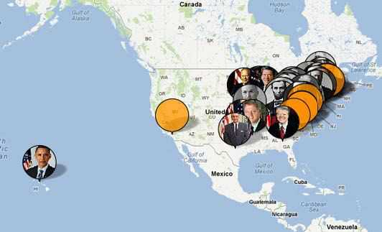

Slide 9
Quantitative Messages
Eight types of quantitative messages for users to understand/communicate from data and graphs:
  Time-series – single variable over period of time
  Ranking – categorical subdivisions in descending/ascending order
  Part-to-whole – categorical subdivisions measured as a ratio to the whole
  Deviation – categorical subdivisions compared to reference
  Frequency distribution – number of observations for given interval
  Correlation – Comparison between observations represented by two variables
  Nominal comparison – comparing categorical subdivisions in no particular order
  Geographical or geospatial – comparison across a map

Slide 10
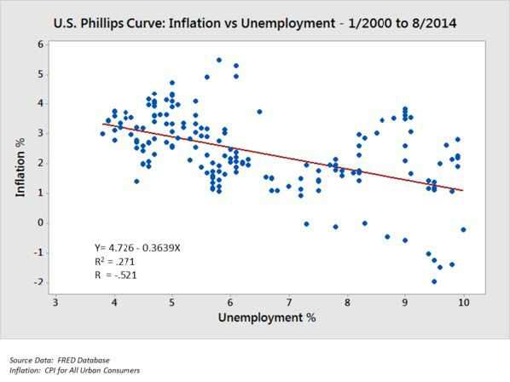

Slide 11
Visual Perception & Data Visualization
Humans can distinguish differences in line length, shape orientation, and color (hue) readily without significant processing effort
  referred to as "pre-attentive attributes.”
Effective graphics take advantage of pre-attentive processing and attributes as well as relative strength of these attributes.

Slide 12
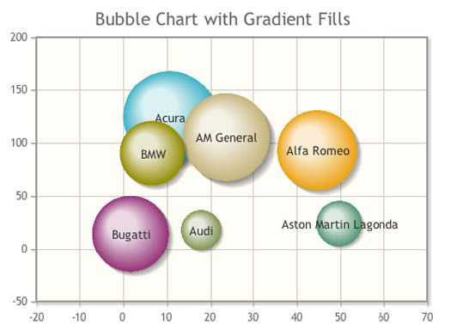

Slide 13
Human Perception/Cognition and Data Visualization 1 of 2
Cognition refers to processes in human beings like perception, attention, learning, memory, thought, concept formation, reading, and problem solving
The basis of data visualization evolved because data displayed graphically allows for easier comprehension of information
Proper visualization provides a different approach to show potential connections, relationships, etc. which are not as obvious in non-visualized quantitative data
Visualization becomes a means of data exploration

Slide 14
Human Perception/Cognition and Data Visualization 2 of 2
Effective visualization follows from understanding the processes of human perception
Being able to apply this understanding to intuitive visualizations is important (actually, it is key)
Understanding how humans see and organize the world is critical to effectively communicating data to the reader
This leads to more intuitive designs

Slide 15
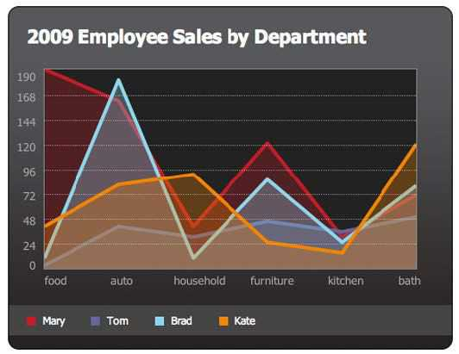

Slide 16
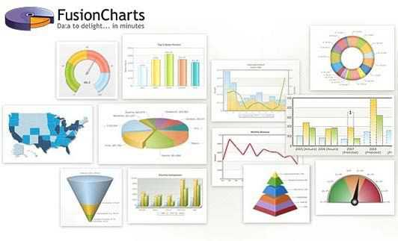

Slide 17
Pictures for the Eyes and Mind
Data visualization is only successful to the degree that it encodes information in a manner that our eyes can discern and our brains can understand
Getting this right is much more a science than an art, which we can only achieve by studying human perception
The goal is to translate abstract information into visual representations that can be easily, efficiently, accurately, and meaningfully decoded
Brain area for thinking – cerebral cortex (slow)
Brain area for visual perception – visual cortex (fast)

Slide 21
Gestalt School of Psychology
Original intent of this effort when it began in 1912 was to uncover how we perceive pattern, form, and organization in what we see
The founders observed that we organize what we see in particular ways in an effort to make sense of it
The result of the effort was a series of Gestalt principles of perception, which are still respected today as accurate descriptions of visual behavior

Slide 22
Some Gestalt Principles
Proximity
Similarity
Enclosure
Closure
Continuity
Connected

Slide 25
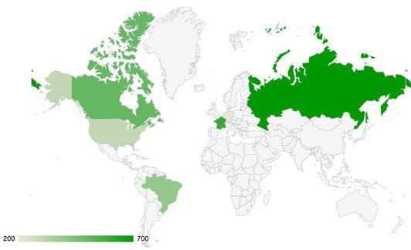

Slide 26
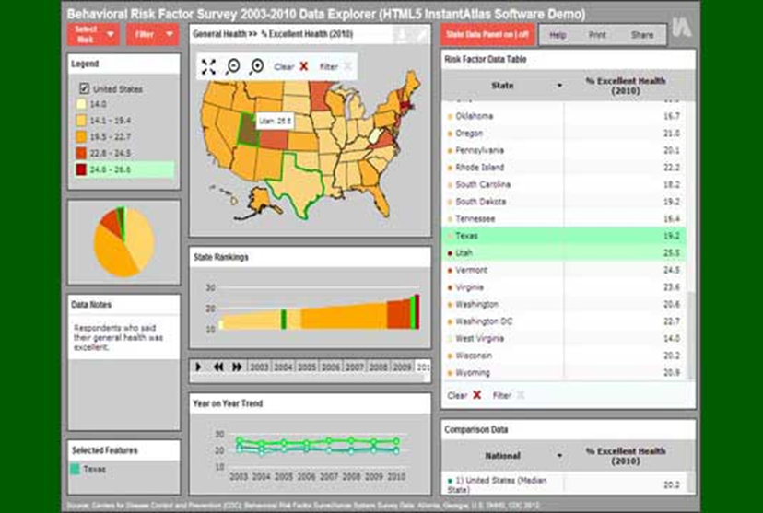

Slide 27
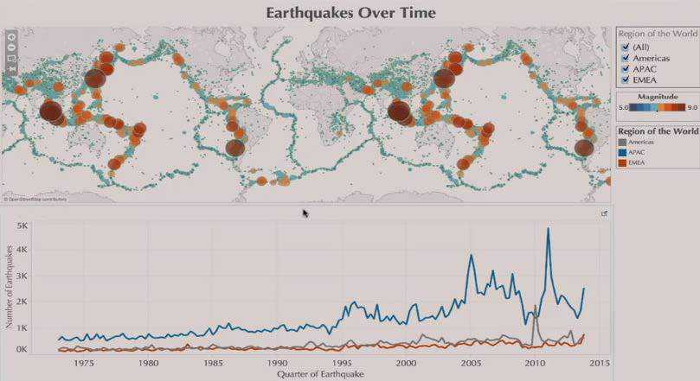
Questions

