Slide 1
Data Presentation
& CDS/Usability/UX
Bob Marshall, MD MPH MISM FAAFP
DoD Clinical Informatics Fellowship

Slide 2
What is this Discussion About
The presentation of data can directly impact how people understand and use the data to care for patients
Data has many uses in healthcare, one of the most important but least developed, is in dynamic clinical decision support (CDS)
Incorporating the aesthetics and human factors engineering components of user interface design/user experience with data presentation can result in better understanding of the information and its use in driving CDS

Slide 3
Visual Aesthetics
Visual aesthetics refers to the beauty or pleasing appearance of things
Why might this be important to data presentation?
Visual aesthetics in HCI covers three areas/perspectives: design, psychological and practical
  All three are important, and you never completely separate one from the others
  We will focus mostly on design and psychological aesthetics for data presentation and CDS

Slide 4
Design Aesthetics
Aesthetics constitutes an important and integral part of any design discipline
As the interface between people and the computer screen becomes more comprehensive (like in an EHR), the more important design aesthetics becomes
Visual aesthetics is often related to other design aspects and often augments (or detracts from) other aspects of the design and overall interactive experience
Computer aesthetics is informed by Vitruvian design principles (1st century BC)
  Three principles:
    Firmitas – strength and durability,
    Utilitas – utility or usability, and
    Venustas - beauty

Slide 6
Aesthetics and Other Design Principles
HCI and usability experts used to warn against putting too much emphasis on aesthetics
However, research has shown a positive correlation between aesthetics and usability
As discussed previously, the Gestalt principles take into account design aesthetics as a component of usability – orderly displays, grouping, etc
When studies are done on usability, participants do not distinguish between design aesthetics and usability when stating preferences…they end up being the same

Slide 7
Psychological Aesthetics
The universality of visual arts across cultures and the pleasures induced by it are cited by evolutionary psychologists as evidence for the fundamental role of aesthetics in the psyche of modern Homo sapience
Task-related criteria are often based on extrinsic motivation, aesthetics, through pleasure and engagement, primarily contributes to intrinsic motivation
There is empirical evidence that aesthetic design of interactive technology increases users’ pleasure and engagement
It has been found that they also may make us more tolerable of other design imperfections
Aesthetic impressions can be very fast. Studies of brain activity suggests that aesthetic impressions form within 300ms to 600ms

Slide 8
Psychological Aesthetics cont
The visual aesthetics of interactive systems, both hardware and software, may affect our evaluation of other system attributes.
Hence, the suggestion that “beautiful is usable” that is, beautiful systems are considered by users to be more usable
  A prime example of this is the more visually appealing Apple operating systems and applications versus Windows OS and applications
  This is even more apparent when it comes to the iOS versus Windows Mobile

Slide 9
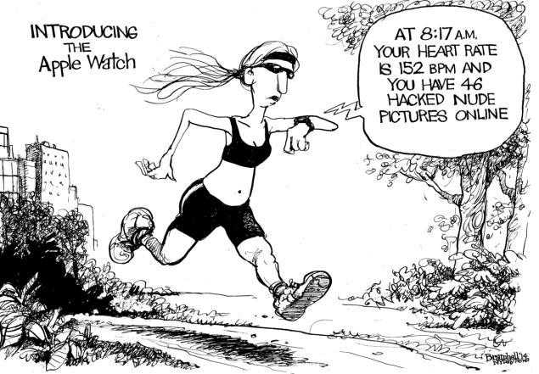

Slide 10
Clinical Decision Support
Key questions in designing or selecting CDS systems are whose decisions are being supported, what information is presented, when it is presented, and how it is presented to the user
Whatever the features of CDS delivery of information, the quality of the information and the evidence underlying it are the major determinants of the impact of CDS on patient safety and quality improvement
CDS should be designed to provide the right information to the right person in the right format through the right channel at the right time (i.e., when the information is needed)
Achieving the five rights for CDS presents challenges, and the challenges differ depending on how closely the CDS is tied to what the clinician already intends to do

Slide 11
Several Key Questions about CDS
The key issue in reminding the user about things they choose to be reminded about is the timing of the reminder
Key issues for consultation that the user seeks out (on-demand CDS) are speed and ease of access
The major issue involved in correcting errors or making suggestions that users change what they had planned is balancing clinicians’ desire for autonomy with other demands, from or on clinicians, such as improving patient safety or decreasing practice costs
Another question related to autonomy is how much control users have over how they respond to the CDS

Slide 12
Data Driven Design
Designers should not provide a picture of the data, but rather provide end users with ‘understanding’ so that they can make better decisions
Common mistake to think too much about the data set and specific UI elements before theorizing the overall UI that would make use of it
One of the most important aspects of designing heavily data-driven interfaces is to make them consistent
In order to make consistency a reality, there needs to be a set of rules that can be applied to any view
  Patterns
  States
  Components

Slide 14
Presenting Data
Ensure that whatever data a user needs will be available for display
Tailor displayed data to user needs, providing only necessary and immediately usable data; do not overload displays with extraneous data
Display data to users in directly usable form; do not make users convert displayed data
Display data consistently with standards and conventions familiar to users
When no specific user conventions have been established, adopt some consistent interface design standards for data display
For any particular type of data display, maintain consistent format from one display to another
Ensure that data display is consistent in word choice, format, and basic style with requirements for data and control entry

Slide 15
Presenting Data cont
Ensure that each data display will provide needed context, recapitulating prior data as necessary so that a user does not have to rely on memory to interpret new data
The wording of displayed data and labels should incorporate familiar terms and the task-oriented jargon of the users
Ensure that wording and grammar consistent from one display to another
Ensure that abbreviations are distinctive, so that abbreviations for different words are distinguishable
Use forms to display related sets of data items in separately labeled fields
Provide clear visual definition of data fields and provide labels
Ensure that the ordering and layout of corresponding data fields is consistent from one display to another

Slide 16
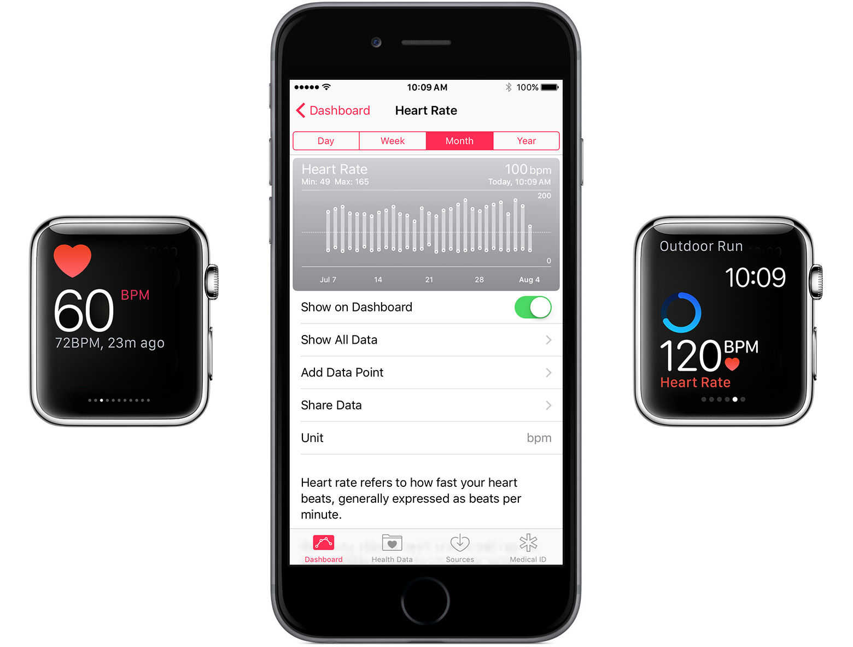

Slide 17
Review of the Literature
Advisory information needs to be delivered to the appropriate clinician at the time he or she is making a decision, has to include content that is relevant in the context of the clinical task in a concise form that allows quick and unambiguous interpretation, and must provide response options whose effects are clearly understandable
Alerts should not create unnecessary distractions but still be distinctly noticeable when warning about events that may negatively affect patient safety
Decision support attempts to assist clinicians with diagnostic and care decisions by displaying relevant and often patient-specific information at various points in the course of care

Slide 18
Data-Driven CDS
Of the different types a clinical decision support commonly cited (alerts/reminders, ordering support, guidelines, forms/templates, clinical context and clinical pathways), the most likely candidates for data presentation as a component of their CDS include ordering support and clinical context
However, any clinical decision support capability could be data-driven if you had a true learning healthcare system implemented
Indirect decision support fosters optimal decision-making in a more subtle manner by:
  Focusing attention on specific information,
  Encouraging systematic consideration of data
  Possibly influencing prioritization of actions

Slide 19
Literature Review Cont
A substantial amount of medical knowledge can be embedded in the design of information displays, entry modules, templates, order sets and in the visual representation of clinical data that help clinicians better comprehend patient’s current physiological state
While the acceptable screen transition time is well under a second, the overall perceived difficulty of interaction is directly related to the number of clicks required to respond, the complexity of menus to navigate when entering coded data and the time and cognitive effort required to find items on the screen
Tight integration with clinical workflows and presentation of relevant advice at the time and place of decision making are key to effective performance
Clinicians are more likely to accept and routinely use an electronic system that meets their expectations of flexibility, individuality of advice, and reliability
Optimal CDS performance is thus determined by appropriate matching of interventions to specific clinical goals, workflow contexts and clinical environments.

Slide 20
CDS Advice Presentation
Clinicians must be convinced that the advice is accurate and relevant and will contribute to improving prescribing safety, quality of documentation and efficiency
Visual, cognitive and interaction characteristics of CDS interventions can determine whether clinicians will regard CDS as effective and useful clinical tools or rather as unwelcome and irrelevant intrusions
For example, high specificity and relevance of alerts is crucial for developing confidence in the ability of the system to make accurate and comprehensive inferences about a patient’s medical state, take into account appropriate clinical context, present the advice at the appropriate level of urgency and suppress irrelevant messages
Interventions should unobtrusively, but effectively, remind clinicians of things they have truly overlooked, support corrections, and present key data and knowledge in appropriate context so the right decisions are made in the first place

Slide 21


Slide 22
Data Formats for CDS
The representational format of clinical data (e.g., HbA1c values over several months as a table or a trend graph) is important for supporting quick perceptual judgments and accurate decisions
Anticoagulation orders, for example, should display clotting times (INR) as trends, not as isolated numbers, with medication dosage displayed in a way that facilitates temporal associations and trends
Ordering screens should display appropriate contextual information from the electronic record such as laboratory values required for dosing adjustments so that clinicians do not have to navigate away from the ordering screen to see or recall from memory key data
Contextual information should account for the relationships and correlates between clinically dependent data

Slide 23
Bringing It All Together
Decision support systems are potentially powerful and effective information tools, particularly when providing well-founded, unambiguous and actionable advice tightly integrated into clinical workflows
Inadequately designed systems may become disruptive and give only marginally relevant guidance that is largely ignored or, at worst, irritates and impedes the flow of cognitive and clinical work
Usability is currently one of the primary concerns of clinicians and a key factor in their decisions about adopting HIT for routine use
Consistent design concepts and appropriate forms of visual representation of clinical data and other accepted design collectively lower the necessary cognitive effort for effective interaction and shorten the time needed to acquire use proficiency and result in better use of the data and the CDS driven by that data

Slide 24
Going Forward – How Do We Get There?
Design principles for electronic health records, clinical decision support and learning healthcare system are already established
Real-time, data-driven clinical decision support is likely only possible in either a powerfully server driven or cloud driven system due to the intense processing power required
However, advanced clinical decision support, that is easy to use and data-driven is well within reach at this time
Vendors need to be provided incentive to make data-driven clinical decision support, as well as improved heuristics/human computer interfaces much more visually aesthetic and usable
The most expedient way to accomplish the latter is to make it a priority for the office of the national coordinator for health information technology and make it a requirement for EHR certification

Slide 25

Questions

