Slide 1
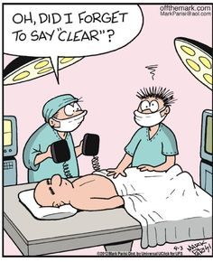
The Learning Healthcare System
Bob Marshall, MD MPH MISM
01/2017

Slide 2
Objectives
Define what a Learning Healthcare System is
Identify challenges and barriers
Explain we are happy to is different
Review current state versus LHS
Discuss EBM and the LHS
Making EHR’s work to support an LHS
Examples of making an LHS work
What is next?

Slide 3
What is a Learning Healthcare System?
The IOM’s vision:
  Research happens closer to clinical practice than in traditional university settings.
  Scientists, clinicians, and administrators work together.
  Studies occur in everyday practice settings.
  Electronic medical records are linked and mined for research.
  Recognition that clinical and health system data exist for the public good.
Evidence informs practice and practice informs evidence.

Slide 4
Identifying Challenges and Opportunities
The IOM’s 2008 Roundtable on Evidence-Based Medicine identified problems with U.S. health care:
  Evidence is often not available for clinical decision making.
  Uptake of new discoveries can be slow and false starts are common.
  Even when evidence is available, it is not applied consistently—meaning variation, inefficiencies, and disparities persist.
  Opportunity:
  We need a new clinical research paradigm.
  We need “learning health care systems.”

Slide 5
What is Different About an LHS?
In learning health care systems, traditional principles of research can be used in more practical ways so that:
  Decisions can be made more quickly.
  Better information is available for clinical decision making, for managing health care delivery.
  The system learns from the actions of the people using it

Slide 6
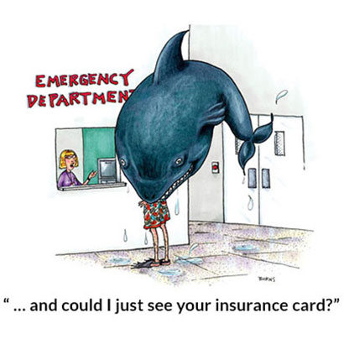

Slide 7
What is a Learning Healthcare System?
The IOM’s vision:
  Research happens closer to clinical practice than in traditional university settings.
  Scientists, clinicians, and administrators work together.
  Studies occur in everyday practice settings.
  Electronic medical records are linked and mined for research.
  Recognition that clinical and health system data exist for the public good.
Evidence informs practice and practice informs evidence.

Slide 8
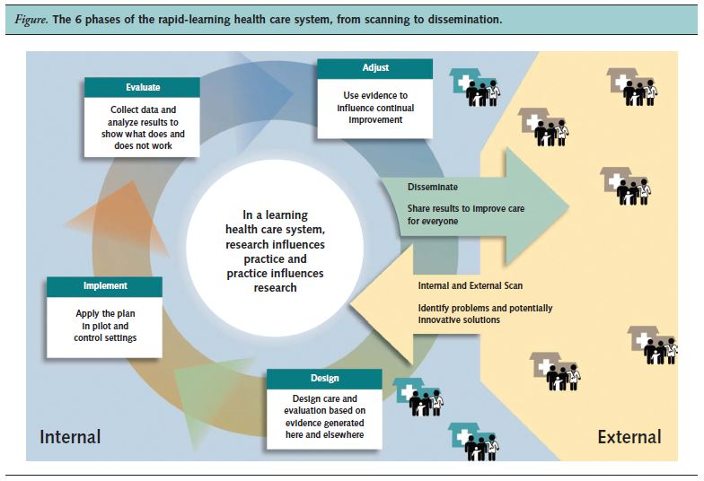

Slide 9
Why is This Important?
Evidence on what is effective, and under what circumstances, is often lacking, poorly communicated to decision makers, or inadequately applied
Despite significant expenditures on health care for Americans, these investments have not translated to better health
Studies of current practice consistently show failures to deliver recommended services, wide geographic variation in the intensity of services without demonstrated advantage and waste levels that may approach a third or more of the $2 trillion in annual healthcare expenditures
In performance on the key vital statistics, the United States ranks below at least two dozen other nations, all of which spend far less for health care

Slide 10
Why is it so bad?
In part, these problems are related to fragmentation of the delivery system, misplaced patient demand and responsiveness to legal and economic incentives unrelated to health outcomes
To a growing extent, however, they relate to the structural inability of evidence to keep pace with the need for better information to guide clinical decision making at the point of care
In addition, if current approaches are inadequate, future developments are likely to accentuate the problem

Slide 11
Piling on – the Gap Continues to Widen
These issues take on added urgency in view of the rapidly shifting landscape of available interventions and scientific knowledge, including the:
  increasing complexity of disease management,
  development of new medical technologies,
  promise of regenerative medicine, and
  growing utility of genomics and proteomics in tailoring disease detection and treatment to each individual
Yet, the share of health expenses devoted to determining what works best is about one-tenth of 1 percent

Slide 12
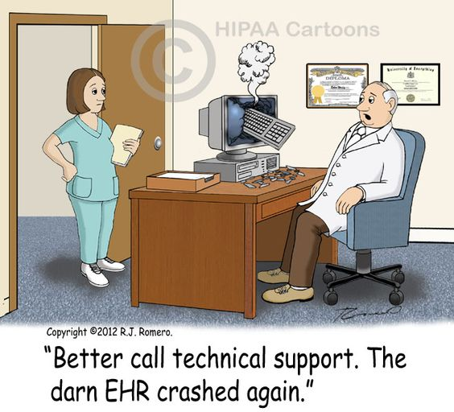

Slide 13
Knowledge in Healthcare
Scientific Research Knowledge
  Clinical trials
  Controlled populations
  Well-defined questions
Routinely Collected Knowledge
  EHR systems
  Wide coverage
  Vast quantity
  May lack in detail and quality
Actionable Knowledge
  Distilled scientific findings
  Usable in clinical practice
  Decision support

Slide 14
Evidence –Based Medicine
EBM has resulted in many advances in health care:
  Highlighting the importance of a rigorous scientific base for practice and the important role of physician judgment in delivering individual patient care.
However, increased complexity of health care requires a deepened commitment to produce the kinds of evidence needed at the point of care for individual patients
Beyond determinations of basic efficacy and safety, dependence on individually designed, serially constructed, prospective studies to establish relative effectiveness and individual variation in efficacy and safety is simply impractical for most interventions

Slide 15
EBM and the LHS
Standard EBM trials/studies will continue to be very important
For the LHS to work, however, we need to get to the place where POC research has to be part of the equation
Care and research must be part of a single continuous cycle
This means that the data coming out of the EHR’s has to be of high quality, so the providers must be given the tools and incentives to document accurately and as completely as needed
This translates to better EHR designs to support the needed activities by the healthcare team

Slide 16
Makings EHR’s Support the LHS
EHR use is critical to the LHS
What EHR characteristics are needed?
  Full interoperability
  Governed by agreed-upon and uniform data standards and definitions
  Shared terms, definitions, quality standards and best practices must be accessible to all participants
  Standards organizations must drive this work (Clinical Data Interchange Standards Consortium and HL7)
  Development of computable electronic phenotypes – patients identifiable directly by query of EHR data repositories

Slide 17
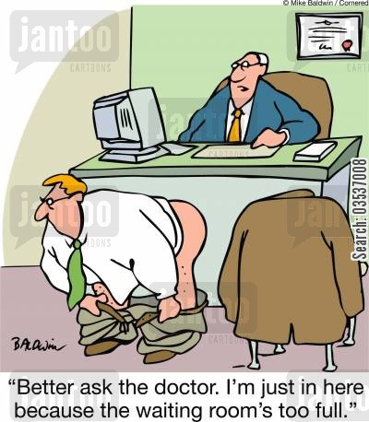

Slide 18
One Set of Models (UK NHS)
Clinical Data Integration Model (CDIM)
  Mapping clinical data from EHRs and aggregated data repositories
Clinical Research Information Model (CRIM)
  Research process information
  Evolution of Primary Care Research Information Model (PCROM).

Slide 19
Making the LHS Work – Decision Support Tools
Providing POC individual patient risk info one of most valuable benefits of LHS
Archimedes (a KP innovation) can predict patient risk for MI, CVA and DM
  In addition, can predict outcomes based on different health care treatments and lifestyle choices
  Called IndiGO – presents graphical of risk based on “what if” models
  Draws on information from clinical trials, EHR’s, literature reviews and epidemiology

Slide 20
Making the LHS Work – Reducing Provider Overload
Using the data in EHR’s, can use analytics (Big Data or health analytics/BI tools) to highlight vital clues about a patient’s condition and potential for complications
Very useful in high acuity and high volume settings (ex. CCU or ED)
Can be used as early warning systems or to present information about at risk parameters and treatment options to reduce readmissions or return ED visits
The end effect is reducing the continual information overload in those settings

Slide 21
Making the LHS Work – Point of Care Trials
Can use the EHR, the LHS and its infrastructure (next talk) to establish “point-of-care” clinical trials
  This can produce effectiveness data about already approved medications and treatments
In a VA study, such a tool uses EHR data to make recommendations about one treatment versus another in terms of efficacy for the patient at hand
  The ongoing trial collects data until there is enough to power the decision tool
  The tool also identifies which patients qualify for the study to compare treatment options and lets the provider know
  The system can even generate the correct consent form to use to enroll and inform patients

Slide 22
Making the LHS Work – Living CPG’s
Boston Children’s has developed “living clinical guidelines” that suggest sound practices, based initially on medical literature
  The LCG’s continue to evolve over time as they collect more data and practical experience
  Providers can deviate from LCG’s (including the reason for diverting), but outcomes and practice patterns continue to be collected to inform future iterations
  The iterative process leads to greater adoption and thus less variation in practice…as well as overall improved outcomes
    80% for the LCG’s (called SCAMPs) versus 39-53% for traditional CPG’s

Slide 23
Making the LHS Work – Using “Dirty Data”
High quality data is best, but you can still make good decisions over time by collecting continuous data
Harvard Predictive Medicine Group
  Collected administrative claims data (diagnosis), prescription use and lab tests to predict future clinical risk
  One example was risk for domestic violence up to two years in advance
Can use public health data, based on Zip Code, to make many healthcare/health resource utilization predictions
  Allows one to both resource appropriately, but also helps providers identify folks who need specific interventions or treatment

Slide 24
Questions

