Slide 1
The Learning Healthcare System: Create, Implement and Maintain
Bob Marshall, MD MPH MISM FAAFP
Faculty, DoD Clinical Informatics Fellowship

Slide 2
Learning Objectives

Slide 3
What is a Learning Healthcare System?
The IOM’s vision:
  Research happens closer to clinical practice than in traditional university settings.
  Scientists, clinicians, and administrators work together.
  Studies occur in everyday practice settings.
  Electronic medical records are linked and mined for research.
  Recognition that clinical and health system data exist for the public good.
Evidence informs practice and practice informs evidence.

Slide 4
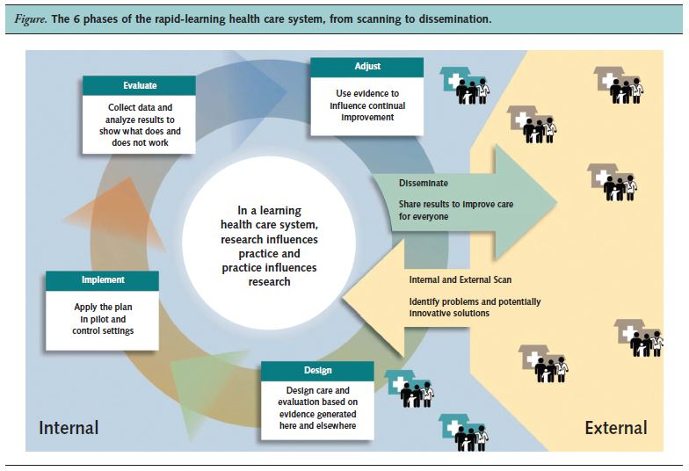

Slide 5
Internal/External Scan
Perform an internal scan to determine what issues or problems need to be corrected
Also perform an internal scan to determine what data is being captured and how much of that data can be used for analysis
Do both an internal and an external scan to look for intrinsic data solutions as well as external capabilities that can provide support for an LHS
Your approach is similar to that of any PI/QI project

Slide 6
Design
As with a PI/QI project, the next step is to design your approach to solving the problems/address the issues discovered in the scan phase
Remember the rules of an LHS - design the solution so that you get ongoing and valid feedback from the point-of-care so the system can continue to improve
Design how the data will be captured, which includes making sure the UX makes it easy to capture valid and accurate data
Design the database and analytics tools to perform any calculations and support any analysis needed
Design the feedback loop so the LHS provides ongoing, improving information to the end users so they can provide ever better care

Slide 7
Implement
Once you have designed your system, pilot it in a small, real-life setting (a simulation lab is also acceptable as long as there are well-designed use cases and real end users)
Once the pilot is complete and validated, implement the solution in either a progressive or “Big Bang” format
Monitor end users closely to ensure there are no immediate system glitches; make immediate repairs as needed
When fully implemented and operational for 30 days, move into maintenance phase
Make updates to the system as needed (for hard stop problems), but on a regularly scheduled interval for routine improvements

Slide 8
Evaluate/Adjust
As with any PI/QI project, design your evaluation criteria and intervals before you implement
Collect ongoing data, both electronically and by end user interviews, about all aspects of the implemented solution: UX, data and knowledge returned, usability of the resulting CDS
Using both end user and development/implementation team feedback, make ongoing adjustments to the system to improve functionality and accuracy/validity

Slide 9
Maintenance
Once you have completed a full cycle of Design-Implement-Evaluate-Adjust, it is time to move to maintenance phase
Maintenance does not mean place on auto-pilot
Maintenance means continue the D-I-E-A cycle on a regular, pre-determined interval and continue to make incremental adjustments based on feedback/objective measures
Depending on the topic for the LHS component, it is also important to involve SME’s on a regular basis to ensure the validity of the rules engine for the LHS/CDS
In addition, updates to OS, the EHR itself or to the data analytics engine underlying the LHS/CDS make for ongoing maintenance requirements/updates

Slide 10
Data Infrastructure for an LHS

Slide 11
Why is This Important?
Since EHR interoperability and data interoperability from those EHR’s are both years away, creating a data infrastructure is critical to the various aspects of the Learning Healthcare System
Numerous data sharing systems/collaboratives have been created to allow for data sharing and data governance
These systems/collaboratives share a common theme that allows them to pool data from disparate EHR’s and create a unified LHS for CDS, comparative effectiveness research, population-based research, QI/PI and other functions of an LHS

Slide 12
What is Involved?
Differences in configurations, workflows and codes (as well as differences in various applications/EHR’s) creates significant barriers to data sharing between partners
Even among systems using the same EHR or ancillary applications, different configurations create barriers with dissimilarities in data variable names, formats and meanings
The best practice approach to addressing these issues is the use of a common data model (CDM)
The CDM provides definitions for how each shared data element must be structured and which codes must be assigned to data values

Slide 13
What is Already Available?
One model is the HMO Research Network Virtual Data Warehouse (HMORN VDW).
Another model is the 3M Health Data Dictionary (HDD)
MU2 required certain terminologies (but not specific versions of those terminologies) for EHR certification
  In order for a CDM to truly be “Common”, the parties involved have to agree on which exact versions of the required terminologies will be used (i.e., data and terminology governance)

Slide 15
Some Example Use Cases

Slide 16
Oschner Clinic and REACHNet
Improving Patient Enrollment in Cardiovascular Research

Slide 18
Enhanced Efficiencies

Slide 19
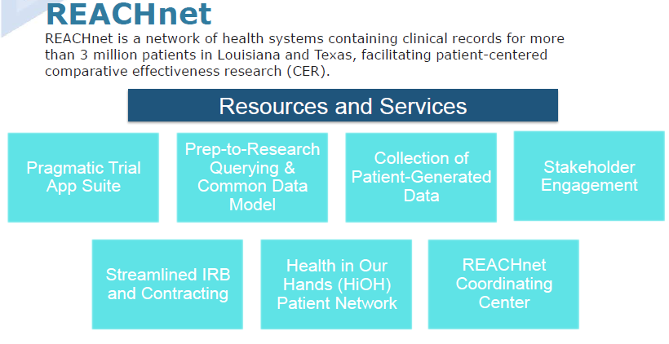

Slide 24
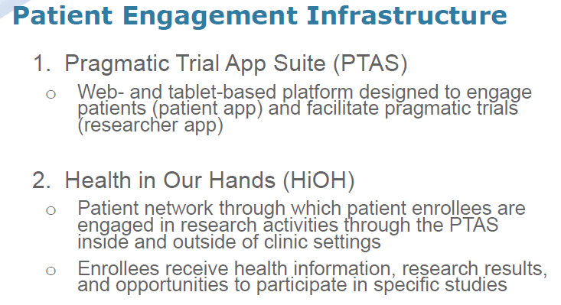

Slide 25
PTAS Apps, Modes and Functions

Slide 26
Health in Our Hands Patient Network

Slide 27
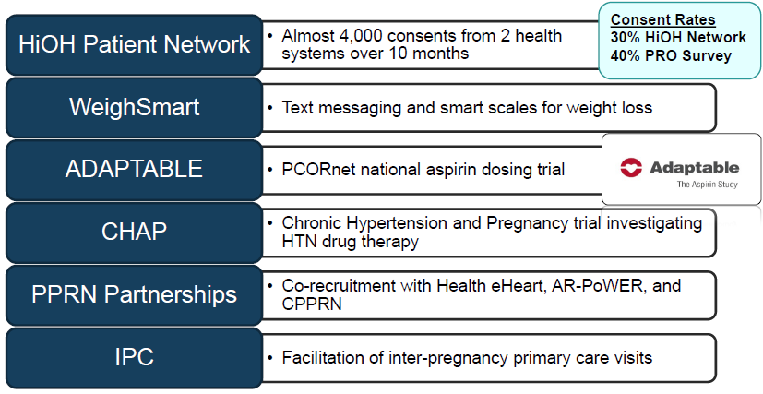

Slide 31
Lessons Learned

Slide 32
University of Rochester VNA LHS
Creating a Learning Healthcare System Around VNA’s

Slide 34
Healthcare Content Management System

Slide 37
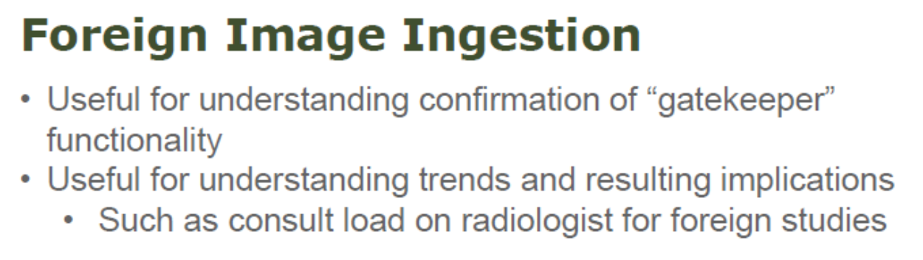
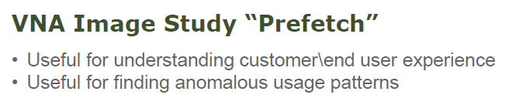

Slide 40

Questions?

