Slide 1
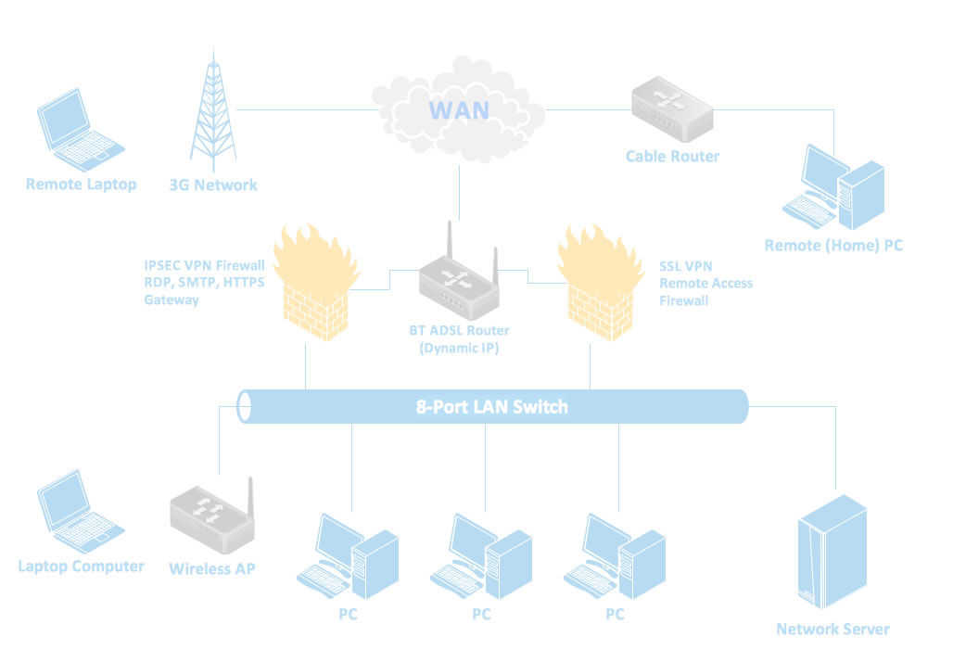
Computer Networks Part - 2
Bob Marshall, MD MPH MISM
Faculty, DoD CI Fellowship

Slide 2
IEEE 802
Complete IEEE 802 protocol suite provides diverse set of networking capabilities.
Protocols have flat addressing scheme.
Operate mostly at levels 1 and 2 of the OSI model

Slide 3
Network Protocols
Ethernet
  Often simply called LAN
  Family of protocols used in wired LANs
  Described by set of standards together called IEEE 802.3
  published by Institute of Electrical and Electronics Engineers

Slide 4
Network Protocols
Wireless Protocols/Wireless LAN
  Widely known as WLAN or WiFi
  Most well-known member of the IEEE 802 protocol family for home users today
  Standardized by IEEE 802.11
  Operate in the 2.4, 3.6, 5, and 60 GHz frequency bands.
  Shares many properties with wired Ethernet

Slide 5
802.11 Protocols
The 802.11 family: series of half-duplex over-the-air modulation techniques that use the same basic protocol.
802.11b was the first widely accepted one, followed by 802.11a, 802.11g, 802.11n, and 802.11ac.
Other standards in the family (c–f, h, j) are service amendments used to extend scope of existing standard
  May also include corrections to a previous specification

Slide 6
Spectrum and Speed
802.11a – 54Mb/s in 5 GHz band
802.11b – 11 Mb/s in 2.4 GHz band
  Compatible with 802.11b and 802.11n protocols
802.11g – 54 Mb/s in 2.4 GHz band
802.11n – up to 1 Gb/s in 2.4 or 5 GHz bands
802.11ac – up to 1.3 Gb/s in 5 GHz band
802.11ad – operates in 60 GHz band; up to 7 GB/s; called WiGig
802.11ax – successor to 802.11ac; operates at 4x throughput of 802.11ac (early stages)

Slide 7
Channels & Frequencies
802.11b, 802.11g, and 802.11n-2.4 utilize the 2.400–2.500 GHz spectrum, one of the ISM bands.
802.11a and 802.11n use the more heavily regulated 4.915–5.825 GHz band
2.4 GHz band divided into 14 channels spaced 5 MHz apart, beginning with channel 1, centered on 2.412 GHz.
  Can result in overlap of channels/interference

Slide 8
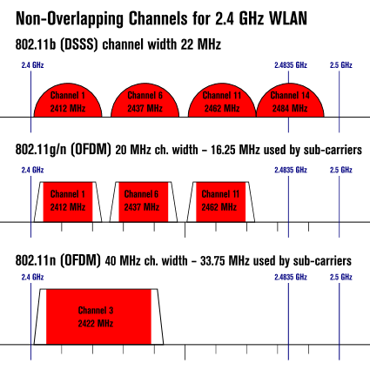
Non-Overlapping Channels

Slide 9
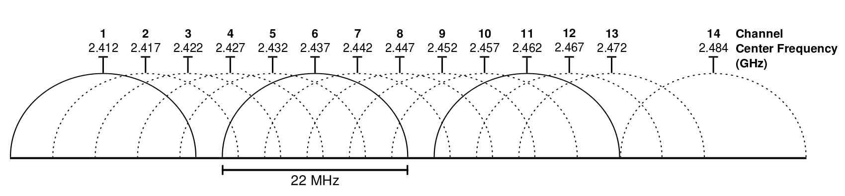
2.4 GHz Wi-Fi channels (802.11b,g WLAN)
"2.4 GHz Wi-Fi channels (802.11b,g WLAN)" by Michael Gauthier

Slide 10


Slide 11
Network Devices
Components used to connect computers or other electronic devices together so that they can share files or resources like printers or fax machines
Devices used to setup a Local Area Network (LAN) are the most common type of network devices used by the public
A LAN requires at least a hub, switch, router
Networking Devices also called Communicating Devices

Slide 12
NIC - Network Interface card
Provides the physical interface between computer and cabling
Prepares data, sends data, and controls data flow
Can also receive and translate data into bytes for the CPU to understand
Has specific MAC address (48 bit)
Ethernet is a physical and data link layer technology for local area networks (LANs)
Media Access Control (MAC) address

Slide 14
Repeater
Network repeaters regenerate incoming electrical, wireless or optical signals
With physical media like Ethernet or Wi-Fi, data transmissions can only span a limited distance before the quality of the signal degrades
Repeaters preserve signal integrity and extend the distance over which data can safely travel
Repeaters remove unwanted noise in incoming signals
Cannot filter the signal traffic
Works in physical layer of OSI Model

Slide 16
Hubs – Active/Passive
Two types of hubs: active and passive
Passive hubs simply connect all ports together electrically; usually not powered
Active hubs use electronics to amplify and clean up signal before it is broadcast to other ports
Used to link several computers together
Repeat any signal that comes in on one port and copy it to other ports (also called broadcasting)
Works in physical Layer of OSI Model

Slide 18
Bridges
Join similar topologies; used to divide network segments
Can filter traffic on basis of MAC address
If aware of destination address, is able to forward packets; otherwise bridge will forward packets to all segments.
More intelligent than repeaters, but unable to move data across multiple networks simultaneously
Unlike repeaters, bridges can filter out noise

Slide 19
Bridges cont.
Works in Data link Layer (2) of OSI Model
Multiple collision Domain, but single Broadcast Domain
Main disadvantage: cannot connect dissimilar network types or perform intelligent path selection.
  For that function, need a router
Local (LAN), remote (WAN) and wireless bridges
  Remote bridges replaced by routers

Slide 21
Switches
Computer networking device that connects network segments
Populates MAC address table on the basis of source MAC address of a Frame
Network switches capable of inspecting data frames as received, determining source and destination device of frame, and forwarding it appropriately
Data Link Layer or Layer 2 Device

Slide 22
Switches cont.
Multiple collision Domain but single Broadcast Domain
Vital difference between hub and switch is that all the nodes connected to a hub share the bandwidth among themselves, while a device connected to a switch port has the full bandwidth all to itself
For example:
  If 10 nodes communicating using a hub on 10- Mbps network, each node may only get a portion of 10 Mbps if other nodes on the hub want to communicate as well
  With a switch, each node could possibly communicate at the full 10 Mbps
  Like a multi-port bridge

Slide 24
Routers
Highly intelligent devices that connect multiple network types and determine best path for sending data (embedded software)
Normally used to connect one LAN to another
Examine incoming packets to determine data destination address
Then examines internal routing table to choose best packet pathway through network, and switches them to the proper outgoing port

Slide 25
Routers cont.
Slower than bridges because they are more intelligent devices
Analyze every packet, causing packet-forwarding delays.
Because of this intelligence, also more expensive
OSI network layer 3 devices (Internet protocol)
Typically, when WAN set up, there will be at least two routers used

Slide 26
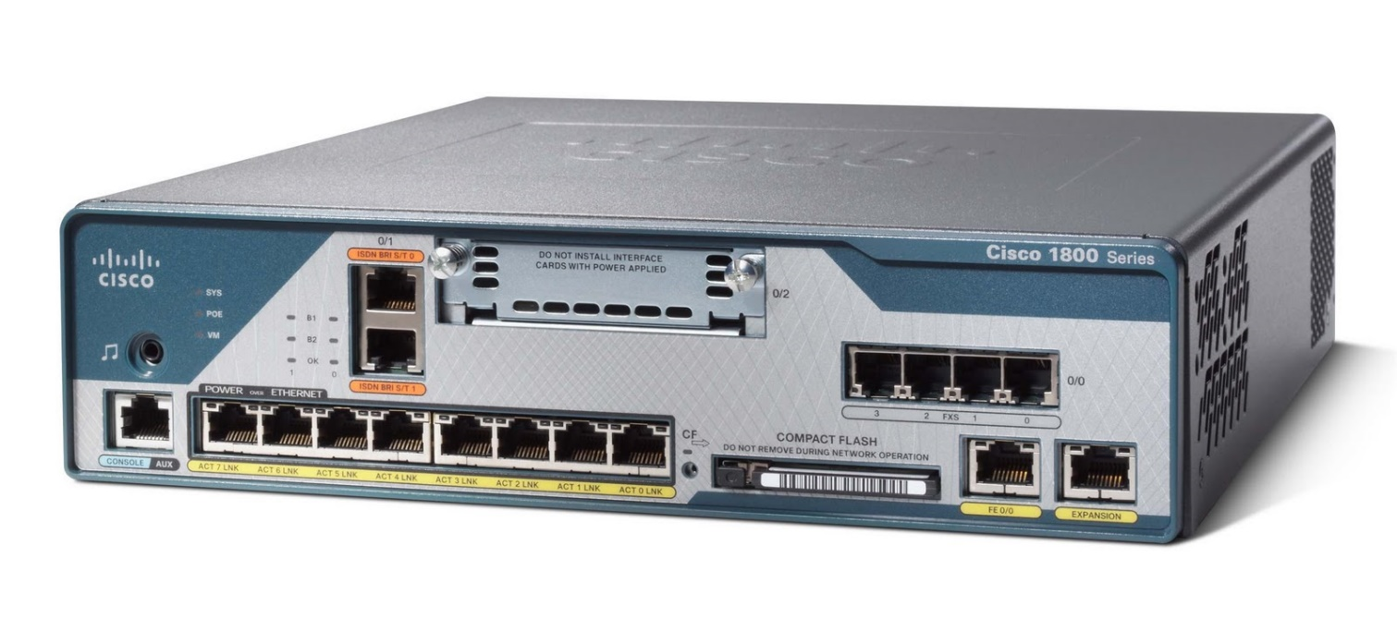

Slide 27
Modem
Modems (MOdulator-DEModulator): used to connect network nodes via wire not originally designed for digital network traffic, or for wireless
One or more carrier signals are modulated by digital signal to produce analog signal that can be tailored to give required properties for transmission
Commonly used for telephone lines, using Digital Subscriber Line technology.

Slide 29
Firewalls
Network device for controlling network security and access rules.
Typically configured to reject access requests from unrecognized sources while allowing actions from recognized ones
Vital role firewalls play in network security grows in parallel with constant increase in cyber attacks

Slide 30
Network Congestion
Network congestion occurs when a link or node is carrying so much data that quality of service deteriorates
Typical effects include queueing delay, packet loss or blocking new connections
  Consequence of these latter two: incremental increases in load lead either to only small increase in network throughput, or to actual reduction in network throughput
  Premise behind DDOS attacks

Slide 31
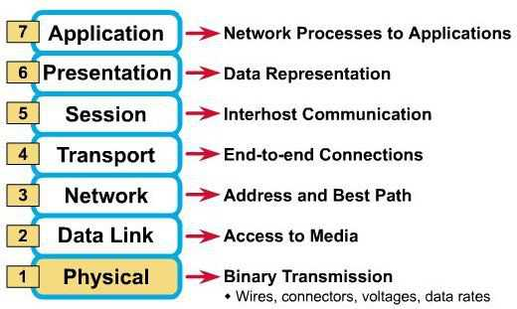
Questions

