Slide 1
Clinical Research Informatics and Interdepartmental collaboration
Bob Marshall, MD MPH MISM FAAFP
DoD Clinical Informatics Fellowship
January 2016

Slide 2
Objectives
Define Clinical Research Informatics
Discuss how CRI fits into the Clinical Informatics universe
Discuss the conceptual aspects of CRI
Present a model for CRI and how to support it
Discuss the practical aspects of making CRI work

Slide 3
Clinical Research Informatics
Rapidly evolving sub-discipline within biomedical informatics
Focuses on developing new informatics theories, tools, and solutions to accelerate the full translational continuum: basic research, clinical trials, and medical centers and community practice
Two recent factors accelerating CRI research and development efforts:
Extensive and diverse informatics needs of the NIH Clinical and Translational Sciences Awards, and
Growing interest in sustainable, large-scale, multi-institutional distributed research networks for comparative effectiveness research

Slide 4
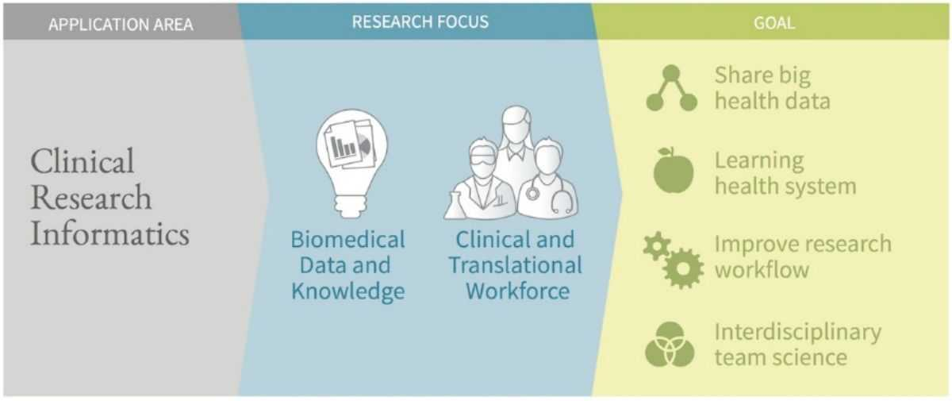

Slide 5
Translational Continuum
Four parts to the full translational continuum:
basic research to clinical trials (T1),
clinical trials to academic health center practice (T2),
diffusion and implementation to community practice (T3), and
‘real world’ outcomes (T4)

Slide 6
AMIA Definition
Clinical Research Informatics involves use of informatics in discovery and management of new knowledge relating to health and disease
Includes management of information related to clinical trials and also involves informatics related to secondary research use of clinical data.
Clinical research informatics and translational bioinformatics are the primary domains related to informatics activities to support translational research

Slide 7
Conceptual Model for CRI

Slide 8
Conceptual Model Explained
CRI integrates clinical and translational research workflows in addition to core informatics methodologies and principles into framework that reflects the unique informatics needs of translational investigators
The model is organized around three conceptual components: workflows; data sources and platforms; and informatics core methods and topics
The central structure that establishes the unique context for CRI is the informatics-enabled clinical research workflow
Figure applies informatics-centric perspective to each step and contains two translational workflow cycles, reflecting use of CRI technologies in both early (‘T1-T2’) and later (‘T3-T4’) translational phases

Slide 9
Conceptual Model continued
The ‘inner’ cycle represents translational discoveries within carefully controlled study conditions in limited number of clinical trial sites
The ‘outer’ cycle represents later stages of clinical translational research, where implementation and dissemination tasks become more prominent across community practices
Later stages of clinical translational research represented by implementation-oriented translational activities such as:
evidence generation and synthesis,
personalized evidence application, and
population surveillance

Slide 10
Helping to Advance Clinical Research
During early planning phases, study feasibility assessment and cohort identification are important tasks for ensuring that sufficient study participants and data exist to move proposed study forward
Eligibility alerting, to notify physicians of their patients’ eligibility for clinical trials, is major informatics solutions to address the leading cause of failures in clinical studies: inability to recruit sufficient study participants
CRI supports the cycle for converting data into knowledge by encompassing data analysis, evidence generation, and evidence synthesis
1 of 3

Slide 11
Helping to Advance Clinical Research
data integration across EHRs or over time to form integrated longitudinal data repositories, which in turn are integrated across institutions to form multi-institutional federated data networks
Can also integrate data across different storage and input methods:
personal health records, registries, claims databases, public reports, and social media that contain patient self-reported outcome data
Informatics research has developed alternative models for data federation across independent data sources, including distributed, federated, and mediator-based architectures
2 of 3

Slide 12
Helping to Advance Clinical Research
The bottom portion of figure highlights major core research topics in CRI:
Secondary use of clinical data for research, distributed queries, data integration, record linkage, data quality assessment, integrated data models and terminologies, and
Set of common informatics methods, including human-computer interaction, knowledge management, NLP, information extraction, and text classification
Each core topic builds upon and extends fundamental informatics theories and methodologies that are implemented and assembled into functioning CRI solutions
3 of 3

Slide 13
Practical Application
Ensure that you have robust tools to provide useful information to clinical researchers
Once the robust tools are in effect, make sure you advertise across the medical staff your ability to support their research efforts
In a location with a formal clinical research department, you can go directly to the CRD director and let him or her know of your capabilities
You might negotiate making inquiries by researchers of the clinical informatics department a required step in clinical research design
You will want a formal governance process, easy for end-users, to help with understanding what the researchers need/want

Slide 14
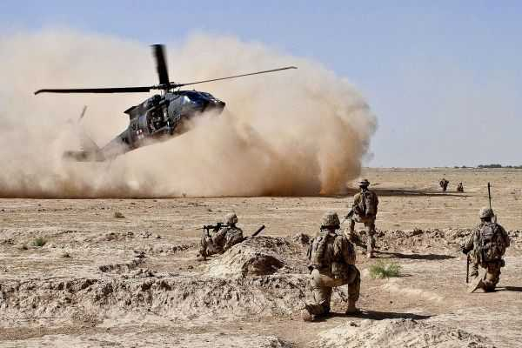
Questions

Slide 15
Interdepartmental Collaboration and quality initiatives

Slide 16
First Step First
Determine need for clinical information/knowledge
Talk with department heads about what they and their people need in terms of information and knowledge to do their jobs better
Know/determine what information you can provide
Determine what gaps exist between knowledge/information desired and ability to provide said information/knowledge
Let the department heads know what gaps exist and what you can provide now
Determine in working with your people what sort of timeline might be appropriate to provide the missing information/knowledge

Slide 17
First Step First
Let the department heads know what the projected timeline would be to obtain and provide the information they need that you cannot currently provide
Follow-up with the department heads regularly to keep them apprised of your progress in closing any existing gaps

Slide 18
Quality Improvement
Take the same approach with the quality improvement people, both for the MTF and for the individual departments/divisions, as you did with the department heads in determining what information is needed/desired
As with the department heads, determine what gaps may exist between information desired/needed in the information you can currently provide
Again, work with your people to determine a potential timeline for closing said gaps
Communicate with the QI people regularly to keep them informed

Slide 19
Bidirectional Collaboration
Part of the discussion that you will have with both the department heads and the QI people, centers around what information you need from them to provide them with the information they need
This goes back to the entire discussion about knowledge management and data quality
One of the major supporting products clinical informatics can provide to both department heads and QI people comes from clinical workflow improvement
This in and of itself can help both QI folks and the department heads by eliminating or improving dysfunctional clinical workflow

Slide 20
Bidirectional Collaboration
The clinical workflow analyst needs to be able to observe clinical workflow in various departments and the various steps in the process
This requires cooperation from everyone on the healthcare team to be able to be successful
In addition to observation, the clinical workflow analyst needs to be able to talk to people and ask them what they would do to improve clinical workflow
In addition, the CWA’s need to be able to ask people in the trenches what information would make their job easier in terms of taking care of patients

Slide 21
Improving Quality and Workflow
Once you have buy-in from the department heads and the QI people, and you've been able to observe and talk to the folks in the trenches, now you need to turn that around and help folks be successful
This goes back to the initial step of determining need at both a high level and in the trenches
Even if you cannot provide all of the information initially, the combination of workflow improvement and what information you can provide, as long as it is in a usable format for multiple levels of end-users, you can provide at least a modicum of success for all

Slide 22
Improving Quality and Workflow
That modicum of success will lead to increased collaboration for all levels within the organization
However, you need to keep moving forward with providing the information people need and closing any existing gaps
Success will breed further collaboration
If you can also improve data quality, that will be a huge win for everyone along the chain of command
Remember: the two major things that clinical informatics can help both clinical end-users and supervisory/command personnel are: improving clinical workflow and providing information back in a timely fashion

Slide 23
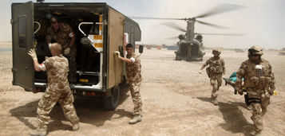
Additional Questions

